Slide 1
The Goodness of Creation
The Paschal Mystery
Unit 1, Chapter 1
Document #: TX005432

Slide 2
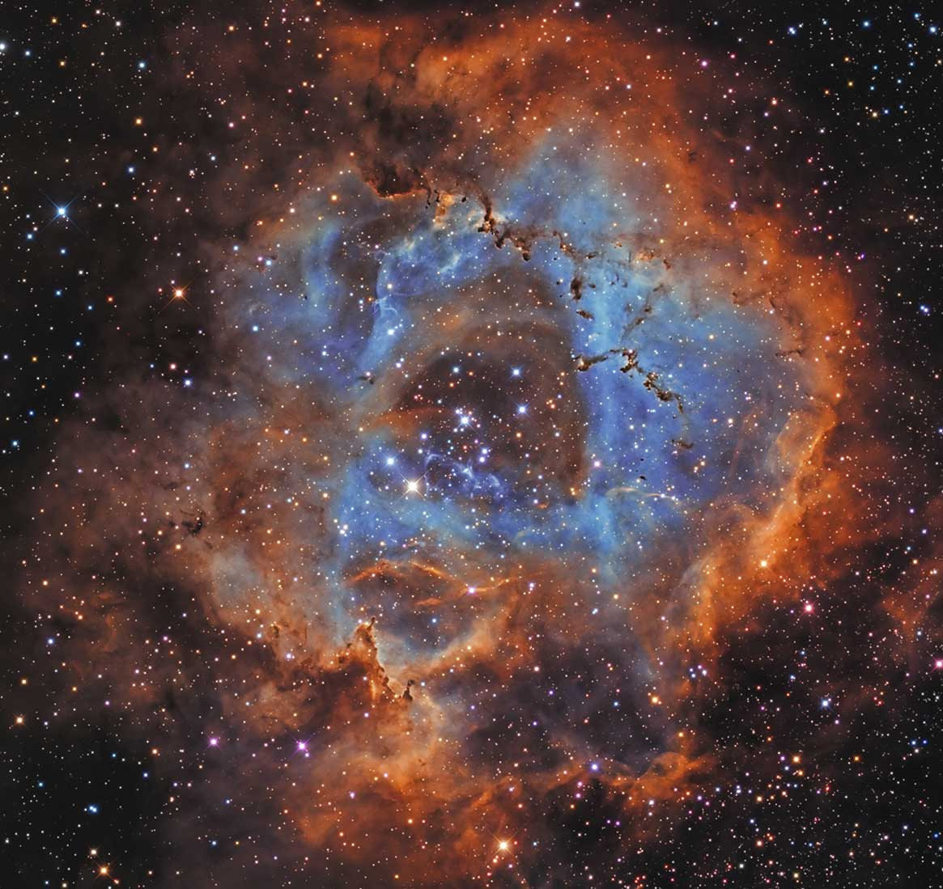
The Primeval History
The two Creation accounts in the Book of Genesis reveal truths about God.
God sustains the whole universe.
He created the world out of love.
God’s love for humanity remains faithful.
© AstroStar / Shutterstock
Notes:
Notes: Explain biblical primeval history, as in article 1 of the student text. Point out that the inspiration of the Holy Spirit was active in each step of the process of transmitting (telling and recording) the accounts. Ask what term describes the Spirit’s role in the process (inspiration).
This slide corresponds to student book content in article 1.

Slide 3

Literary Forms in the Bible
Sacred Scripture has many literary forms, or genres.
We take into account what the human authors intended to communicate through the different literary forms.
© AstroStar / Shutterstock
Notes:
Notes: Using the example of a newspaper, ask the students what each genre might be used to communicate: a news story, an editorial, an announcement of a charity event. Using the list of biblical genres in the section “Literary Forms in the Bible” in article 1, discuss what some of these genres might communicate (e.g., hymns could express praise of God; laws could teach morality).
This slide corresponds to student book content in article 1.

Slide 4
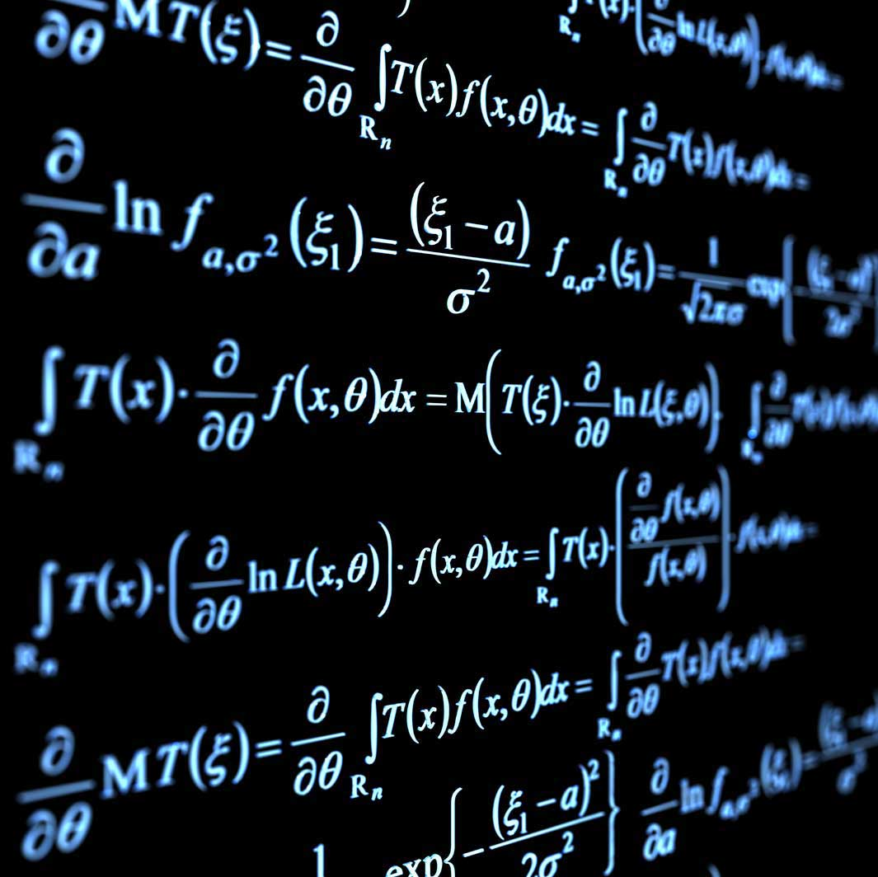
Religious Truth and Scientific Truth
The primeval history in Sacred Scripture teaches religious truth, not science.
This history is written in figurative language.
It uses symbolic images, stories, and names to point to a deeper truth.
© Andrey Prokhorov / istock
Notes:
Note: Explain why we should not try to interpret figurative language as scientific truth. Ask the question that concludes article 1, “How would you explain the difference between religious truth and scientific truth to a friend?”
This slide corresponds to student book content in article 1.

Slide 5
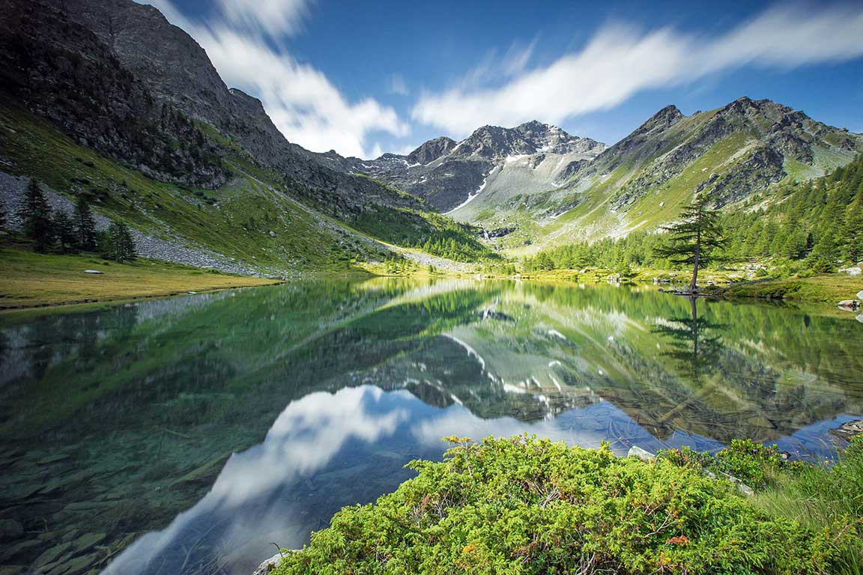
Creation Reflects the Glory of God
Scripture proclaims that creation reveals the power of God.
© albertoperer / Shutterstock
Notes:
Notes: Ask for examples of experiences that might inspire awe and reveal God’s power in creation. (Some are mentioned at the opening of article 2 in the student text.) Consider sharing one of your own experiences.
This slide corresponds to student book content in article 2.

Slide 6
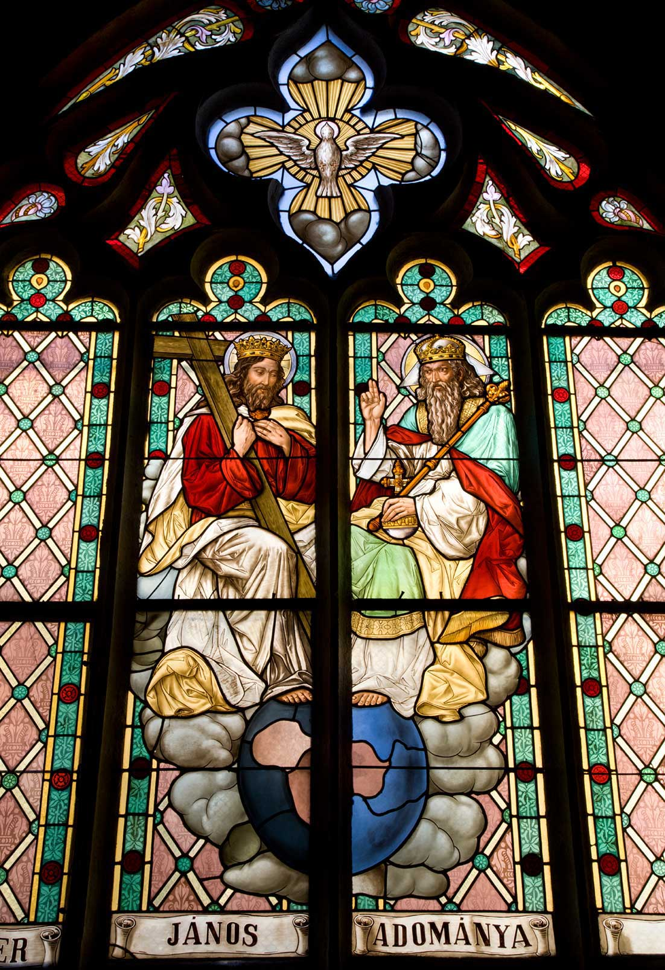
Creation: The Work of the Trinity
God created the universe and continues to sustain it through his love.
Creation is the work of all three Divine Persons of the Trinity: Father, Son, and Holy Spirit.
© sedmak / istock
Notes:
Notes: Explain how the Second and Third Persons of the Holy Trinity, Jesus Christ and the Holy Spirit, were both present and active in Creation. This is described in the section “Creation: The Work of the Three-in-One,” in article 2 of the student text.
This slide corresponds to student book content in article 2.

Slide 7

Human Beings: The Summit of Creation
We are the only creature God created with a body and an immortal soul.
We were created, male and female, in the image of God.
God intended us to be in communion with each other.
© wong sze yuen / Shutterstock
Notes:
Notes: Discuss the meaning of the term soul. Explain our soul’s journey from the moment of conception to its final resurrection.
This slide corresponds to student book content in article 3.

Slide 8
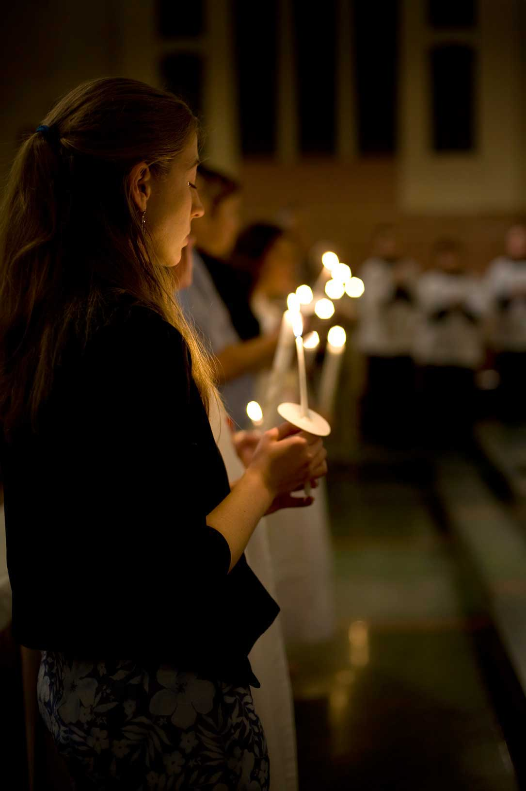
Humanity’s Role
We are the only creatures who can freely choose to return God’s love . . .
. . . because he gave us free will and self-knowledge.
© rappensuncle / istock
Notes:
Notes: Direct the students to read the Live It! sidebar in article 3 of the student text, “Be Whom God Created You to Be.” Discuss what it would mean to treat ourselves and everyone we meet the way we would treat Jesus.
This slide corresponds to student book content in article 3.

Slide 9

Our Responsibility for Creation
God has given human beings all the other creatures for our benefit.
He has put the earth and everything that lives on it in our care.
© Goodluz / Shutterstock
Notes:
Notes: Discuss the phrases “for our benefit” and “in our care,” used in the section “Our Responsibility for Creation” in article 3 of the student text to describe creation’s relation to us. Ask how we can view creation in both of these ways without contradiction.
This slide corresponds to student book content in article 3.

Slide 10

The Garden of Eden: The Perfect Life
God intended the first human beings to be in direct communion with him . . .
. . . and to be in a state of harmony with each other and the rest of creation.
© Christopher Futcher / istock
Notes:
Notes: Explain how the Creation accounts in Genesis support these two bullet points, as in the section “Original Holiness and Original Justice” in article 4 of the student text.
This slide corresponds to student book content in article 4.

Slide 11
Original Holiness and Original Justice
We can experience a taste of original holiness and original justice in this life . . .
. . . and we will know it completely in Heaven.
Notes:
Notes: Ask the students to define original holiness and original justice in the slide’s title (Adam and Eve’s direct communion with God; their complete harmony with each other and with creation). Point out that if we have faith in God, we can experience original holiness and original justice in this life when we have communion with God, with one another, and with creation.
This slide corresponds to student book content in article 4.

