Slide 1
Liturgy of the Hours
The New Testament
Document #: TX002192

Slide 2
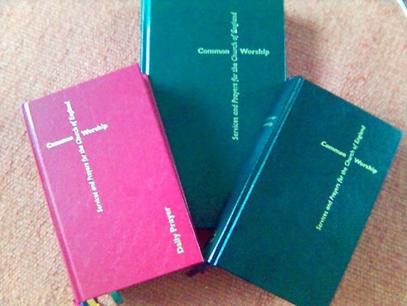
The Liturgy of the Hours is also known as the Divine Office, the Daily Office, the breviary, or the prayer of the Church.
Image from Public Domain

Slide 3
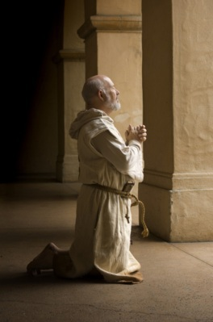
The Liturgy of the Hours is most often associated with those who live a monastic lifestyle, in cloistered settings.
These monks and nuns structure their whole lives
around this prayer.
© James Steidl/shutterstock.com

Slide 4

All those who are ordained or who have taken religious vows—even those who are not cloistered—are expected
to pray the Liturgy of the
Hours throughout
each day.

Slide 5
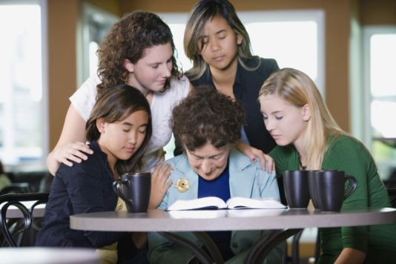
Most important to know, however, is that anyone can pray the Liturgy of the Hours. It is truly the prayer of the Church, or the entire people of God.
© Vibe Images/shutterstock.com

Slide 6
We can pray the Liturgy of the Hours alone or as part of a community. In either case, we join in unity with countless others who are praying the prayer of
the Church.
© Vibe Images/shutterstock.com

Slide 7
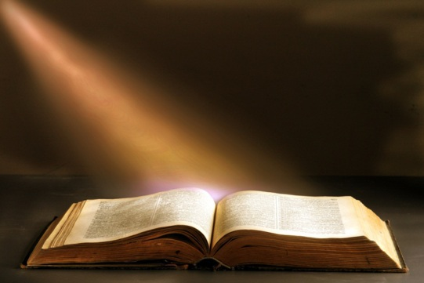
The Liturgy of the Hours consists almost entirely of Scripture. Praying it is a way of infusing Scripture into our everyday lives, of allowing Scripture to take deep root in our minds and hearts and to bear fruit in our attitudes and actions.
© Z-River/shutterstock.com

Slide 8
The Liturgy of the Hours follows a set format.
Notes:
Notes: Explain that you are reviewing this format now in preparation to offer this prayer together as a class.

Slide 9
It begins with an opening dialogue or call to prayer.

Slide 10
The heart of the Liturgy of the Hours is psalmody: one, two, or three psalms.
Each psalm begins and ends with an antiphon.
When the Liturgy of the Hours is prayed communally, these psalms are prayed “choir to choir,” with half the assembly praying one verse, the other half praying the following verse, and so forth.
All 150 psalms are prayed over the course of a four-week cycle.

Slide 11
After the psalmody, there is a short Scripture reading and a short spoken response to that reading.

Slide 12
Next is a Gospel canticle, which is also prayed choir to choir in communal settings:
at Morning Prayer, the Canticle of Zechariah (Luke 1:68–79)
at Evening Prayer, the Canticle of Mary, also known as the Magnificat (Luke 1:46–55)
at Night Prayer, the Canticle of Simeon (Luke 2:29–32)

Slide 13
The Liturgy of the Hours concludes with
prayers of petition, for our own needs and the needs of the world
the Lord’s Prayer
closing prayer and blessing

