Slide 1
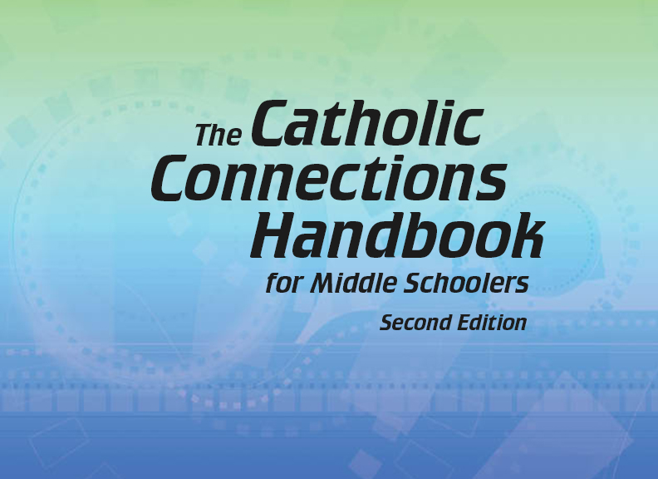


Slide 2
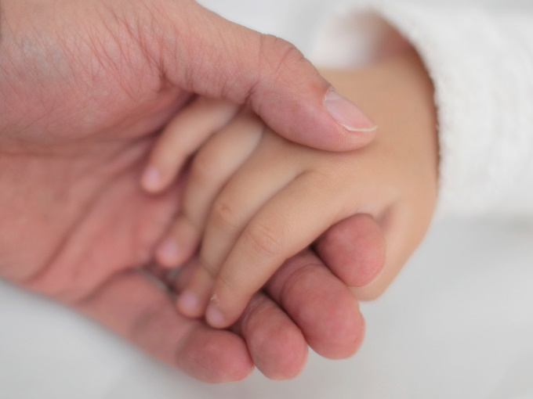
The Old Testament
and the Trinity
Chapter 3
God the Father
© Laikwunfai/www.istockphoto.com

Slide 3
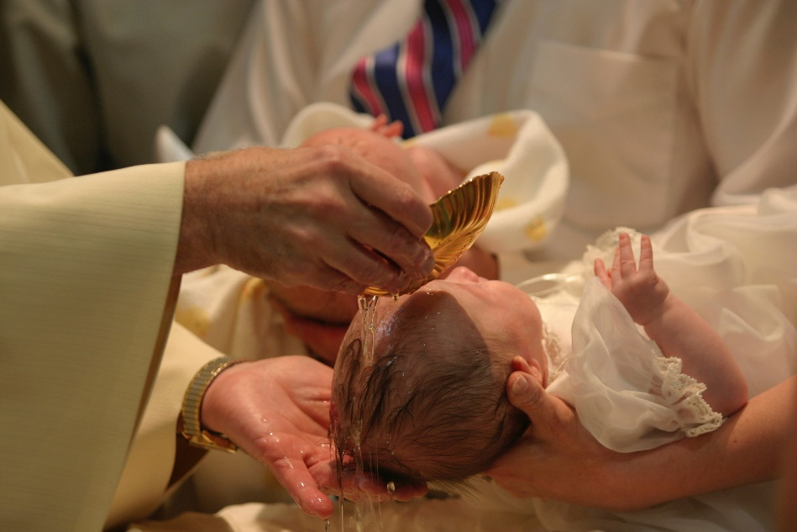
Chapter Summary
God the Father
In this chapter, we will look at the nature of God. God is Lord of all and the Trinity, yet Jesus calls God “Abba,” or “Father.” Because of Baptism, we too share in the inheritance of adopted sons and daughters and are also privileged to call God not only “Lord” but “Father.”
© TerryHealy/www.istockphoto.com

Slide 4
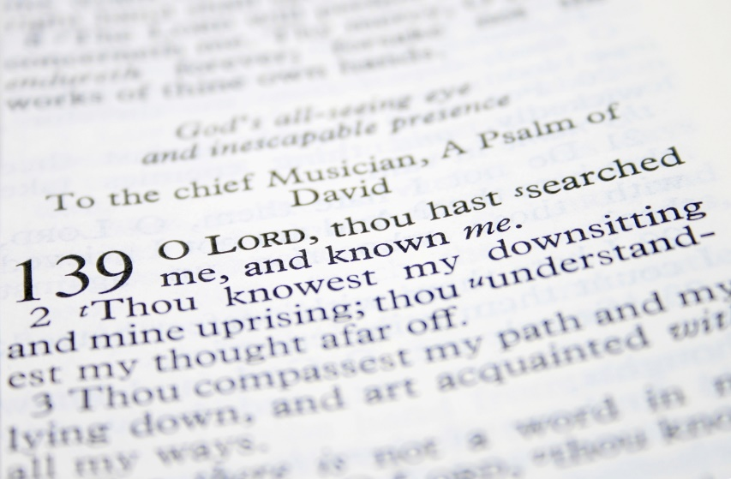
Introduction and “Who Is God?”
(Handbook, pages 36–39)
God revealed himself to us as “the Lord” who knows us completely and is always with us.
© JanineBM/www.shutterstock.com

Slide 5
Introduction and “Who Is God?”
(Handbook, pages 36–39)
We use various images and words for God.
God has revealed himself as Yahweh, which means “I am.”
Although God is powerful, great, and beyond us, he is also very close to us.
Reflect: How might knowing that God is “I am” bring us comfort in times of worry, stress, and other kinds of suffering?

Slide 6
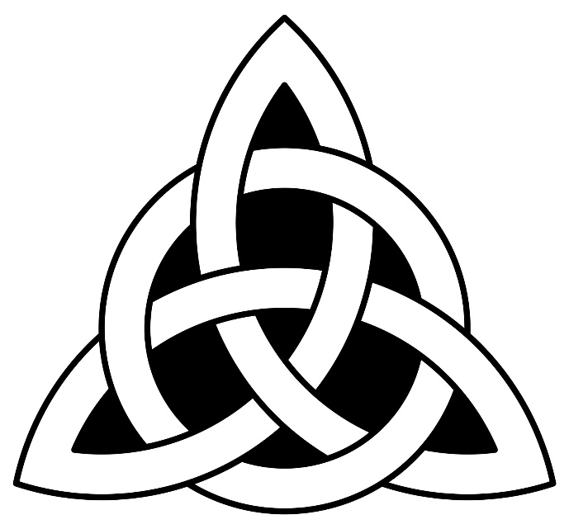
“The Trinity”
(Handbook, pages 39–40)
In the mystery of the Holy Trinity, God revealed himself as the Father, the Son, and the Holy Spirit—three Persons in one God.
© polosatik/www.shutterstock.com

Slide 7
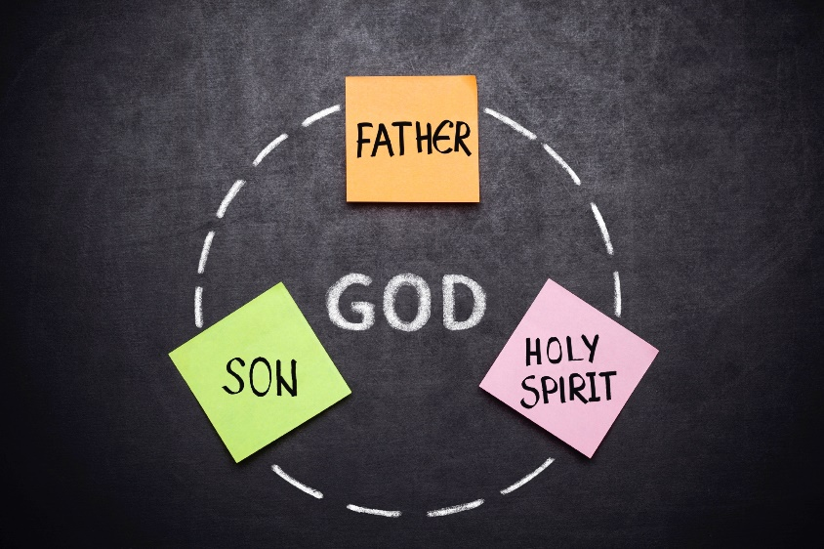
“The Trinity”
(Handbook, pages 39–40)
God revealed himself as a Trinity of Father, Son, and Holy Spirit.
This is the central mystery of our Christian faith.
Even when God reveals himself to us, he still remains a mystery.
© pepifoto/www.istockphoto.com

Slide 8
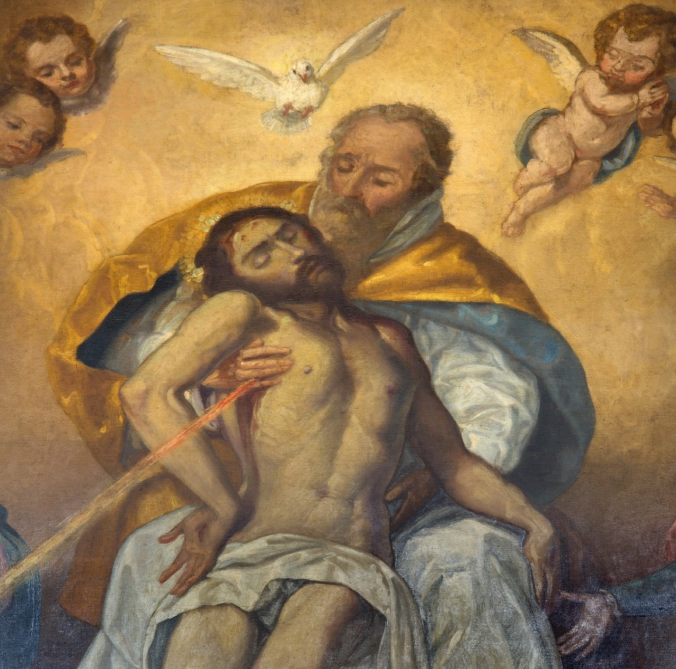
“God the Father”
(Handbook, pages 40–42)
Through Jesus we share in the close relationship he has with God, so we too can call God “Father.”
© sedmak/www.istockphoto.com

Slide 9
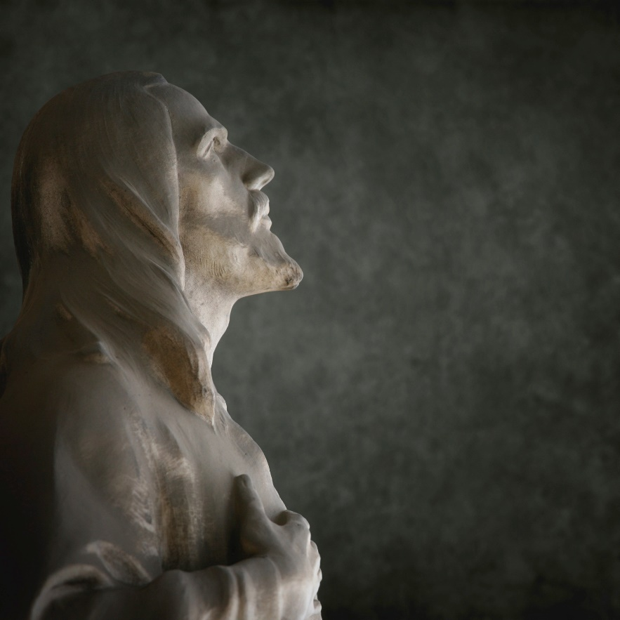
“God the Father”
(Handbook, pages 40–42)
God the Father is the first person of the Blessed Trinity.
The Bible recognizes both masculine and feminine qualities in God, but God is neither male nor female.
Jesus called God “Father,” and we do the same.
© mammuth/www.istockphoto.com

Slide 10

“God the Father”
(Handbook, pages 40–42)
God created the universe, including time. God is beyond time. God is not a created being. He is, always was, and always will be.
God is a mystery. A religious mystery is a truth so big that no human being can completely understand it.
© Ogphoto/www.istockphoto.com

Slide 11


“God Is Truth and Love”
(Handbook, pages 42–43)
Because God is truth and love, and we are his children, we can share his truth and love with others.
GOD
truth
His children
love

Slide 12

“God Is Truth and Love”
(Handbook, pages 42–43)
God is truth because what he tells us is true. We can trust his Word in Scripture and in the living Word, his Son, Jesus Christ.
God the Father sent his only Son for our salvation and sent the Holy Spirit to be with us always.
© mjbs/www.istockphoto.com

Slide 13
Group Activity
Please get into groups of three or four according to the teacher’s instructions.
Using what you have learned about God the Father, imagine that your group must tell someone who doesn’t know anything about God what it means for him to be our Father.
Choose one of the following ways to do so, and then present it to the rest of the class:
  Write a poem or short story.
  Create a rap or song.
  Perform a skit.
  Make a poster.
  Create a drawing or diagram.

Slide 14
Acknowledgments
To view copyright terms and conditions for Internet materials cited here, log on to the home pages for the referenced websites.
During this presentation’s preparation, all citations, facts, figures, names, addresses, telephone numbers, Internet URLs, and other pieces of information cited within were verified for accuracy. The authors and Saint Mary’s Press staff have made every attempt to reference current and valid sources, but we cannot guarantee the content of any source, and we are not responsible for any changes that may have occurred since our verification. If you find an error in, or have a question or concern about, any of the information or sources listed within, please contact Saint Mary’s Press.

