Slide 1
Understanding Sacred Scripture
The Living Word: The Revelation of God’s Love, Second Edition
Unit 2, Chapter 4
Document#: TX004682

Slide 2
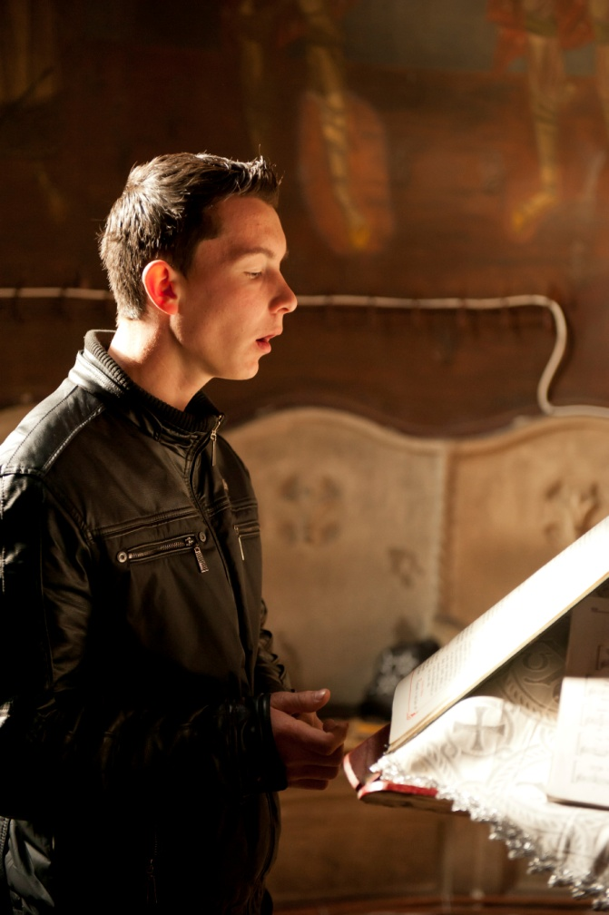
Divine Inspiration
The Holy Spirit inspired the human authors who wrote the Bible’s books.
Scripture teaches the truths that God wished to reveal.
© buburuzaproductions / iStockphoto.com
Notes:
Notes: Direct the students to reflect on a time when they felt inspired. Ask the question at the end of article 15 in the student book: What does it mean to be inspired by God?
This slide corresponds to content in article 15, “Divine Inspiration and Biblical Inerrancy,” in the student book.

Slide 3
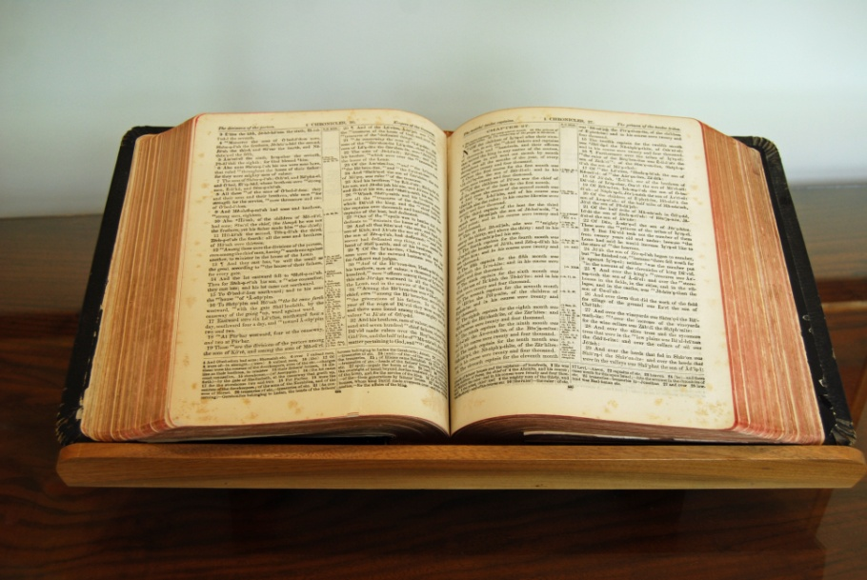
The Author of Scripture
The Bible’s human authors were true authors.
But God acted in them and through them.
God is the ultimate author.
The saving truths God willed us to know are without error.
© Colleen E. Scott/Scott Designs / Shutterstock.com
Notes:
Notes: Explain to the students that biblical inerrancy, the doctrine that the books of Sacred Scripture are free from error, applies specifically to the truth that is necessary for our salvation.
This slide corresponds to content in article 15, “Divine Inspiration and Biblical Inerrancy,” in the student book.

Slide 4
Through Human Words
We can understand God’s Revelation because Scripture uses human words.
The human authors used the languages and communication styles of their times and cultures.
© Linda & Colin McKie / Thinkstock
Notes:
Notes: Explain to the students that we need to understand what the human authors were trying to communicate through their writings, but we must also look for the truth that God wanted to reveal to us through the authors’ words.
This slide corresponds to content in article 15, “Divine Inspiration and Biblical Inerrancy,” in the student book.

Slide 5
From the Spoken to the Written Word
Three basic forms of communication are nonverbal actions, the spoken word, and the written word.
All three were instrumental in the development of Sacred Scripture as we know it today.
© Meg Wallace Photography / Shutterstock.com
Notes:
Notes: Direct the students to reflect on examples of each type of communication they have experienced in the past few days. Ask the students for examples of new learnings they acquired through these experiences.
This slide corresponds to content in article 16, “From the Spoken to the Written Word,” in the student book.

Slide 6
First, an Experience
Before human beings can communicate anything, they must have an experience.
Central to the experiences of people during Old Testament times was their relationship with God.
© Christopher Futcher / iStockphoto.com
Notes:
Notes: Call the students’ attention to the second bullet point, and ask what kinds of experiences were central to those living in New Testament times (the life and ministry of Jesus, life in the early Church).
This slide corresponds to content in article 16, “From the Spoken to the Written Word,” in the student book.

Slide 7
Next, the Spoken Word
The Israelites first handed down their experience by word of mouth.
They used prophecy, preaching, stories, poetry, and worship.
Jesus used the spoken word in a powerful and transforming way.
© Vibe Images / Dollar Photo Club
Notes:
Notes: Be sure the students know the terms oral tradition and written tradition defined in article 16 in the student book. Ask them to name examples of oral tradition in their families (e.g., stories about previous generations).
This slide corresponds to content in article 16, “From the Spoken to the Written Word,” in the student book.

Slide 8
Finally, the Written Word
People wanted to preserve God’s message of salvation for later generations.
The spoken and written traditions have communicated God’s wisdom for more than two thousand years.
© tovfla / iStockphoto.com
Notes:
Notes: Ask for a volunteer to explain the three-step progression of the Gospels, from spoken word to written account, as described in article 16 in the student book.
This slide corresponds to content in article 16, “From the Spoken to the Written Word,” in the student book.

Slide 9
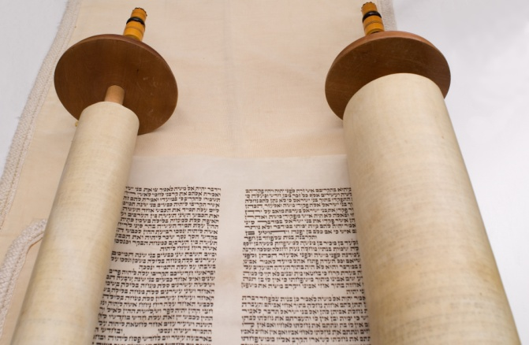
Dates of Events and Writings
Many of the biblical books were written down years, even centuries, after the events they describe.
Most books do not appear in the Bible in the order in which they were written.
© Howard Sandler / Shutterstock.com
Notes:
Notes: Explain to the students that more important than the dates of the Bible’s books, or their order, is the picture of our compassionate God that is woven through the words of Sacred Scripture.
This slide corresponds to content in article 17, “When Did It Happen? When Was It Written?” in the student book.

Slide 10
Setting the Canon of Scripture
The canon of the Bible is the official collection of inspired books.
Three Church councils discerned the canon of Sacred Scripture.
© Thomas Bethge / Shutterstock.com
Notes:
Notes: Point out to the students that there are forty-six Old Testament books and twenty-seven New Testament books in the canon of the Catholic Bible. Ask the students this question: How many books of the Bible are you familiar with?
This slide corresponds to content in article 18, “Setting the Canon of Scripture,” in the student book.

Slide 11
Standards Used to Determine the Canon of Scripture:
Apostolic origin
Community acceptance
Use in early Christian worship
Consistency
© Magdalena Kucova / Shutterstock.com
Notes:
Notes: Ask the students to explain in their own words each of these four standards used by the early bishops to determine whether a book was divinely inspired. (See article 18 in the student book.)
This slide corresponds to content in article 18, “Setting the Canon of Scripture,” in the student book.

Slide 12
Many Translations: One Revelation
Different translations serve different purposes.
Four Catholic biblical translations are widely used today.
All four present one message of God’s saving love.
© Christopher Futcher / iStockphoto.com
Notes:
Notes: Ask the students how a translation for children might differ from one for scholars (a child needs simpler language, a scholar needs a precise translation). Identify the translation they will use in this course. Ask if they know which translation is the approved Lectionary text (NABRE for the United States, NRSV for Canada).
This slide corresponds to content in article 19, “Different Translations: The Same Revelation,” in the student book.

