Slide 1
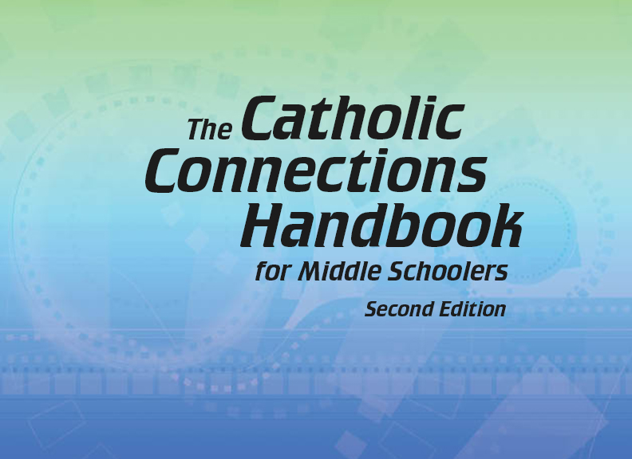

Document #: TX005841

Slide 2
Prayer and Church History
Chapter H
An Age of Renewal and Growth

Slide 3
Chapter Summary
The Renaissance both enriched and tested the Church.
As the Church grew, dissent rose up and another schism occurred: the Protestant Reformation.
At the Council of Trent, the Church looked at its own practices.
The Church expanded to the New World and the Far East.

Slide 4
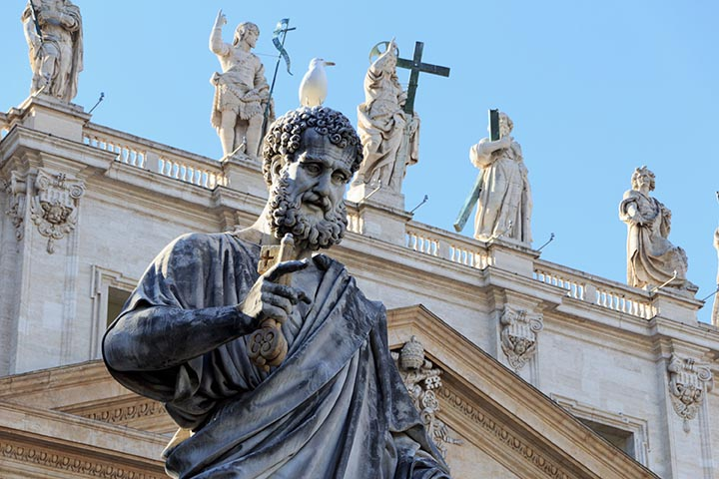
Introduction (Church History, pages 62–63)
After the Middle Ages,
the Church participated
in the Renaissance.
(This statue of Saint Peter and Saint Peter’s
Basilica behind it, in Rome, are examples of Renaissance architecture.)
© Fabianodp/Shutterstock.com

Slide 5
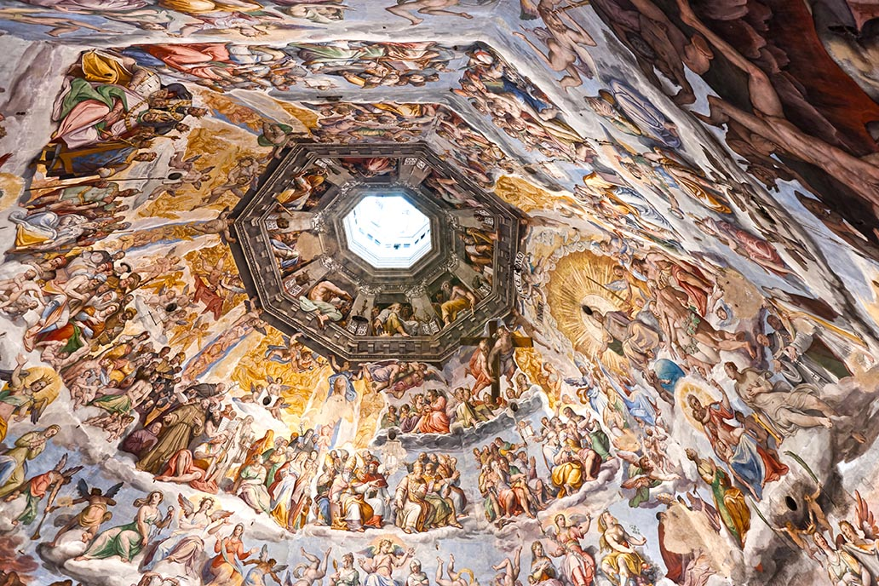
An Age of Humanism
During this era, artists and thinkers discovered the beauty and sig- nificance of human achievement.
It was an age of beauty and sometimes excess.
(This photo shows the Duomo, or dome, of the cathedral in Florence, Italy.)
© Luciano Mortula / Shutterstock.com

Slide 6
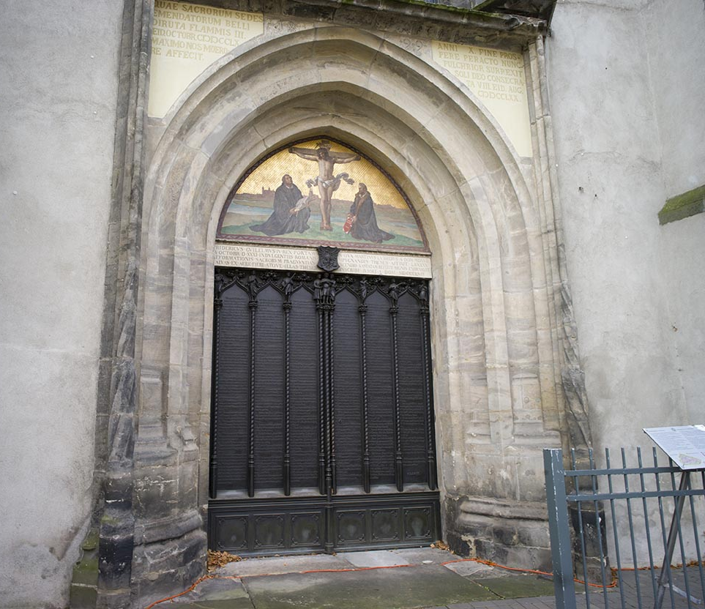
“Martin Luther’s Complaint” and “Renewal: The Council of Trent” (Church History, pages 63-70)
Martin Luther’s dissent led to a protest movement.
Other Christians splintered off in Protestant factions, which led the Church to counter with reforms.
(These are the doors to the church at Wittenberg, where Martin Luther posted his Ninety-Five Theses.)
© gary yim / Shutterstock.com

Slide 7
Journal It!
Here are the key points in Martin Luther’s doctrine:
Sola Scriptura (Scripture alone)
Sola fide (faith alone)
Sola gratia (grace alone)
In the Catholic view, what do these beliefs leave out? Use page 66 and the Did You Know? article on page 67 to write a short response to each statement.

Slide 8
Share It!
Gather in groups of two or three.
Choose one topic addressed by the Council of Trent. (See the chart on page 70.)
Plan and make a poster that will help people to understand this topic. Use art, photos, and a short paragraph of explanation in your poster.

Slide 9
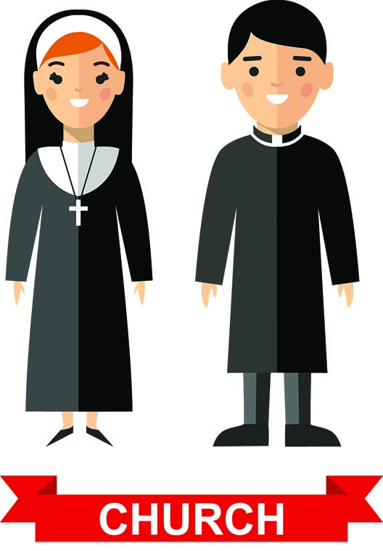
“Following Christ Anew” (Church History, pages 71–74)
New religious orders were
begun by holy men and women
after the Council of Trent.
© Annasunny24/Shutterstock.com

Slide 10
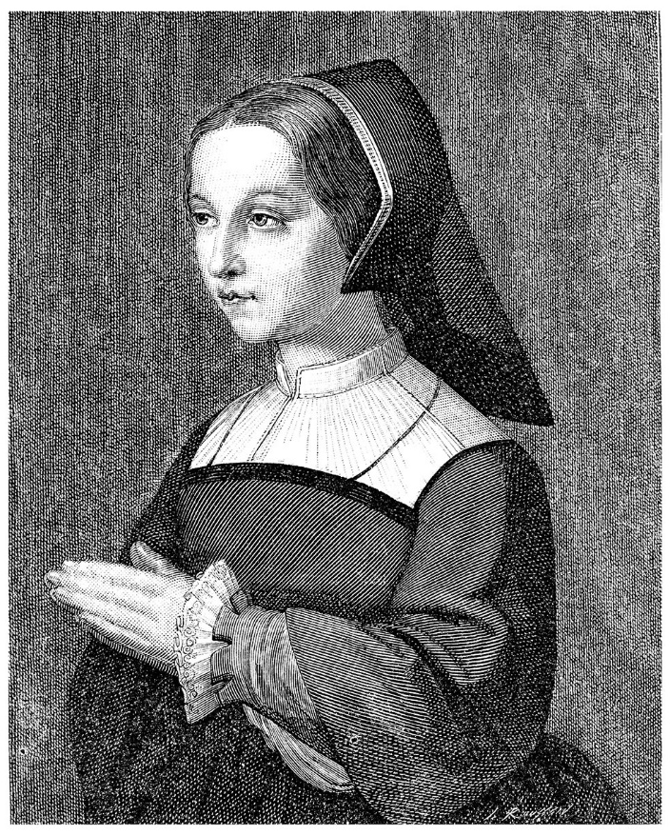
Renewal Movers and Shakers
Saint Ignatius of Loyola
Saint Teresa of Ávila
Saint Peter Canisius
Saint Francis de Sales
Saint Jane Frances de Chantal
(Saint Jane de Chantal, at age twenty, before she founded her religious community.)
© Morphart Creation / Shutterstock.com

Slide 11
Search It!
Gather in groups of two or three. Choose one of the following and research:
the Society of Jesus (Jesuits),
the Order of Carmel (either men or women),
the Order of the Visitation of Holy Mary.
All of these religious institutes still exist today.
Share your findings with your group.

Slide 12

“New Explorations” (Church History, pages 74–84)
The Church expanded and
evangelized as European
nations explored
North America,
Latin America, and
the Far East.
© Sarunyu_foto/Shutterstock.com

Slide 13
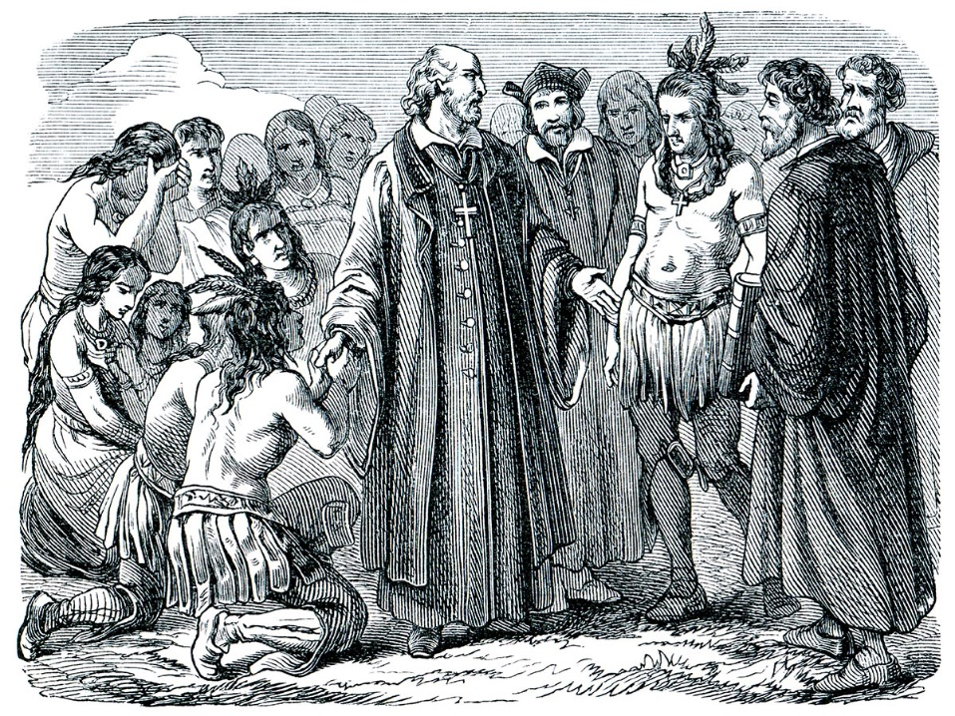
Latin America
The following saints and holy people were influential in Latin America:
Bartolomé de las Casas
(pictured here)
Saint Peter Claver
Saint Martin de Porres
Saint Rose of Lima
© Sergey Kohl / Shutterstock.com

Slide 14
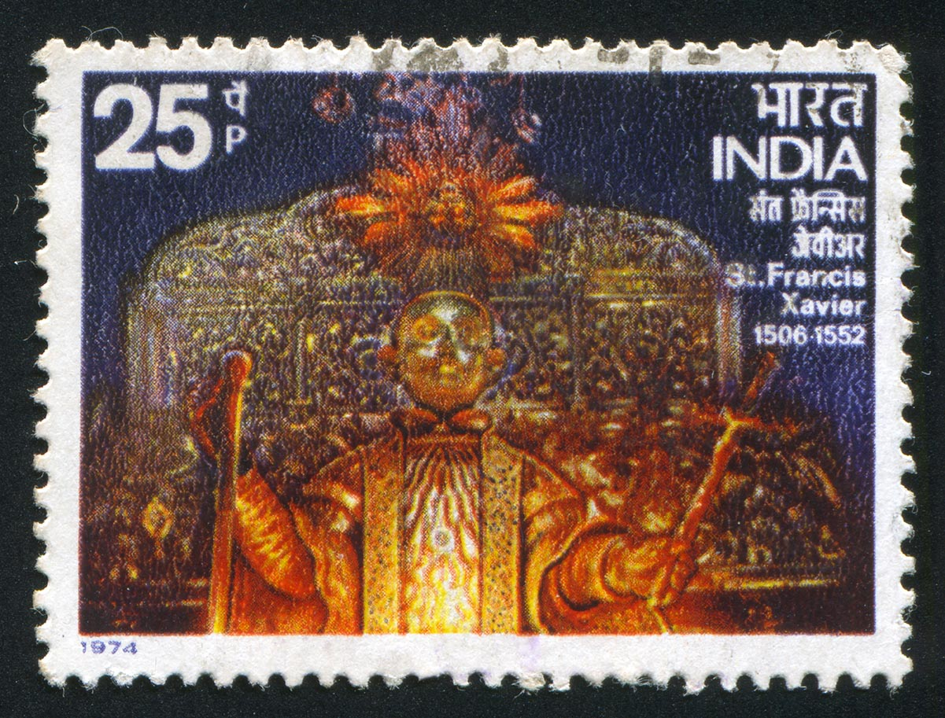
The Far East
The following saints and holy people were influential in the Far East:
Saint Francis Xavier (India, pictured here)
Father Matteo Ricci (China)
©rook76/www.shutterstock.com

Slide 15
North America
The following saints and holy people were influential in North America:
Saint Junipero Serra and the Franciscan missions in California
Saint Isaac Jogues (Jesuit) and Saint John de Brebeuf (layman helping the Jesuits) and Companions

Slide 16
Think About It!
Think back to all of the people who taught you about Jesus, from the time you were small until now. Choose one of these persons. Write that person a note, thanking him or her for teaching you about Jesus, for helping you make your First Communion, for teaching you about the Mass and the Sacraments, or for helping you to serve others. Mail your note. If you do not know this person’s address, keep this note as a reminder to pray for him or her. We come to God together!

