Slide 1
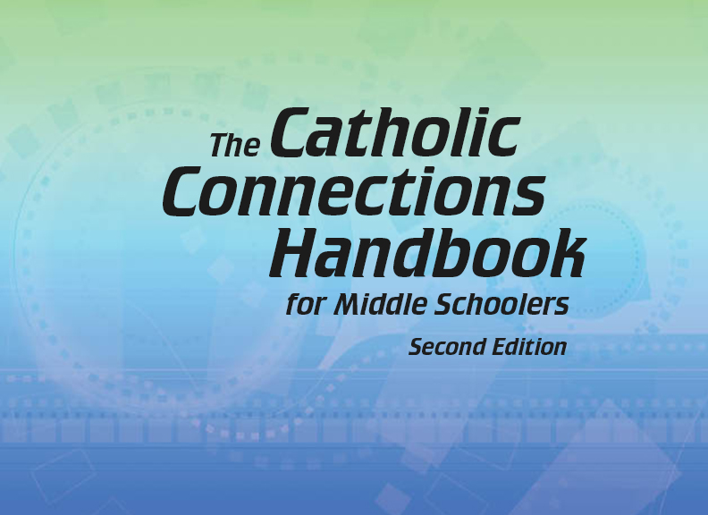


Slide 2
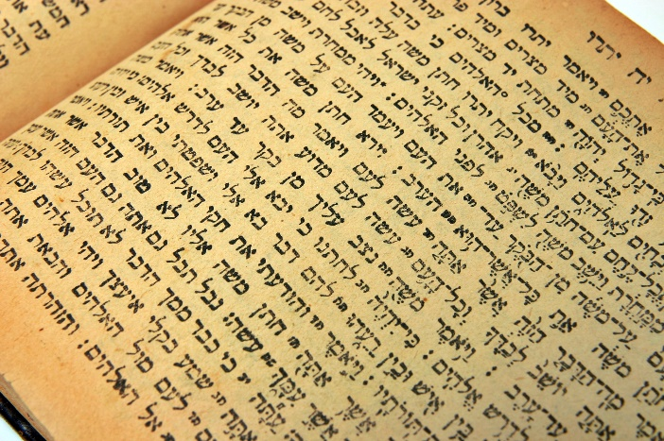
The Old Testament
and the Trinity
Chapter 5
The Bible: The Old Testament
© boryak/www.istockphoto.com

Slide 3
Chapter Summary The Bible: The Old Testament
The Jewish Scriptures play an important role in the life of the Christian community.
There are four major divisions of the books in the Old Testament: the Pentateuch, the historical books, the wisdom and poetry books, and the books of the prophets.
Old Testament
Pentateuch
Historical Books
Wisdom and Poetry Books
Books of the Prophets

Slide 4
Introduction and “The Pentateuch” (Handbook, pages 52–56)
The Old Testament is divided into four major parts and includes a variety of literary genres. The first section is the Pentateuch, which reveals foundational truths about God’s plan for Creation and humanity.
Genesis
The Pentateuch
Exodus
Leviticus
Numbers
Deuteronomy

Slide 5
Introduction and “The Pentateuch” (Handbook, pages 52–56)
The Pentateuch is the first five books of the Bible:
These five books of the Pentateuch reveal important things about God and his original plan for Creation and humanity.
Genesis
Leviticus
Deuteronomy
Exodus
Numbers

Slide 6

Introduction and “The Pentateuch” (Handbook, pages 52–56)
God made everything good, and humans, in particular, to be in a special relationship with him.
Human sin disrupts our relationship with God, but God continues to reach out and teach us how to live in union with him and with each other.
© CHOATphotographer/www.shutterstock.com

Slide 7
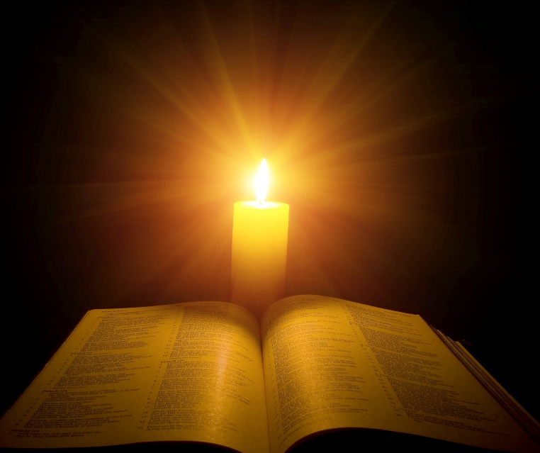
“The Historical Books” (Handbook, pages 56–61)
The second section is the historical books. These books are not unbiased history but instead are written to emphasize God’s action in history.
© vovan/www.shutterstock.com

Slide 8
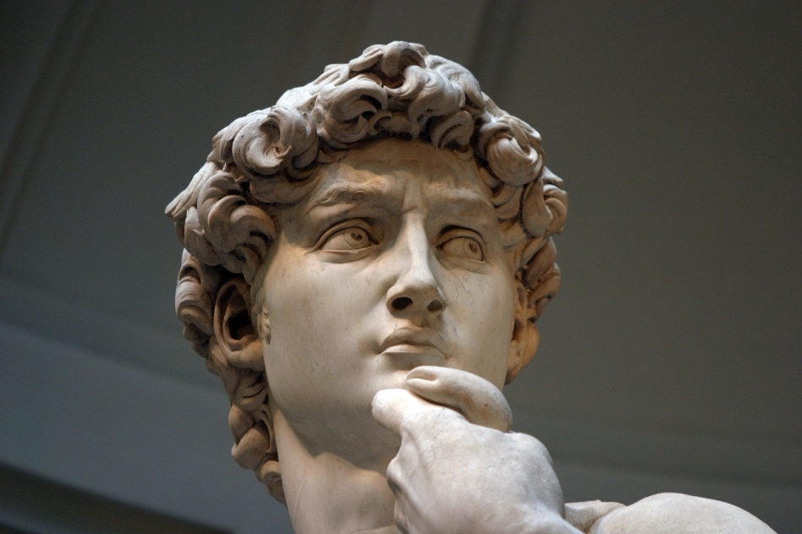
“The Historical Books” (Handbook, pages 56–61)
The historical books are not books of pure history but instead emphasize God’s actions in the history of the Jewish people.
After Joshua led the Israelites into the land of Canaan, God raised up spirit-filled leaders, called Judges, who helped to lead the Israelites.
© lillisphotography/www.istockphoto.com

Slide 9
“The Historical Books” (Handbook, pages 56–61)
Samuel, the last Judge of Israel, anointed Saul as the first king of Israel, who was then followed by the great kings David and Solomon. David united all the Israelites together, and Solomon built the Temple in Jerusalem.
After Solomon’s death, civil war split the kingdom of Israel into two separate kingdoms that were later conquered by the Assyrians and the Babylonians.
Kingdom of Israel
Kingdom of Judah
Israel

Slide 10

“The Wisdom and Poetry Books” (Handbook, pages 62–64)
The third section is the wisdom and poetry books, which use Hebrew poetry to teach how to live a good and holy life.
© JarenJaiWicklund/www.shutterstock.com

Slide 11
“The Wisdom and Poetry Books” (Handbook, pages 62–64)
The wisdom and poetry books provide teachings about how to be a wise person, that is, a person who lives a good and holy life.
The Book of Psalms contains 150 prayers that are meant to be sung as part of Jewish worship, and today we encounter the Psalms in the Responsorial Psalm at Mass.
The Book of Job seeks to understand the age-old question, “Why does God allow bad things to happen to good people?”
The Book of Proverbs is a collection of sayings that gives advice on how to be a good and wise person.

Slide 12
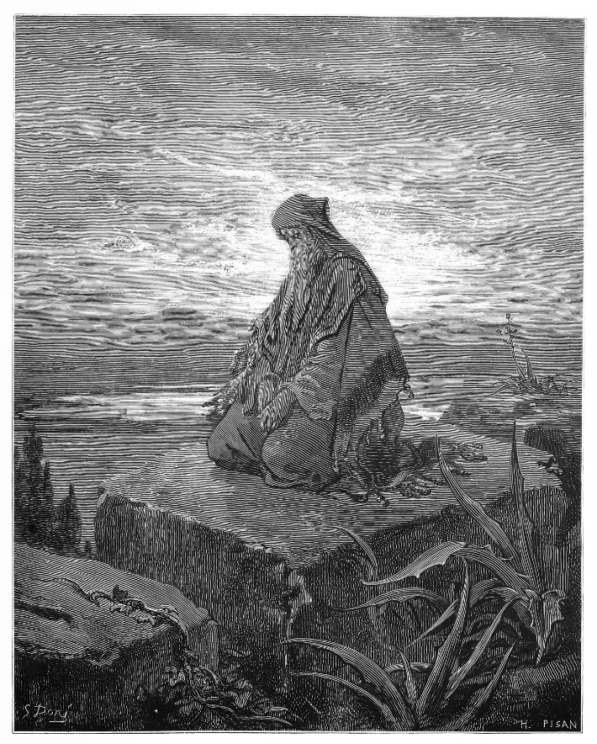
“The Prophets” (Handbook, pages 65–67)
The fourth section is the prophets. The prophets of Israel had two basic messages:
Calls to reform
Hope-filled promises
© Nicku/www.shutterstock.com

Slide 13
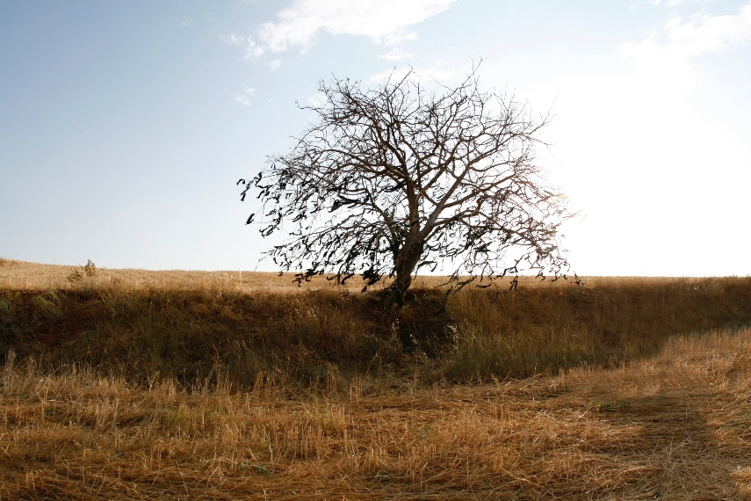
“The Prophets” (Handbook, pages 65–67)
A prophet is a person that God calls to speak on his behalf.
The prophets of Israel had two basic types of messages:
The first type was condemnation because the Chosen People had failed to live out their promises to God in keeping their part of the covenant.
The second basic type was messages of hope, focusing on themes such as God’s faithfulness to his people, the survival of the faithful, and God sending a Messiah.
© hulyakarakas/www.istockphoto.com

Slide 14
Let’s Review!
Check your understanding of this chapter by filling in the blanks:
The Old Testament is divided into ____sections.
The first section is called the ________________, which reveals God’s original plan for humanity and the world.
The second section consists of the ____________ books. These books show God’s action in __________.
The third section is the ________ and _______ books. These books offer advice on how to ___________________.
The fourth section is the _________________. Two basic messages are conveyed through these books: calls to ___________ and hope-filled _________________.

Slide 15
How Did You Do?
Here are the completed sentences:
The Old Testament is divided into four sections.
The first section is called the Pentateuch, which reveals God’s original plan for humanity and the world.
The second section consists of the historical books. These books show God’s action in history.
The third section is the wisdom and poetry books. These books offer advice on how to live a good and holy life.
The fourth section is the prophets. Two basic messages are conveyed through these books: calls to reform and hope-filled promises.

