Slide 1
The Suffering and Death of Jesus
The Paschal Mystery
Unit 3, Chapter 6
Document #: TX005437

Slide 2
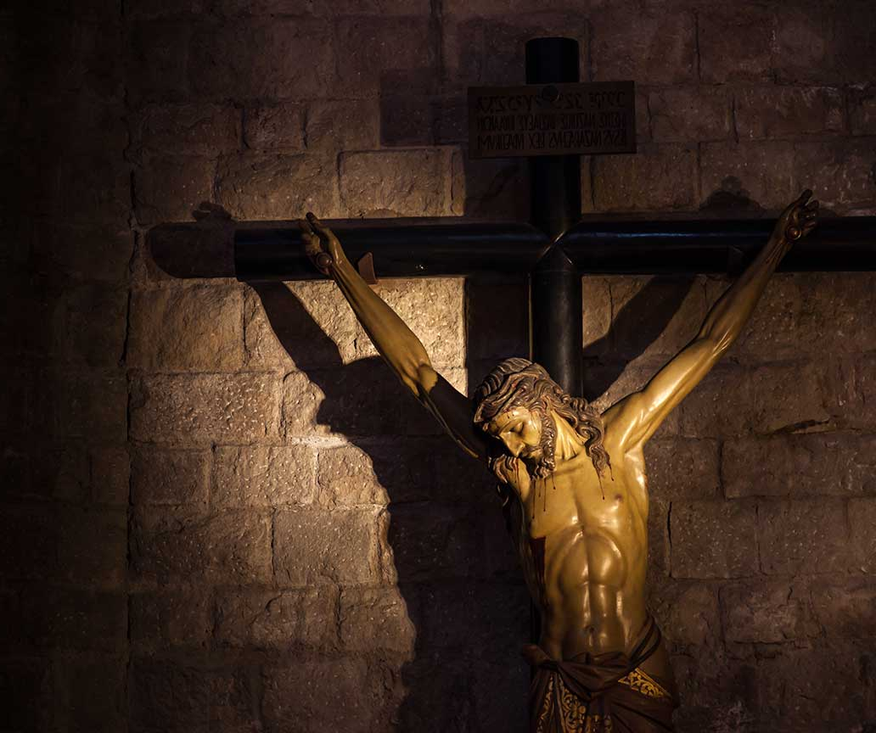
Christ’s Passion
Jesus’ death was not a senseless execution.
It was a supernatural event that freed all humanity from the bonds of death.
Jesus’ Passion and Resurrection were at the center of the early Church’s first preaching.
© PerseoMedusa / Shutterstock
Notes:
Notes: Point out how firmly the early followers of Jesus must have believed in the Resurrection of Christ and the salvation it accomplished. Explain that otherwise we might expect them to conceal the fact that their founder had been shamefully executed.
This slide corresponds to student text content in article 21.

Slide 3
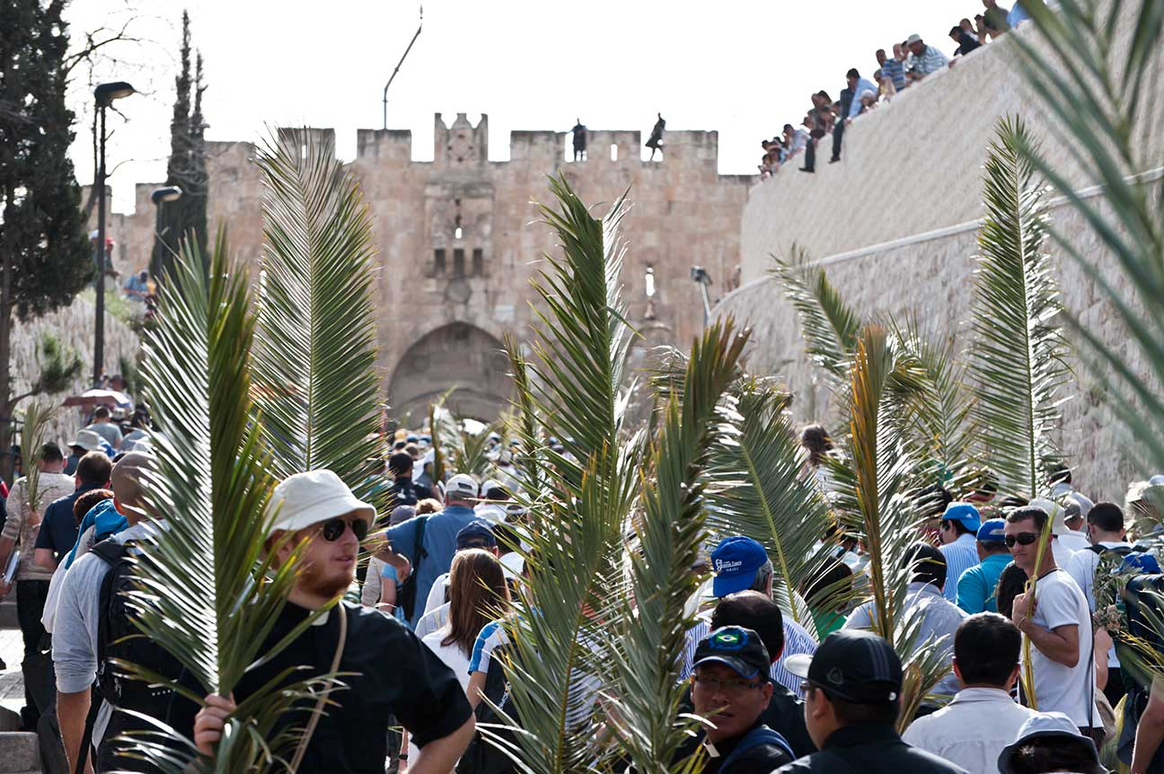
Sunday
Jerusalem was the center of Jewish faith and worship.
When Jesus first arrived, crowds welcomed him as a triumphant king.
The Jewish leaders
began looking for
ways to kill Jesus
after he cast the
moneychangers
out of the Temple.
© Ryan Rodrick Beiler / Shutterstock
Notes:
Notes: For the second bullet point, ask for a volunteer to identify the image (a Palm Sunday procession). After the last bullet point, discuss how Jesus might challenge us too, regarding our religious practice. Ask what might please him, and what might anger him.
This slide corresponds to student text content in article 21.

Slide 4
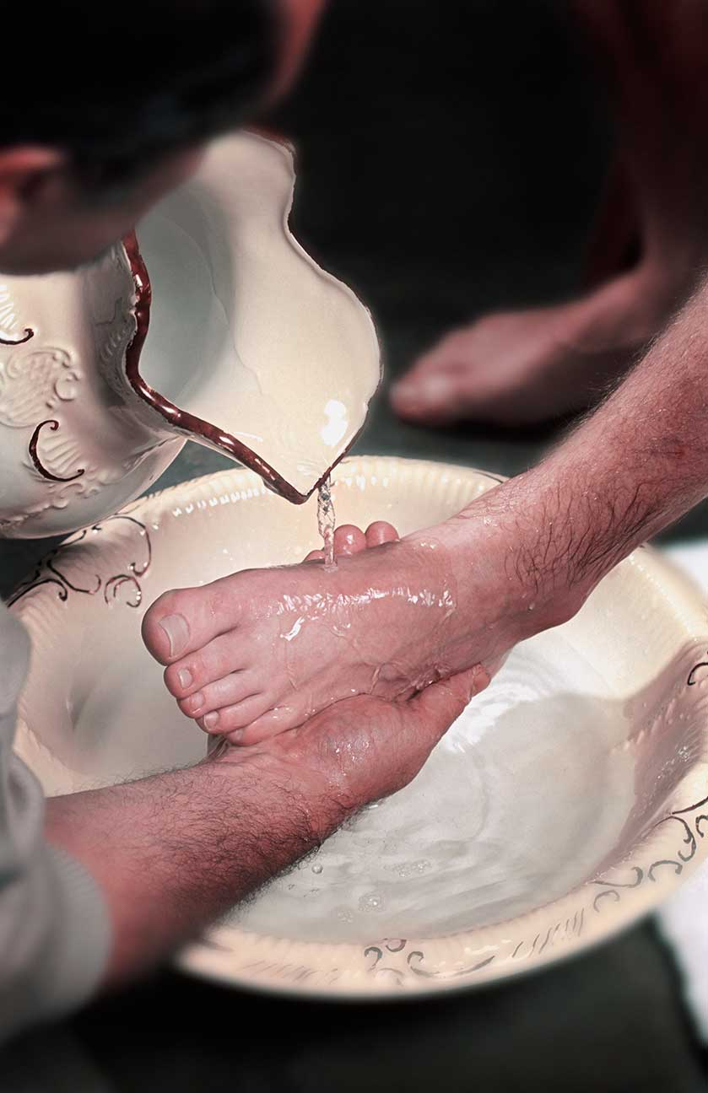
Thursday Evening
Early Thursday evening, Jesus gathered with the Apostles to celebrate his last Passover.
Jesus washed their feet to show that true leadership is service.
He instituted the Eucharist at this meal.
© Vibeimages / istock
Notes:
Notes: Ask about the students’ experience of the foot washing on Holy Thursday in their parishes. Explain that on Holy Thursday we commemorate the institution of the Eucharist and of the priesthood. Discuss the variety of ways that Christians are called to be servant leaders.
This slide corresponds to student text content in article 21.

Slide 5
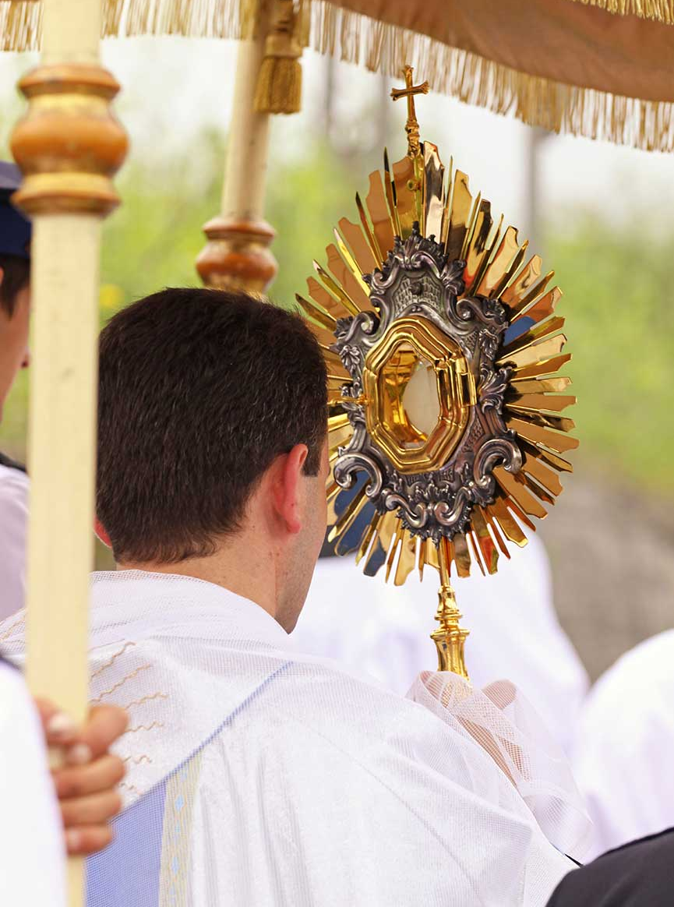
Thursday Night
Jesus went with his Apostles to pray in the garden at Gethsemane.
Judas led the Temple guards to Jesus so that they could arrest him.
Jesus was tried and found guilty of blasphemy by the Sanhedrin.
© Avalon_Studio / istock
Notes:
Notes: Point out that after Mass on Holy Thursday, people often spend time praying before the Blessed Sacrament, just as Jesus prayed the night before his death. Discuss Peter’s denial of Jesus, and ask for examples of times when people today might be tempted to deny Jesus.
This slide corresponds to student text content in article 21.

Slide 6
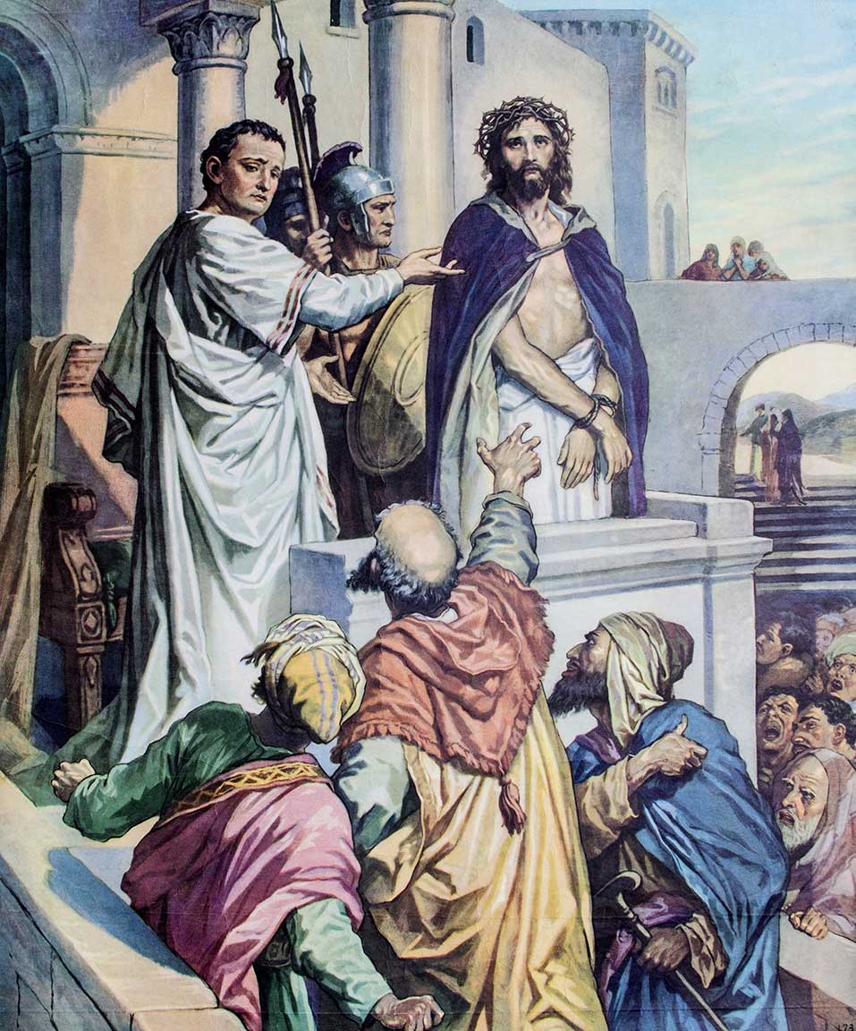
Creation: The Work of the Trinity
God created the universe and continues to sustain it through his love.
Creation is the work of all three Divine Persons of the Trinity: Father, Son, and Holy Spirit.
© iamfree007 / Shutterstock
Notes:
Notes: Explain that two sets of laws governed Israel at the time, Jewish and Roman. Ask what charge was brought by each authority (Jewish: blasphemy; Roman: treason). Ask for the students’ interpretation of Jesus’ refusal to offer a defense.
This slide corresponds to student text content in article 21.

Slide 7
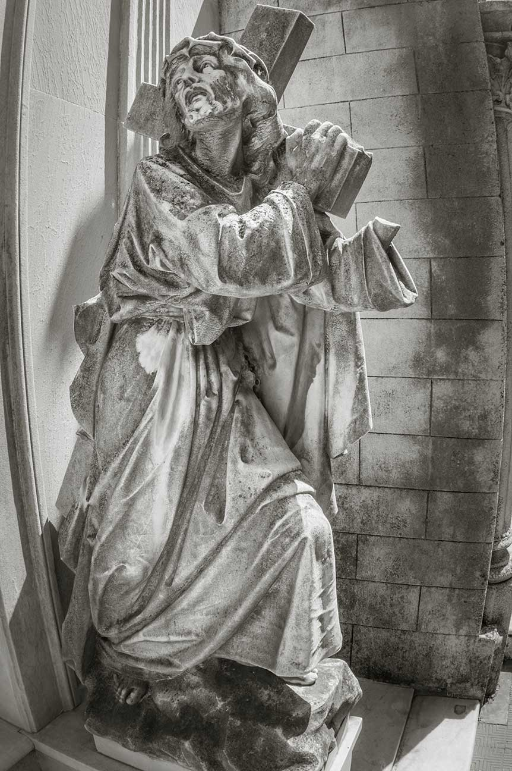
Friday Afternoon
A Roman execution was meant to be horrible to frighten people into obedience.
First, Jesus was scourged, or whipped, then publicly humiliated.
Jesus then carried his cross to Golgotha.
© alex_black / Shutterstock
Notes:
Notes: Direct the students to read the Did You Know? sidebar, “Walking in Jesus’ Footsteps,” in article 21 of the student text. Invite them to share their experience of praying the Stations of the Cross; consider sharing your own experience.
This slide corresponds to student text content in article 21.

Slide 8
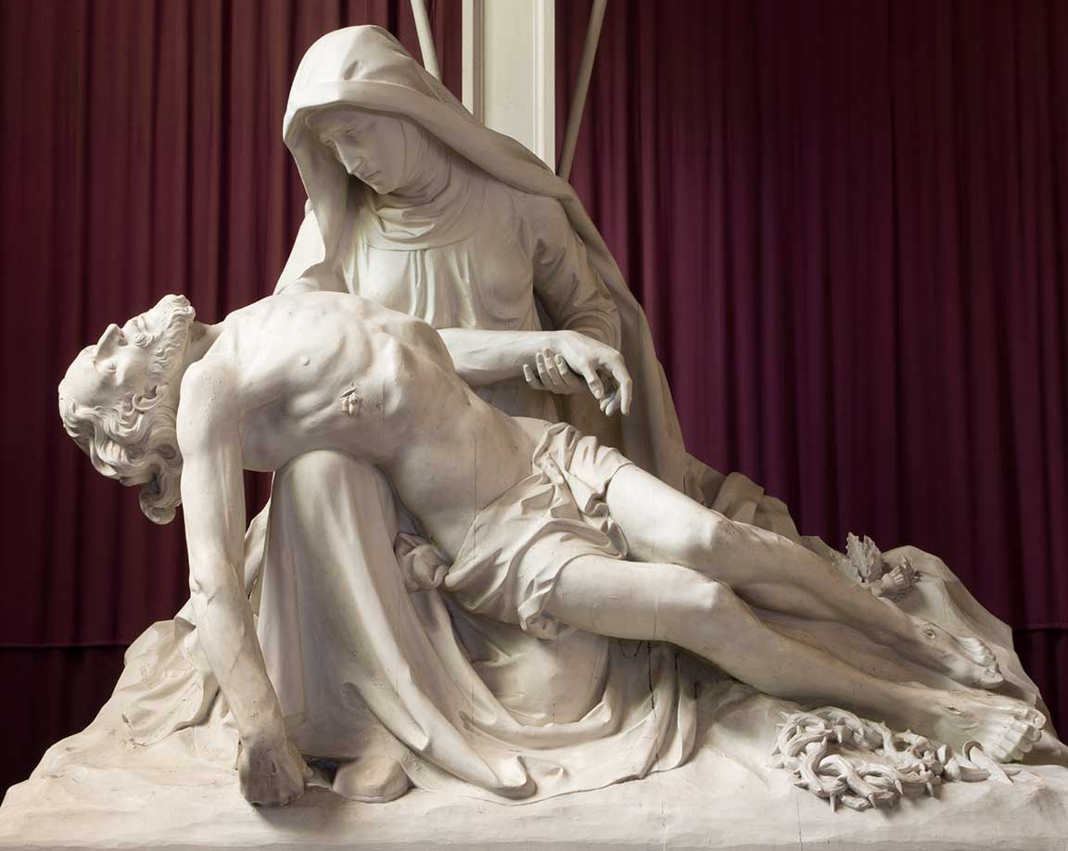
Jesus’ Death
Jesus died in about six hours.
A solar eclipse and an earthquake accompanied his death.
Jesus’ body was placed in a tomb.
© sedmak / istock
Notes:
Notes: Discuss the courageous faith shown by several figures in the Passion account: the women and the Beloved Disciple stood at the foot of the cross; Joseph of Arimathea asked for Jesus’ body. Explain that these individuals, as followers of Jesus, risked arrest or crucifixion themselves. Discuss how Christians today may take risks for their faith.
This slide corresponds to student text content in article 21.

Slide 9
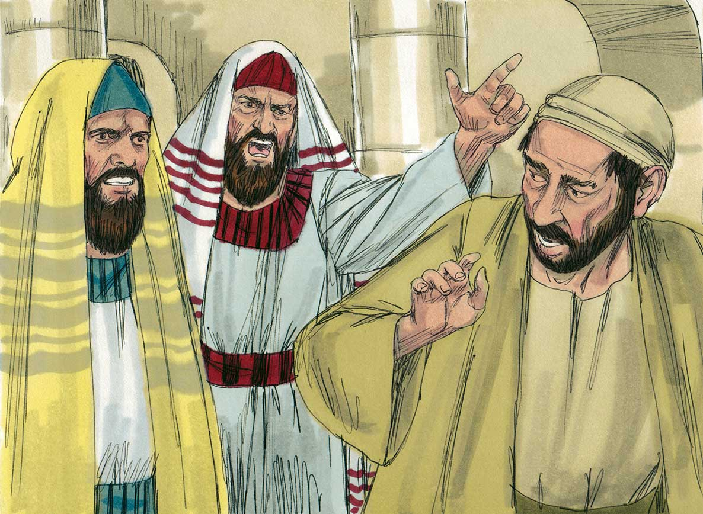
The Jewish Leaders’ Reasons
They believed Jesus was undermining their authority with the common people.
They said Jesus committed blasphemy when he claimed he had powers that belonged to God alone.
© BibleArtLibrary / istock
Notes:
Notes: Direct the students to read the Live It! sidebar, “Jewish People Are Our Spiritual Brothers and Sisters,” in article 22 of the student text. Explain that wrongly blaming Jews for the death of Jesus has been a way to stir up hatred against Jews for centuries, leading to discrimination and violence, and to the Shoah, or Holocaust. (The image on the slide depicts the Jewish leaders’ expelling a man who was healed by Jesus on the Sabbath from the synagogue; see the full story in John, chapter 9.)
This slide corresponds to student text content in article 22.

Slide 10
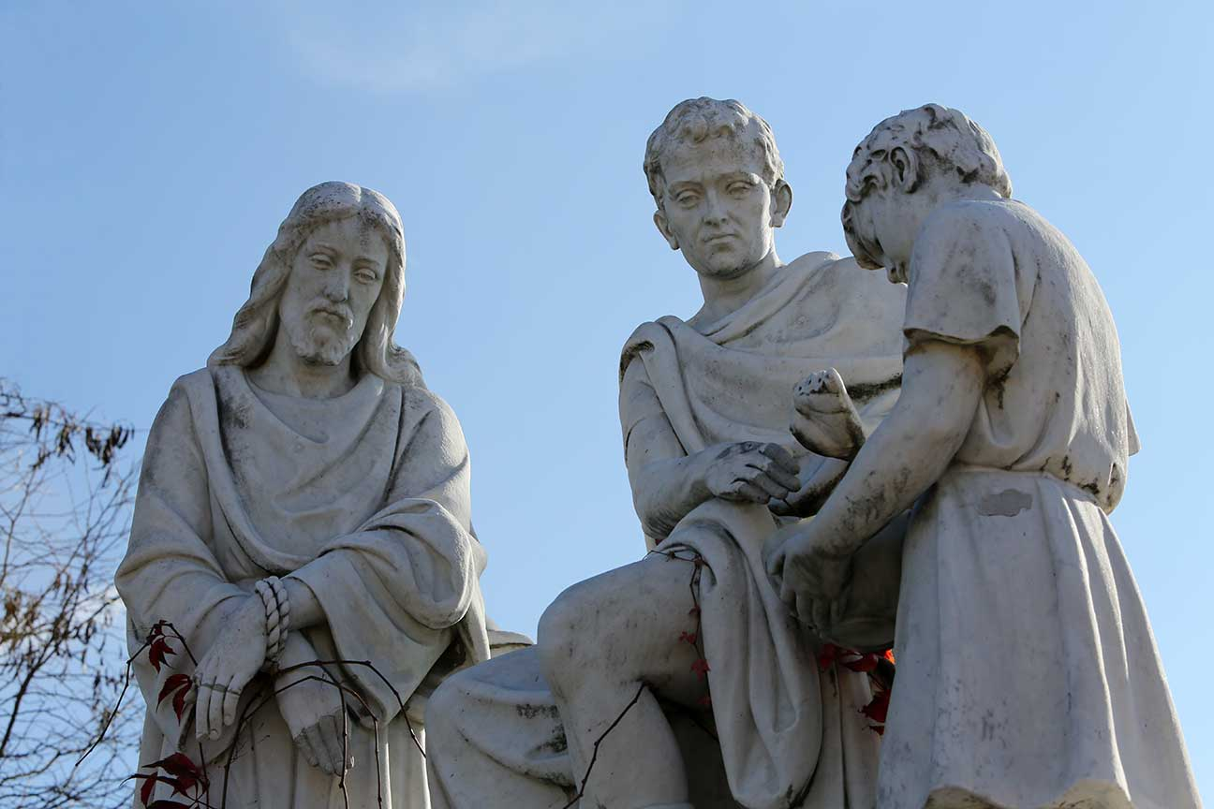
The Roman Leaders’ Reasons
As procurator, Pilate was
to send taxes to Rome and maintain the peace.
Jesus was a threat to the peace.
Pilate proclaimed Jesus innocent, yet he ordered the execution.
© Zvonimir Atletic / Shutterstock
Notes:
Notes: Ask how leaders today may “wash their hands” after making a decision. Ask how we may sometimes do so as well. Briefly discuss the last section of the article, on the irony of these two condemnations: Jesus really is the Son of God, so his actions were not blasphemy, and his execution did not stop the spread of his message but instead fulfilled it.
This slide corresponds to student text content in article 22.

Slide 11
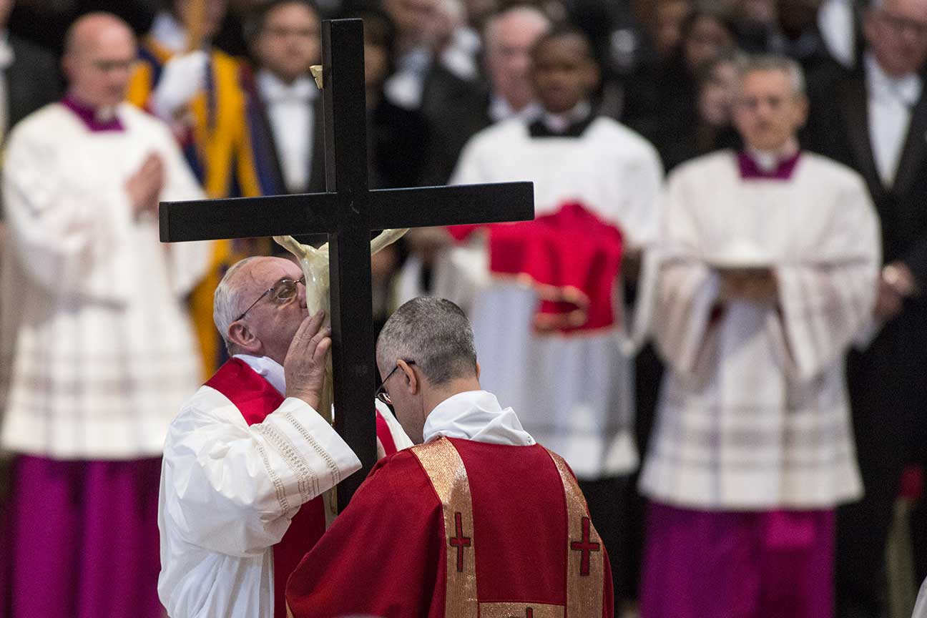
The Meaning of the Cross
The Father planned that his Son would die so that we might be free from death.
Our salvation comes through the death and Resurrection of Jesus.
© giulio napolitano / Shutterstock
Notes:
Notes: Point out that we reverence the cross in the liturgy on Good Friday. Invite the students to share their own use of the cross as a symbol for faith: do they wear a cross, or display a cross at home? Ask what this symbol means for them.
This slide corresponds to student text content in article 23.

Slide 12
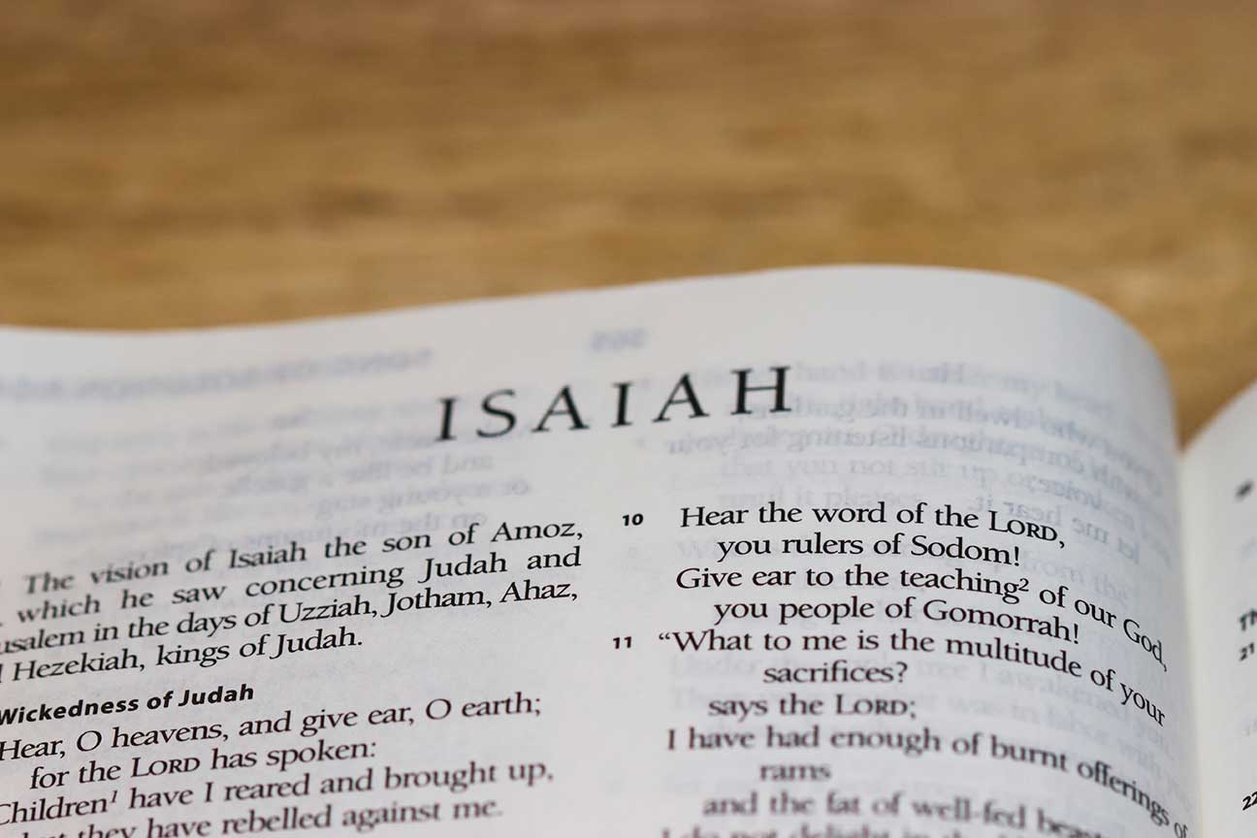
Jesus, the Suffering Servant
The first Christians recalled the “Suffering Servant” passages in Isaiah.
These verses describe a servant of the Lord who suffers . . .
. . . to save the people from their sins.
© JerryGrugin / istock
Notes:
Notes: Read and discuss Romans 5:19, quoted at the end of the section “Jesus, the Suffering Servant,” in article 23 of the student text. Ask for a volunteer to explain the passage.
This slide corresponds to student text content in article 23.

Slide 13
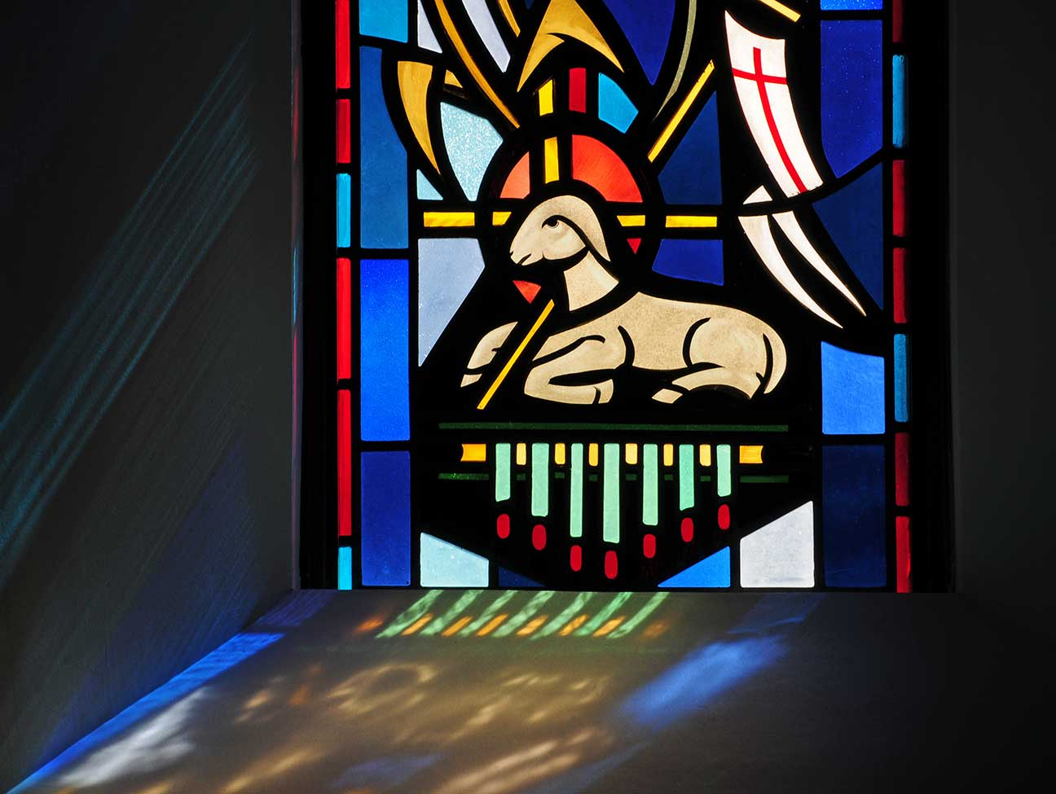
Jesus, the Paschal Lamb
The first Christians also recalled the Passover story.
The Israelites had sacrificed a Paschal, or Passover, Lamb at God’s command.
They put its blood on their doorposts to escape the death of the firstborn.
© Nancy Bauer / Shutterstock
Notes:
Notes: Remind the students of the events of Passover. Ask why Jesus is called the Paschal Lamb.
This slide corresponds to student text content in article 23.

Slide 14
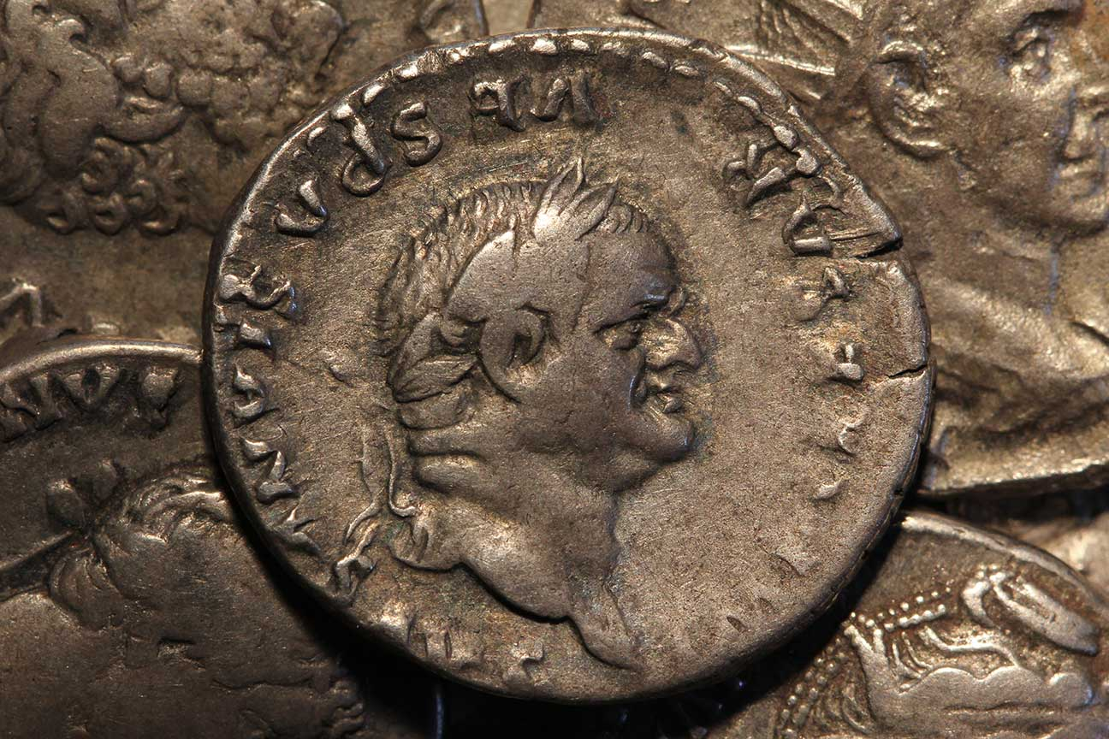
Jesus, the Ransom for Many
For Romans, a ransom was the price paid to release a slave.
Jesus paid God the price of our freedom; we are no longer “owned” by sin and death.
© nevio / Shutterstock
Notes:
Notes: Read aloud or paraphrase the last paragraph in the section “Jesus, the Ransom for Many,” in article 23 of the student text. Ask the questions that conclude article 23: Which of the metaphors in this section helps you to understand something new about the Paschal Mystery? Why?
This slide corresponds to student text content in article 23.

Slide 15
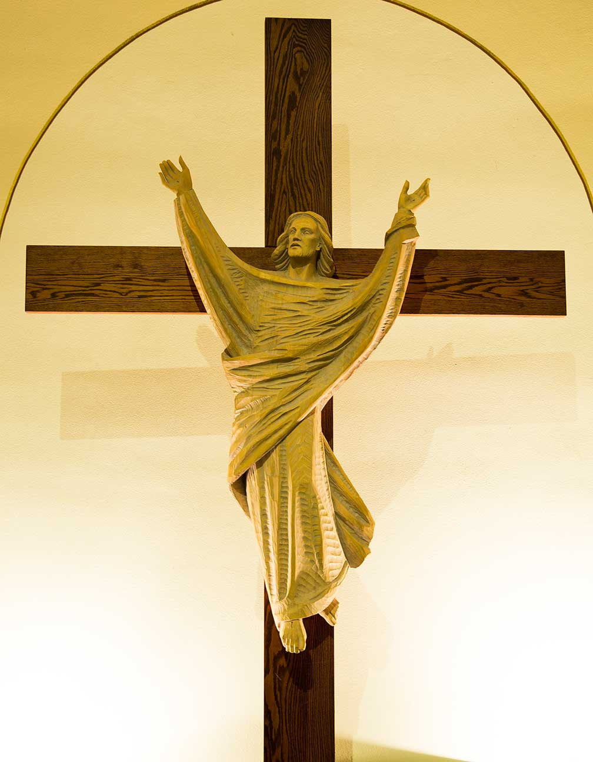
Why Did the Father Allow His Son to Suffer?
Our first parents’ Original Sin necessitated Jesus’ sacrifice.
The Father allowed his Son’s death in order to destroy the power of death.
Jesus Christ freely accepted his Passion and death.
© Saint Mary's Press
Notes:
Notes: Remind students that death was not part of God’s original plan for humanity; it was a result of our first parents’ sin. Point out that Jesus is the Second Person of the Trinity and that his death was part of his divine mission in the work of salvation.
This slide corresponds to student text content in article 24.

