Slide 1
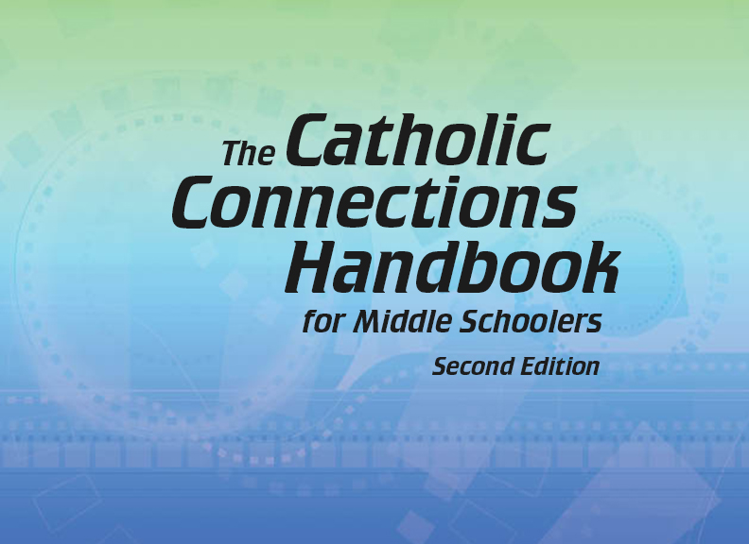


Slide 2
The New Testament
and the Church
Chapter 23
The Structure of the Church

Slide 3
Chapter Summary The Structure of the Church
This chapter will consider the structure of the Church and the unique function of each role within the Church: ordained, consecrated religious, and the laity.
You will also explore your own role in the Church and contemplate how all are called to share in Christ’s ministry.

Slide 4
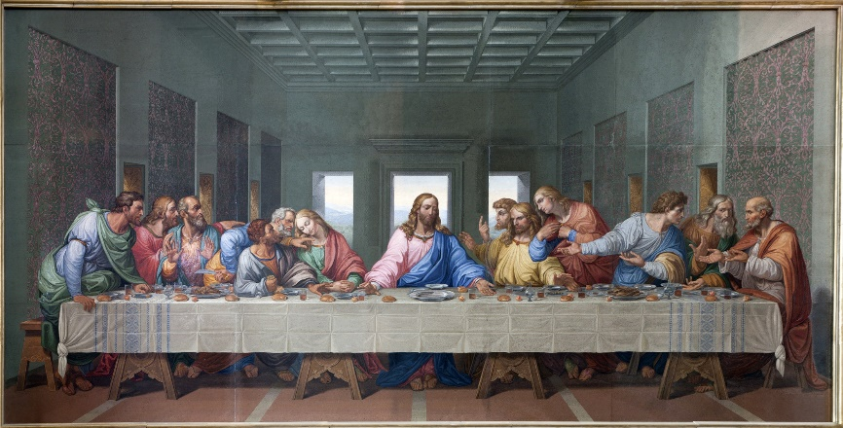
Introduction and “To the Ends of the Earth” (Handbook, pages 244–245)
As disciples, we all share in the mission of Christ.
Jesus gave his Apostles the mission of bringing God’s love and salvation to all people.
The Great Commission says, “Go . . . and make them my disciples” (Matthew 28:18).
In telling everyone about God’s Kingdom, Jesus’ followers share in his mission and his kingly role.
©Renata Sedmakova/www.shutterstock.com

Slide 5
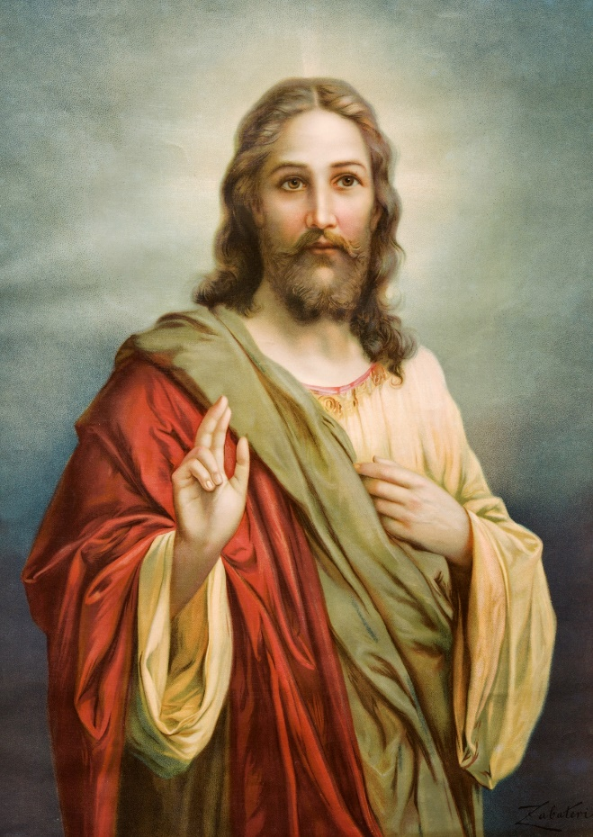
Introduction and “To the Ends of the Earth” (Handbook, pages 244–245)
Activity
Read Mark 16:14-18
According to Mark, what does Jesus tell his Apostles? What is their Mission?
Does Jesus say what will happen to those new believers?
How is this passage different from Matthew’s version?
Does the ultimate mission change?
Based on our list, what is the mission of the disciples of Jesus?
©Renata Sedmakova/www.shutterstock.com

Slide 6
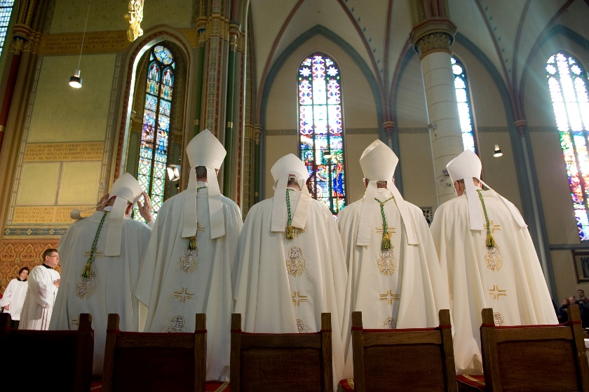
“Caretaker of Souls,” “The Pope,” and “Bishops, Priests, and Deacons” (Handbook, pages 245–248)
Bishops are pastors and caretakers of the faithful, carrying out the mission of Christ and his Church in a particular geographical area.
The structure of the Church includes leaders that guide it in continuing the work of Christ.
©Robert Hoetink/www.shutterstock.com

Slide 7
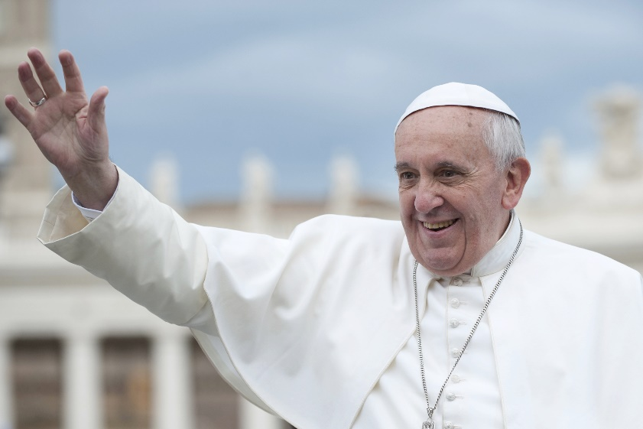
“Caretaker of Souls,” “The Pope,” and “Bishops, Priests, and Deacons” (Handbook, pages 245–248)
The Bishop of Rome, called the Pope, is the head of the Church. The Pope is Peter’s successor and the caretaker of all members of the Church.
Bishops are caretakers of a particular diocese, with ordained priests and deacons assigned to help.
©neneo/www.shutterstock.com

Slide 8
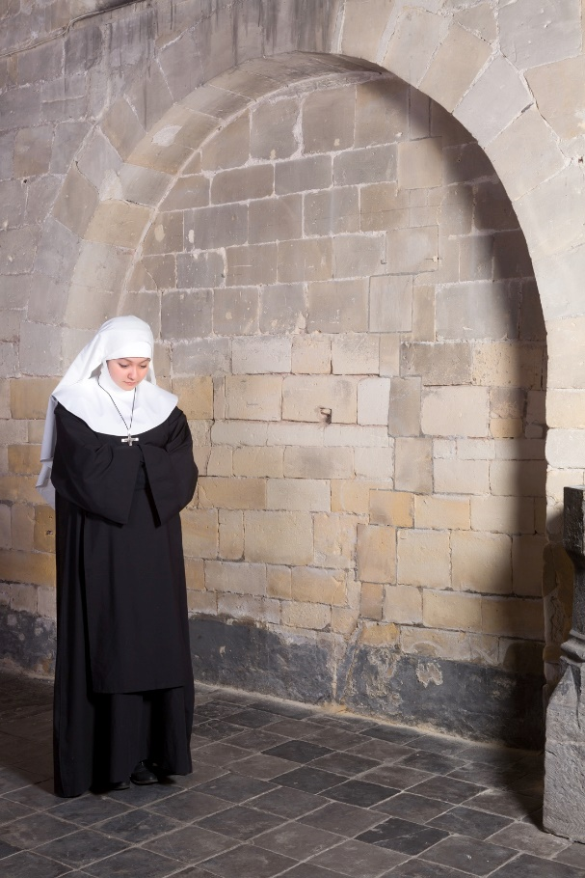
“Consecrated Religious” (Handbook, pages 248–249)
Those living as consecrated religious dedicate their lives to Jesus by taking vows of poverty, chastity, and obedience.
Some live their vocation in the Church as consecrated religious, also known as religious sisters and brothers.
©Anneka/www.shutterstock.com

Slide 9
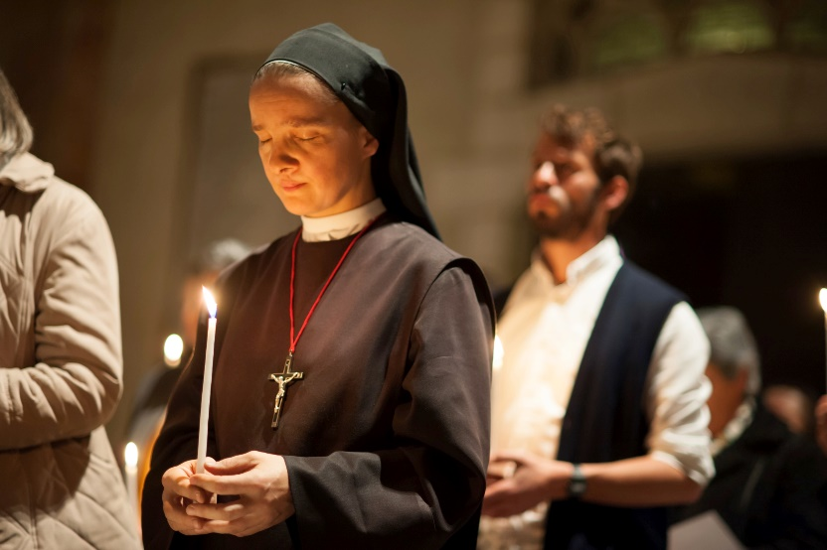
“Consecrated Religious” (Handbook, pages 248–249)
Consecrated religious take public vows, called evangelical counsels, of poverty, chastity, and obedience.
These vows free them to dedicate their efforts to bring Christ to the world.
Discussion Question
Which of your attitudes and actions in the past week have helped bring Christ to the world?
©Ryan Rodrick Beiler/www.shutterstock.com

Slide 10

“We Share in Christ’s Ministry,” “Priest,” “Prophet,” and “King” (Handbook, pages 249–253)
The laity is called to share in Christ’s ministry as priest, prophet, and king.
Non-ordained members of the Church are called laity, or lay faithful.
© Christopher Futcher/www.istockphoto.com

Slide 11

“We Share in Christ’s Ministry,” “Priest,” “Prophet,” and “King” (Handbook, pages 249–253)
The job of the lay faithful is to make Christ’s presence known in the world.
The laity shares in the priestly, prophetic, and kingly work of Christ.
Discussion Questions
What images come to mind when you think of a king?
Does Jesus fit these images, or would you describe him differently?
© Margot Kessler/www.istockphoto.com

Slide 12
Acknowledgments
The scriptural references and quotations in this presentation are from the Good News Translation® (Today’s English Version, Second Edition). Copyright © 1992 by the American Bible Society. All rights reserved. Bible text from the Good News Translation (GNT) is not to be reproduced in copies or otherwise by any means except as permitted in writing by the American Bible Society, 1865 Broadway, New York, NY 10023 (www.americanbible.org).
To view copyright terms and conditions for Internet materials cited here, log on to the home pages for the referenced websites.
During this presentation’s preparation, all citations, facts, figures, names, addresses, telephone numbers, Internet URLs, and other pieces of information cited within were verified for accuracy. The authors and Saint Mary’s Press staff have made every attempt to reference current and valid sources, but we cannot guarantee the content of any source, and we are not responsible for any changes that may have occurred since our verification. If you find an error in, or have a question or concern about, any of the information or sources listed within, please contact Saint Mary’s Press.

