Slide 1
The God-Human Relationship
Jesus Christ: God’s Love Made Visible, Second Edition
Unit 2, Chapter 3
Document#: TX004808

Slide 2

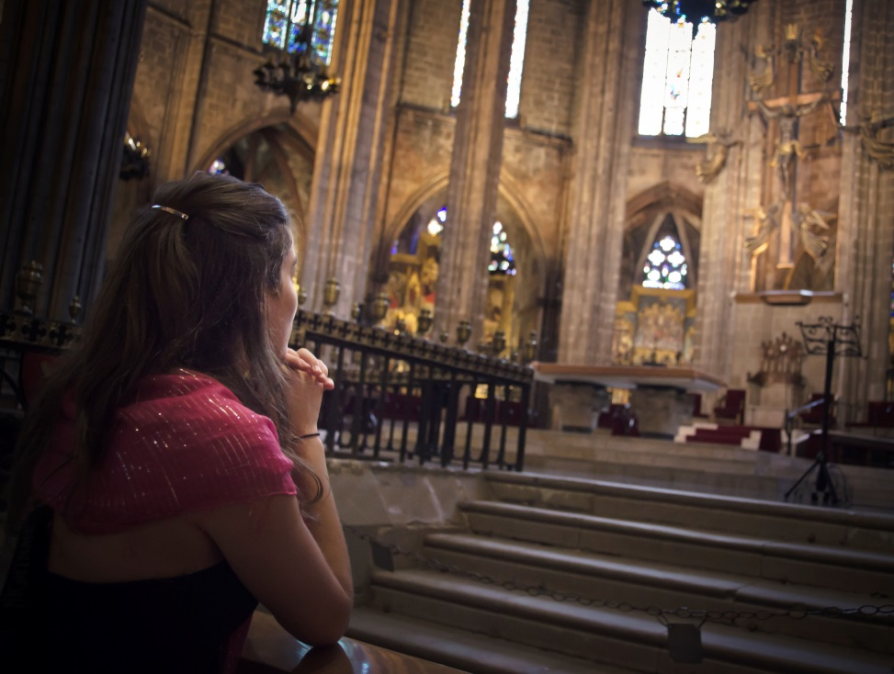
What Is Revelation?
Revelation is God’s
self-disclosure to us.
God freely chooses to share his Divine Self
with us.
Revelation empowers
us to love God.
The more we know
God, the more we will love him.
© meshaphoto / iStockphoto.com
Notes:
Discuss the students’ experience of getting to know a new friend, and point out that to really get to know someone means that the person has to share who he or she is in words and deeds. Discuss whether the last bullet point is also true for human relationships.
This slide corresponds to content in article 11, “What is Revelation,” in the student book.

Slide 3
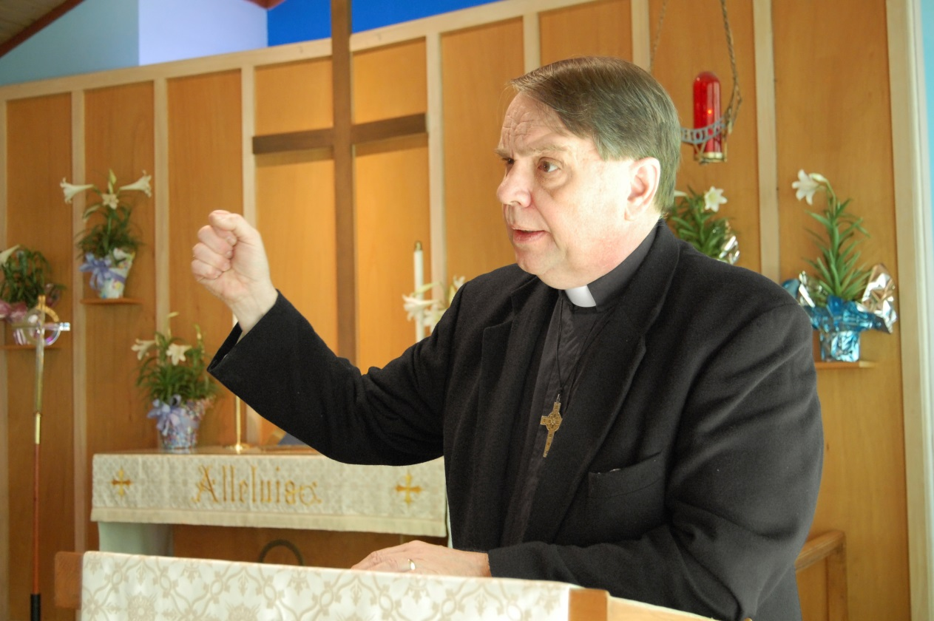
How Does Revelation Occur?
Revelation of the divine plan has unfolded slowly.
The Old Testament tells how God reached out to our ancestors in faith.
The New Testament tells of God’s final and full Revelation in Jesus Christ.
© JerryPDX / iStockphoto.com
Notes:
Explain that today the Holy Spirit empowers the Church to interpret, and to shed light on, the mystery of God’s Revelation. Provide an example of a modern interpretation of a commandment, such as the U.S. bishops’ call to ban landmines.
This slide corresponds to content in article 11, “What Is Revelation?” in the student book.

Slide 4
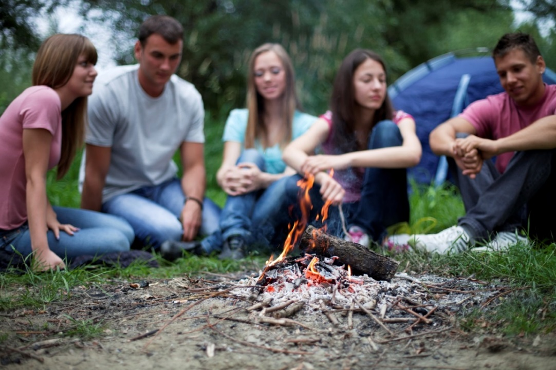
We Cannot Fully Know God
Revelation is complete in Jesus Christ, but we don’t have God “all figured out.”
God is beyond our limited capacity for words and understanding.
Even if we cannot fully know God, we can experience his love.
© Svetlana Braun / iStockphoto.com
Notes:
To explain the first bullet point, direct the students to read the quotation from Divine Revelation in article 12 of the student book that begins, “Jesus perfected revelation . . .” Discuss the ways in which Jesus fulfilled revelation.
This slide corresponds to content in article 11, “What is Revelation?” in the student book.

Slide 5
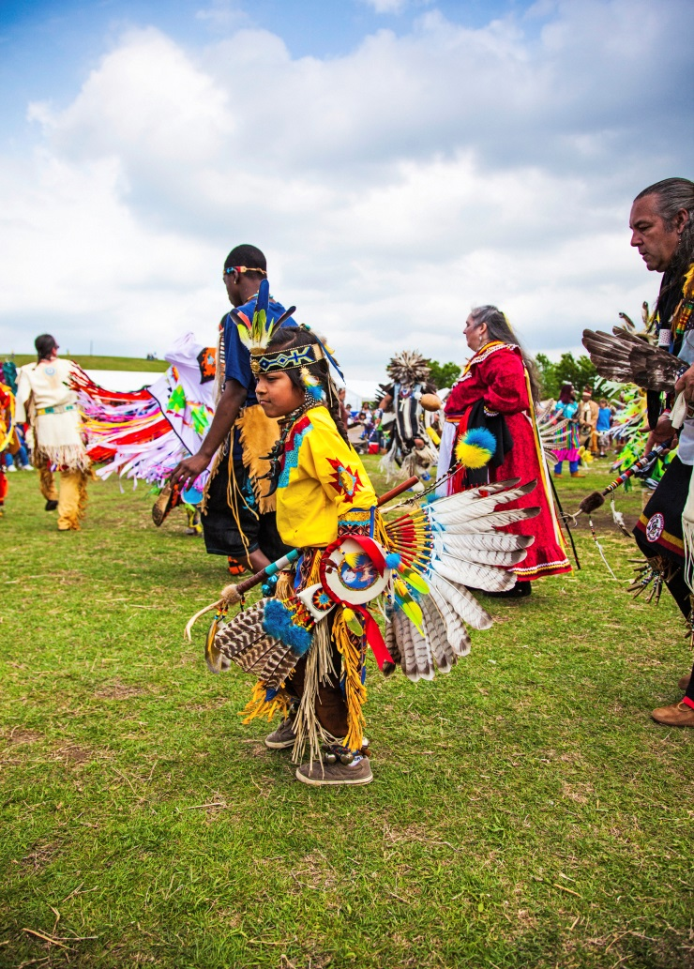
Sharing in God’s Life
We have been created to live in communion with God.
Our desire for God is indelibly imprinted on our hearts.
© Catherine Lane / iStockphot.com
Notes:
Discuss our vocation, by our very nature, to be in relationship with God. Point out that nearly every human culture has sought out the Divine through prayer and ritual.
This slide corresponds to content in article 12, “Sharing in God’s Life,” in the student book.

Slide 6
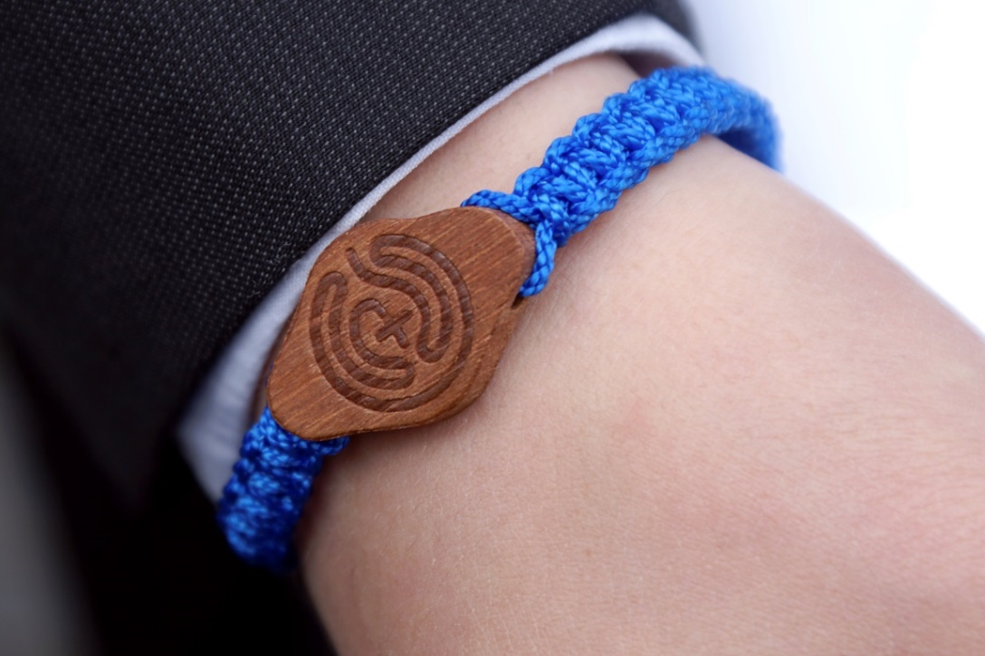
God Calls Us to Fullness of Life
God has reached out to humanity repeatedly throughout history.
Jesus shows us how much God loves us.
Today, through the Sacraments, God continues to offer us his friendship.
© NaLha / iStockphoto.com
Notes:
Point out that God has revealed himself throughout history to the Israelites and by becoming one of us to save us. Ask the students how God continues to show his love for us in the Sacraments.
This slide corresponds to content in article 12, “Sharing in God’s Life,” in the student book.

Slide 7
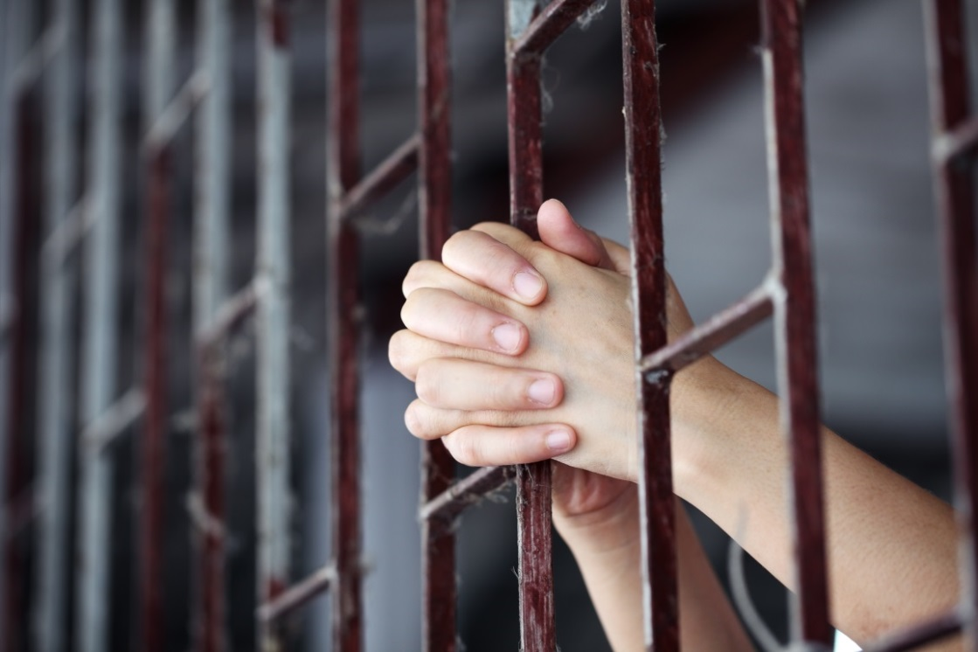
God’s Plan for Our Salvation
Creation makes known to us a loving and wise God.
When human sin threatened God’s purpose, he made a plan for our salvation.
God acts in the events of the world and the events
of our daily lives to save us.
© sakhorn / Shutterstock.com
Notes:
Share with the students an event from your own life or from the life of another person to illustrate the last bullet point (e.g., a change of heart spurred by someone’s words or actions, the conversion of a saint, humanitarian or missionary work).
This slide corresponds to content in article 13, “God’s Plan for Our Salvation,” in the student book.

Slide 8
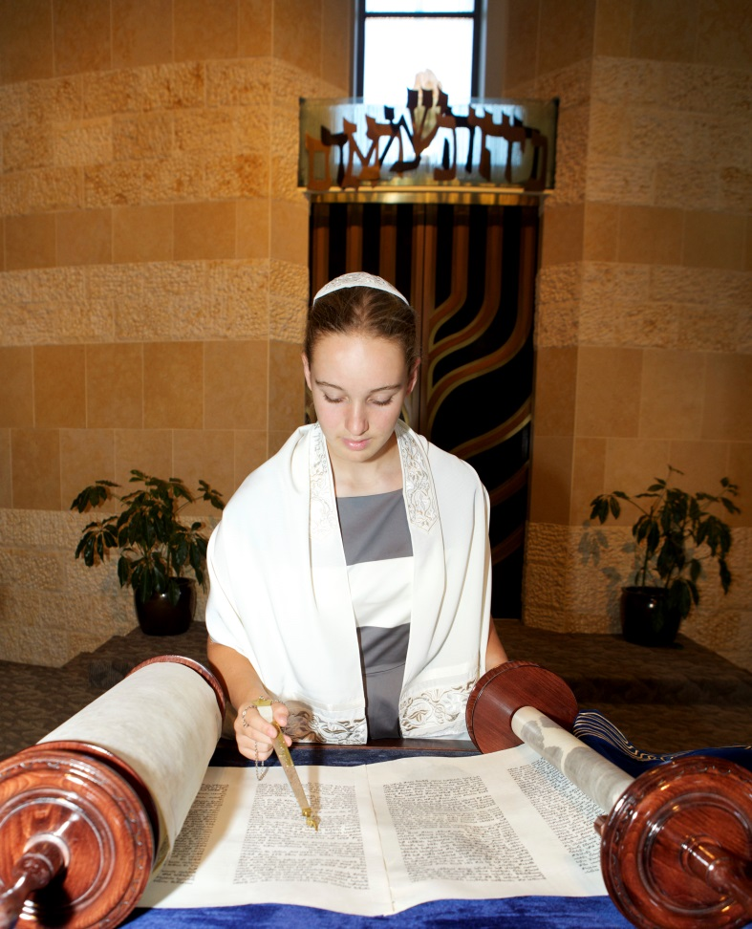
The Promise of the Old Testament
God created us to find our happiness in him.
God has never ceased to share his mercy and love with the people of Israel.
God’s Chosen People (the Israelites) were the first to hear the Word of God.
© 3bugsmom / iStockphoto.com
Notes:
Explain that we call the unfolding of God’s plan for us salvation history. Review the timeline at the end of article 13 of the student book to highlight the events of salvation history.
This slide corresponds to content in article 13, “God’s Plan for Our Salvation,” in the student book.

Slide 9
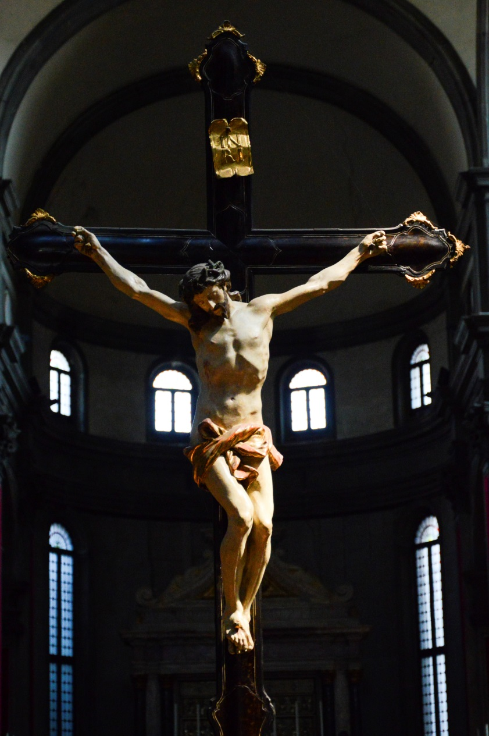
Jesus Christ:
Savior of the World
The revelation of God’s loving plan culminates in the Incarnation.
The plan is fulfilled in the life, Passion, Death, and Resurrection of Jesus.
These events reveal the truth and bring us to fullness of life.
© bluegame / iStockphoto.com
Notes:
Ask what kinds of things we learn about God from the events in Jesus’ life and ministry.
This slide corresponds to content in article 13, “God’s Plan for Our Salvation,” in the student book.

Slide 10

We Encounter God . . .
in the Scriptures, written through the inspiration of the Holy Spirit
through the witness of faith-filled people—saints and people in our lives
by means of reason and conscience, which help
us to explore our faith
© BevLinder / iStockphoto.com
Notes:
Explain that it can be hard to accept something we can’t see with our eyes, so God has given us these means as help. Ask the students for stories of people whose faith has inspired them.
This slide corresponds to content in article 14, “Encountering God with the Eyes of Faith,” in the student book.

Slide 11
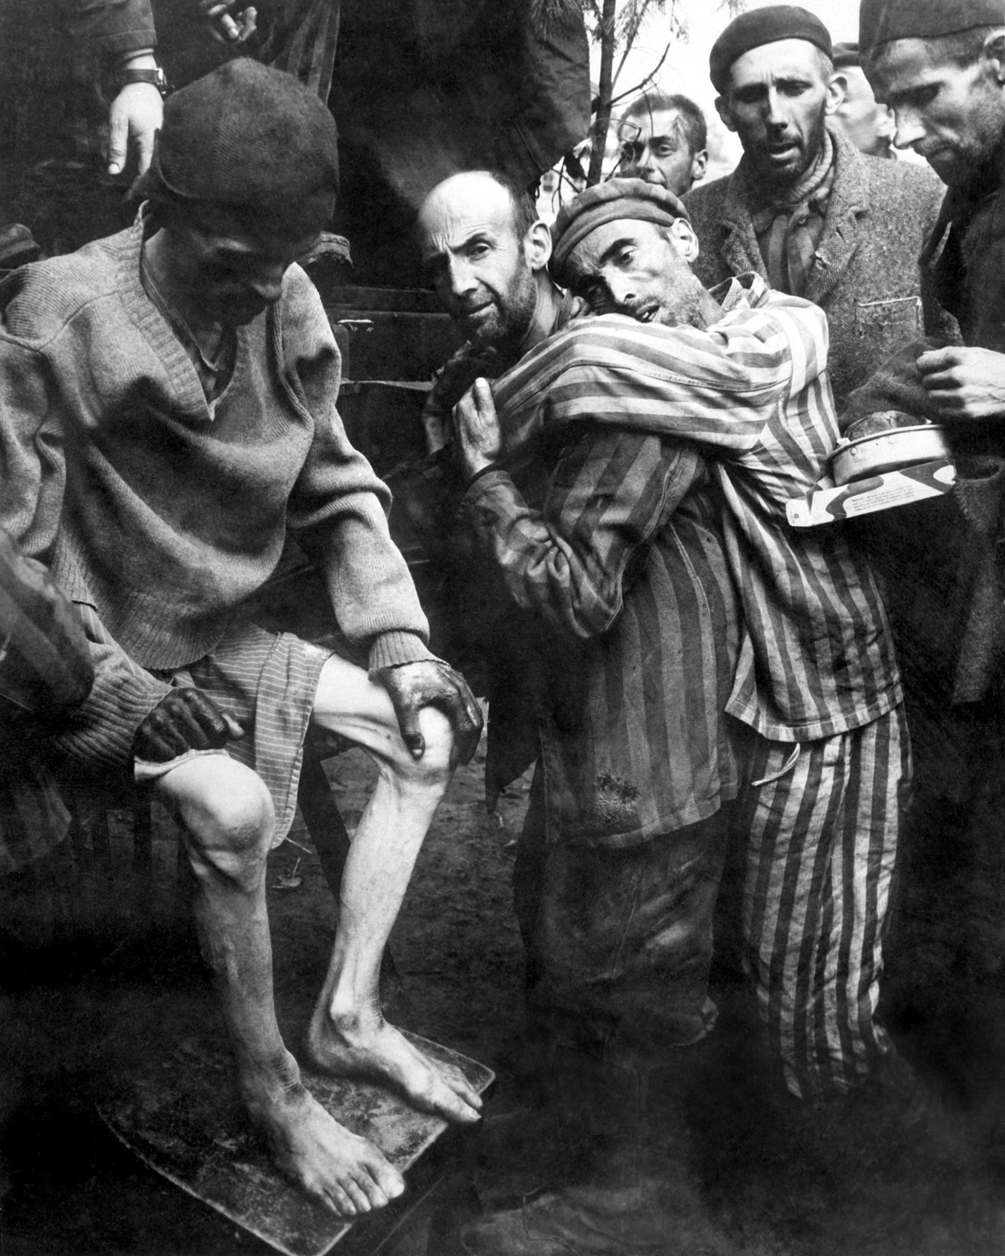
Evil and Suffering and a Good and Powerful God
Many people struggle with the presence of evil in the world.
We ask, “If God is all-powerful and all-good, how can there be suffering?”
There are four key elements to the Church’s answer.
© Everett Historical / Shutterstock.com
Notes:
Ask for a definition of theodicy. The four key elements of the Church’s answer follow in the next slides.
This slide corresponds to content in article 15, “Evil and Suffering and a Good and Powerful God,” in the student book.

Slide 12
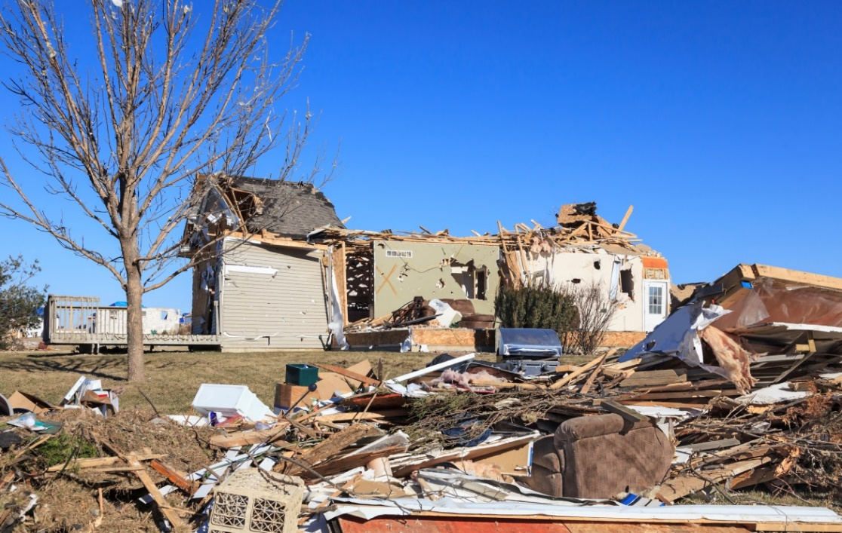
The World Is Yet Imperfect
Natural disasters like floods and droughts are part of the laws of nature.
God created us with free will, so we have the option to sin and commit evil acts.
© ghornephoto / iStockphoto.com
Notes:
Explain that our free will is a sign of God’s great love and respect for us. Discuss how we can use our free will to participate in God’s work in the world.
This slide corresponds to content in article 15, “Evil and Suffering and a Good and Powerful God,” in the student book.

Slide 13
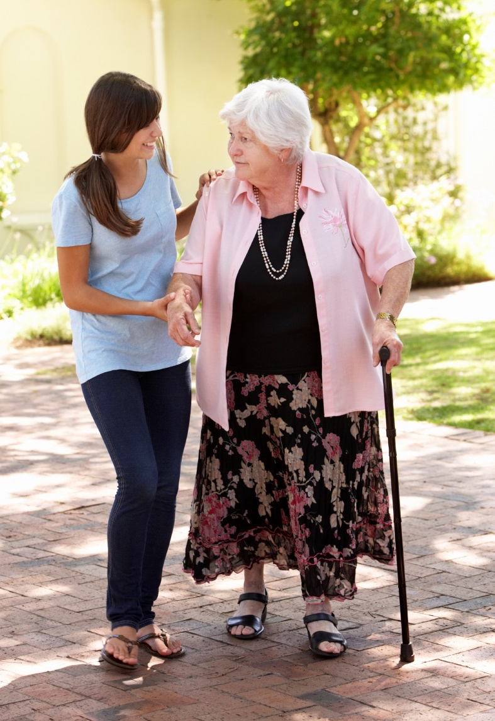
Suffering Can Be Redemptive
Our suffering unites us with the Crucified Christ.
In our efforts to alleviate the suffering of others, we serve the Crucified Lord.
© Mark Bowden / iStockphoto.com
Notes:
Explain that suffering is never a good thing, though God can bring good out of suffering. Share an example from your own or another’s life, and ask for examples.
This slide corresponds to content in article 15, “Evil and Suffering and a Good and Powerful God,” in the student book.

Slide 14
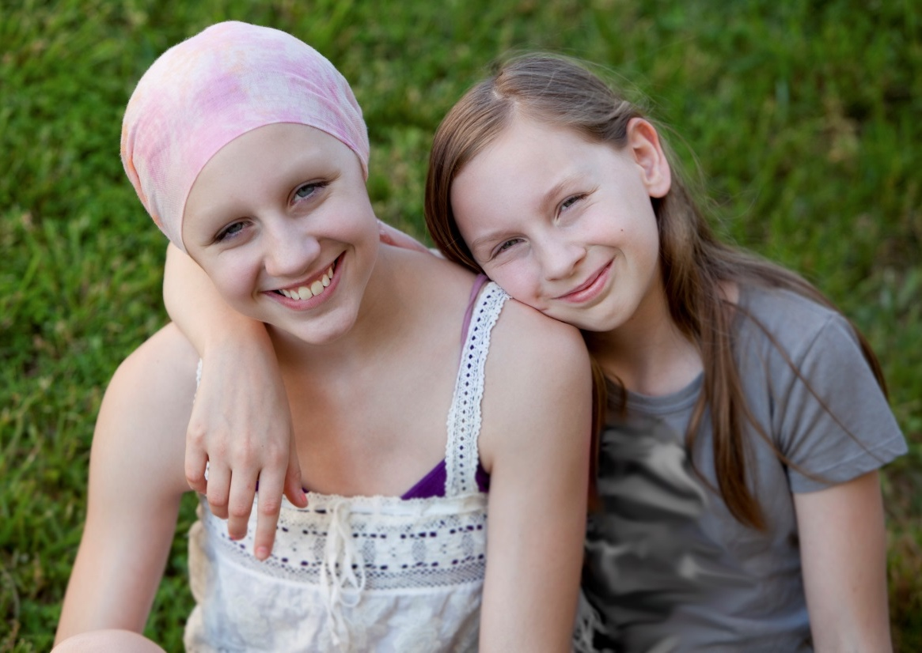
The Paschal Mystery Gives Us Hope
We were baptized into Christ’s Death, and we will share in his Resurrection.
The Paschal Mystery shows us that suffering, sin, and evil will never have the last word.
God will bring forth new life and hope out of seemingly hopeless situations.
© jessicaphoto / iStockphoto.com
Notes:
Discuss Resurrection as a past, present, and future event (the historical event, in our life experiences, and our hope of heaven).
This slide corresponds to content in article 15, “Evil and Suffering and a Good and Powerful God,” in the student book.

Slide 15
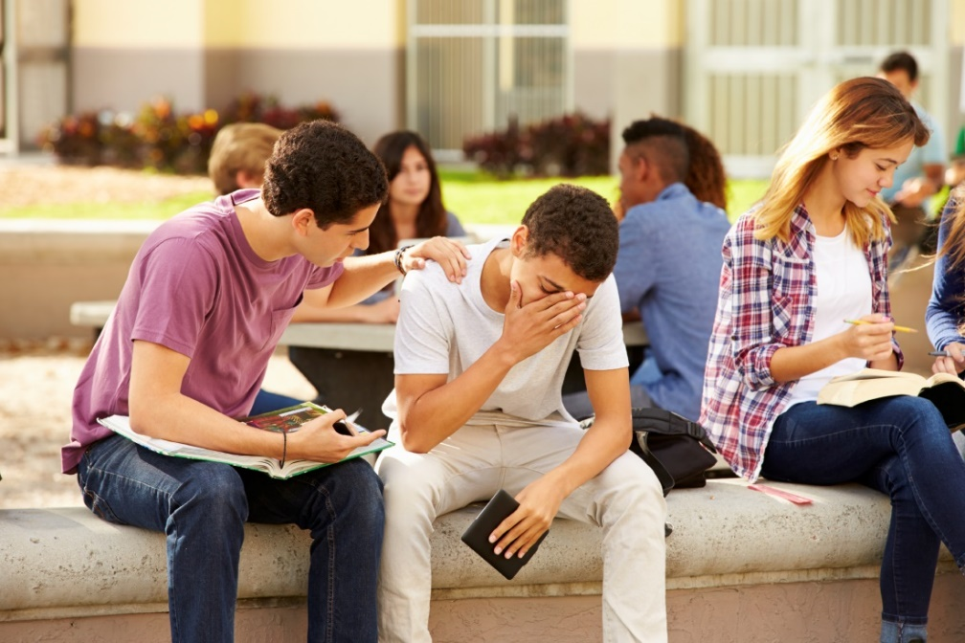
We See Only Partially
God always wills and desires what is best for us.
Through faith we can be certain that God causes good to come from every evil.
This may occur in ways we will only fully understand in eternal life.
© monkeybusinessimages / iStockphoto.com
Notes:
Ask the question from the end of article 15 in the student book, “In what ways do you rely on God during times of personal pain and loss?” Point out that our experience of relying on God is one good that comes from evil.
This slide corresponds to content in article 15, “Evil and Suffering and a Good and Powerful God,” in the student book.

