Slide 1
Mark’s Christology
The New Testament
Document #: TX002239
Notes:
Notes: The students may need to refer to their student books during the presentation. Direct them to take notes.

Slide 2
This presentation will cover the following topics:
Jesus’ miracles
Jesus’ parables
the human Jesus
the suffering Jesus
Notes:
Notes: Be sure the students understand that all of these topics pertain to Mark’s Gospel only, which is the focus of this unit. Similar topics regarding the other Gospels—for example, the miracles in Matthew or the parables in Luke—will be treated in subsequent units.

Slide 3
Jesus’ Miracles
What did you learn about Jesus’ miracles in Mark’s Gospel from article 13 of the student book?
Notes:
Notes: Direct the students to have a brief conversation with their partners about this question, coming up with at least three responses. After 2 or 3 minutes, invite the students to share some of their responses in the large group. The next slides contain information that you may use to augment whatever the students mention.

Slide 4
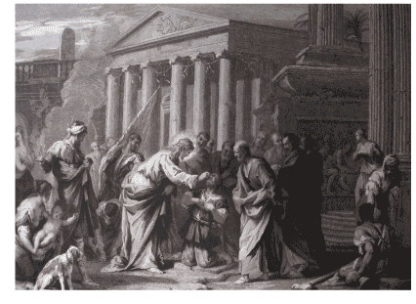
Jesus’ Miracles in Mark’s Gospel
The word that is translated into English as “miracle” is the Greek word dynameis. A more literal translation is “act of power.” This means that in the miracles, Jesus demonstrates his own power and allows people to experience God’s power through him.
In Mark’s Gospel the miracles are a primary way in which Jesus proclaims the Reign of God. Through these actions, Jesus demonstrates that the Reign of God has both already begun and not yet been fully realized.

Slide 5
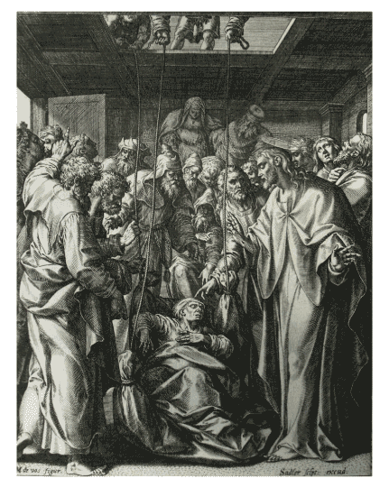
Jesus’s Miracles in Mark’s Gospel
Jesus often instructs those whom he has helped or healed not to speak of the miracle to others. Biblical scholars call this the “messianic secret.”
Literary criticism and form criticism help us to see that the miracles follow an established form: the problem is stated and then brought to Jesus’ attention, Jesus solves the problem, and the onlookers react.
The miracle stories help to establish Jesus’ identity as the Messiah and the Son of God.

Slide 6
What did you learn about Jesus’ parables in Mark’s Gospel from article 14 of the student book?
Notes:
Notes: Direct the students to have a brief conversation with their partners about this question, coming up with at least three responses. After 2 or 3 minutes, invite the students to share some of their responses in the large group. The next slide contains information that you may use to augment whatever the students mention.

Slide 7
Jesus’ Parables in Mark’s Gospel
A parable is a story that Jesus tells his listeners to call them to self-knowledge and conversion. In telling parables Jesus follows a long Jewish tradition of teaching through stories, going back at least to the time of King David.
Parables always use images drawn from everyday life. For example, the parables of Jesus use imagery drawn from agriculture, fishing, family life, travel, and cooking—the common realities of the people of his day.
Careful literary and theological analysis can help us to understand the message of a parable. For example, we must study the characters, setting, and plot of the parable itself; we must examine to whom Jesus tells the parable and the larger context of their conversation; and we must establish how the parable reflects the overall Christology of that particular Gospel.

Slide 8
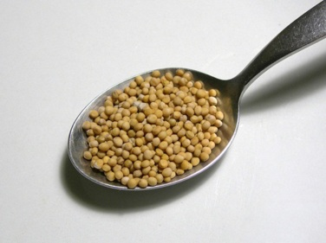
Jesus’ Parables in Mark’s Gospel
Although some parables can be interpreted allegorically, parables are not allegories. An allegory has only one meaning, with a clear, one-to-one correspondence between the literal plot elements and their allegorical counterparts. In contrast, a parable can support a wide range of meanings and interpretations.
Along with miracles, parables are a primary way in which Jesus announces the advent of the Reign of God and urges his listeners to participate in bringing that Reign to its full realization.
Image from Public Domain

Slide 9
The Human Jesus
More than the other Gospels, Mark emphasizes the humanity of Jesus, presenting him as someone who embraces all the joys and sorrows of human life.
Mark portrays Jesus as experiencing the full range of human emotions, such as compassion for those in need of healing, love for children brought to him to be blessed, indignation toward those who try to keep the children away from him, frustration with the disciples’ lack of understanding, and anger with those buying and selling in the Temple area.
Jesus also experiences the physical realities of human life, like fatigue, thirst, and hunger. The latter even prompts him to curse a fruitless fig tree in exasperation.
In his suffering and death, in particular, the human Jesus stands in solidarity with all humanity.

Slide 10
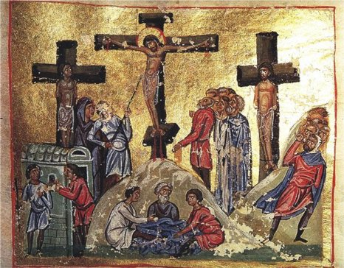
The Suffering Jesus
Why does Mark emphasize the suffering of Jesus so much? How does he convey this emphasis?
Notes:
Notes: Direct the students to have a brief conversation with their partners about these questions. After 2 or 3 minutes, invite the students to share some of their responses in the large group. The next slide contains information that you may use to augment whatever the students mention.

Slide 11
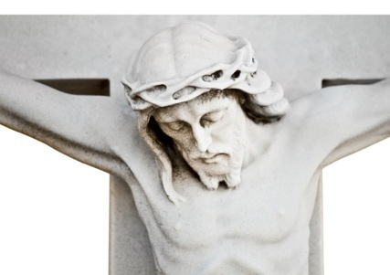
The Suffering Jesus in Mark’s Gospel
All four Gospels contain a Passion narrative: an account of Jesus’ suffering and death. However, Mark greatly emphasizes the suffering of Jesus, so much so that many biblical scholars, beginning in 1892 with the biblical scholar Martin Kähler, have called his Gospel “a passion narrative with an extended introduction.”
In Mark’s Gospel, Jesus predicts his coming Passion three times.
© Kamira/shutterstock.com

Slide 12
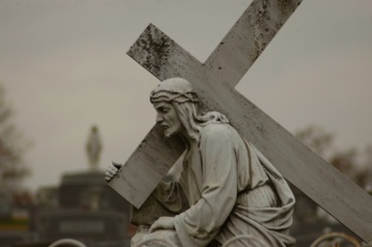
The Suffering Jesus in Mark’s Gospel, continued
This emphasis on Jesus’ suffering can partially be explained by the historical circumstances in which this Gospel was written and the audience to whom it was directed. The first readers and hearers of this Gospel were facing the possibility of persecution, or even martyrdom, for their faith in Jesus. Mark intended to strengthen the resolve of these people by giving them a powerful example of a suffering Messiah.
Mark’s Passion narrative supports his presentation of Jesus as fully human, as Jesus is abandoned by his friends; expresses fear, distress, and sorrow; and cries out to God for help.
© Les byerley/shutterstock.com

