Slide 1
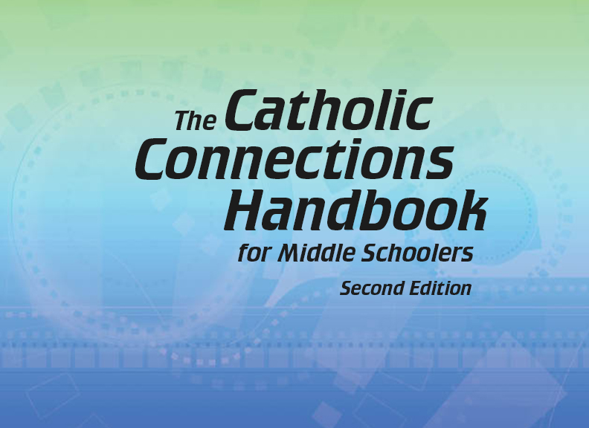

Document #: TX005823

Slide 2
Liturgy
and Sacraments
Chapter 36
The Sacraments of Matrimony
and Holy Orders

Slide 3
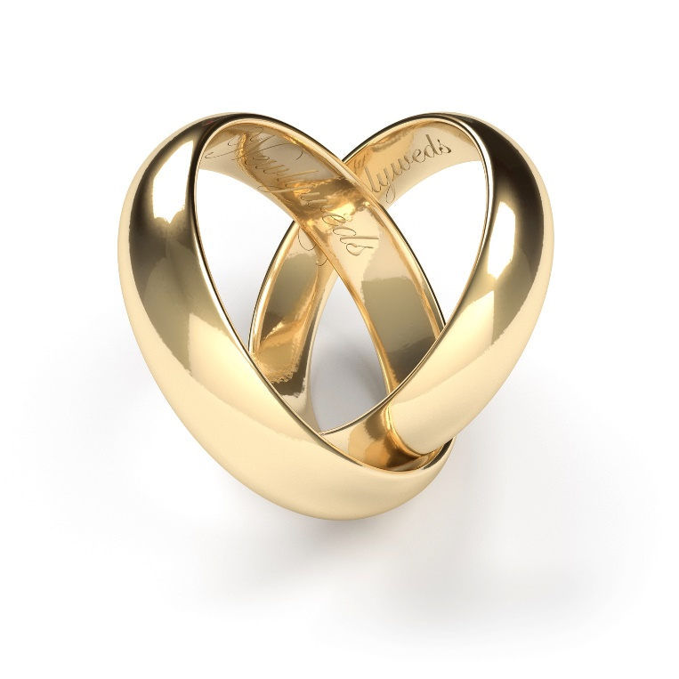
Chapter Summary
In this chapter, we will consider the Sacraments of Matrimony and Holy Orders.
© jalcaraz/Shutterstock.com
In examining the lifetime commitment of marriage and the ministerial priesthood, we will learn about vocation, the call to serve Christ and his Church, and the rites of each Sacrament.

Slide 4
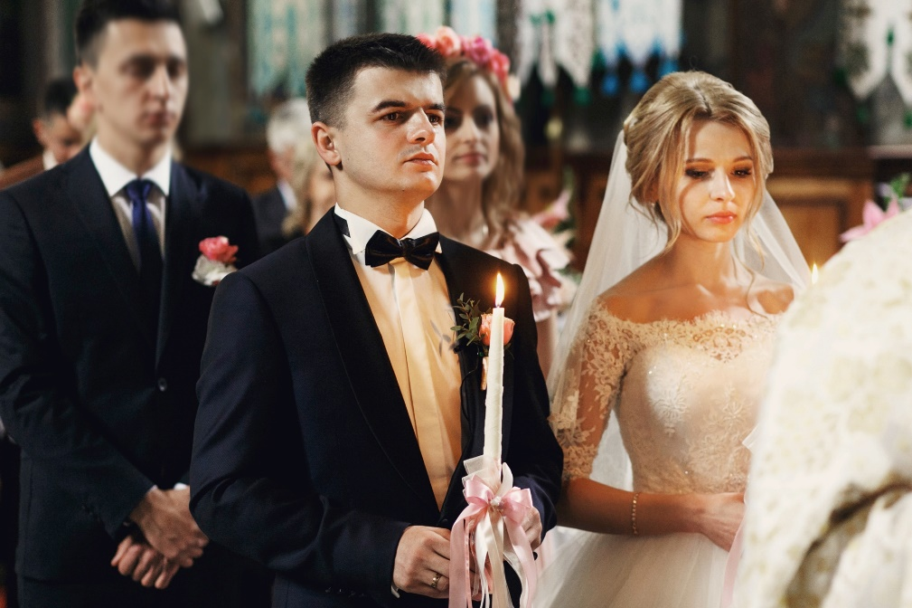
Introduction and “The Sacrament of Matrimony”
(Handbook, pages 390‒392)
The Sacrament of Matrimony is a special relationship in which a baptized woman and a baptized man promise to love each other for the rest of their lives.
© IVASHstudio/Shutterstock.com

Slide 5

“In Good Times and in Bad, in Sickness and in Health” and “I Will Love You and Honor You All the Days of my Life”
(Handbook, pages 392‒395)
Marriage is a vocation, or a lifelong promise, in which a woman and man promise to be faithful to each other.
© Artefacti/Shutterstock.com

Slide 6

Journal It!
Have you ever been to a wedding?
What do you remember?
If you haven’t been to a wedding, search for an image online. What do
you notice?
© Astock-Studio/Shutterstock.com

Slide 7

Search It!
Use a dictionary or go online to look up the word covenant. Write down the definition in your notebook. Then use the word in a sentence.
© Airdone/Shutterstock.com

Slide 8
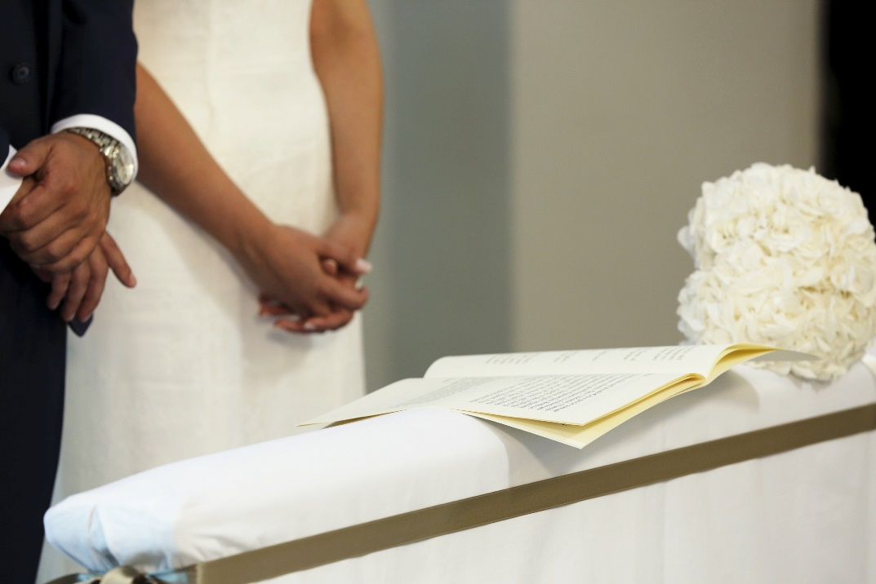
“The Rite of Marriage”
(Handbook, pages 396‒397)
In the Rite of Marriage, a woman and man publicly promise to love each other. They exchange rings as a symbol of their covenant promise to each other and the Church.
© AlbertoTirri/Shutterstock.com

Slide 9
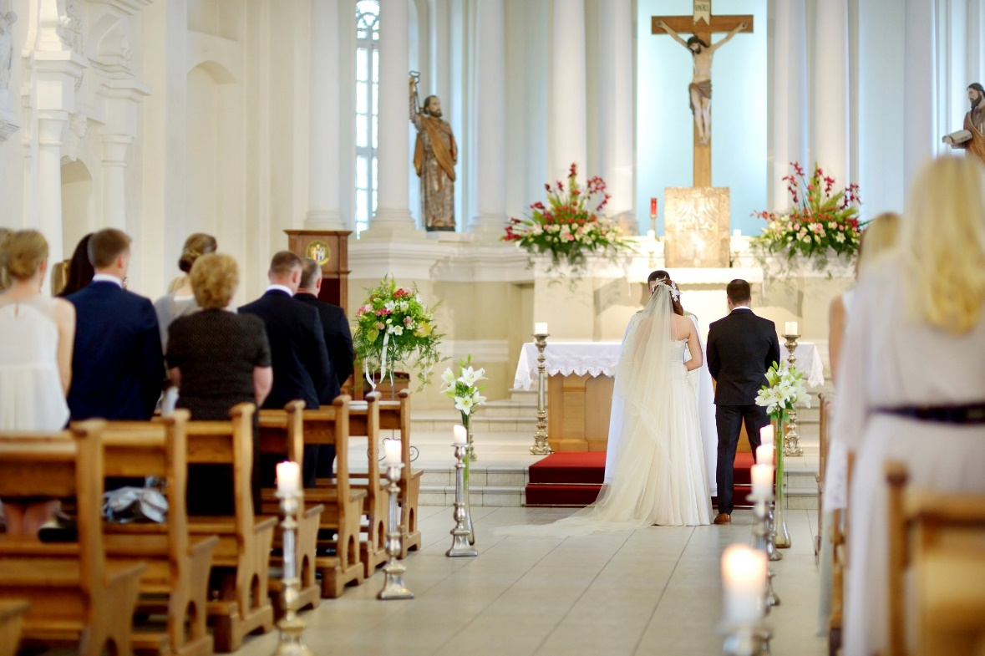
Journal It!
Why is the Rite of Marriage not a private ceremony?
Why should it be public?
© MNStudio/Shutterstock.com

Slide 10
“The Sacrament of Holy Orders,”
“Rite of Ordination,”
and “Three Degrees of Holy Orders”
(Handbook, pages 397‒402)
Some men are called to enter into a covenant in the Sacrament of Holy Orders as they share in Christ’s mission
to serve.
© RoslenMack/Shutterstock.com

Slide 11

Review It!
List the three types of
ordained ministers.
© DawnHudson/Shutterstock.com
Notes:
Answers: bishops, priests, deacons

