Slide 1
What Is the Bible?
Document #: TX004700

Slide 2
Bible(English)
=
=
Biblios (Greek)
“Books” (Literal Meaning)
© Nataliia Natykach/Shutterstock.com
Notes:
This slide allows you to talk about the etymology of the word Bible, which has its root in a Greek word meaning “books.” After presenting this you might ask, “What does the meaning of the word Bible imply about the nature of the Bible?” (answer is in next slide)

Slide 3
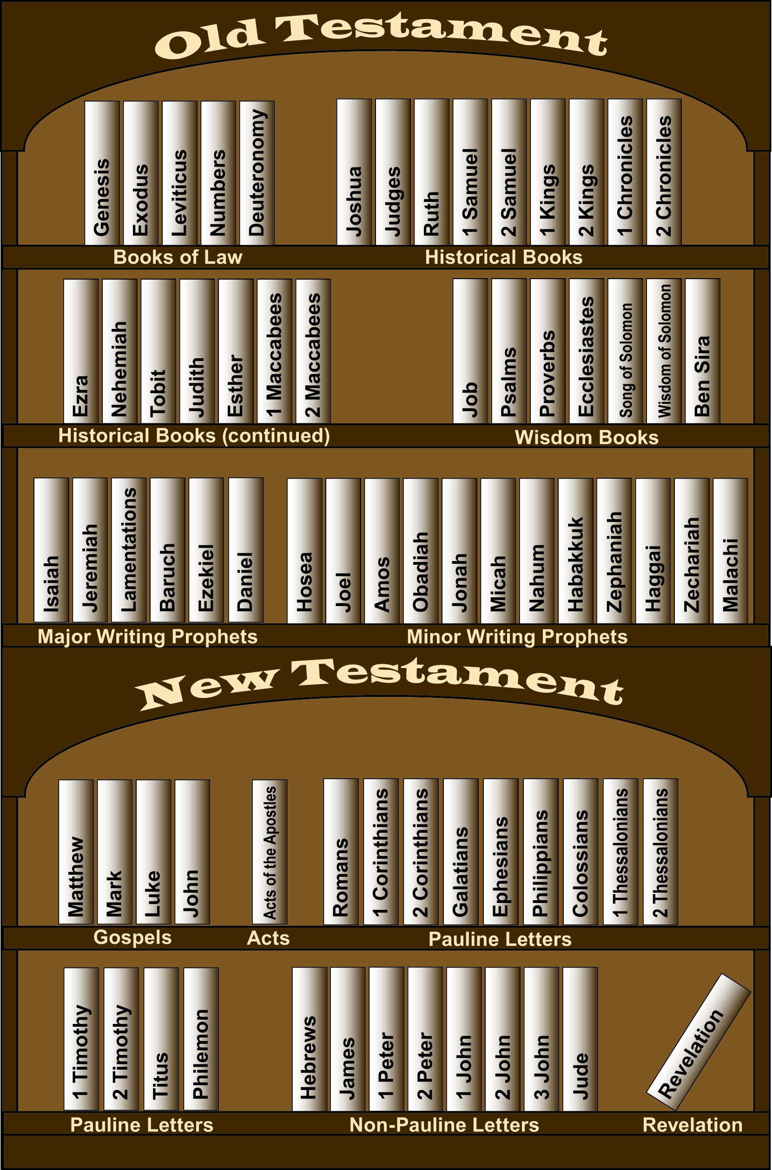
The Bible is a library of books.
© Paul Casper/Saint Mary’s Press
Notes:
This slide shows all the books of the Bible arranged in order, by section, on a bookshelf. It is a visual depiction to help get across the idea that the Bible is not just a book, but a library of seventy-three books. But don’t start describing the various sections yet. That comes later.

Slide 4
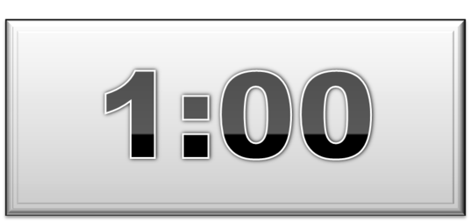
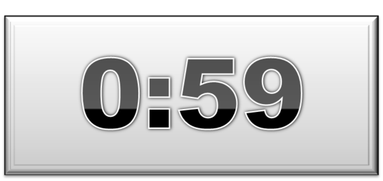
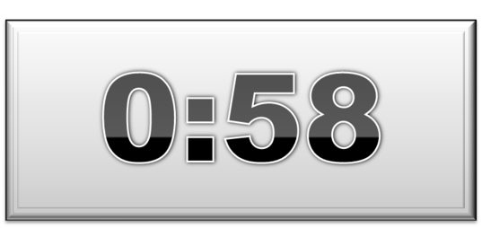
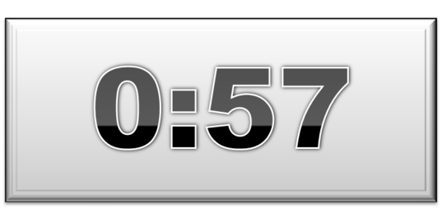
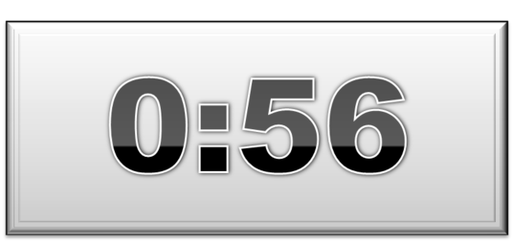
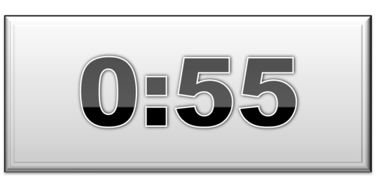
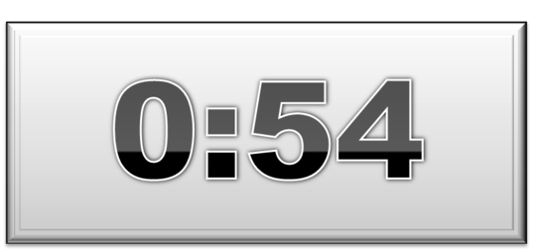
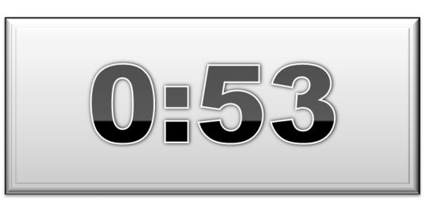
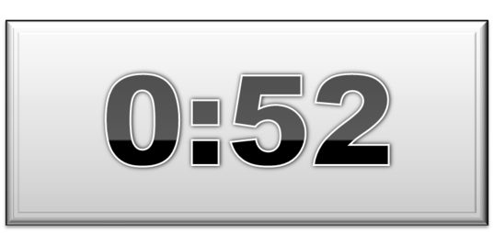
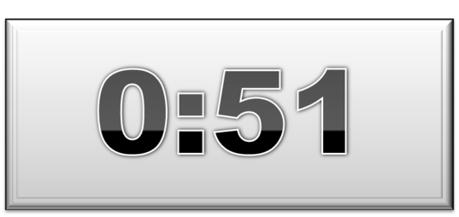
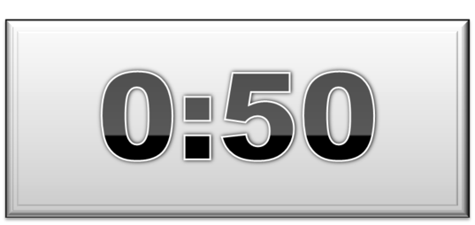
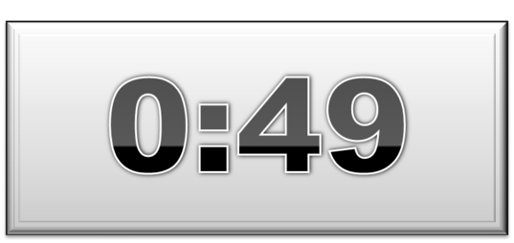
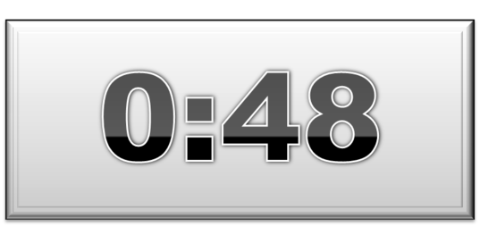
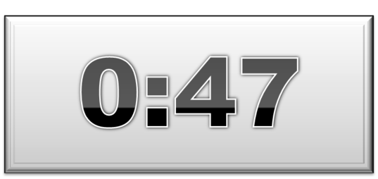
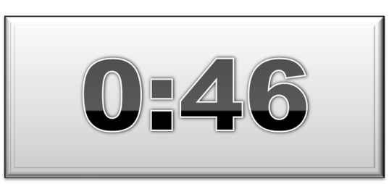
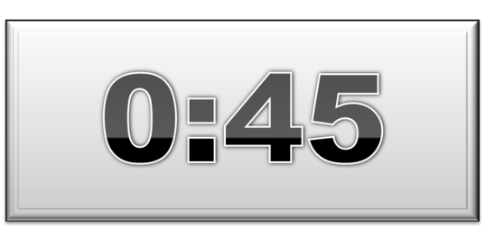
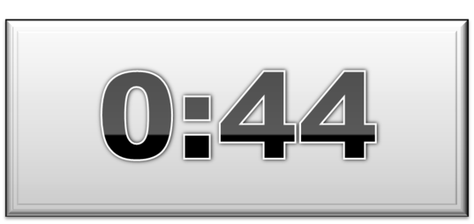
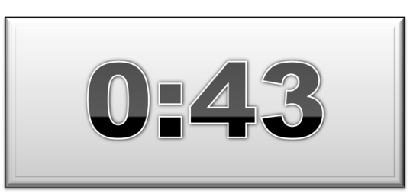
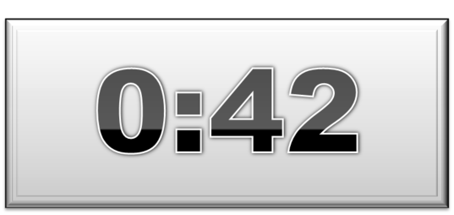
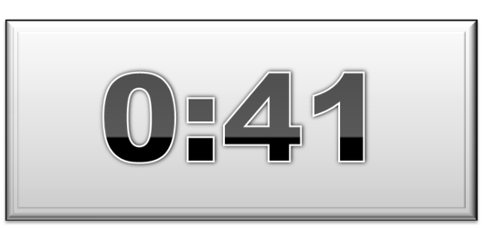
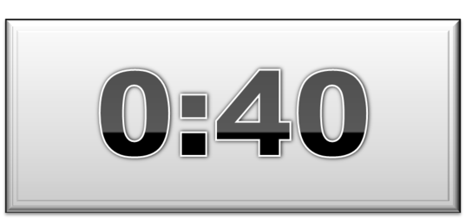
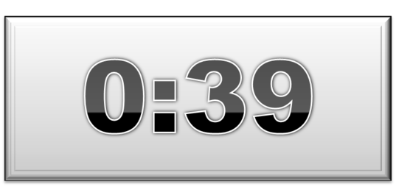
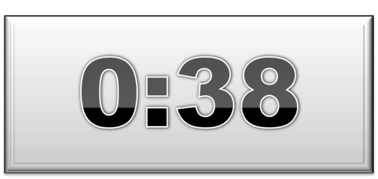
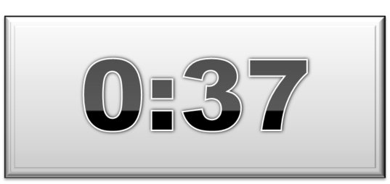
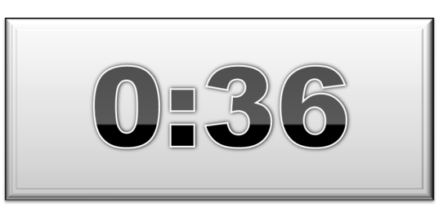
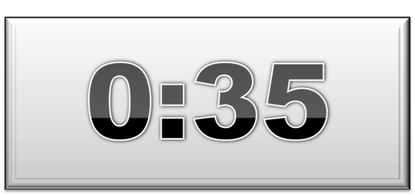
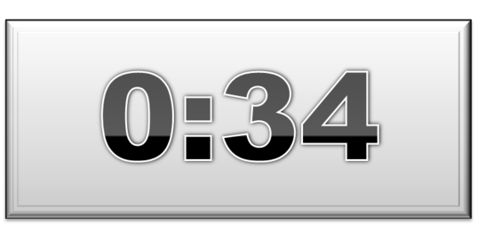
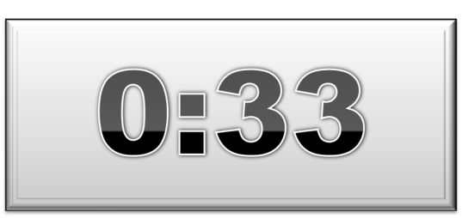
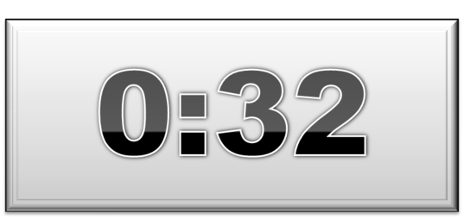
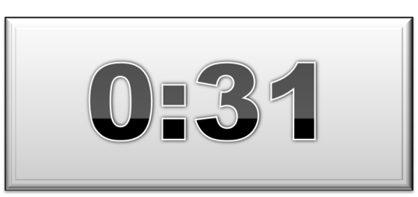
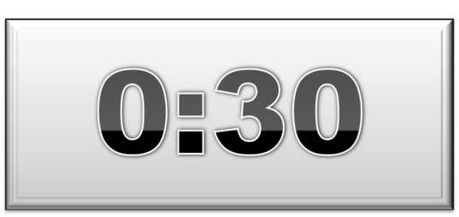
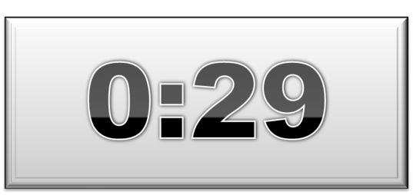
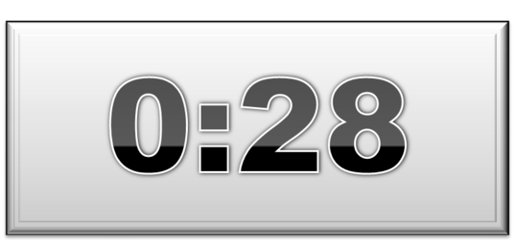
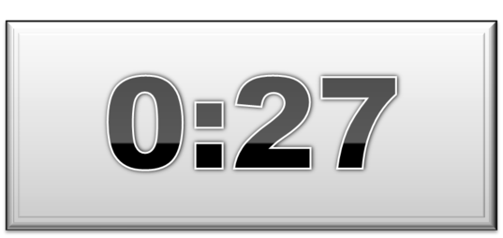
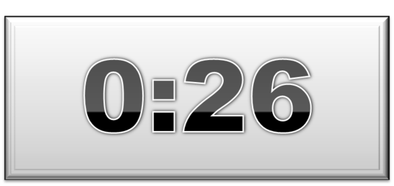
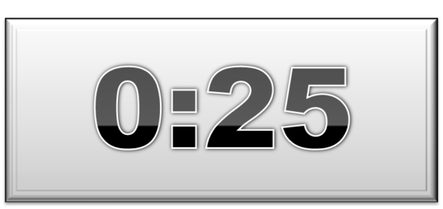
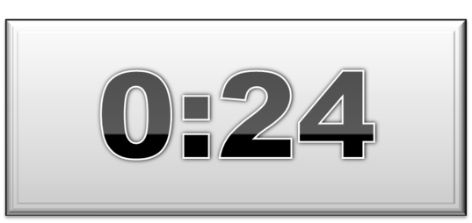
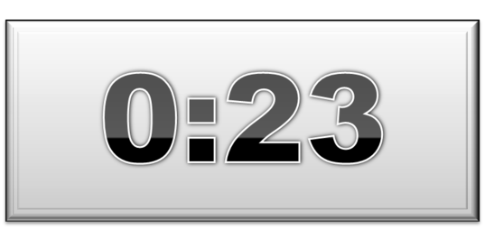
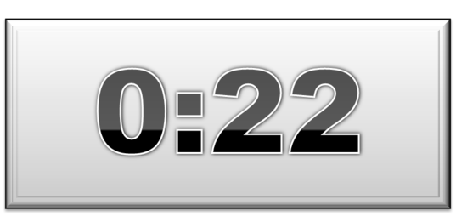
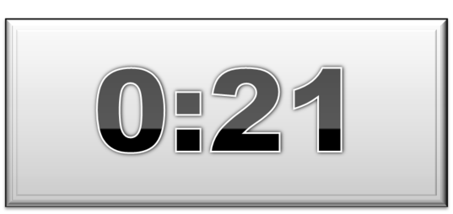
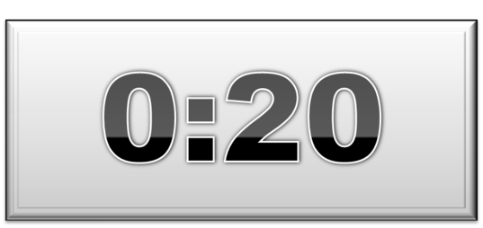
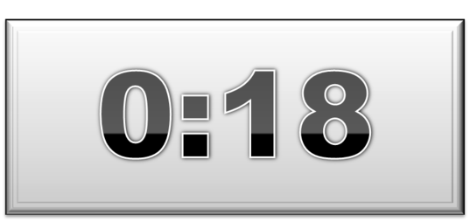
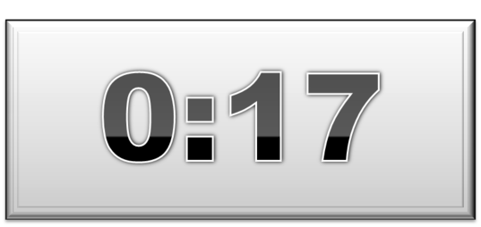
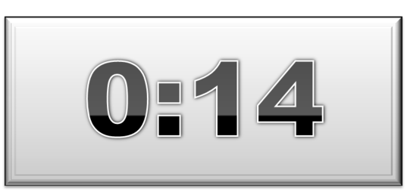
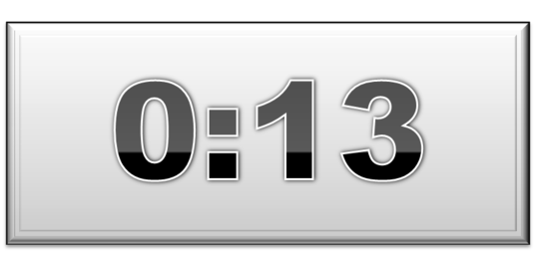
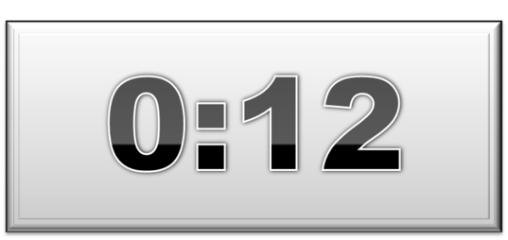
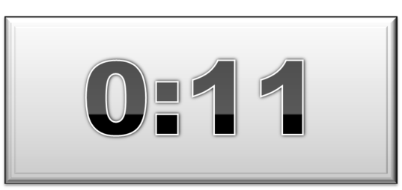
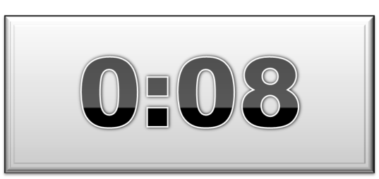
How many books of the Bible can you name?
Notes:
This slide lets you assess informally the students’ knowledge of Bible book names. After the question appears on screen, ask the students to write down as many Bible book names as they can in one minute. You can have them work individually or in teams. When you click again, a 60-second timer appears on screen. When time is up, invite them to share the book names they wrote down, correcting any that are incorrect.

Slide 5
What are the main sections of the Bible?
© Saint Mary’s Press / Catholic Youth Bible®, Third Edition
Notes:
This slide introduces or reviews the concept that the Bible is divided into main sections: the Old Testament and the New Testament. You may wish to assess the students’ knowledge by following this up with a discussion or questions along the following lines:
• Which section of the Bible is bigger? Why?
• What stories can you name from the Old Testament?
• What stories can you name from the New Testament?
• How would you summarize the overall message of the Old Testament in one sentence?
• How would you summarize the overall message of the New Testament in one sentence?

Slide 6
Old Testament
Synonym for
God’s relationship with the Hebrews/Israelites
is a solemn vow
TESTAMENT
Old and New Testaments
New Testament
Our covenant relationship to God
The original covenant is fulfilled
Notes:
This slide is a simple mind map exploring the meaning of the word Testament. Each click reveals another balloon whose words expand the meaning of Testament until you have a basic explanation of the Old and New Testaments. You may wish to begin by having the students create their own mind map before you present.

Slide 7
Books of Law
The first five books of the Bible, the heart of the Old Testament
Historical Books
Sixteen books of religious history and a few “historical novellas”
Prophetic Books
Eighteen books recording the warnings and promises of Israel’s prophets
Wisdom Books
Seven books of poetry and wise sayings
© Paul Casper/Saint Mary’s Press

Slide 8
Connect the Old Testament Books to Their Sections
BOOKS OF LAW
HISTORICAL BOOKS
PROPHETIC BOOKS
WISDOM BOOKS
Micah
2 Chronicles
Song of Songs
Jeremiah
Deuteronomy
Proverbs
Exodus
Judges

Slide 9
Pauline Letters
(Epistles)
Thirteen letters by Saint Paul or his disciples written to provide teaching and to correct abuses in the early churches
Gospels
The story of Jesus’ life and ministry and the start of the Church, told from four complementary
faith perspectives
Non-Pauline Letters
Eight letters written by Christ’s Apostles or their disciples to provide teaching and to correct abuses in the early churches
Acts
This books tells about the early Christian community
Revelation
A book written as apocalyptic literature during a time when
Christians were being persecuted
© Paul Casper/Saint Mary’s Press

Slide 10
Connect the New Testament Books to Their Sections
GOSPELS
ACTS
PAULINE LETTERS
NON-PAULINE LETTERS
REVELATION
2 John
Mark
Galatians
John
Revelation to John
Romans
James
Acts of the Apostles
Notes:
Click to add notes

Slide 11
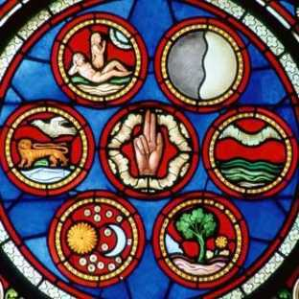
The Bible Is the Story of Our Salvation
Images - © The Crosiers/Gene Plaisted, OSC
Notes:
The images on the next three slides represent different periods in salvation history. You can present a brief walk through biblical salvation history in anticipation of the more in-depth treatment in future units. Alternatively, you could use this as a kind of pre-assessment by asking the class to name the event and its significance as each image appears.
The events are:
Creation
Adam and Eve in the Garden of Eden (Primeval History)
Abraham and the Sacrifice of Isaac (Period of the Patriarchs)
Moses Presenting the Ten Commandments (Period of the Exodus)
King David (Period of the Monarchy)
The Prophet Isaiah (Period of the Monarchy)
Birth of Jesus Christ (Life and ministry of Jesus Christ, the fulfillment of salvation history)
Death of Jesus Christ (Life and ministry of Jesus Christ, the fulfillment of salvation history)
Resurrection of Jesus Christ (Life and ministry of Jesus Christ, the fulfillment of salvation history)

Slide 12
The Bible Is the Story of Our Salvation (cont’d.)
Images - © The Crosiers/Gene Plaisted, OSC
Notes:
The images on the next three slides represent different periods in salvation history. You can present a brief walk through biblical salvation history in anticipation of the more in-depth treatment in future units. Alternatively, you could use this as a kind of pre-assessment by asking the class to name the event and its significance as each image appears.
The events are:
Creation
Adam and Eve in the Garden of Eden (Primeval History)
Abraham and the Sacrifice of Isaac (Period of the Patriarchs)
Moses Presenting the Ten Commandments (Period of the Exodus)
King David (Period of the Monarchy)
The Prophet Isaiah (Period of the Monarchy)
Birth of Jesus Christ (Life and ministry of Jesus Christ, the fulfillment of salvation history)
Death of Jesus Christ (Life and ministry of Jesus Christ, the fulfillment of salvation history)
Resurrection of Jesus Christ (Life and ministry of Jesus Christ, the fulfillment of salvation history)

Slide 13
The Bible Is the Story of Our Salvation (cont’d.)
Images - © The Crosiers/Gene Plaisted, OSC
Notes:
The images on the next three slides represent different periods in salvation history. You can present a brief walk through biblical salvation history in anticipation of the more in-depth treatment in future units. Alternatively, you could use this as a kind of pre-assessment by asking the class to name the event and its significance as each image appears.
The events are:
Creation
Adam and Eve in the Garden of Eden (Primeval History)
Abraham and the Sacrifice of Isaac (Period of the Patriarchs)
Moses Presenting the Ten Commandments (Period of the Exodus)
King David (Period of the Monarchy)
The Prophet Isaiah (Period of the Monarchy)
Birth of Jesus Christ (Life and ministry of Jesus Christ, the fulfillment of salvation history)
Death of Jesus Christ (Life and ministry of Jesus Christ, the fulfillment of salvation history)
Resurrection of Jesus Christ (Life and ministry of Jesus Christ, the fulfillment of salvation history)

Slide 14
Points to Remember
The Bible is a library of seventy-three books.
The Bible has two main sections: the Old Testament and the New Testament.
Testament is another word for covenant. A covenant is a sacred vow.
The Old Testament covenants are between God and his Chosen People, who are called Hebrews, Israelites, or Jews.
Notes:
Click to add notes

Slide 15
Points to Remember (cont’d.)
The New Covenant (New Testament) shows how the former covenants are fulfilled by the life, Death, and Resurrection of Jesus Christ.
The Old Testament is divided into four sections of books.
The New Testament is divided into five sections of books.
In the Bible God reveals his plan for our salvation.
Notes:
Click to add notes

