Slide 1
Catholics Come to America
Church History, Unit 7

Slide 2
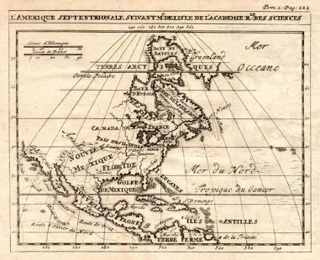
Catholics began to migrate from England to the American colonies to escape persecution for their faith after the Protestant Reformation.
Historians credit Queen
Elizabeth I with establishing
some degree of religious
toleration in England—but it
was not religious toleration
as we understand it today.
© shutterstock/Steven Wright

Slide 3
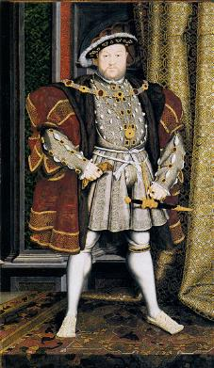
For decades, religious persecution had been common in England. First Protestants were persecuted, then Catholics, and then
Protestants again during the reigns of
Henry VIII and his first two successors,
Edward VI and Mary I.
By the time she became queen in 1558, Elizabeth I had seen firsthand that
religious persecution did not work.
As a princess, Elizabeth herself had
even been imprisoned by Mary I out of
suspicion about her religious views.
Image in public domain
Notes:
Image: Portrait of Henry VIII

Slide 4
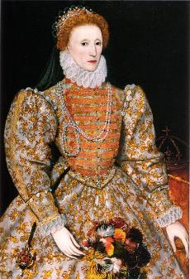
A year after she became queen, Elizabeth I was made the supreme governor of the Church of England through the Religious Settlement of 1559.
The Religious Settlement of 1559 sought to put the religious debates to rest.
As part of the Religious Settlement, everyone was required to attend Sunday service in the Church of England.
However, Elizabeth cautiously tolerated Catholic worship—as long as Catholic subjects were loyal and discreet.
Image in public domain
Notes:
Image: The “Darnley Portrait” of Elizabeth I of England. It was named after a previous owner. Probably painted from life, this portrait is the source of the face pattern called “The Mask of Youth,” which would be used for authorized portraits of Elizabeth for decades to come. Recent research has shown the colors have faded. The oranges and browns would have been crimson red in Elizabeth’s time.

Slide 5
Catholics continued to experience persecution in England, despite Elizabeth’s policy of religious toleration:
Catholics could not worship openly in their own churches. Instead they often had to worship in private homes.
Bishops who did not recognize Elizabeth as the head of the Church of England continued to be persecuted.
Some Protestants in power feared that Catholics—whom they called Papists—were an ongoing threat to order and stability. Many Catholics, especially Jesuit priests, were arrested, tried, and executed for treason based on these fears.
Image in public domain

Slide 6
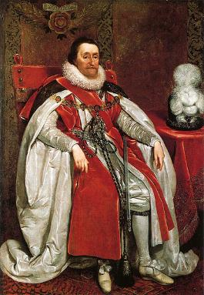
After Elizabeth’s death in 1603, King James VI of Scotland became James I of England.
James, a Protestant, tried at first to continue the uneasy religious toleration practiced under Elizabeth I.
He soon approved stricter measures to suppress the Catholic Church altogether.
Image in public domain
Notes:
Image: King James I of England and VI of Scotland, by Daniel Mytens, 1621

Slide 7
Near the end of his reign, James I granted Lord Baltimore land in the New World to build a settlement.
Lord Baltimore, who was Catholic, established the colony of Maryland in 1632—desiring in part to create a new home for Catholics who wanted to flee religious persecution in England and practice their faith openly and peacefully.
Image in public domain
Notes:
[Note: You may wish to inform the students that Maryland was not named after the Virgin Mary—a common misconception. Rather, it was named after Henrietta Maria, the wife of James I’s son, who became Charles I. Henrietta Maria herself was Catholic, and some in England saw her as a politically dangerous queen as a result.]

Slide 8
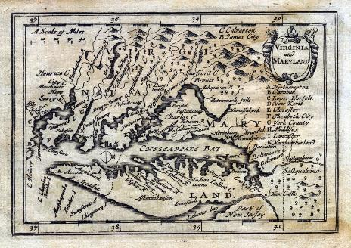
The other British colonies required colonists to follow the Church of England. But Maryland welcomed anyone who wanted to settle there.
Maryland’s assembly passed the Act Concerning Religion in 1649.
The Act Concerning
Religion required
religious tolerance in
Maryland. It protected
all colonists who did
not follow the Church
of England, including
Catholics and Puritans.
© Steven Wright/Shutterstock.com

Slide 9

Although many Catholics settled in Maryland, Puritans outnumbered the Catholics in the colony by the end of the 1600s.
In 1689 an army of Puritans revolted and formed a new government for Maryland—one that outlawed Catholicism.
The new government prohibited Catholic church buildings and excluded Catholic
men from holding political office.
Persecution of Catholics in
Maryland continued until the
American Revolution.
© Steven Wright/Shutterstock.com

Slide 10
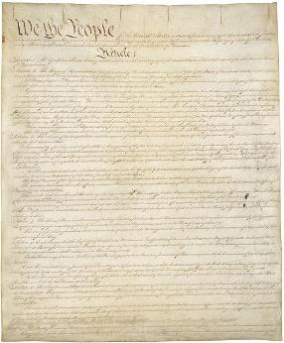
After the American Revolution, the Bill of Rights officially established freedom of religion throughout the United States of America.
Image in public domain

Slide 11
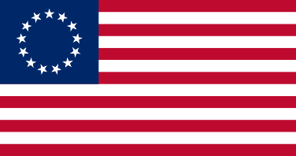
The approximately thirty thousand Catholics in the new nation enjoyed greater freedom and a more neutral political climate.
However, the Church in the United States faced a shortage of priests. Lack of funds made it difficult to pay to train and support new priests.
The Church also lacked the funds to begin building new churches.
Fr. John Carroll, a Jesuit
priest in Maryland, began
to address the needs of
American Catholics.
Image in public domain
Notes:
Image: Betsy Ross Flag. This was the first flag of the United States. Legend states it was created by Betsy Ross. The stars all face outward and represent a new constellation.

Slide 12
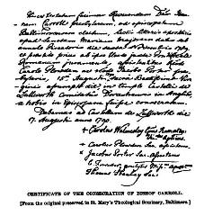
A Catholic diocese in London had long overseen the Church in America. When the bishop in London died in 1781, the Catholic priests in the United States asked the Pope to allow them to elect their own bishop.
The Pope traditionally appoints bishops of his own choosing.
However, Catholics felt pressured
to demonstrate that they were loyal
to the new republic, not to a foreign
leader (that is, the Pope or another
British bishop).
Pope Pius VI allowed the Catholic
priests in America to elect Father
Carroll as the first American bishop.
Image in public domain

Slide 13
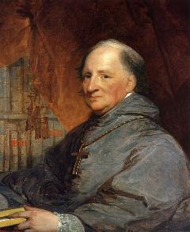
The Work of Bishop Carroll
Bishop Carroll made many significant
advances for the Church in America:
Bishop Carroll established the first
American diocese in Baltimore.
He took control of Church
governance in the United States—
especially the management of
American parishes in the absence of priests.
He set out to find priests who could speak the languages of the many new immigrants to America.
He demonstrated a commitment to American democracy while remaining fully loyal to the Pope.
Image in public domain

Slide 14
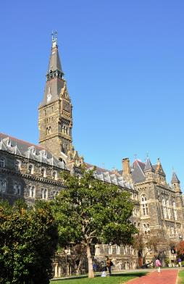
The Work of Bishop Carroll (continued)
Bishop Carroll sought to build the Church in America through education.
He planned and opened Georgetown Academy—today’s Georgetown University.
With his support, the Sulpicians founded St. Mary’s Seminary in Baltimore—the first seminary for priests in the United States.
When religious orders for women sought to settle in his diocese, he insisted that they establish schools at their convents.
© Shutterstock/Vsevolod33

Slide 15
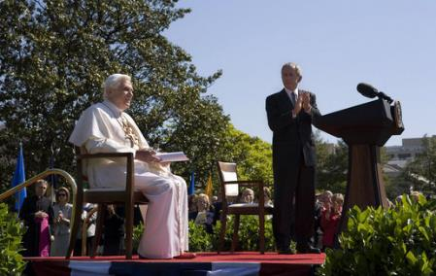
According to a 2007 estimate from the Pew Forum on Religion and Public Life, Catholics today make up nearly 24 percent of adults in the United States.
The Church in America has come a long way since the first Catholic colonists arrived to create a new life.
Image in public domain
Notes:
Image: President George W. Bush applauds Pope Benedict XVI, Wednesday, April 16, 2008, during an arrival ceremony for the Pope on the South Lawn. During his remarks the Pope encouraged the American people, saying, “I am confident that the American people will find in their religious beliefs a precious source of insight and an inspiration to pursue reasoned, responsible and respectful dialogue in the effort to build a more human and free society.”
(The statistic on slide 15 is from “U.S. Religious Landscape Survey: Summary of Key Findings,” by the Pew Forum on Religion and Public Life, at religions.pewforum.org/reports. Copyright © 2010 The Pew Forum on Religion and Public Life.)

