Slide 1
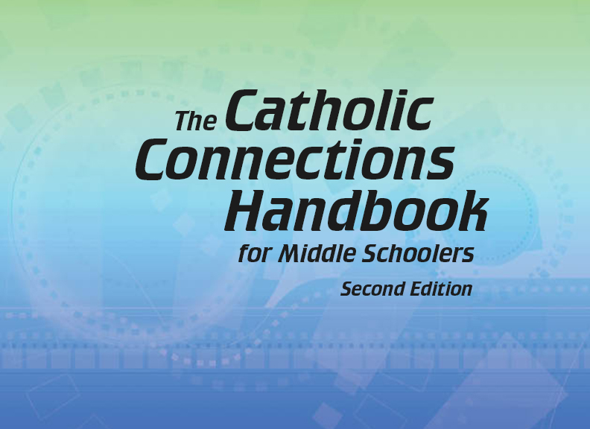


Slide 2
Christian Morality
and Social Justice
Chapter D
Working for Justice

Slide 3
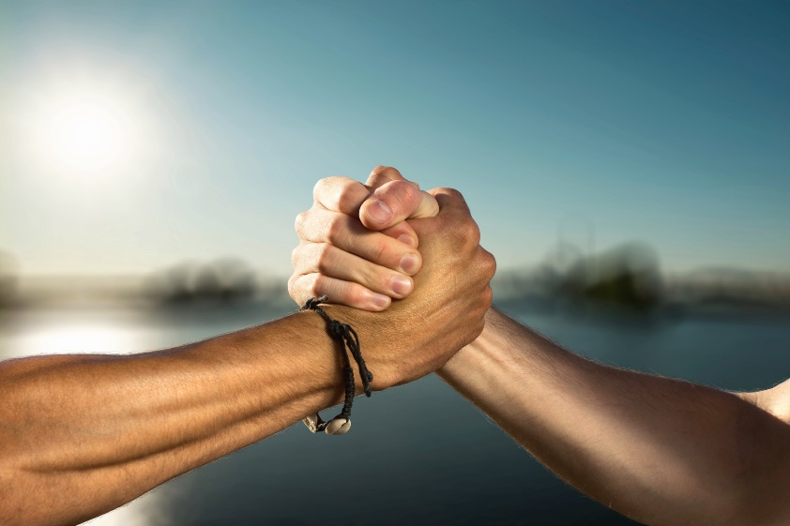
Chapter Summary
Working for Justice
In this chapter (a continuation of chapter 45 in the Handbook), you will consider the concepts of common good, Catholic social teaching, and solidarity. You will come to realize that in order for an action to support the common good, it must be good for the whole of society, not just for one group or one individual. As Catholics, we are called to stand together in solidarity with those who are disenfranchised. The welfare of the earth itself is part of our stewardship and is addressed in this chapter.
© lassedesignen/www.shutterstock.com

Slide 4
“Together for Good”
(Handbook, pages 493–496)
We all have a duty to work together for the common good.
© Artishok/www.shutterstock.com

Slide 5
“Together for Good”
(Handbook, pages 493–496)
God asks us to work for the common good of all.
Helping those in need is everybody’s responsibility.
God calls us to work at local, state, national, and global levels to help bring about social justice.

Slide 6

“Together for Good”
(Handbook, pages 493–496)
Activity
Look up the definition of common good in the Handbook.
Create a list of synonyms and antonyms for this word.
Each of you will write one synonym and one antonym on the board.
Discuss as a class!
© carmen2011/www.shutterstock.com

Slide 7

“The Secret Is Out” (Part 1)
(Handbook, pages 496–497)
We are called to live the truths of Catholic social teaching.
© SilviaJansen/www.istockphoto.com

Slide 8
“The Secret Is Out” (Part 1)
(Handbook, pages 496–497)
Catholic social teaching recognizes the human dignity of each person.
Catholic social teaching is concerned with making sure all people have what they need.
When members of our society lack basic needs, the whole society suffers.

Slide 9
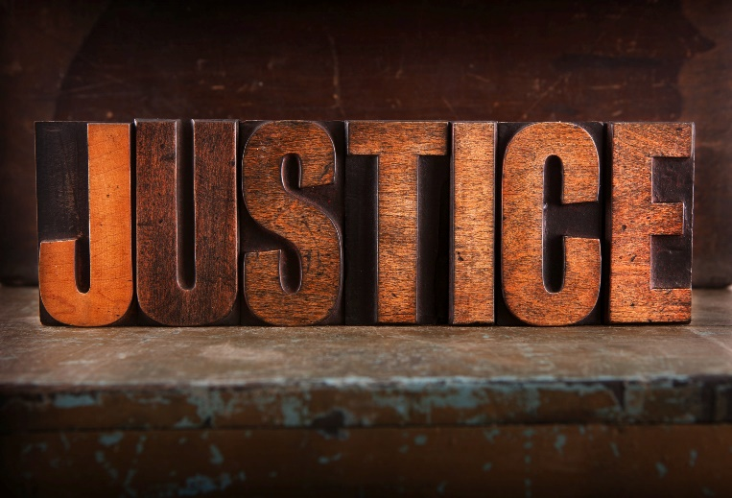
“The Secret Is Out” (Part 1)
(Handbook, pages 496–497)
Activity: “Stand Out for Justice”
Your teacher will arrange the class into groups of two or three.
Your group will be assigned one of the following quotes:
“If you want peace, work for justice.” (Pope Paul VI)
“Injustice anywhere is a threat to justice everywhere.” (Martin Luther King Jr.)
“Let us remember that justice must be rendered even to the lowest.” (Cicero)
“It is in justice that the ordering of society is centered.” (Aristotle)
“I have always found that mercy bears richer fruits than strict justice.” (Abraham Lincoln)
“Justice cannot be for one side alone, but must be for both.” (Eleanor Roosevelt)
3. Design a poster featuring your quote.
© hidesy/www.istockphoto.com

Slide 10
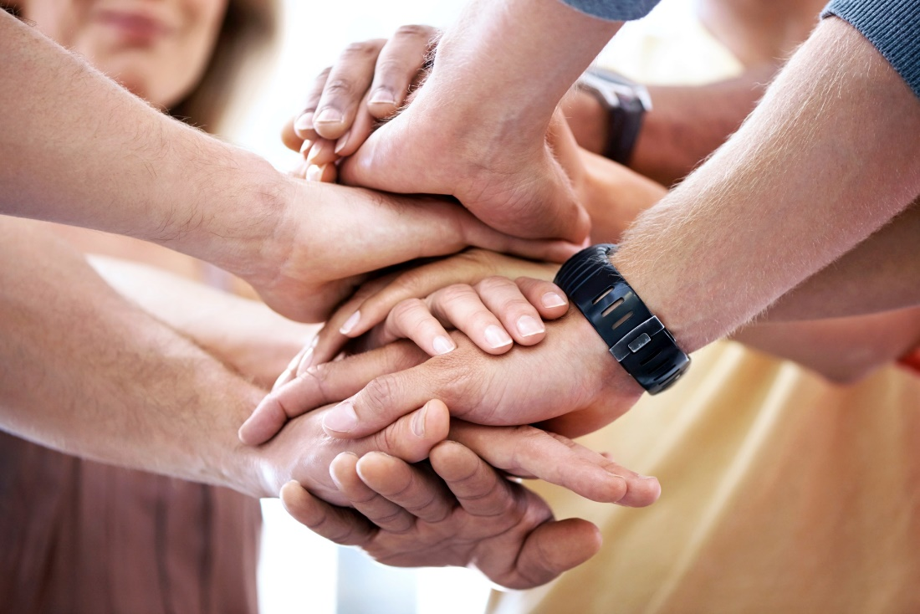
“The Secret Is Out” (Part 2)
(Handbook, pages 498–499)
We are called to live in solidarity with others, especially those in need.
© shapecharge/www.istockphoto.com

Slide 11
“The Secret Is Out” (Part 2)
(Handbook, pages 498–499)
Jesus sent us to bring Good News to those who are poor, through charity and justice.
Everyone is our brother and sister.
In solidarity, we can work together for justice and peace.

Slide 12
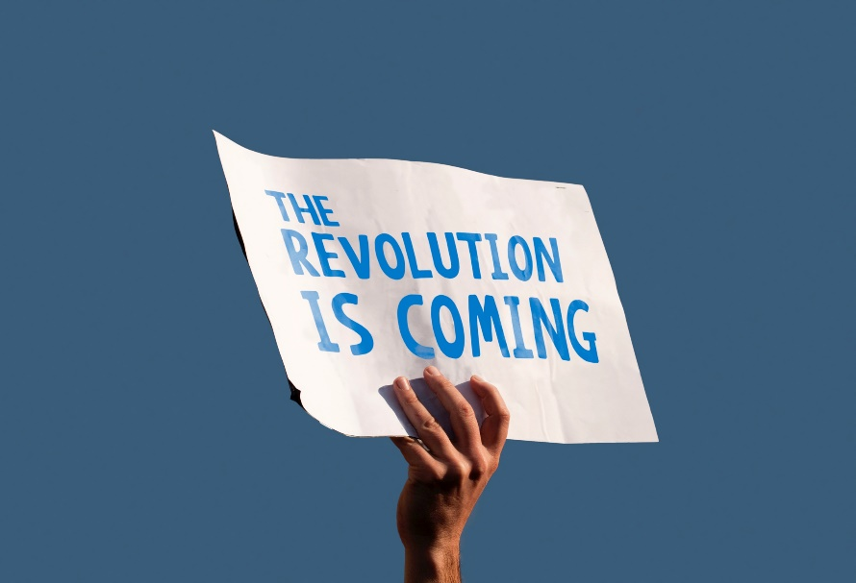
“The Secret Is Out” (Part 2)
(Handbook, pages 498–499)
Activity: “Revolution of the Heart”
Your teacher will arrange the class into pairs.
In pairs, read together “People of Faith: Dorothy Day” on page 501 in the Handbook.
Discuss this quote: “The greatest challenge of the day is how to bring about a revolution of the heart, a revolution which has to start with each one of us.” (Reminder: A revolution does not imply violence, only change.)
Ask yourselves, how would you start a revolution of the heart? Then create a poster encouraging others to join your “revolution.” Illustrate the poster with appropriate images.
© EduardoLuzzatti/www.istockphoto.com

Slide 13
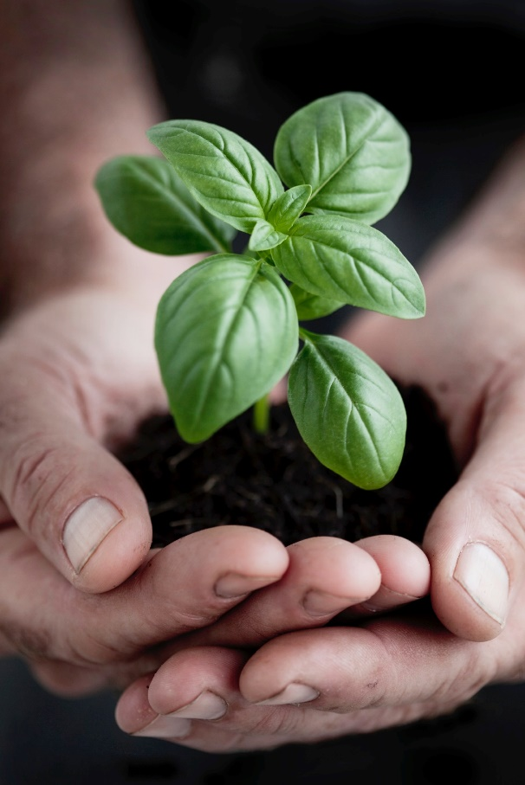
“The Secret Is Out” (Part 3)
(Handbook, page 500)
We are called to care for all of creation.
© LondonEye/www.istockphoto.com

Slide 14
“The Secret Is Out” (Part 3)
(Handbook, page 500)
God tells us to care for all of creation.
Like the Iroquois, we should make environmental decisions based on how they will affect the next seven generations.
Caring for other people and caring for our earth are part of God’s plan for us.

Slide 15
“The Secret Is Out” (Part 3)
(Handbook, page 500)
Activity: “Stewardship Over All”
The teacher will arrange the class into pairs.
Read Genesis 1:20–31 with your partner.
One of you should record your answers to the following questions in a chart, as follows:
  Column 1: How are we preserving the environment today?
  Column 2: How are we hurting the environment today?
  Column 3: What choices can we make to help change the situation in Column 2?
4. Discuss your responses as a class!
© ARTQU/www.istockphoto.com

Slide 16
Acknowledgments
The scriptural references and quotations in this presentation are from the Good News Translation® (Today’s English Version, Second Edition). Copyright © 1992 by the American Bible Society. All rights reserved. Bible text from the Good News Translation (GNT) is not to be reproduced in copies or otherwise by any means except as permitted in writing by the American Bible Society, 1865 Broadway, New York, NY 10023 (www.americanbible.org).
The quotation by Pope Paul VI on slide 9 is from “Message of His Holiness, for The Celebration of the Day of Pace, January 1, 1972,” www.vatican.va/holy_father/paul_vi /messages/peace/documents/hf_p-vi_mes_19711208_v-world-day-for-peace_en.html
To view copyright terms and conditions for Internet materials cited here, log on to the home pages for the referenced websites.
During this presentation’s preparation, all citations, facts, figures, names, addresses, telephone numbers, Internet URLs, and other pieces of information cited within were verified for accuracy. The authors and Saint Mary’s Press staff have made every attempt to refer-ence current and valid sources, but we cannot guarantee the content of any source, and we are not responsible for any changes that may have occurred since our verification. If you find an error in, or have a question or concern about, any of the information or sources listed within, please contact Saint Mary’s Press.

