Slide 1
The Holy Spirit
The Catholic Faith Handbook for Youth, Third Edition
Chapter 12
Document #: TX003143
Notes:
Use this presentation, which is a collection of images, as a review of biblical references, titles, and symbols of the Holy Spirit, described on pages 128–130. Or play quiet music while showing the images without comment, allowing time for the students to journal on the reflection questions on page 126 of the student handbook, or on one of the symbols of the Holy Spirit.

Slide 2
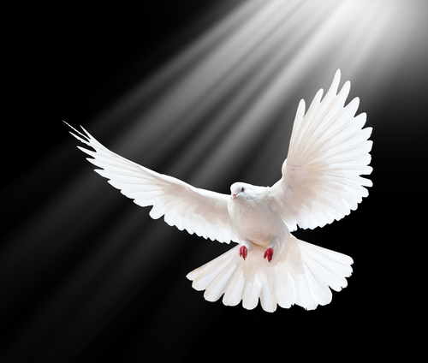
The Holy Spirit: Third Person of the Holy Trinity
Copyright: Tischenko Irina / www.shutterstock.com
Notes:
Have the students gather in four separate groups, and assign each group one of the Resurrection accounts. After the groups have read their accounts, invite them to present the details (in their own words) of each account.

Slide 3
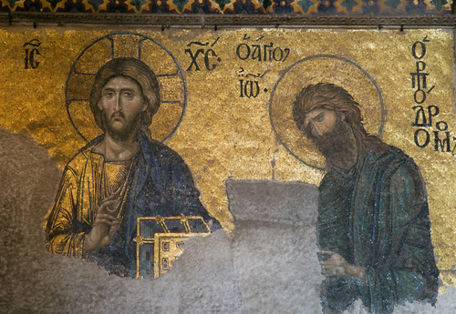
Copyright: Mykola Ivashchenko / www.shutterstock.com
Notes:
For this and the next five slides, ask the students to recount the stories about the Holy Spirit being represented. Ask how the Holy Spirit was active in the life of John the Baptist. (He was filled with the Holy Spirit at his birth; he prophesied that Jesus would baptize with the Holy Spirit.)

Slide 4
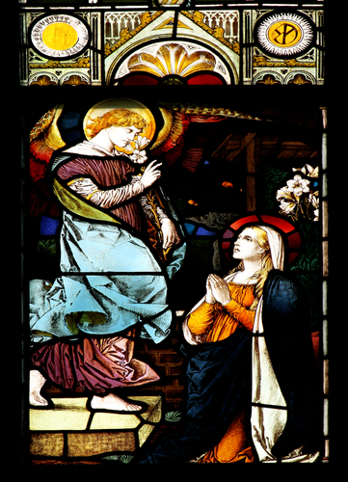
Copyright: Tiberiu Stan / www.shutterstock.com
Notes:
Ask how the Holy Spirit was active in the life of Mary. (The Angel Gabriel told Mary that she would conceive through the power of the Holy Spirit.)

Slide 5
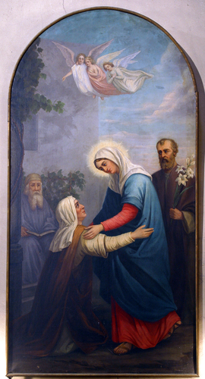
Copyright: Zvonimir Atletic / www.shutterstock.com
Notes:
Ask how the Holy Spirit was active in the life of Mary’s cousin Elizabeth. (The Holy Spirit filled Elizabeth when Mary visited her.) You may remind the students of the details of this story, found in Luke 1:39–56.

Slide 6
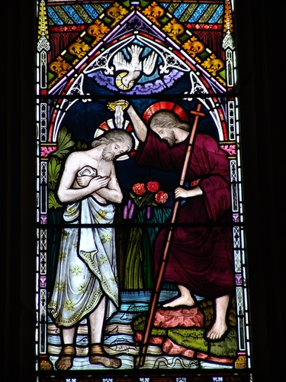
Copyright: Roger de Montfort / www.shutterstock.com
Notes:
Ask how the Holy Spirit was presented at Jesus’ Baptism. (When John baptized Jesus, the Holy Spirit descended on him in the form of a dove.) Remind the students that a voice came from Heaven, proclaiming Jesus to be God’s Beloved Son.

Slide 7
Copyright: I. Pilon / www.shutterstock.com
Notes:
Ask what promise Jesus made regarding the Holy Spirit at the Last Supper. (Jesus promised he would send an Advocate to teach the disciples.) Refer the students to the reflection questions on page 126 of the student handbook. Invite them to reflect on the Holy Spirit’s role as Advocate.

Slide 8
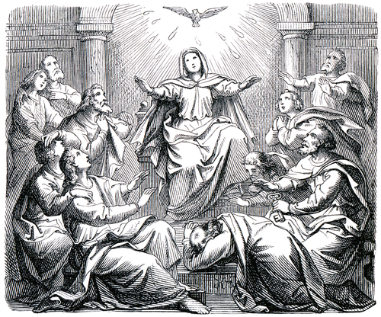
Copyright: Bocman1973 / www.shutterstock.com
Notes:
Ask how the Holy Spirit was presented at Pentecost. (The Holy Spirit filled the house where the disciples were gathered; there was the sound of a rushing wind and flames appeared over each person; the Spirit enabled the followers of Jesus to preach and be understood by people from all around the world.)

Slide 9
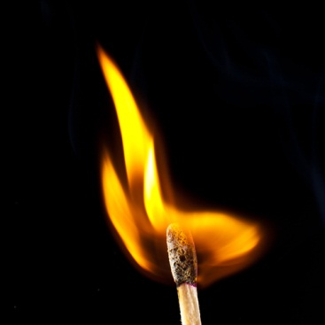
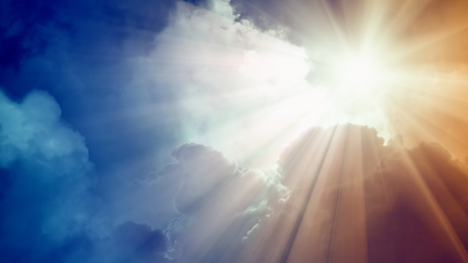
Copyright: melodija / www.shutterstock.com
Copyright: Andreev Alexey / www.shutterstock.com
Copyright: Igor Zh. / www.shutterstock.com
Symbols of the Holy Spirit
Water
Fire
A cloud and light
Notes:
As you click to show these terms, call on students to read aloud the descriptions of each symbol, found on pages 129–130 of the student handbook.

Slide 10
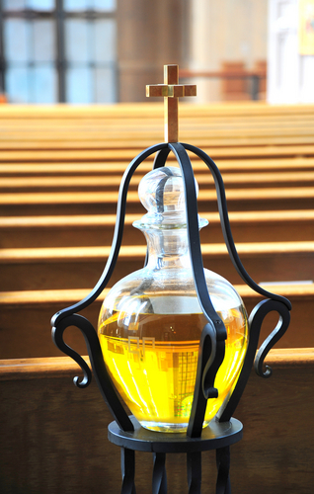
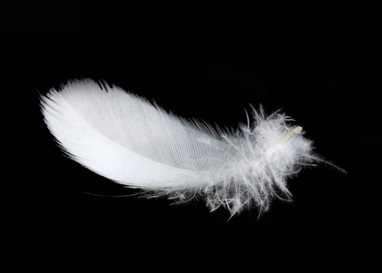
Copyright: Vasilius / www.shutterstock.com
Copyright: Oscar C. Williams / www.shutterstock.com
Copyright: Anna Jurkovska / www.shutterstock.com
Symbols of the Holy Spirit
Dove
Anointing
Laying on hands
Notes:
As you click to show these terms, call on students to read aloud the descriptions of each symbol, found on page 130 of the student handbook.

