Slide 1
The Word Became Flesh
The Paschal Mystery
Unit 2, Chapter 4
Document #: TX005435

Slide 2
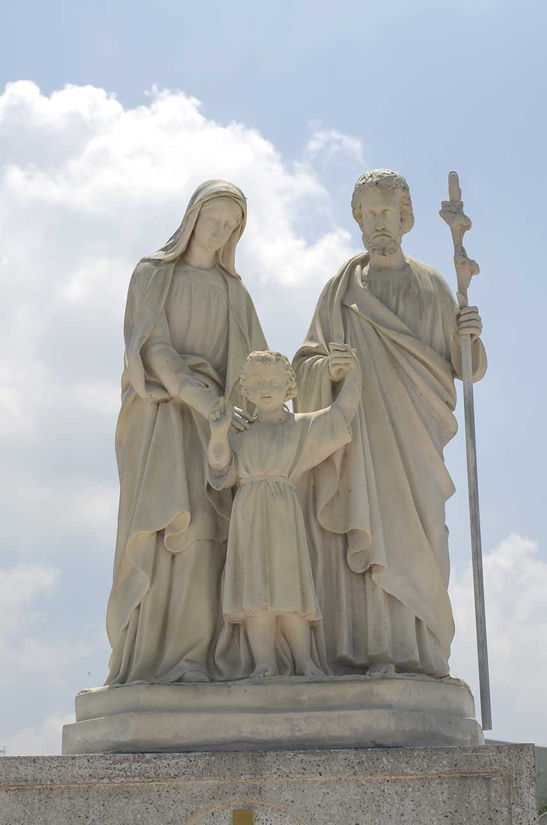
The Holy Family
God intends that families reflect the love among the Divine Persons of the Holy Trinity.
We have a model for this in Mary, Joseph, and Jesus.
Through the Holy Family, God set in motion his plan for our salvation.
© boy 13 / Shutterstock
Notes:
Notes: Direct the students to read the Faith in Action sidebar, “Living the Gospel Together,” in article 12. Discuss the three-step method for faith in action used by the Christian Family Movement. Ask for examples of how this method could help a family, a community, and the world.
This slide corresponds to student text content in article 12.

Slide 3
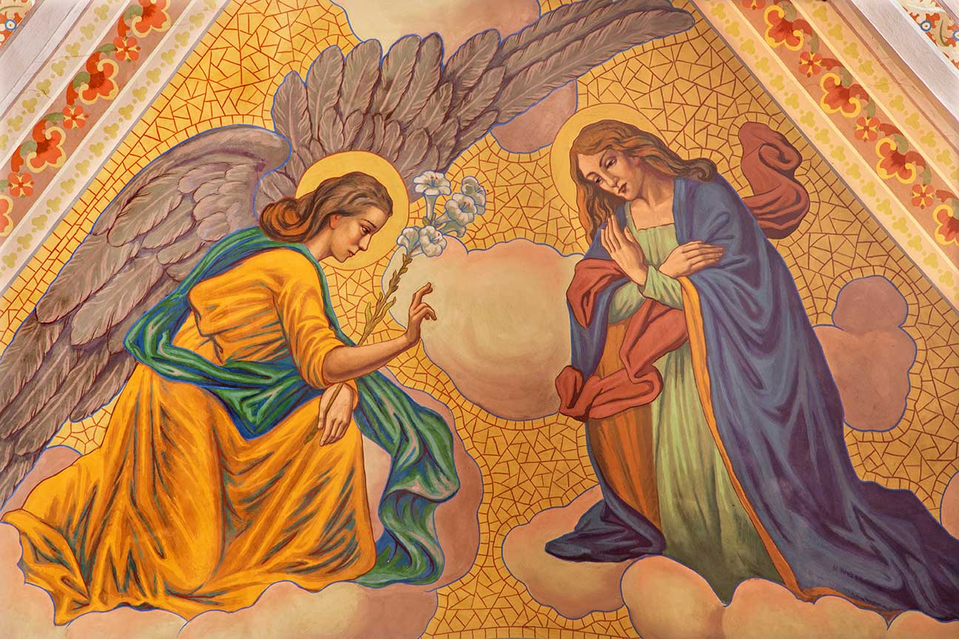
Mary’s Faith and Trust
Mary showed her complete trust in God when she said “yes” to his plan.
God chose Mary from all the descendants of Eve to bear his Eternal Son.
Mary was free of Original Sin, and without personal sin her whole life.
© boy 13 / Shutterstock
Notes:
Notes: Point out that Jesus Christ was born of a virgin as a sign of his divine identity. Explain that the virgin birth also symbolizes that Jesus is the New Adam (who also did not have an earthly father).
This slide corresponds to student text content in article 12.

Slide 4
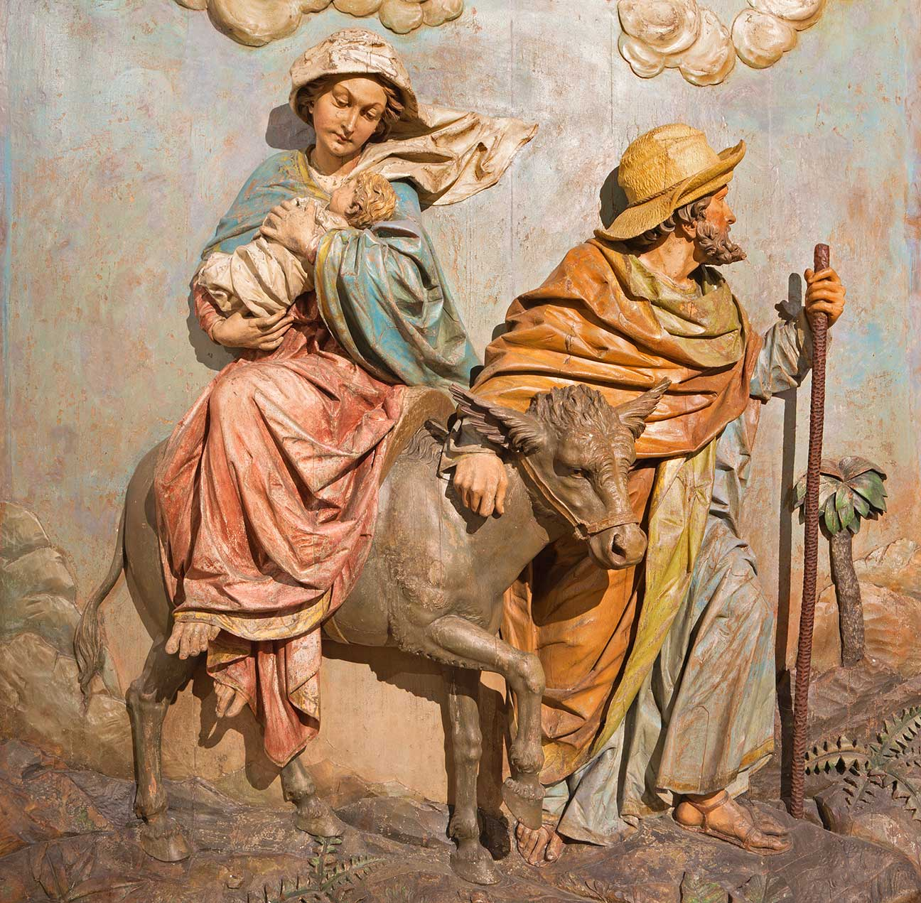
Joseph’s Faith and Trust
Joseph chose not to expose Mary to shame.
In Joseph’s dream, an angel explained the truth about Mary’s child.
Joseph took Mary into his home, as the angel directed.
When the infant Jesus was in danger, Joseph fled to safety with his family.
© Renata Sedmakova / Shutterstock
Notes:
Notes: Ask the questions that conclude article 12 in the student text: Whom do you know in your own life who models faith and trust in God’s plan? How do they do this? Consider sharing your own answers.
This slide corresponds to student text content in article 12.

Slide 5
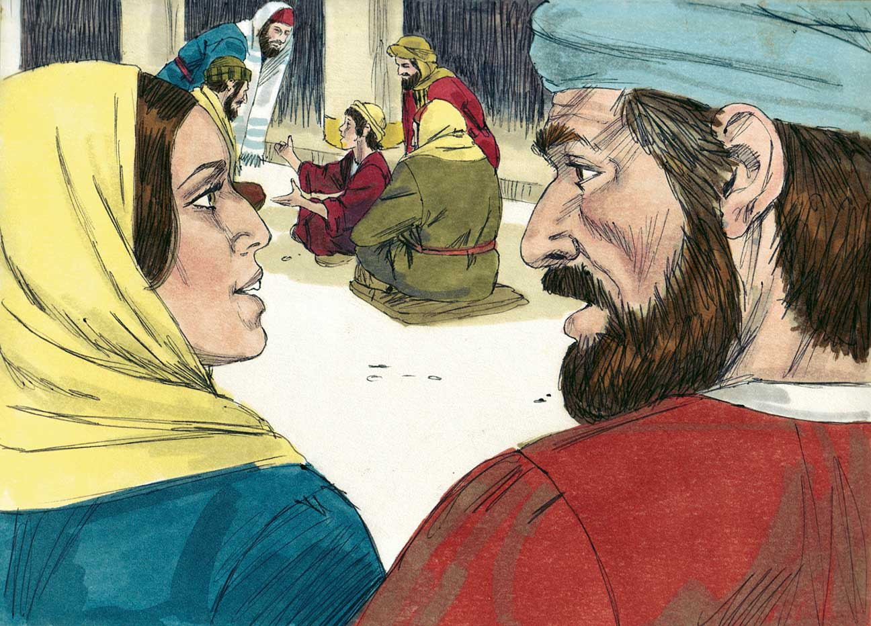
The Gospels and Christological Prophecies
The Gospels show how many Old Testament prophecies apply to Jesus.
Much of Jesus’ life and mission was foreshadowed in the Old Testament Scriptures.
Jesus himself explained many of these passages after his Resurrection.
© BibleArtLibrary / istock
Notes:
Notes: Direct the students to read the chart in article 13 of the student text. Ask why Jesus was born in Bethlehem (the census), how he showed zeal for the Temple (the cleansing of the Temple), and when he rode on a donkey (entry into Jerusalem).
This slide corresponds to student text content in article 13.

Slide 6
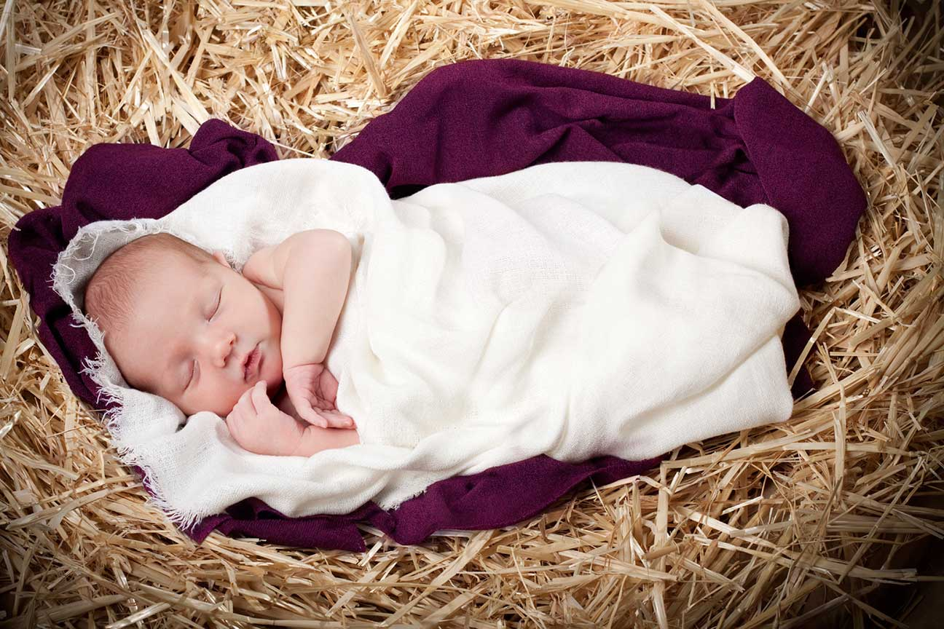
The Word Became Flesh
Without losing his divine nature, the Word of God became fully man.
The union of Jesus’ divine and human natures in one Divine Person is the Incarnation.
It is a mystery we will never fully understand.
© Cindy Singleton / istock
Notes:
Notes: Tell the students that the next slides discuss the reasons for the Incarnation. Ask the students to brainstorm some reasons and list them on the board, without commenting, before going on.
This slide corresponds to student text content in article 14.

Slide 7
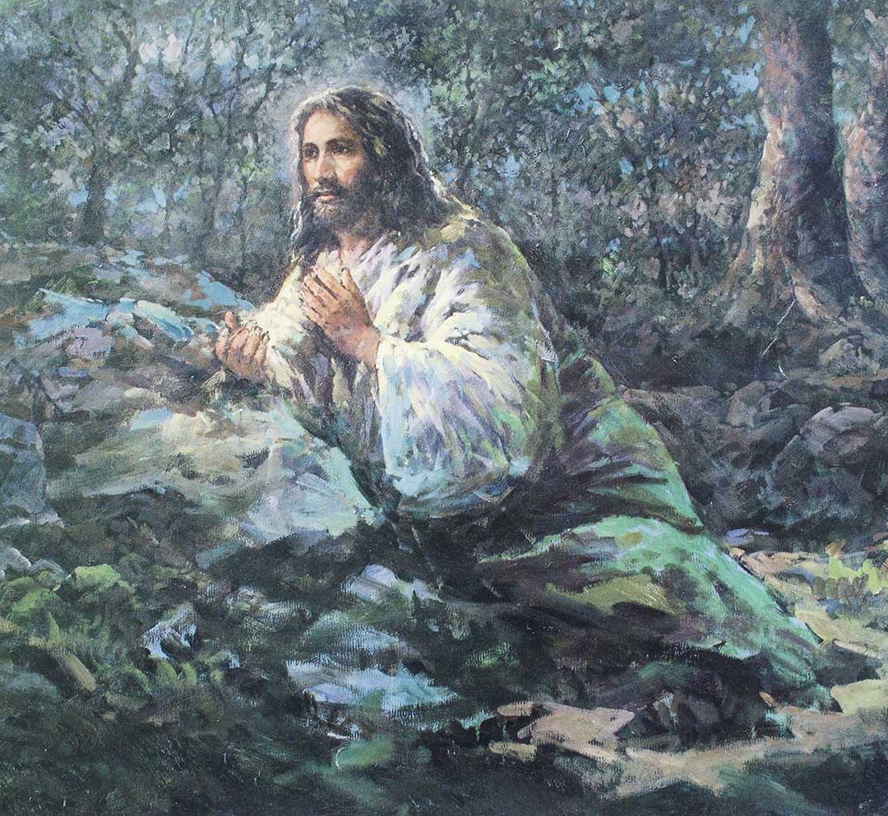
Reasons for the Incarnation
To reconcile us with God through the forgiveness of sins
To help us know the depth of God’s love
To be our model of holiness
© iamfree007 / Shutterstock
Notes:
Notes: Explain each reason for the Incarnation presented in article 14 of the student text. On the board, check off items from the students’ brainstorm that relate to each reason.
This slide corresponds to student text content in article 14.

Slide 8
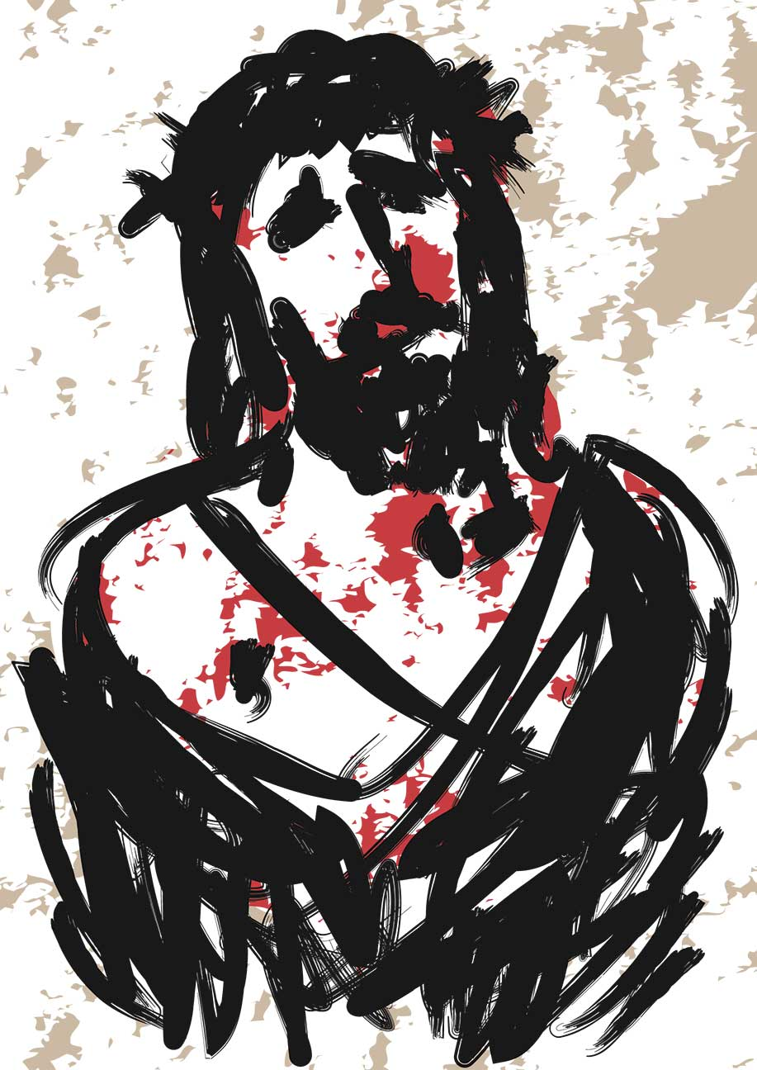
More Reasons for the Incarnation
To make us partakers of the divine nature
To destroy the power of the devil
© robodread / Shutterstock
Notes:
Notes: Continue explaining the reasons for the Incarnation in article 14 of the student text. Discuss any items on the board without checkmarks.
This slide corresponds to student text content in article 14.

Slide 9
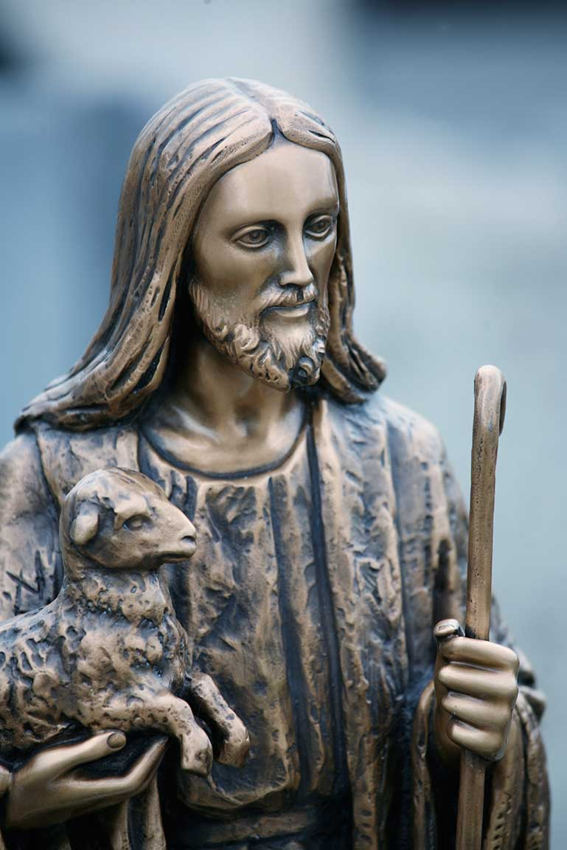
The Titles Say It All
In the New Testament, Jesus is given a variety of titles.
They indicate his central role in salvation history.
© clu / istock
Notes:
Notes: Direct the students to read the chart in article 15 of the student text. Ask for comments, or provide information about Jesus’ titles.
This slide corresponds to student text content in article 15.

Slide 10
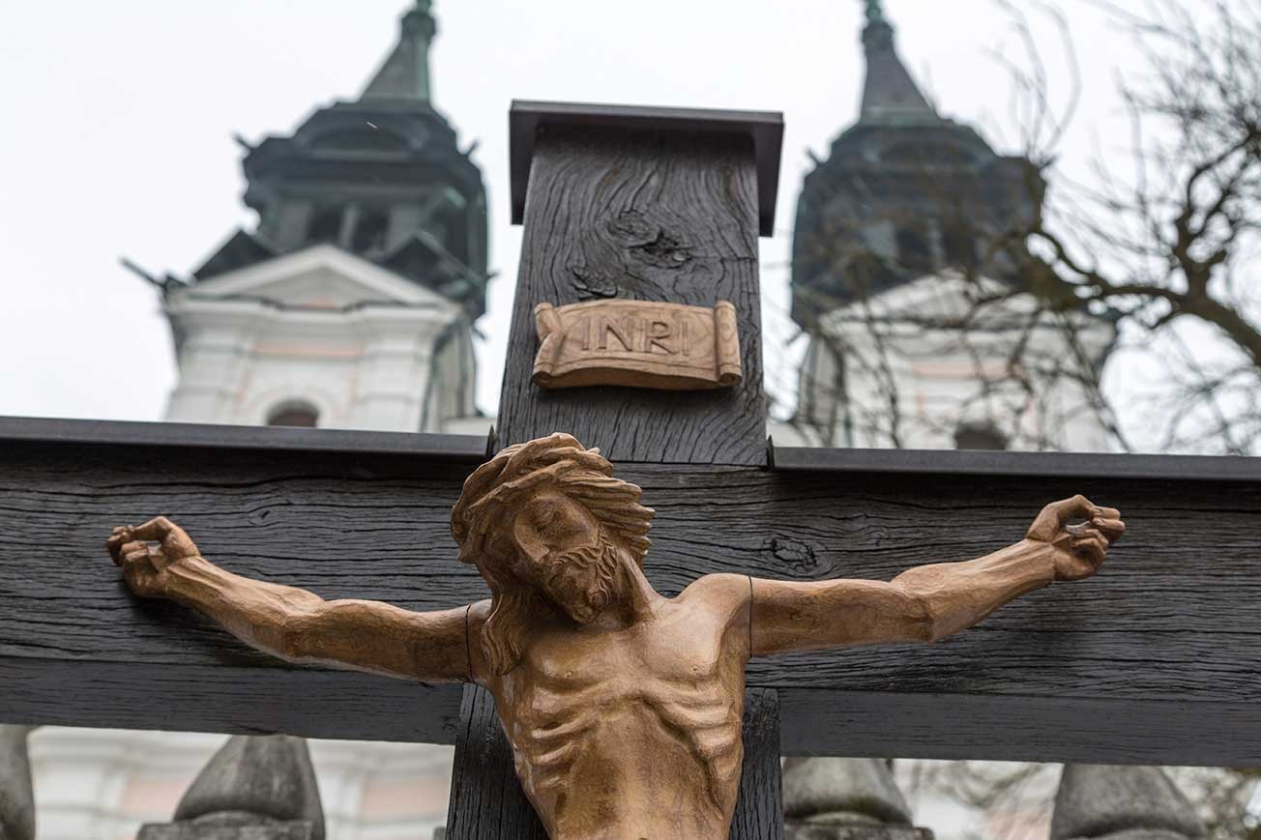
Some Titles of Note
Jesus means “God saves” in Hebrew, reflecting his mission.
Christ is the Greek translation of the Hebrew word messiah, which means “anointed.”
© erwo1 / istock
Notes:
Notes: Ask volunteers to comment on the mission for which Jesus was anointed. (He was anointed priest, prophet, and king to be savior of the world.)
This slide corresponds to student text content in article 15.

Slide 11
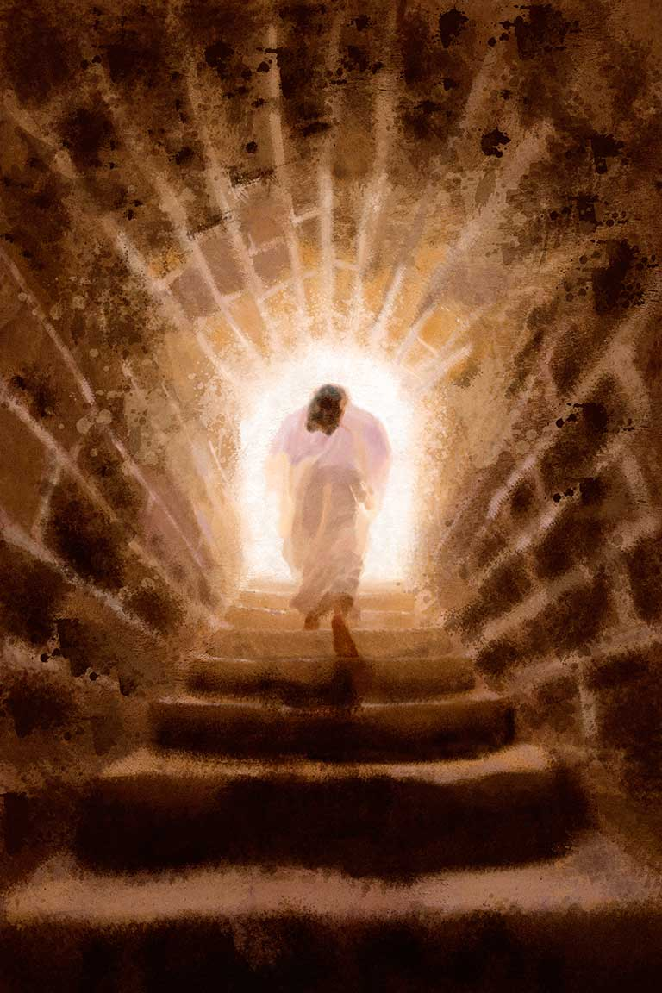
More Titles of Note
Son of God points to Jesus’ unique relationship with the Father.
Lord is the Greek word the Jews used for God.
© kreicher / istock
Notes:
Notes: Point out that both of these titles highlight Jesus’ divinity. Ask the question in the student text that concludes article 15: Which title for Jesus helps you to feel most connected with him?
This slide corresponds to student text content in article 15

