Slide 1
Revelation in and through Jesus in the Synoptic Gospels
The Living Word: The Revelation of God’s Love, Second Edition
Unit 4, Chapter 13
Document#: TX004691

Slide 2

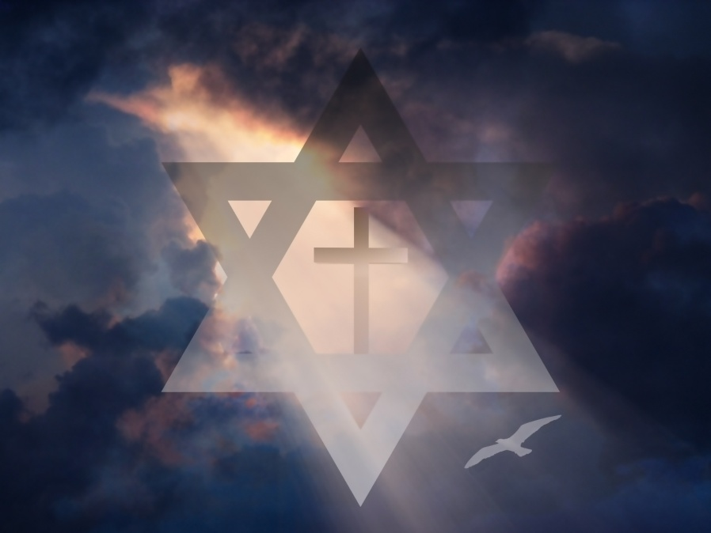
The Gospel of Matthew
The Gospel of Matthew addresses a mixed community of Jewish Christians and Gentiles.
It highlights Jesus as
the fulfillment of
many Old Testament
prophecies.
It presents Jesus as
the supreme teacher
and the savior of all.
© Bruce Rolff / Shutterstock.com
Notes:
Notes: Explain to the students that Matthew wanted his Jewish Christian readers to know that believing in Jesus was not a break with their tradition but rather a continuation of it. Explain that the non-Jewish readers would have appreciated the accounts of Jesus’ encounters with Gentiles.
This slide corresponds to content in article 60, “The Gospel of Matthew,” in the student book.

Slide 3
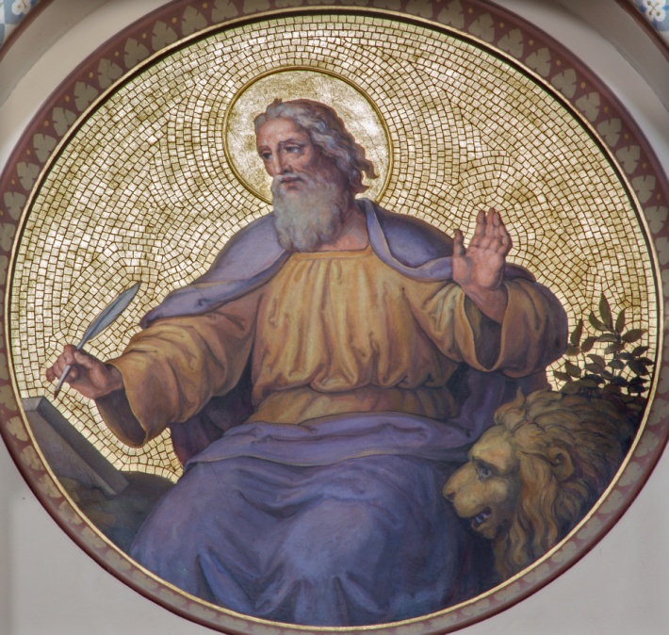
The Gospel of Mark
Mark was the first Gospel written, between approximately AD 65 and 70.
It emphasizes the
humanity of Jesus,
showing his anguish
and pain.
It teaches us that
disciples must imitate
Jesus in both his
ministry and his
suffering.
© Renata Sedmakova / Shutterstock.com
Notes:
Notes: Explain to the students that Mark’s non-Jewish community was experiencing persecution, possibly at the hands of the Roman emperor Nero. Mark wanted to help them make sense of their suffering.
This slide corresponds to content in article 61, “The Gospel of Mark,” in the student book.

Slide 4
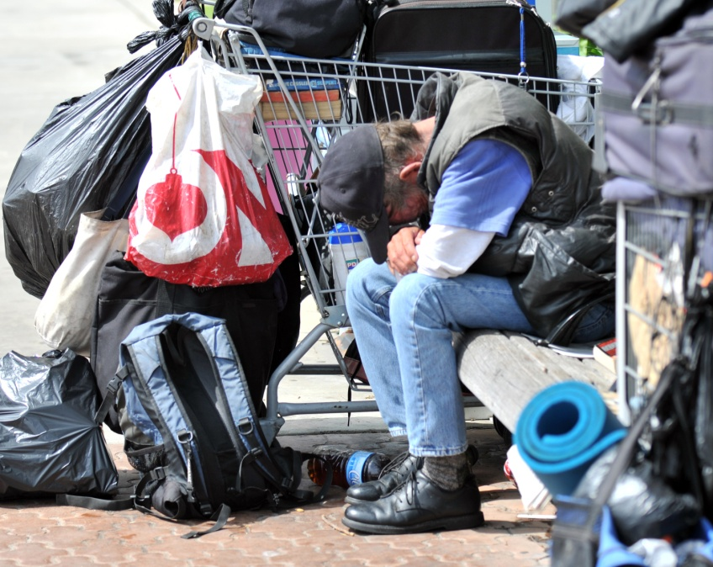
The Gospel of Luke
The Gospel of Luke and the Acts of the Apostles form a two-volume work.
Luke makes clear
that Jesus is the
compassionate
Savior who
welcomes all.
Luke also portrays
Jesus as a friend to
those who were
rejected by society.
© justasc / Shutterstock.com
Notes:
Notes: Ask the students what the two volumes of Luke-Acts cover (Luke, the life and mission of Christ; Acts, the life and growth of the early Church).
This slide corresponds to content in article 62, “The Gospel of Luke,” in the student book.

Slide 5
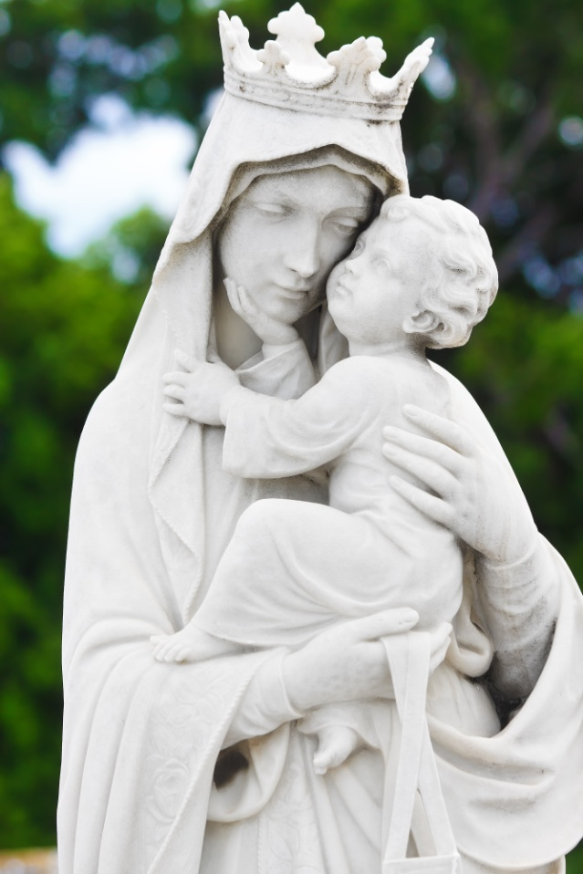
The Birth of a Savior
The Gospels of Matthew and Luke provide accounts of Jesus’ birth.
By the power of the Holy Spirit, the Virgin Mary conceived the Son of God.
Salvation comes in the form of an ordinary child, clothed in humility.
© Kamira / Shutterstock.com
Notes:
Notes: Explain to the students that because she is the mother of the Son of God, who is also God himself, we call Mary the Mother of God.
This slide corresponds to content in article 63, “Central Accounts in the Synoptic Gospels,” in the student book.

Slide 6
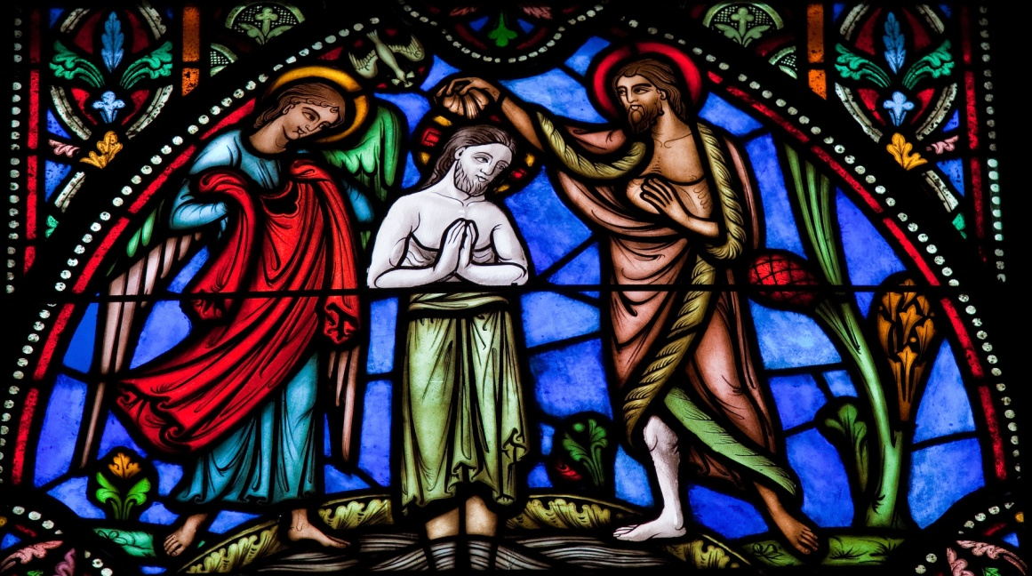
The Baptism of Jesus
Jesus went to John to be baptized at the beginning of his public ministry.
The Baptism of Jesus revealed he was the Messiah of Israel and the Son of God.
© jorisvo / Shutterstock.com
Notes:
Notes: Explain to the students that John the Baptist, who was also Jesus’ cousin, prepared the way for the Messiah through his ministry of repentance.
This slide corresponds to content in article 63, “Central Accounts in the Synoptic Gospels,” in the student book.

Slide 7

The Temptation of Jesus
Jesus was led by the Holy Spirit into the desert, where he met with temptation.
Jesus remained faithful
and totally obedient to
his Father’s will.
Jesus is the New Adam,
who conquers sin and
evil.
© Galyna Andrushko / Shutterstock.com
Notes:
Notes: Explain to the students that Jesus’ temptation mirrors that of Adam in the Garden of Eden and of the Israelites in the wilderness during the Exodus.
This slide corresponds to content in article 63, “Central Accounts in the Synoptic Gospels,” in the student book.

Slide 8
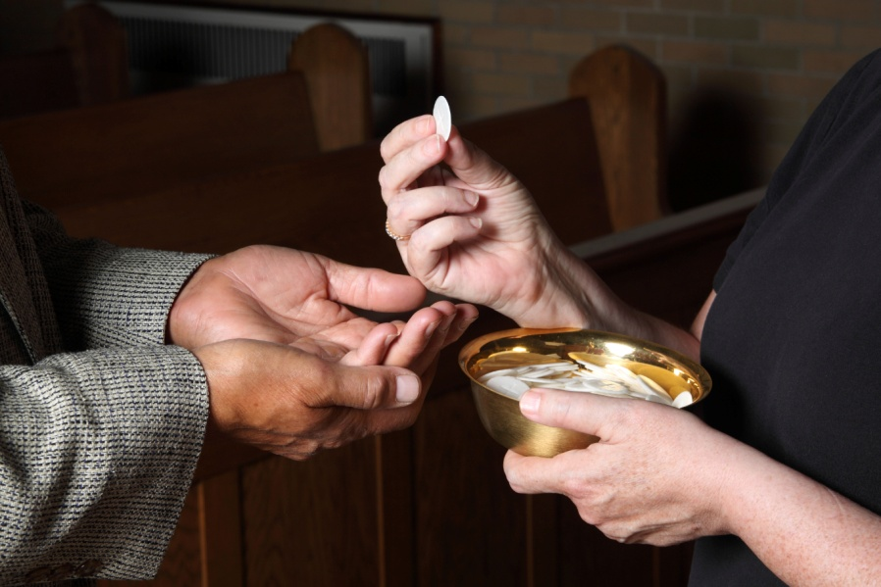
The Multiplication of the Loaves
This miracle appears in all four Gospels.
Jesus blessed a few loaves of bread and miraculously fed thousands of people.
At the Eucharist,
Jesus satisfies our
spiritual hunger with
his own flesh and
blood.
© princessdlaf / iStockphoto.com
Notes:
Notes: Ask the students these questions: How does it feel to be physically hungry? How does it feel to be spiritually hungry?
This slide corresponds to content in article 63, “Central Accounts in the Synoptic Gospels,” in the student book.

Slide 9
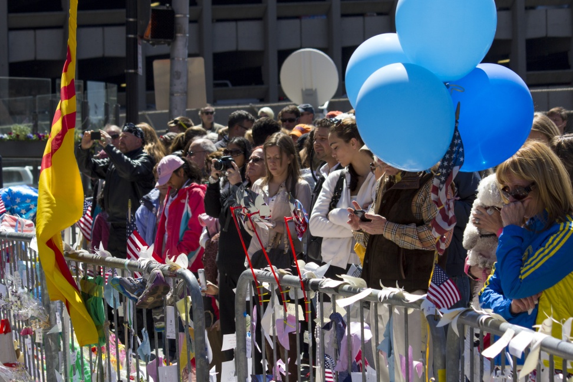
The Beatitudes
The Beatitudes show us that God calls us to communion with him in the Kingdom of Heaven.
They call for a reversal of the world’s value system and a total conversion of the heart.
© Marcio Jose Bastos Silva / Shutterstock.com
Notes:
Notes: Direct the students to read the Live It! in article 63 in the student book, and then ask this question: What obstacles in the world today make it difficult to follow the Beatitudes?
This slide corresponds to content in article 63, “Central Accounts in the Synoptic Gospels,” in the student book.

Slide 10
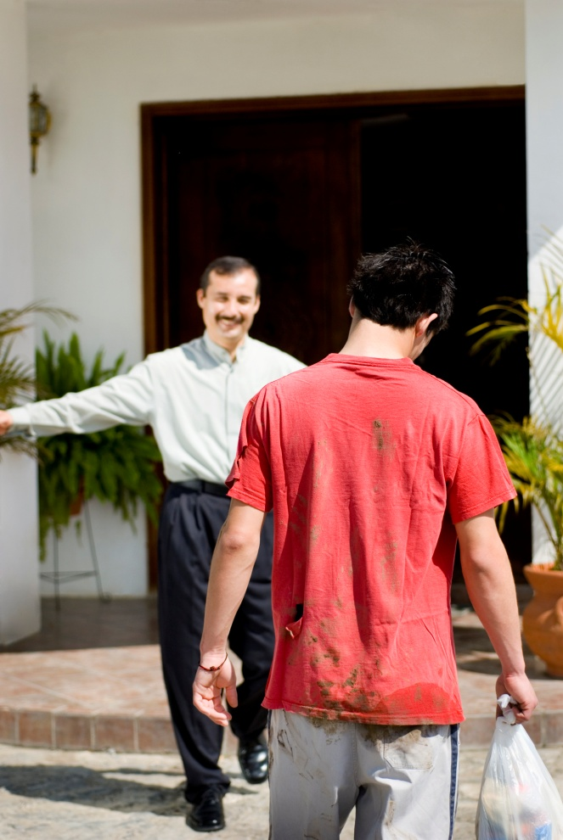
Parables
Parables are stories where two different things are compared to illustrate a point.
Jesus’ parables are based on everyday life.
They often have a surprising twist or ending.
They teach timeless spiritual and ethical truths.
© Aldo Murillo / iStockphoto.com
Notes:
Notes: Lead a discussion with the students, applying the characteristics of parables in article 64 in the student book to the Parable of the Prodigal Son, also described in that article.
This slide corresponds to content in article 64, “The Parables and Miracles in the Synoptic Gospels,” in the student book.

Slide 11
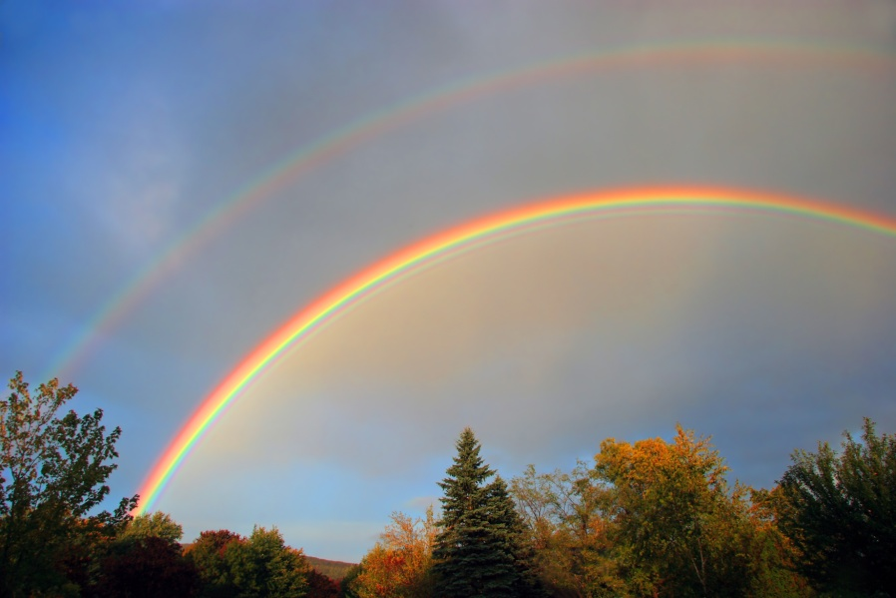
Miracles
Jesus’ miracles revealed him to be the embodiment of the Kingdom, the Messiah promised by the prophets.
They provided
credibility to his
words.
They revealed the
Reign of God as a
place where all are
welcome.
© Claud B. / Shutterstock.com
Notes:
Notes: Ask the students to identify and give examples of the four types of miracles Jesus performed. (See article 64 in the student book for examples of healing miracles, exorcisms, nature miracles, and restorations of life.)
This slide corresponds to content in article 64, “The Parables and Miracles in the Synoptic Gospels,” in the student book.

Slide 12
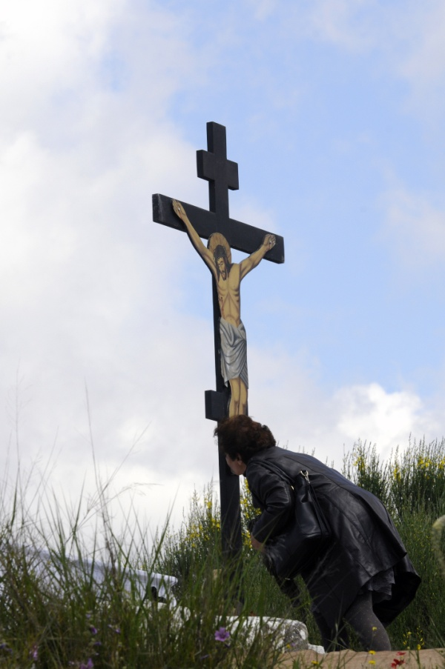
The Paschal Mystery
We are redeemed through the events of the Paschal Mystery.
They include Christ’s Passion, Death, Resurrection, and Ascension.
The synoptic Gospel writers introduce these events with accounts of the Last Supper.
© Kostas Koutsaftikis / Shutterstock.com
Notes:
Notes: Review with the students the highlights of the Last Supper in the synoptic Gospels, as described in article 65 in the student book.
This slide corresponds to content in article 65, “The Paschal Mystery in the Synoptic Gospels,” in the student book.

Slide 13
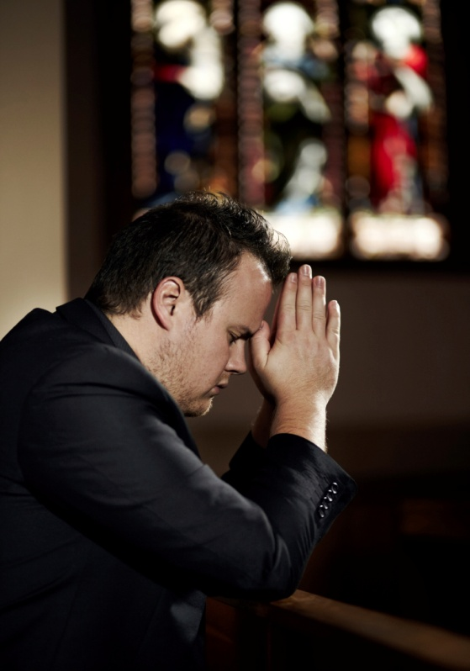
From Passion to Death
The Passion of Christ begins with his agony in the garden at Gethsemane.
It includes his trial and
scourging, and his
Crucifixion.
Jesus obediently
accepted suffering
and death on a cross
to atone for our sins.
© Yuri / iStockphoto.com
Notes:
Notes: Ask the students these questions: Why does true discipleship require us to accept suffering? How can this help us to weather difficult times?
This slide corresponds to content in article 65, “The Paschal Mystery in the Synoptic Gospels,” in the student book.

Slide 14
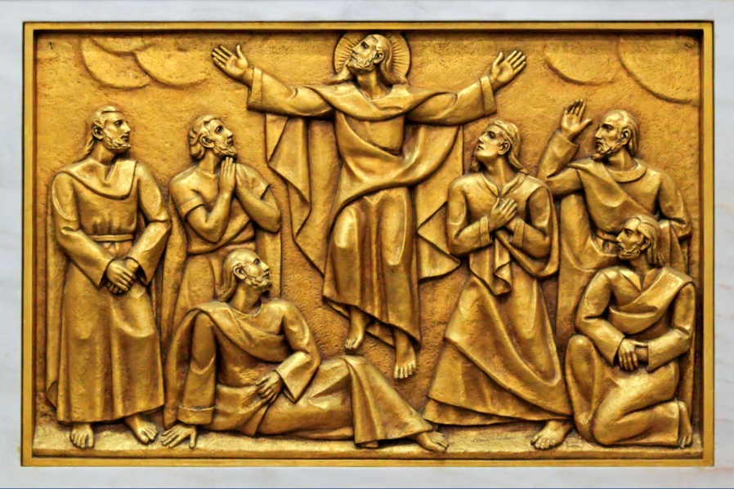
From Resurrection to Ascension
The Resurrection affirmed the truth of Jesus’ teachings.
It showed that Jesus is the Savior.
It points to our own future resurrection.
In ascending, Jesus
passed into the
presence of God,
beyond space and
time.
© Zacarias Pereira da Mata / Shutterstock.com
Notes:
Notes: Explain to the students that Jesus did not leave us at his Ascension; this allows him to be anywhere at any time.
This slide corresponds to content in article 65, “The Paschal Mystery in the Synoptic Gospels,” in the student book.

Slide 15
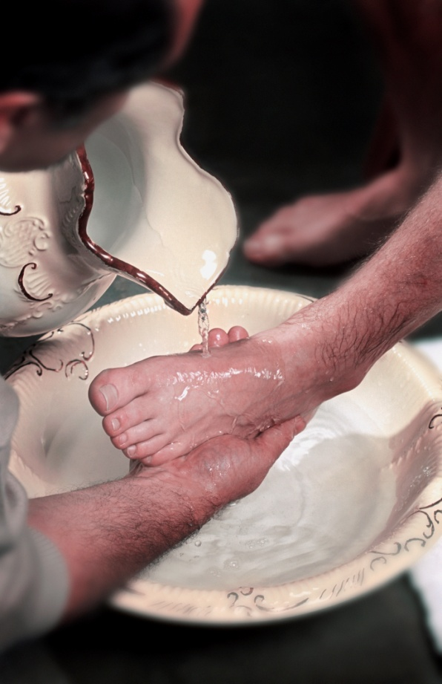
Commemorating the Paschal Mystery
The Easter Triduum is the three-day period when we remember the events of the Paschal Mystery.
We commemorate the Paschal Mystery because it is Christ’s work of redemption that grants us salvation.
© VibeImages / iStockphoto.com
Notes:
Notes: With the help of the students, review the liturgical celebrations during the Triduum (Holy Thursday, Good Friday, and Holy Saturday).
This slide corresponds to content in article 65, “The Paschal Mystery in the Synoptic Gospels,” in the student book.

