Slide 1


Document #: TX005853

Slide 2
The Prophets, Jesus Christ, and the Holy Spirit
Chapter 15
The Death of Jesus

Slide 3
Chapter Summary
Jesus is called the “Lamb of God” and the “Suffering Servant,” titles which emphasize the saving power of his suffering and death.
Jesus overcomes sin and death so that all might be raised to new life and spend eternity with God. This is called the Paschal Mystery.

Slide 4

Introduction (Handbook, Pages 162–163)
Discussion Questions:
Would you be willing to die— to trade your life—for someone you love?
Would you be willing to trade your life for a person you didn’t like? How about for someone who always picked on you?
Would you be willing to trade places with a convicted murderer on death row who was sentenced to die tomorrow?
© View Apart / Shutterstock.com

Slide 5
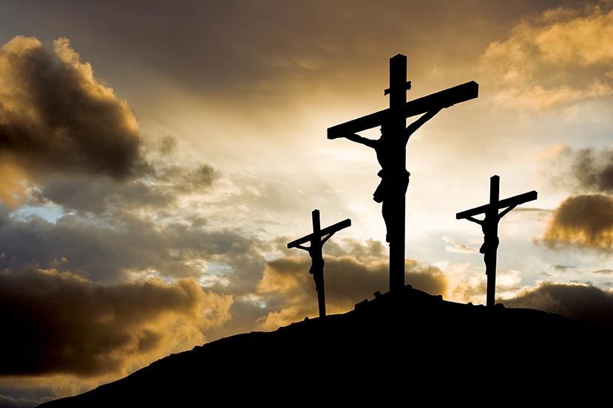
“Jesus’ Passion” (Handbook, Pages 163–164)
Through Jesus’ suffering and death, he freed us from death, which was the result of sin.
During Holy Week and the Easter season, we hear the account of the extreme sufferings of Jesus’ last hours, called the Passion.
Jesus’ Passion teaches us to avoid sin, to bear our sufferings with patience, and to have compassion for others who suffer.
© welburnstuart/Shutterstock.com

Slide 6
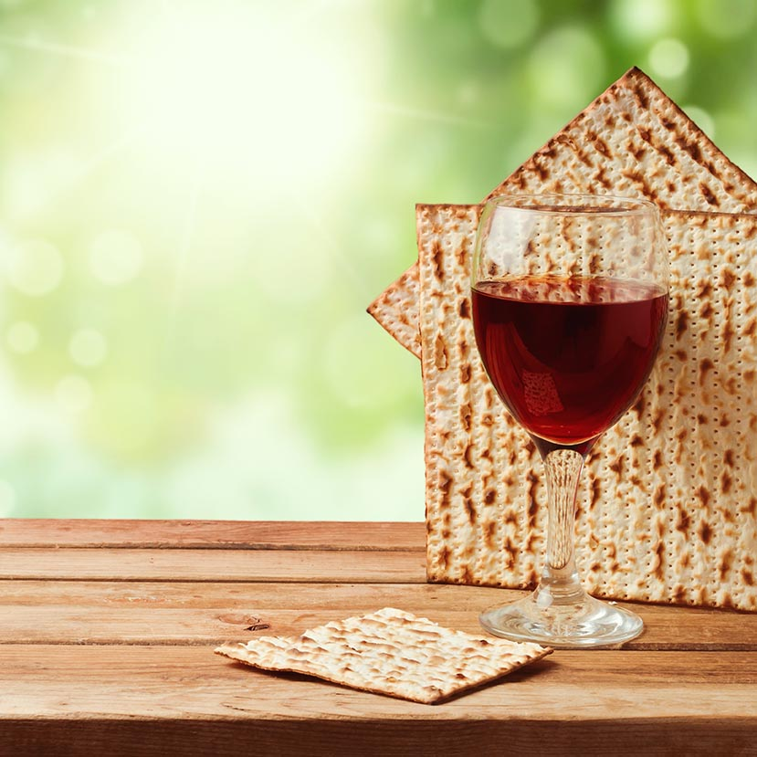
Journal It!
Using Luke, chapter 23, create a timeline of Jesus’ final hours before his death.
Compare your timeline with some of your classmates’ timelines. Discuss what it must have been like for Jesus to go through this.
Work in small groups to create timelines from the Passion accounts in the other Gospels: Matthew, chapter 27; Mark, chapter 15; and John 18:28–19:37, as assigned by your teacher. How do these timelines compare to the one you made using Luke’s account?
© Magiara/Shutterstock.com

Slide 7
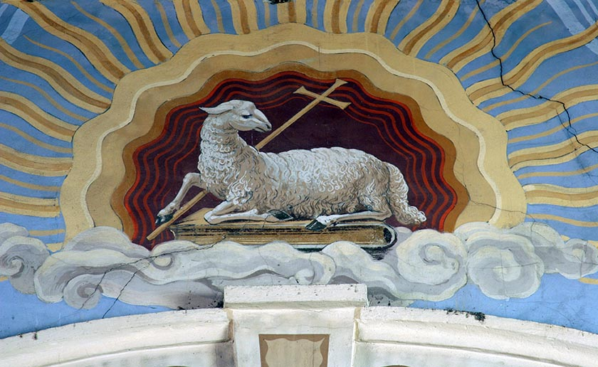
“Images of Jesus’ Suffering and Death” (Handbook, Pages 165–168)
Paschal Lamb
Jesus is called the “Lamb of God” in reference to the sacrificed lamb that saved the Israelites from slavery and death in Egypt.
The Last Supper celebrated by Jesus and his Apostles was the first Eucharist.
© Zvonimir Atletic / Shutterstock.com

Slide 8
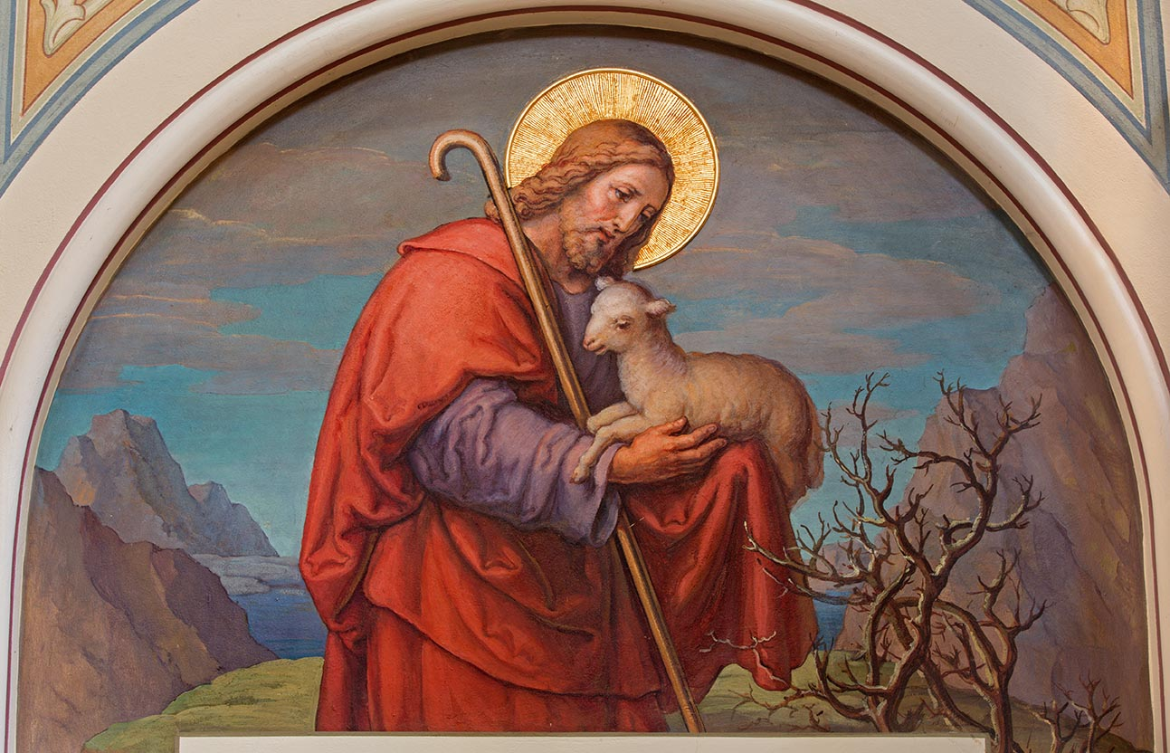
Paschal Lamb
Jesus is both the Good Shepherd and the sacrificial lamb.
The Paschal Mystery is the mystery of how Jesus’ Passion, death, Resurrection, and Ascension save us from sin and death.
© Renata Sedmakova / Shutterstock.com

Slide 9
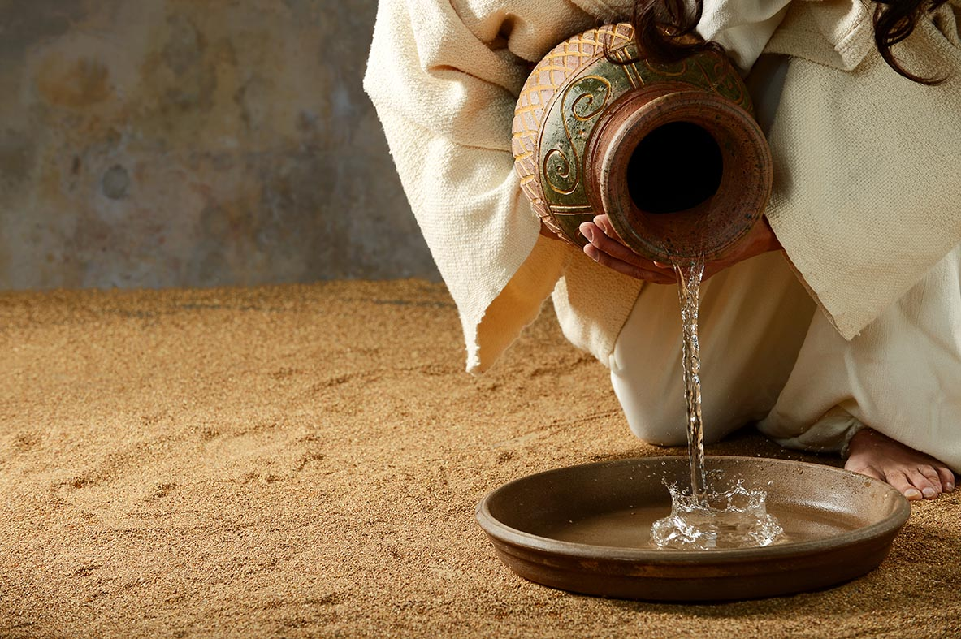
Suffering Servant
Discussion Questions:
In a Christian context, what is a servant?
How would you describe someone who is a servant of others? What are their qualities?
Can anyone think of some examples of people you would name as good servants?
© Carlos E. Santa Maria / Shutterstock.com

Slide 10
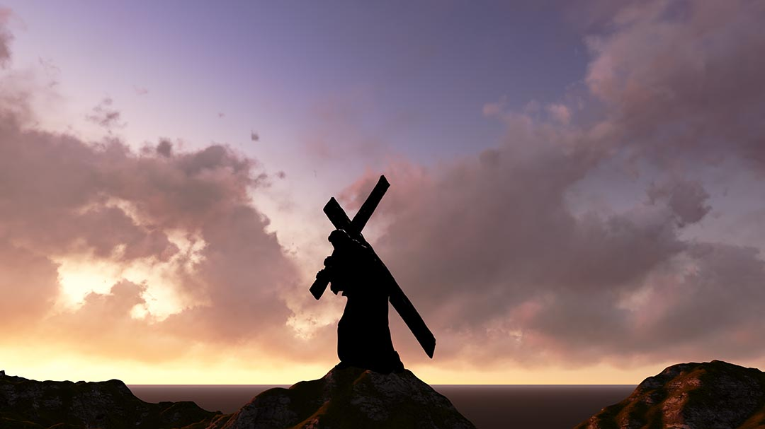
Suffering Servant
The Gospel of Matthew shows Jesus as the Messiah and Suffering Servant predicted in Isaiah.
We know that God can bring about good, even from suffering.
Jesus shows us through his suffering that God understands and feels our pain. Our pain can be offered to God and we can unite our suffering to Jesus.
© jovan vitanovski / Shutterstock.com

Slide 11

Think About It!
Discussion Questions:
What are some common aspects that are usually part of either near-death experiences or the way death is shown on TV and in the movies?
Why do you think that people are so intrigued with what happens after we die?
© photo_journey / Shutterstock.com

Slide 12
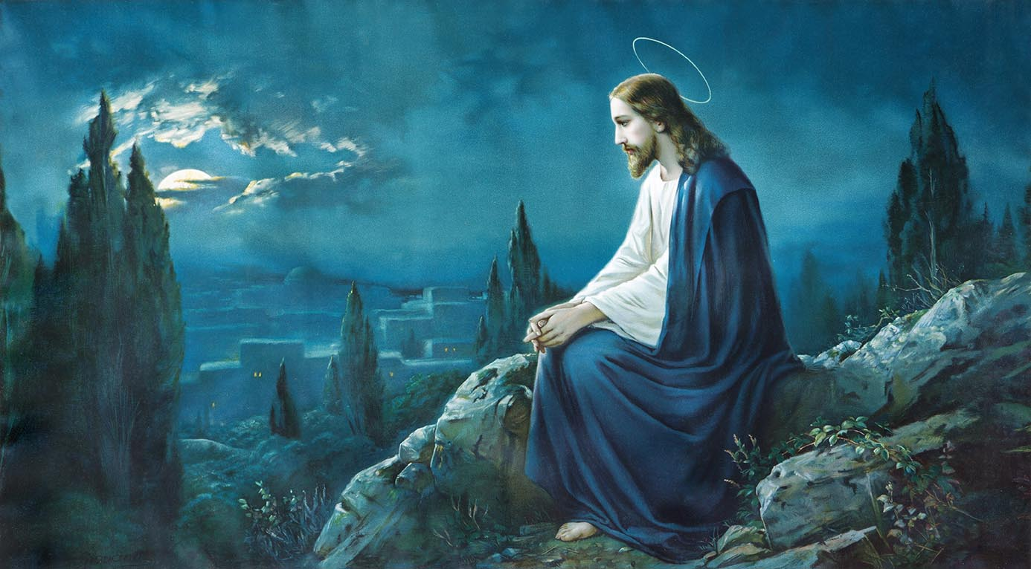
“Jesus Frees Us from Death” (Handbook, Pages 168–170)
Jesus did not have to experience human suffering and death, and prayed in the Garden at Gethsemane that he might avoid it altogether.
Jesus died so we can live forever with God after our earthly lives have ended.
After he died, Jesus descended to Hell to release the souls of the just who had died before him. He led them to Heaven when he rose from the dead.
© Renata Sedmakova / Shutterstock.com

