Slide 1
Revelation in and through Jesus in the Gospel of John
The Living Word: The Revelation of God’s Love, Second Edition
Unit 4, Chapter 14
Document#: TX004692

Slide 2

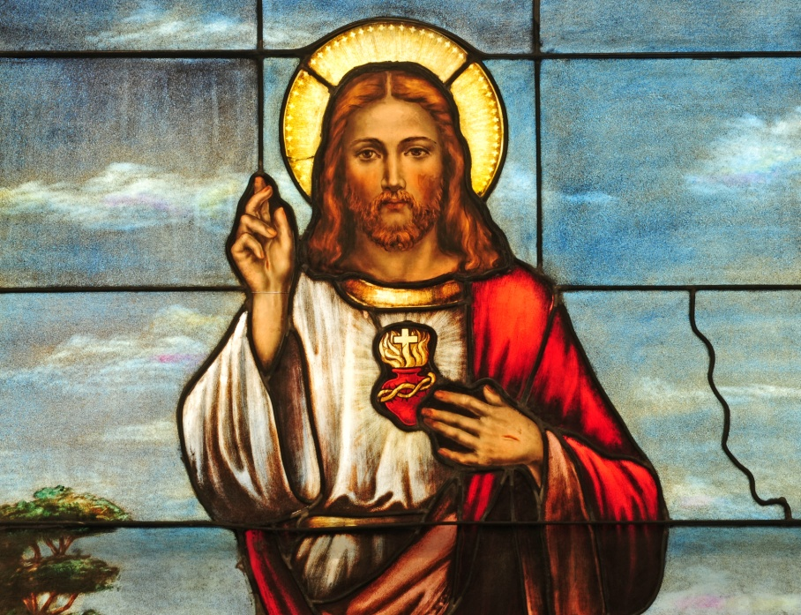
God Incarnate
The Gospel of John is full of symbolic imagery, poetry, and mystery.
It was written between AD 90 and 100 for a community of Gentiles and Jews.
It has two parts: the Book of Signs and the Book of Glory.
© Nancy Bauer / Shutterstock.com
Notes:
Notes: Ask the students to describe the content of the two major sections of John, as in article 66 in the student book.
This slide corresponds to content in article 66, “The Gospel of John: God Incarnate,” in the student book.

Slide 3
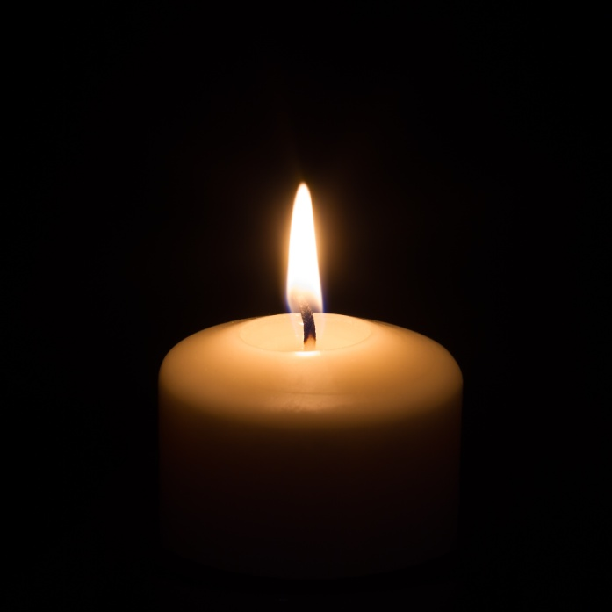
John’s Christology
The Gospel of John stresses the divinity of Jesus.
John describes Jesus as the preexistent Word, incarnate.
Jesus is the Light that overcomes the darkness and gives direction to our lives.
© Sergey Karpov / Shutterstock.com
Notes:
Notes: Ask the students these questions: What words do you associate with light? What words do you associate with darkness?
This slide corresponds to content in article 66, “The Gospel of John: God Incarnate,” in the student book.

Slide 4
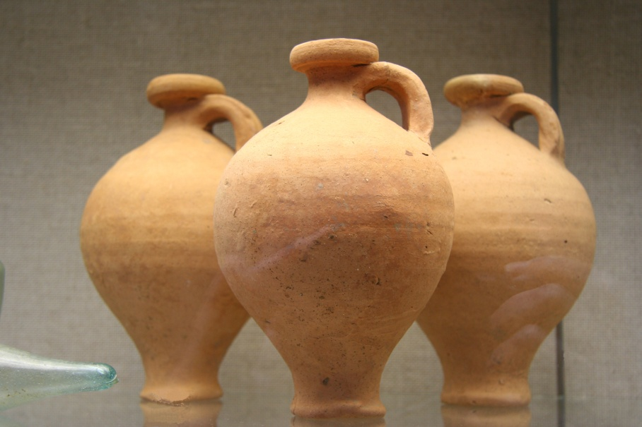
The Seven Signs: The First Four
Jesus changed water into wine at Cana.
Jesus restored the health of an official’s son.
Jesus healed a paralytic.
Jesus multiplied loaves and fish to feed the five thousand.
© riekephotos / Shutterstock.com
Notes:
Notes: Point out to the students that John calls Jesus’ miracles “signs” to convey that these wonders point to a larger truth. Ask for volunteers to read aloud the symbolic meaning of each of the first four signs, as in article 67 in the student book.
This slide corresponds to content in article 67, “Signs and Miracles in John’s Gospel,” in the student book.

Slide 5
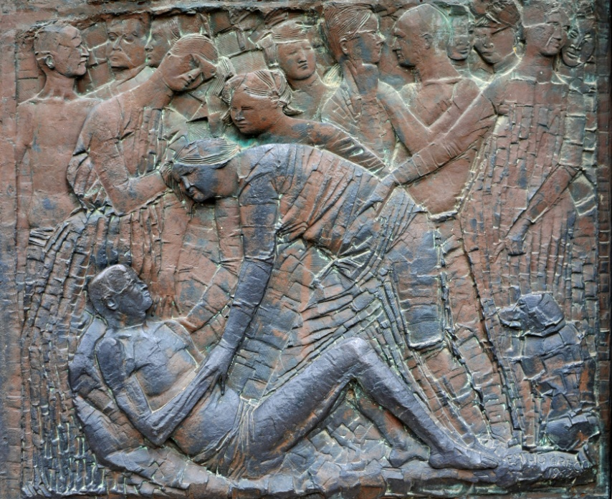
The Seven Signs: The Last Three
Jesus walked on water.
Jesus restored sight to a man born blind.
Jesus raised Lazarus to life.
© Annavee / Shutterstock.com
Notes:
Notes: Call for volunteers to read aloud the symbolic meaning of each of the last three signs, as in article 67 in the student book.
This slide corresponds to content in article 67, “Signs and Miracles in John’s Gospel,” in the student book.

Slide 6
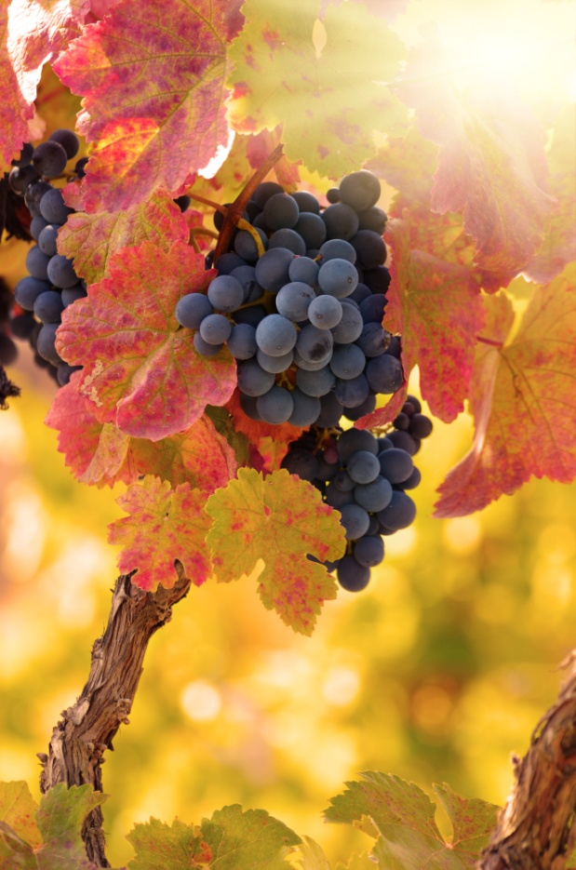
The “I Am” Statements
Jesus declared his identity as Messiah through a series of “I am” sayings.
These sayings ask us to recall God’s revelation of himself to Moses in the burning bush.
They provide us with several ways of understanding Jesus’ mission.
© Dmytro Mykhailov / Shutterstock.com
Notes:
Notes: Refer the students to the list of “I Am” statements in article 68 in the student book. Ask them to choose one of the statements and to think about what it specifically asks us to understand about Jesus Christ.
This slide corresponds to content in article 68, “The ‘I Am’ Statements,” in the student book.

Slide 7
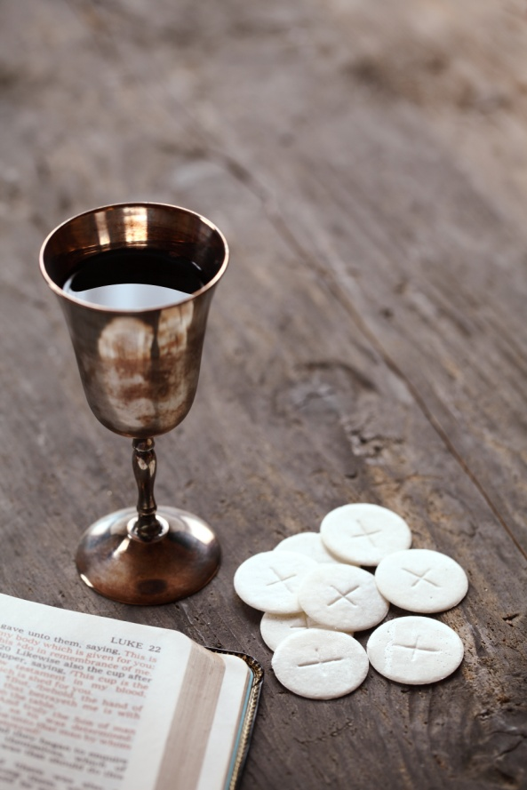
The Discourses in John
A discourse is a long speech.
The discourses in John reveal that Jesus is God: his presence is the presence of God.
To receive Jesus’ words is to receive the Word of God.
© Magdalena Kucova /Dollar Photo Club
Notes:
Notes: Observe for the students that those who did not believe or understand Jesus’ message demanded signs to prove his identity. Ask the students how Jesus’ teachings and signs complement each other, and why both are helpful to believers.
This slide corresponds to content in article 69, “The ‘Bread of Life Discourse’ and the ‘Last Supper Discourse,’” in the student book.

Slide 8
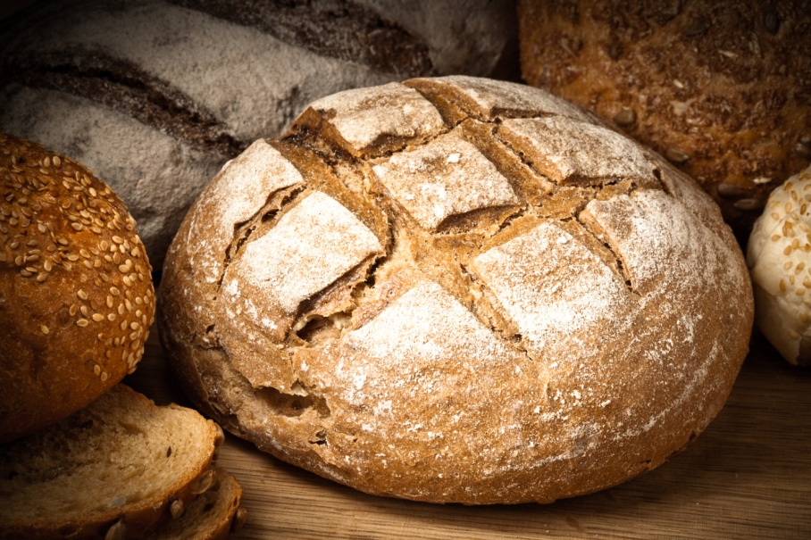
The “Bread of Life Discourse”
Jesus proclaimed himself to be the Bread of Life who satisfies all hunger.
Unlike those ancestors who ate manna in the desert, those who eat the Bread of Jesus will live forever.
© Tim UR / Shutterstock.com
Notes:
Notes: Recount for the students how God fed the Israelites in the desert on their way to the Promised Land (see Exodus, chapter 16). Note how this Bread of Life image reaches back into history and also forward into our own worship when we receive nourishment from Christ’s Body and Word.
This slide corresponds to content in article 69, “The ‘Bread of Life Discourse’ and the ‘Last Supper Discourse,’” in the student book.

Slide 9
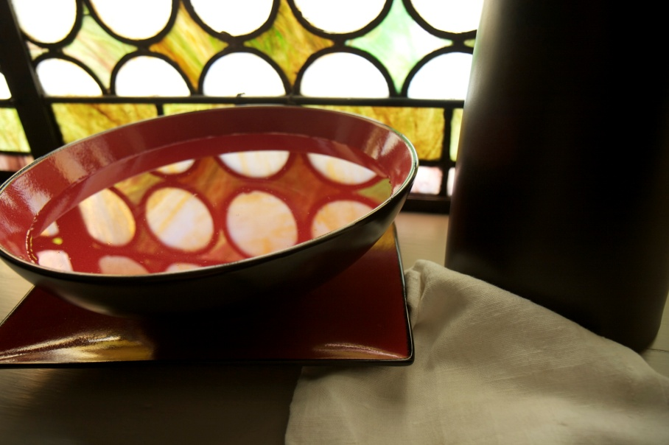
The “Last Supper Discourse”
Jesus gave himself in the breaking of bread and the washing of feet.
He directed us to give our lives in service to others, as he did.
He promised the disciples would receive the gift of the Holy Spirit.
© sterlsev / iStockphoto.com
Notes:
Notes: Read John 13:34–35 to the students. This is the passage from the Last Supper Discourse where Jesus delivers the new commandment of love.
This slide corresponds to content in article 69, “The ‘Bread of Life Discourse’ and the ‘Last Supper Discourse,’” in the student book.

Slide 10
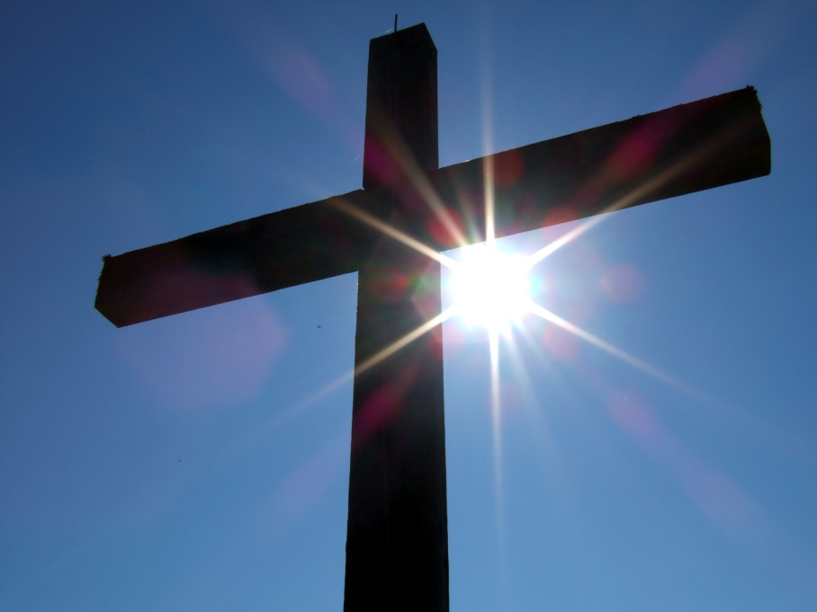
Passion, Death, and Resurrection
The climax of John’s Gospel is Jesus’ willingness to lay down his life for the salvation of all.
The Gospel of John focuses on the glory, not the tragedy, of the Paschal Mystery.
© sandramo / iStockphoto.com
Notes:
Notes: Explain to the students that John portrays every moment, from Jesus’ betrayal to his Resurrection, as God’s glorious power at work in Jesus, even when the forces of evil seemed to be winning.
This slide corresponds to content in article 70, “Jesus’ Passion, Death, and Resurrection,” in the student book.

Slide 11
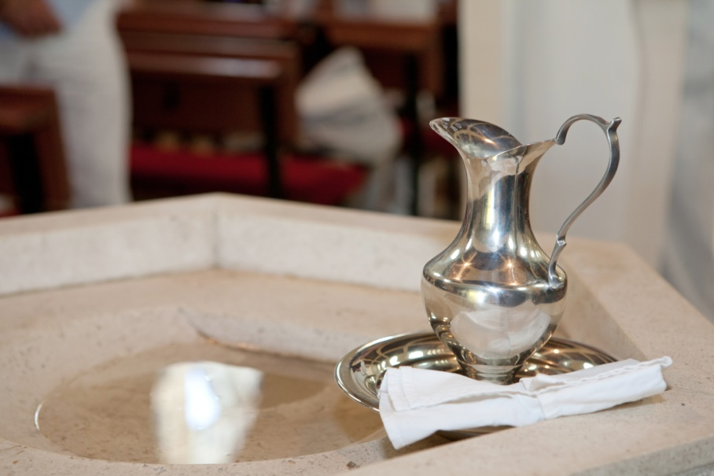
Imminent Glory
The details of Jesus’ Passion, Death, and Resurrection in the Gospel of John differ from their parallels in the synoptic Gospels.
The Gospel of John emphasizes Jesus’ divinity in the details of these events.
© Gordana Sermek / Dollar Photo Club
Notes:
Notes: You may wish to have the students read the details of Jesus’ Passion, Death, and Resurrection in the Gospel of John and compare them to the synoptic Gospel accounts.
This slide corresponds to content in article 70, “Jesus’ Passion, Death, and Resurrection,” in the student book.

Slide 12
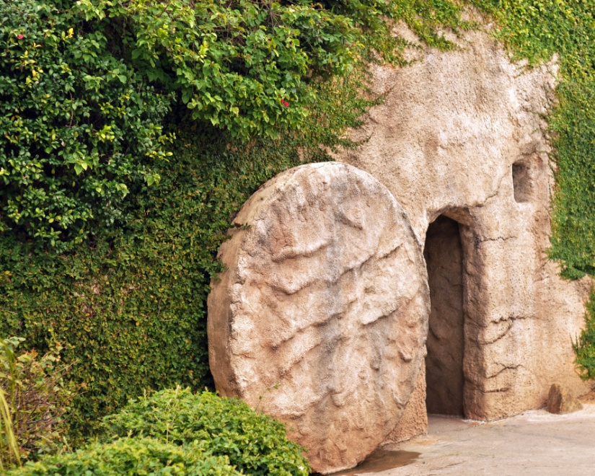
Triumphant Glory
Peter and the Beloved Disciple found the tomb empty and believed.
Mary Magdalene did not believe until she encountered the Risen Christ.
The disciples recognized the Risen Christ by his wounds.
Thomas touched Jesus’ wounds and believed.
© glenda / Shutterstock.com
Notes:
Notes: Invite the students to imagine that Jesus appeared to believers today. Ask them this question: How would you expect believers’ responses today to be like and different from that of the Apostles?
This slide corresponds to content in article 70, “Jesus’ Passion, Death, and Resurrection,” in the student book.

