Slide 1
Key Concepts of Church
The Church Course
Document # TX001507

Slide 2
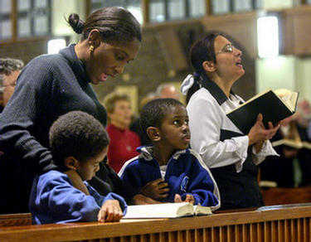
Meanings of Church
The word Church has
three meanings in
Christian usage:
the entire community
of God’s People
around the world
the local community,
which is a diocese or archdiocese
the community assembled for liturgy, especially for the Mass
© wpwittman
Notes:
(Notes: You can ask the students what the three meanings are before you click to reveal the bulleted items. Be aware, however, that they will want to answer in terms of a building. Emphasize that Church with a capital C refers to the faith community, not to the building.)

Slide 3
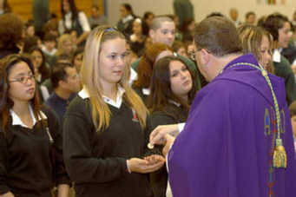
All Three Are Church
It is impossible to separate these three meanings from one another.
The Church is all the people whom God gathers in the world, but she exists concretely in local communities and is made real in the assembly that gathers for liturgy, especially to celebrate the Eucharist.
© wpwittman

Slide 4
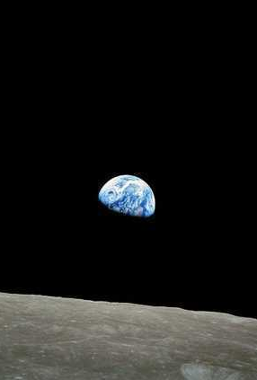
Church as Mystery
“The Church is in history, but at the same time she transcends it. It is only ‘with the eyes of faith’¹ that one can see her in her visible reality and at the same time in her spiritual reality as bearer of divine life.” (Catechism of the Catholic Church [CCC], 770)
1. Roman Catechism I, 10, 20.
Image in public domain

Slide 5
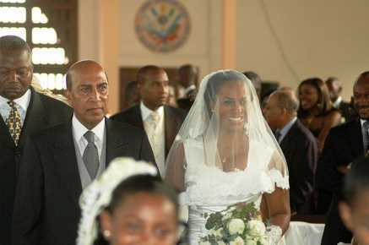
Mystical Union
Saint Paul calls the nuptial union of Christ and his Bride, the Church, “a great mystery.”
Because she is united to Christ as her Bridegroom, the Church becomes, in her turn, a mystery.
Holiness is measured
according to the “great
mystery” in which the
Bride responds to the
gift of the Bridegroom.
Image in public domain
Notes:
(Notes: This is a difficult concept for most students—the idea that the Church is Christ’s Bride. Explain that the image illustrates Christ’s love for the Church, for the People of God who make up this Church, and his never-ending care for the Church and his People. As a man loves his wife, so Christ loves his Church.)

Slide 6
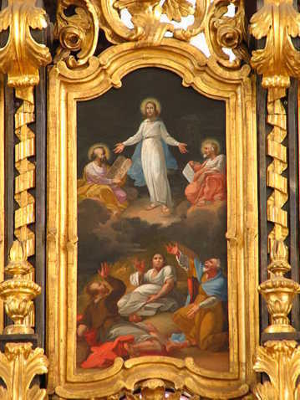
Planned from the Beginning
God the Father planned the
Church from the beginning.
Calling together human
beings is central to the
Father’s plan of salvation,
as he wishes to gather us
as his own People in order
to save us.
Through salvation, we will
dwell with him in Heaven.
Image in public domain
Notes:
(Notes: Emphasize that the Trinity, God and Christ and the Holy Spirit, existed from the beginning of time. Together they planned and created the earth and all upon it. Knowing all things, they knew from the beginning that they would need the Church as the gate to Heaven.)

Slide 7
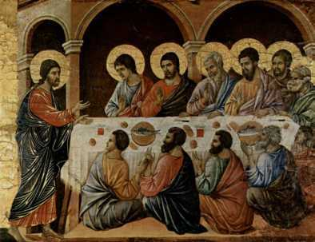
Founded by Christ
The Church is not ours, but the Lord’s, founded by Christ when he proclaimed and ushered in the Kingdom of God.
The Church of the Lord is a place of the presence of the mystery of God and the Lord resurrected in the world.
Image in public domain

Slide 8
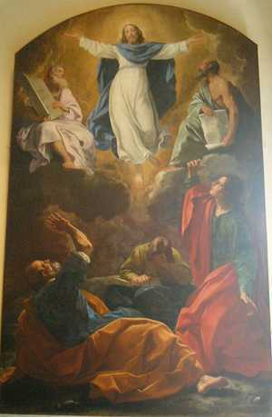
Kingdom of God Is at Hand
“This is the time of fulfillment. The kingdom of God is at hand” (Mark 1:15).
With these words, Christ inaugurated the Church on earth.
Image in public domain

Slide 9
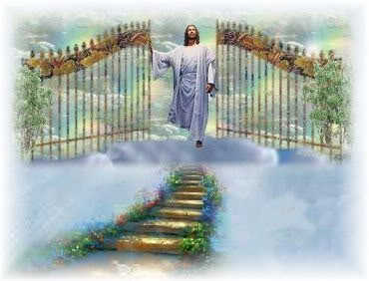
Mystery at the Heart
Vatican II put the reality of the “mystery” at the center and heart of Catholic doctrine, exploring the “divine plan” of salvation.
This plan was proposed and contemplated for the Church from all eternity and destined to be fulfilled historically and visibly in Christ Jesus.
© coolchaser.com
Notes:
(Notes: Stress to the students that prior to Christ’s sacrifice, the gates of Heaven were closed to mankind.)

Slide 10
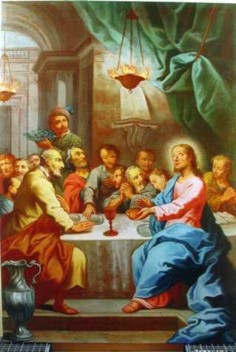
Christ’s Body
Christ’s light shines on the Church’s countenance.
Jesus established the Church primarily by the saving gift of himself.
This gift, which was fulfilled on the cross, was anticipated when Jesus instituted the Eucharist: “This is my body. . . .”
Image in public domain
Notes:
(Notes: Emphasize to the students that Christ’s words are not to be taken merely as symbol, but as reality: “This is my body, . . . this is my blood” (Matthew 26:26–28).

Slide 11
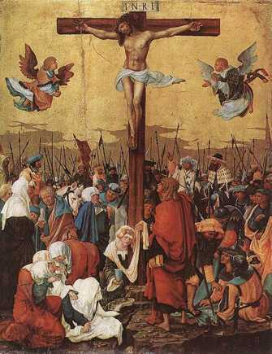
Made Holy
Christ gave his life, dying on the cross, to make his Church holy, sanctified by his blood.
Image in public domain

Slide 12
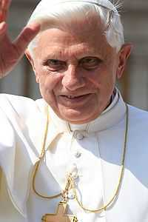
Mystery of Divine Origin
Cardinal Joseph Ratzinger (now Pope Emeritus Benedict XVI) emphasized the mystery of the Church: “The Church is not just a human institution; because of its divine origin, it is, above all, a ‘mystery.’”
Image in public domain
Notes:
(Notes: From an article in the Zenit Daily Dispatch)

Slide 13
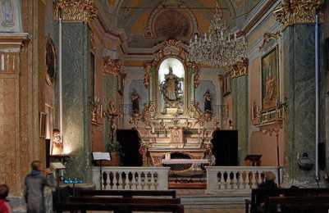
Church as Human and Divine
The Church is both visible and invisible (spiritual), a hierarchical society, and the Mystical Body of Christ.
She is one, yet formed of two components, human and divine.
That is her mystery, which only faith can accept.
Image in public domain
Notes:
(Notes: See CCC, 771)

Slide 14
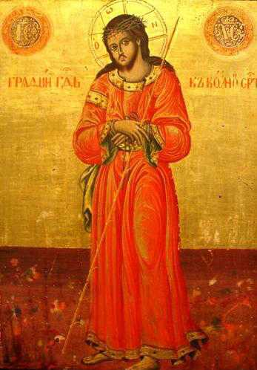
Both Human and Divine
At the time appointed by God, Jesus Christ, the Eternal Word of the Father, became man and lived among us on earth.
He took on a human nature without losing his divine nature.
The mystery of the union of the human and divine natures in one Divine Person is echoed in the nature of the Church.
Image in public domain

Slide 15
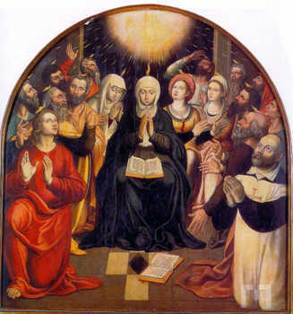
Holy Spirit Animates
The Holy Spirit animates or gives life to the Church.
Prior to his Ascension, Jesus
told his disciples, “You will
receive power when the holy
Spirit comes upon you” (Acts
of the Apostles 1:8).
Image in public domain

Slide 16
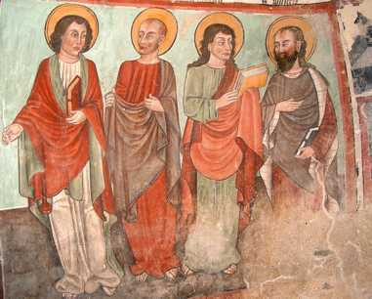
Mission of the Church
The mission of the
Apostles in the early
Church began with their
time with Jesus.
Jesus proclaimed the
Good News and healed
people and sent the Apostles
out to do the same.
What is the Good News?
Image in public domain
Notes:
(Notes: This would be a good time to have a brief, pointed discussion about exactly what the Good News is.)

Slide 17
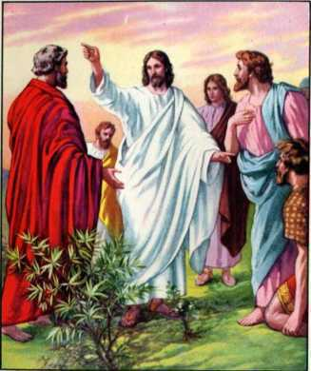
Make Disciples
Jesus provided the Apostles with a significant duty when he commanded them to go and make disciples of all nations.
With that command in mind,
they set out to spread the
Good News throughout the
world.
Image in public domain
Notes:
(Notes: Emphasize the size of Israel at the time of Christ, how tiny and seemingly insignificant it was in contrast to the rest of the world. Yet, from that tiny speck of desert land, Christ’s message has spread to the ends of the earth.)

Slide 18
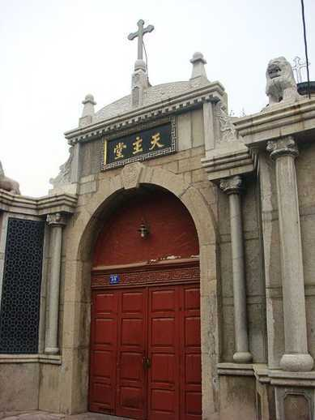
A Global Church
Today the Good News is preached in almost every nation on earth.
The Apostles are no longer with us, but through our Baptism, we have each been entrusted with the same mission: to spread the Good News of salvation through Jesus Christ.
Image in public domain

Slide 19
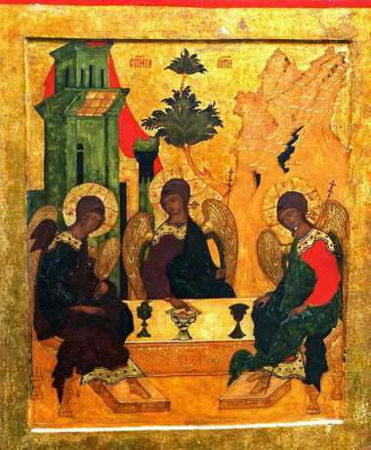
Father, Son, and Holy Spirit
The work of the Church is the work of the three Divine Persons in the Trinity: the Father, the Son, and the Holy Spirit.
According to the Father’s eternal plan, the Church continues the mission of the Son and the Holy Spirit.
Image in public domain

Slide 20
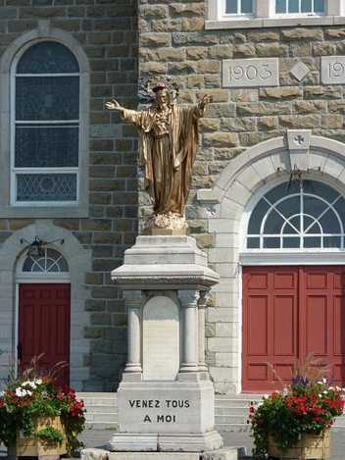
Visible and Spiritual
The Church is both visible and spiritual. The visible elements (hierarchical structure and the People of God) lead to the spiritual (Christ and God).
The Sacraments lead to grace.
The Church leads to salvation.
Image in public domain

Slide 21
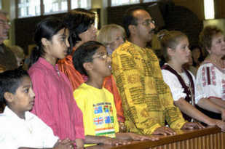
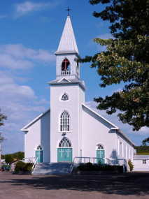
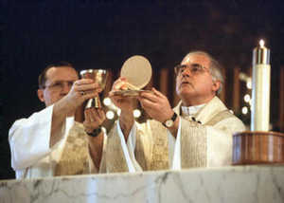
Visible Church
The visible Church consists of the People of God, the physical structures of the Church, and the liturgies and the Sacraments.
What other visible elements of the Church can you think of?
© wpwittman
© wpwittman
Image in public domain

Slide 22
Seeing Is Believing
If you can’t see it, it can’t be real. Do you agree or disagree?
What are some examples of things that are invisible yet real?
Notes:
(Notes: Examples include wind, air, gravity, time, aging, surface tension, the blooming of a flower.)

Slide 23
Invisible Church
What elements of the Church are invisible?
Notes:
(Notes: Examples include faith, grace, forgiveness, holiness, the Holy Spirit, God the Father, Transubstantiation.)

