Slide 1
What Is the Incarnation?
Document # TX004830
Notes:
Resources used for this PowerPoint presentation include Saint Mary’s Press® Glossary of Theological Terms, T. S. Eliot’s “Dry Salvages in the Four Quartets,” and the Catechism of the Catholic Church.

Slide 2
In the beginning was the Word,
and the Word was with God,
and the Word was God.
(John 1:1)

Slide 3
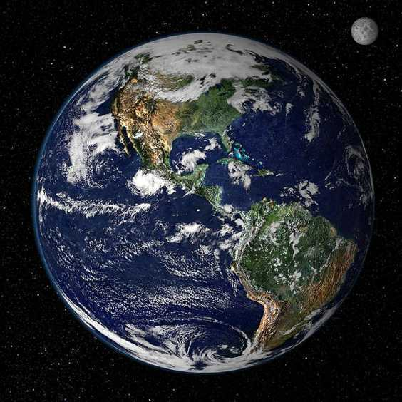
Public domain

Slide 4
And the Word became flesh
and made his dwelling among us.
(John 1:14)

Slide 5
What Is the Incarnation?
The Word became flesh.
That is Incarnation.
The word incarnation comes from the Latin in, meaning “in,” and caro, meaning “flesh.”
Incarnation refers to the central Christian belief that the Son of God assumed human nature and, as stated in the Gospel of John, “became flesh / and made his dwelling among us” (1:14).

Slide 6
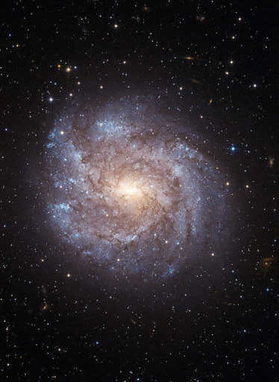
The Incarnation
A mystery.
The divine and the human come together in Jesus Christ.
T. S. Eliot called the Incarnation “the intersection of the timeless with time.”
God is inviting us into relationship.
Public domain
Notes:
Ask the students how they understand mystery and why the Incarnation is a mystery. After the T. S. Eliot quote, allow a few moments for reflection and discussion on what this means.

Slide 7
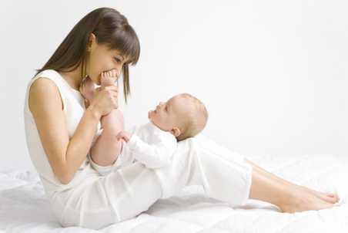
What Is the Incarnation?
All this took place to fulfill what the Lord had said through the prophet:
“Behold, the virgin shall be with child and bear a son,
and they shall name him Emmanuel … ”
(Matthew 1:22–23)
© shutterstock / Tomasz Trojanowski

Slide 8
What Is the Incarnation?
Emmanuel is a Hebrew word that means “God with us.”
עִמָּנוּ ‏אֵל
Notes:
The image on this slide is the Hebrew spelling of “Emmanuel.”

Slide 9
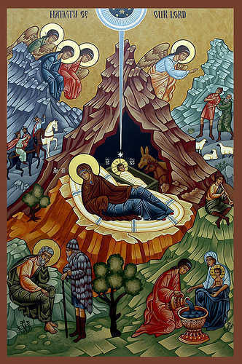
What Is the Incarnation?
We celebrate this great mystery of the Incarnation at Christmas.
Public domain
Notes:
You can insert two or three additional slides here, depending on the needs of your class. Include artwork depicting the Nativity, with a focus on works from various cultures, historic eras, and so on, that show the universal message that is the Incarnation. If you add slides for your class, lead the students in a brief discussion of what they observe.

Slide 10
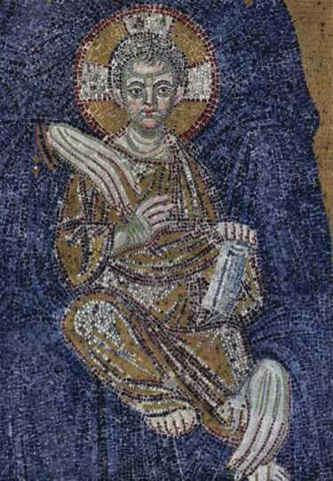
What Is the Incarnation?
Why did God (the Word, the Son) become a human person?
So that we can know God.
So that we can know how to live.
So that we can know God’s great love for us.
Public domain

Slide 11
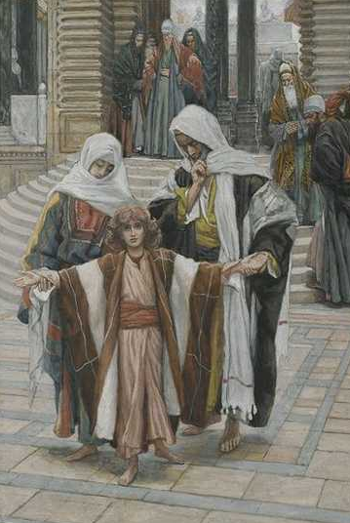
What Is the Incarnation?
Jesus, a person who lived in history, . . .
showed us how to be human.
reconciled us with God.
overcame sin and death.
Public domain

Slide 12
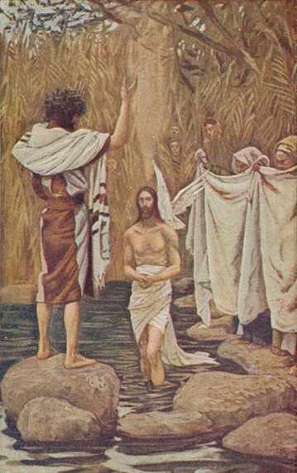
What Is the Incarnation?
Jesus said, . . .
“I am the way and the truth and the life. No one comes
to the Father except
through me.” (John 14:6)
Public domain

Slide 13
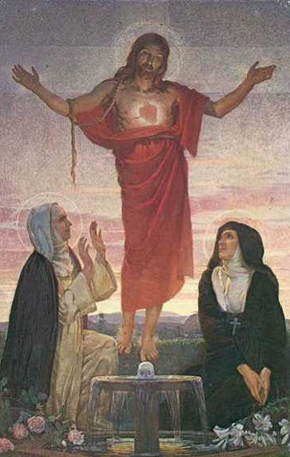
What Is the Incarnation?
“Taking up St. John’s expression ‘The Word became flesh,’¹ the Church calls ‘Incarnation’ the fact that the Son of God assumed a human nature in order to accomplish our salvation in it” (Catechism of the Catholic Church, 461).
Public domain

Slide 14
Acknowledgments
The Scripture quotations in this PowerPoint are taken from the New American Bible, revised edition © 2010, 1991, 1986, 1970 Confraternity of Christian Doctrine, Inc., Washington, DC. All Rights Reserved. No part of this work may be reproduced or transmitted in any form or by any means, electronic or mechanical, including photocopying, recording, or by any information storage and retrieval system, without permission in writing from the copyright owner.
The quotation on slide 13 is from the English translation of the Catechism of the Catholic Church for use in the United States of America, second edition (CCC), number 461. Copyright © 1994 by the United States Catholic Conference, Inc.—Libreria Editrice Vaticana (LEV). English translation of the Catechism of the Catholic Church: Modifications from the Editio Typica copyright © 1997 by the United States Catholic Conference, Inc.—LEV.
Endnote cited in a Quotation from the Catechism of the Catholic Church, Second Edition
1. John 1:14.

