Slide 1
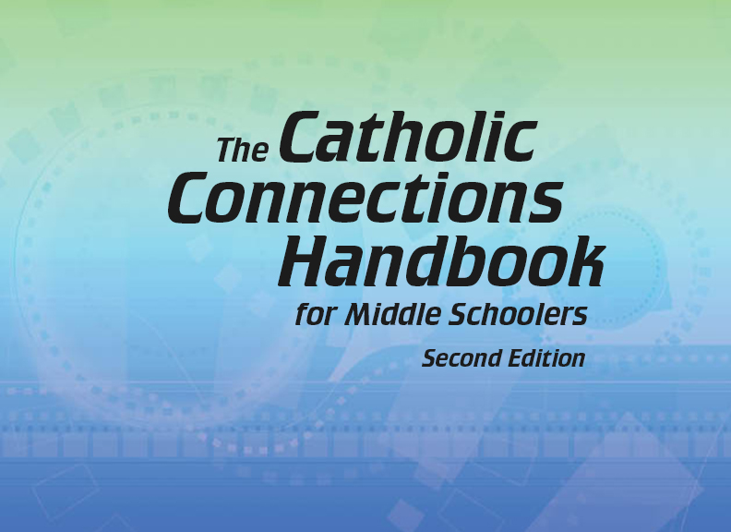


Slide 2
Christian Morality
and Social Justice
Chapter 42
Respecting Life

Slide 3
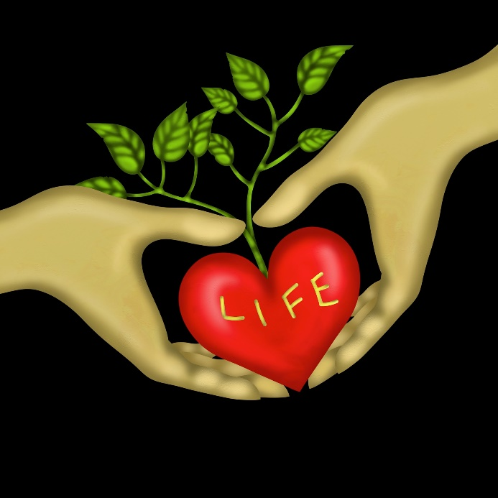
Chapter Summary
Respecting Life
The first half of chapter 42 in the Handbook will lead you to affirm God’s gift of life while considering the topics of abortion, legitimate defense, and domestic violence and abuse. The second half of chapter 42 in the Handbook will continue the “Respecting Life” theme with topics related to the Fifth Commandment and human dignity. Through these lessons, you will be helped to make positive, life-affirming choices now and in years to come.
© goccedicolore.it/www.shutterstock.com

Slide 4

Introduction
(Handbook, pages 458–460)
Life is sacred from the moment of conception.
© hidesy/www.istockphoto.com

Slide 5
Introduction
(Handbook, pages 458–460)
All human life is sacred.
Abortion intentionally ends the life of an unborn child.
Unborn babies have the right to the same protection and care that all humans deserve.

Slide 6
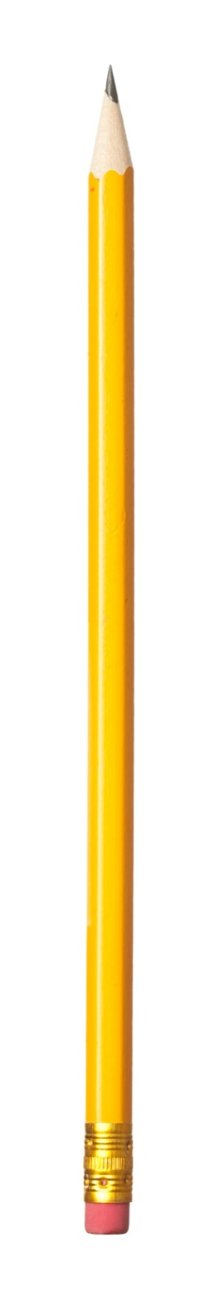
Introduction
(Handbook, pages 458–460)
Journal It!
© RuslanDashinsky/www.istockphoto.com
How does this Scripture passage promote respecting life?
“Then God said, ‘And now we will make human beings; they will be like us and resemble us.’” (Genesis 1:26)

Slide 7
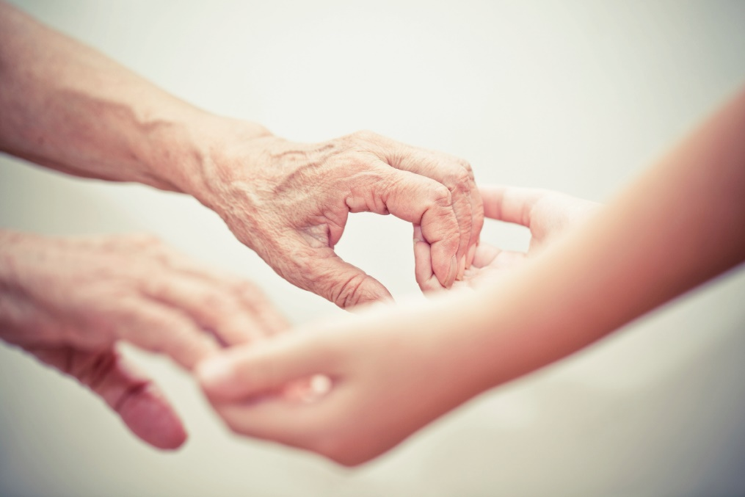
“From Womb to Tomb”
(Handbook, pages 460–462)
All life has dignity and should be protected.
© fzant/www.istockphoto.com

Slide 8
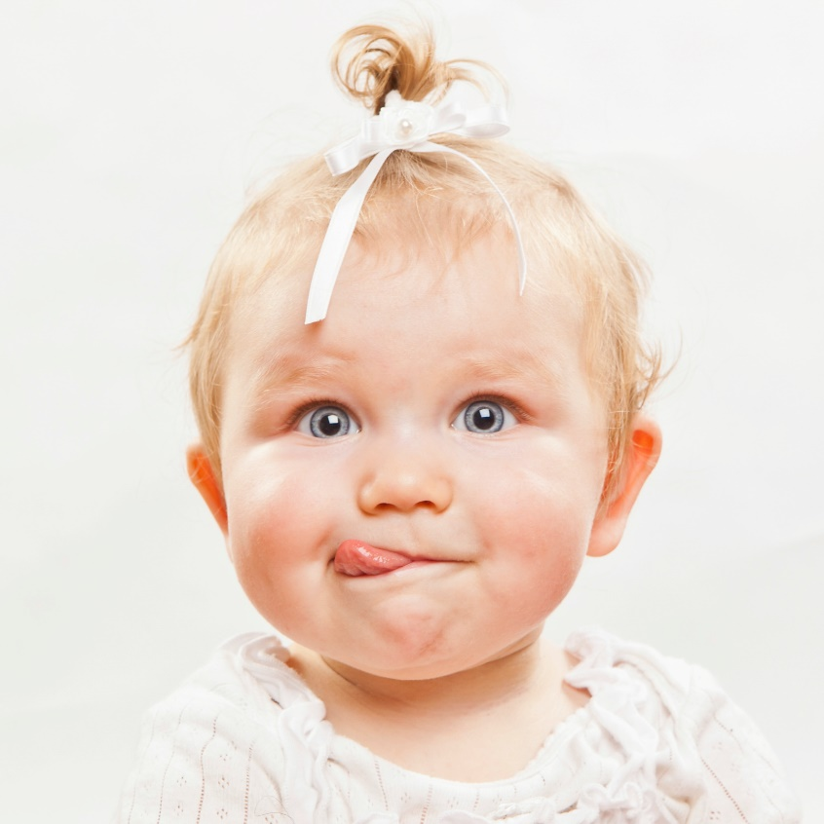
“From Womb to Tomb”
(Handbook, pages 460–462)
© tommasolizzul/www.istockphoto.com
What do we love about babies?

Slide 9


“From Womb to Tomb”
(Handbook, pages 460–462)
© shapecharge/www.istockphoto.com
© RapidEye/www.istockphoto.com
What do we love and respect
about teens and preteens?

Slide 10

“From Womb to Tomb”
(Handbook, pages 460–462)
© GlobalStock/www.istockphoto.com
What do we love and respect about adults?

Slide 11

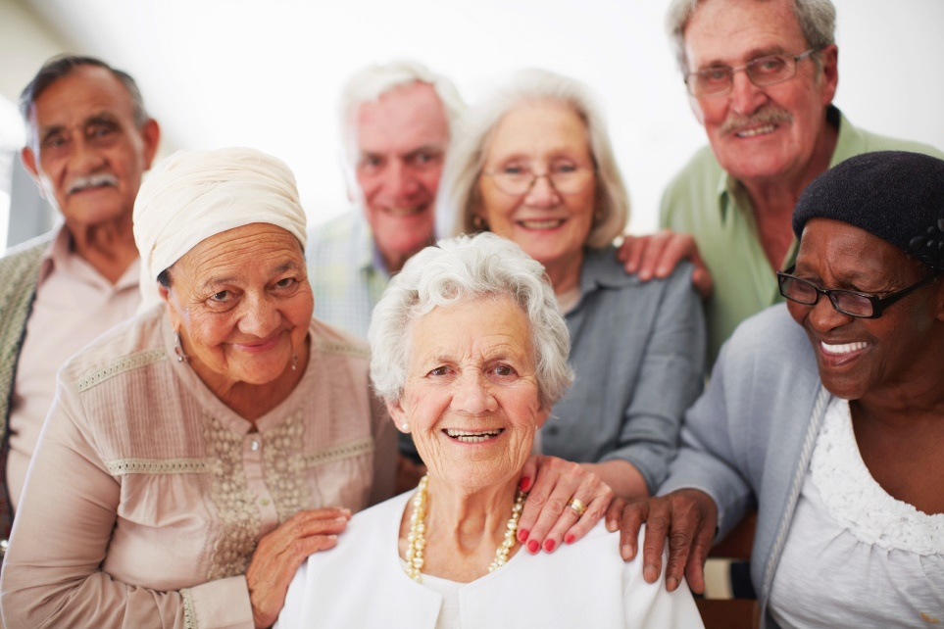
“From Womb to Tomb”
(Handbook, pages 460–462)
© Cpaulussen/www.istockphoto.com
© Squaredpixels/www.istockphoto.com
What do we love and respect about older adults,
senior citizens, and the very old?

Slide 12

“From Womb to Tomb”
(Handbook, pages 460–462)
God made all of these people who are at different stages of life. We love and respect all of them!
© Tigatelu/www.istockphoto.com

Slide 13
“From Womb to Tomb”
(Handbook, pages 460–462)
Every human life is sacred from the moment of conception.
All life has dignity and should be protected, no matter what the stage of life. We should give special consideration to people with disabilities, as their needs require.

Slide 14
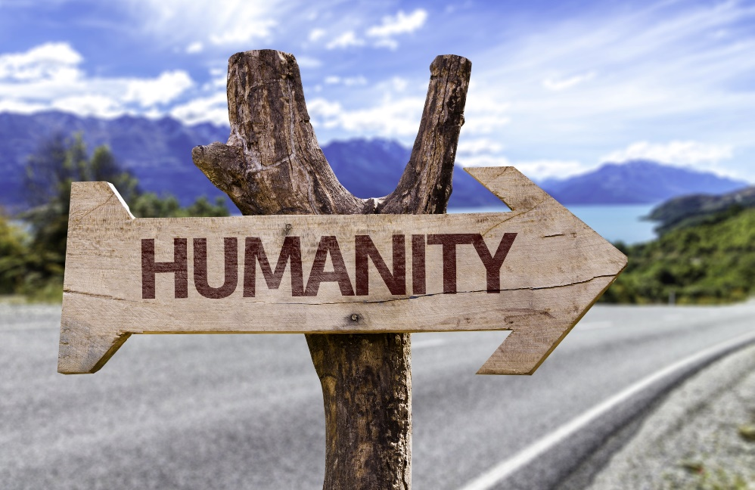
“From Womb to Tomb”
(Handbook, pages 460–462)
Domestic violence and abuse are serious situations and sins against human dignity.
© GustavoFrazao/www.shutterstock.com

Slide 15
“From Womb to Tomb”
(Handbook, pages 460–462)
The dignity of early life is portrayed in the Bible.
All life, from conception to natural death, is sacred.
Violence is not okay. It is not okay in marriage or family life. It is not okay between men and women. It is not okay between teens who are dating. It is not okay to abuse children in any way.

Slide 16
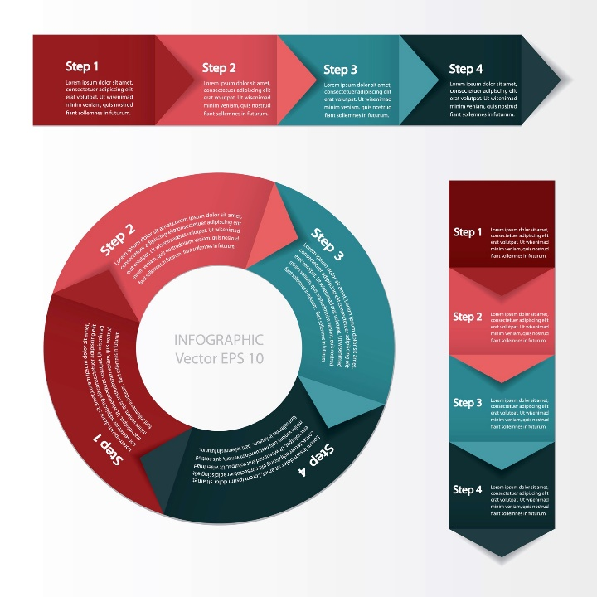
“From Womb to Tomb”
(Handbook, pages 460–462)
Activity: Create a flowchart that depicts why abuse and domestic violence are against human dignity.
© CuteLittleThings/www.shutterstock.com

Slide 17

“From Womb to Tomb”
(Handbook, pages 460–462)
We must counter the violence
in our society with proactive peace.
© iQoncept/www.shutterstock.com

Slide 18
“From Womb to Tomb”
(Handbook, pages 460–462)
Extreme violence begins with simple steps.
The violence we see and hear on television, in video games, or in music can erode our respect for life.
We can counter the violence in our society by being proactive toward peace.

Slide 19

“From Womb to Tomb”
(Handbook, pages 460–462)
Activity: “Countering Violence with Peace”
1. Your teacher will arrange the class into pairs.
2. Each pair will be assigned to read a passage from the New Testament:
Matthew 5:21–24, Matthew 5:38–42, Matthew 5:43–48, or Romans 12:19–21.
3. Record what your passage says about dealing with violence or coercion.
4. Then brainstorm (as a class) ways you can counter violence and coercion in your community.
© iQoncept/www.shutterstock.com

Slide 20
Acknowledgments
The scriptural references and quotations in this presentation are from the
Good News Translation® (Today’s English Version, Second Edition). Copyright © 1992 by the American Bible Society. All rights reserved. Bible text from the Good News Translation (GNT) is not to be reproduced in copies or otherwise by any means except as permitted in writing by the American Bible Society, 1865 Broadway, New York, NY 10023 (www.americanbible.org).
During this presentation’s preparation, all citations, facts, figures, names, addresses, telephone numbers, Internet URLs, and other pieces of information cited within were verified for accuracy. The authors and Saint Mary’s Press staff have made every attempt to reference current and valid sources, but we cannot guarantee the content of any source, and we are not responsible for any changes that may have occurred since our verification. If you find an error in,
or have a question or concern about, any of the information or sources listed within, please contact Saint Mary’s Press.

