Slide 1
Creating a Just Society: Awareness of Sin, Structures of Sin, Circle of Social Action, and Media Literacy
Catholic Social Teaching
Document #: TX001980
Notes:
[Music: Introduction music with the song “Everybody Hurts,” “Lean On Me,” or another appropriate song indicating suffering, sadness, or togetherness.]

Slide 2
As we continue to explore social justice, we need to examine sin and its presence in the world.
Personal sin is defined as an act that is . . .
an offense against God
a rejection of God’s love
a failure to respect a person’s God-given rights
neglecting our God-given responsibilities
a deliberate action
a wound to human nature
Mortal sin is a grave offense against God and results in a total separation from God.

Slide 3
The morality of a human act is determined by answering the following questions about it:
What is the object the person is choosing?
What is the intention of the person doing the action?
What are the circumstances surrounding the action?

Slide 4

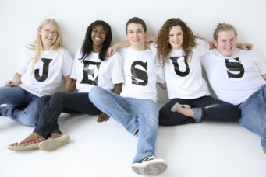
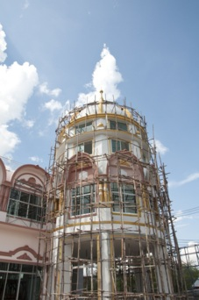
Sin has three dimensions:
personal
social
Image in shutterstock
structural
Image in shutterstock
Image in shutterstock

Slide 5
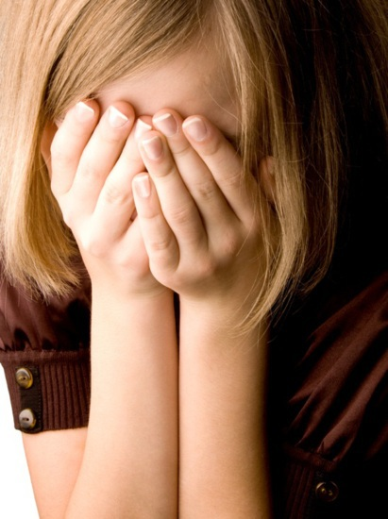
The Personal Dimension of Sin
The personal dimension of sin . . .
harms our relationship with God
harms our relationship with others
Image in shutterstock

Slide 6
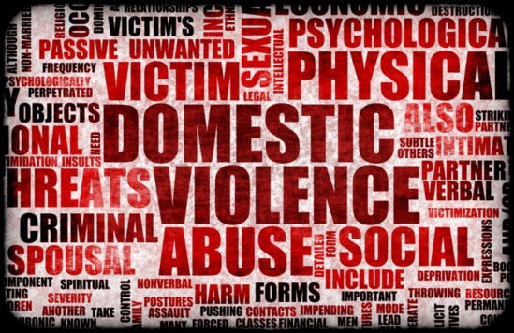
The Social Dimension of Sin
The social dimension of sin affects society and the world through . . .
hurting people through attacks on life, freedom, dignity, or human rights
hurting God’s creation through practices that harm the land and God’s creatures
Image in shutterstock

Slide 7
stems from personal sin
results from collective choices of many and is sustained by selfishness
The Structural Dimension of Sin
becomes a barrier to the common good
affects patterns of relationships

Slide 8
How can we respond to pain and suffering in the world caused by personal and social sin?
Become aware.
Analyze the causes.
Take action.
Provide direct aid.
Correct social structures that cause injustice.
Image in shutterstock

Slide 9
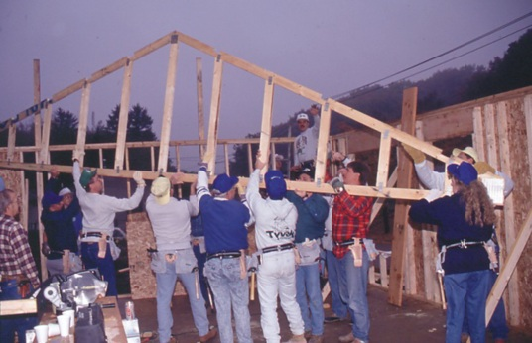
WikiMwdiaCommons
This is the Circle of Social Action. It calls us to . . .
be aware of social needs and injustices
analyze appropriate responses to the needs and injustices in the world
act to help meet the needs of others and correct injustices

Slide 10
“It is too easy to throw back on others responsibility for injustices, if at the same time one does not realize how each one shares in it personally, and how personal conversion is needed first.”
(Pope Paul VI, Octogesima Adveniens, 1971)

Slide 11
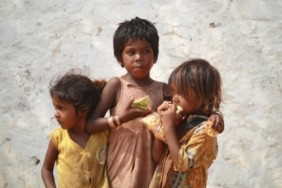
Image in shutterstock
The Circle of Social Action: Be Aware
The first step in the Circle of Social Action calls us to awareness.
What are complex social injustices?
poverty
hunger
homelessness
other

Slide 12
Image in shutterstock
The Circle of Social Action: Analyze the Situation
The second step in the Circle of Social Action is to carefully examine the issue. Ask these questions:
What are the causes of suffering or injustice?
What social structures support injustice?
How do I support these social structures?

Slide 13
Image in shutterstock
The Circle of Social Action: Act
The third step in the Circle of Social Action challenges us to respond. Consider the following:
How can I bring God’s love and justice to those who are suffering?
What personal action can I take?
What long-term action can bring about change in social structures?

Slide 14
Image in shutterstock
My Personal Discernment
Reflecting on these questions can help you to engage in the Circle of Social Justice:
Am I aware of social injustices?
Do I pray to God to help me understand my personal response to injustice?
How willing am I to sacrifice my own comfort to help others in need?
What actions can I take to help eliminate the source of an injustice or need?

Slide 15
Homeless
Hungry
Dead
Naked
Thirsty
Sick
Imprisoned
We need social action to bring about justice. Social action includes works of charity such as the corporal works of mercy:
Feed the hungry.
Give drink to the thirsty.
Shelter the homeless.
Clothe the naked.
Care for the sick.
Visit the imprisoned.
Bury the dead.

Slide 16
Comfort
Knowledge
Pray
Forgive
Counsel
Patience
Correct
We also practice works of charity when we respond to spiritual needs through the spiritual works of mercy:
Share knowledge.
Give advice to those who need it.
Comfort those who suffer.
Be patient with others.
Forgive those who hurt you.
Give correction to those who need it.
Pray for the living and the dead.

Slide 17

Solidarity
We are called by our faith to act in solidarity with one another because . . .
every person is equally loved by God
the person who serves benefits as much as the person being served
acts of solidarity result in life-giving relationships of mutual respect
Image in shutterstock

Slide 18
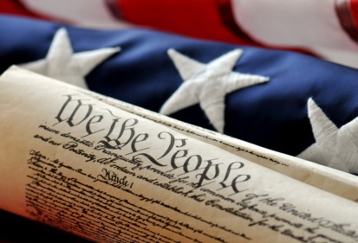
Image in shutterstock
The Role of the State
Working together for the common good involves individuals’ as well as governments’ pledging to serve the needs of others.
The state plays a part in God’s plan of salvation.
The state is the civil authority intended to achieve the common good.
The state recognizes, respects, defends, and promotes citizens’ rights and individuals’ freedom to pursue rights.

Slide 19
Image in shutterstock
The Three Primary Functions of Civil Authority
executive: essential services provided and regulated
legislative: laws and human rights protected
judicial: laws fairly enforced and injustices corrected

Slide 20
The Functions of Public Authority
Needed in a complex, global society
Support international justice and peace (such as the United Nations)

Slide 21
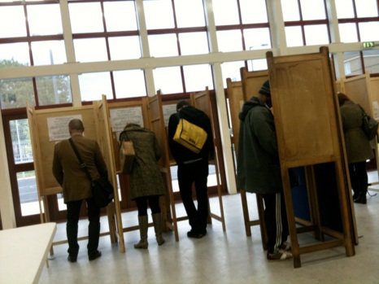
The Role
of Citizens
WikiMediaCommons
Moral responsibility to fulfill civil obligations (such as paying taxes)
Participation in the political life of society (such as voting)

Slide 22

Conscientious Objection to Unjust Laws
If human reason and God’s Law lead us to believe a civil law or civil authority is morally wrong, we are morally obligated to resist it.
Forms of Conscientious Objection:
Voice objection to the law.
Work to change the law.
Organize others to protest against the law.
Directly disobey the law.
Image in shutterstock

Slide 23

Conscientious Objection
to Unjust Laws
What informs our conscience? How do we know when we are hearing the truth?
We can count on the media to communicate the truth to us, right?
Not always!
WikiMediaCommons

Slide 24

Media Literacy
Media literacy is a term used to describe our ability to discern the truth in what is being presented to us on the news, in the newspaper, and from all sources of social media.
On some networks the news is slanted to convey a particular political opinion.
WikiMediaCommons
Some blogs and news stories change the meaning of a politician’s speech by broadcasting or printing only selected parts of what he or she said.
And popular magazines often alter celebrities’ photographs, making the celebrities seem more beautiful or perfect than they really are.

Slide 25

How to Become Media Literate
Read information from a variety of sources to become informed.
Seek out sources that try to be accurate and unbiased in reporting the news.
Image in shutterstock
Learn about an issue, studying it from different perspectives.
Check out multiple media sources.
Listen to people who have different opinions, and apply reason and God’s truth to their arguments.
Pray—ask the Holy Spirit to guide you to the truth.
Notes:
(Vatican documents cited in this presentation are available at www.vatican.va. Copyright © Libreria Editrice Vaticana.)

