Slide 1
Strength Amidst Suffering
The Paschal Mystery
Unit 4, Chapter 10
Document #: TX005799

Slide 2
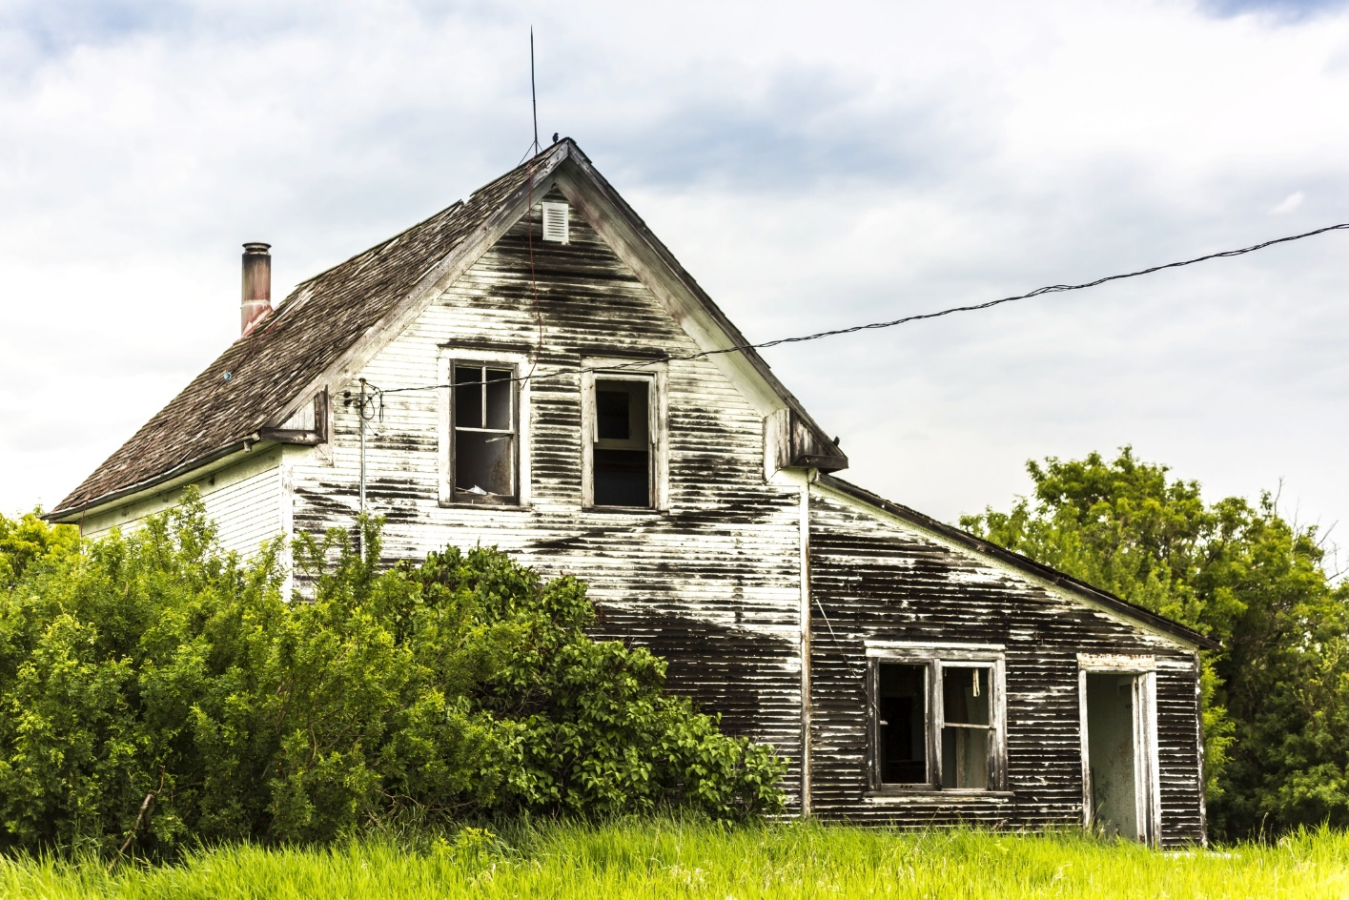
Strength Amidst Suffering (Habakkuk 3:17‒19)
© Scott Prokop / Shutterstock.com

Slide 3
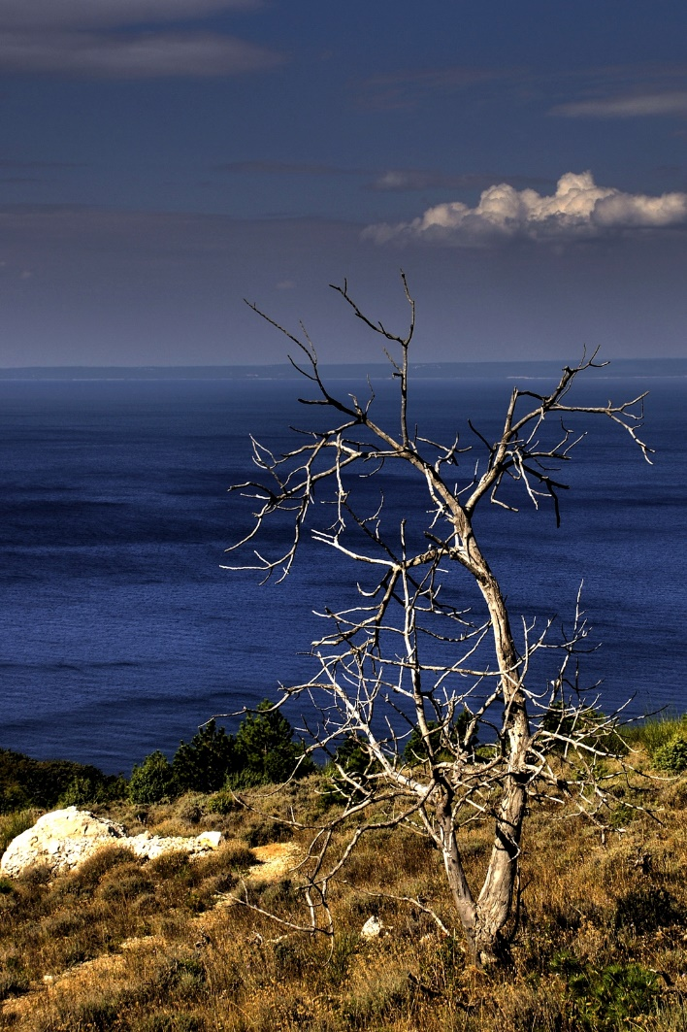
For though the fig tree does not blossom,
and no fruit appears on the vine,
© Ziga Cetrtic / Shutterstock.com

Slide 4
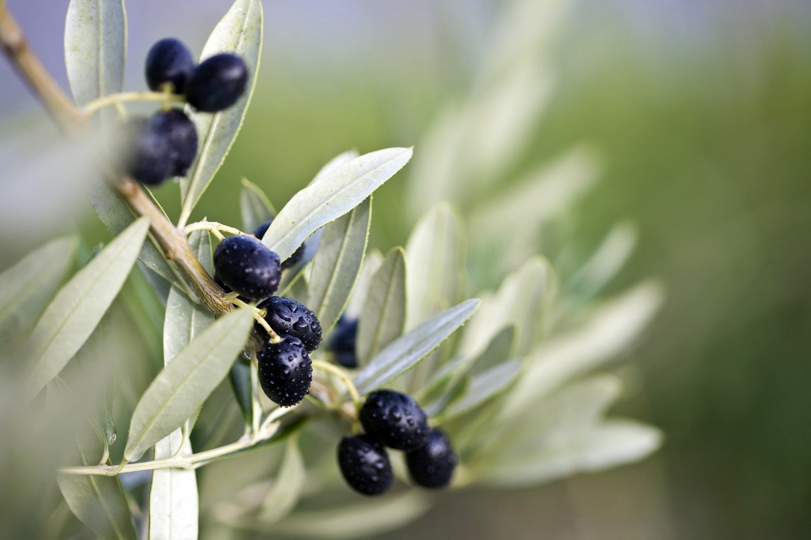
Though the yield of the olive fails
and the terraces produce no nourishment,
© anistidesign / Shutterstock.com

Slide 5
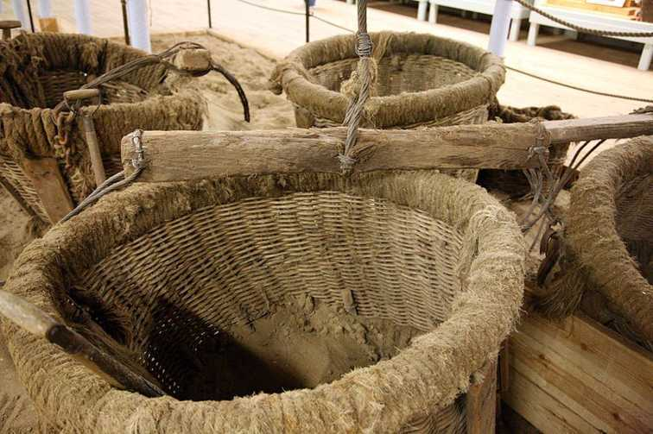
Image in public domain

Slide 6
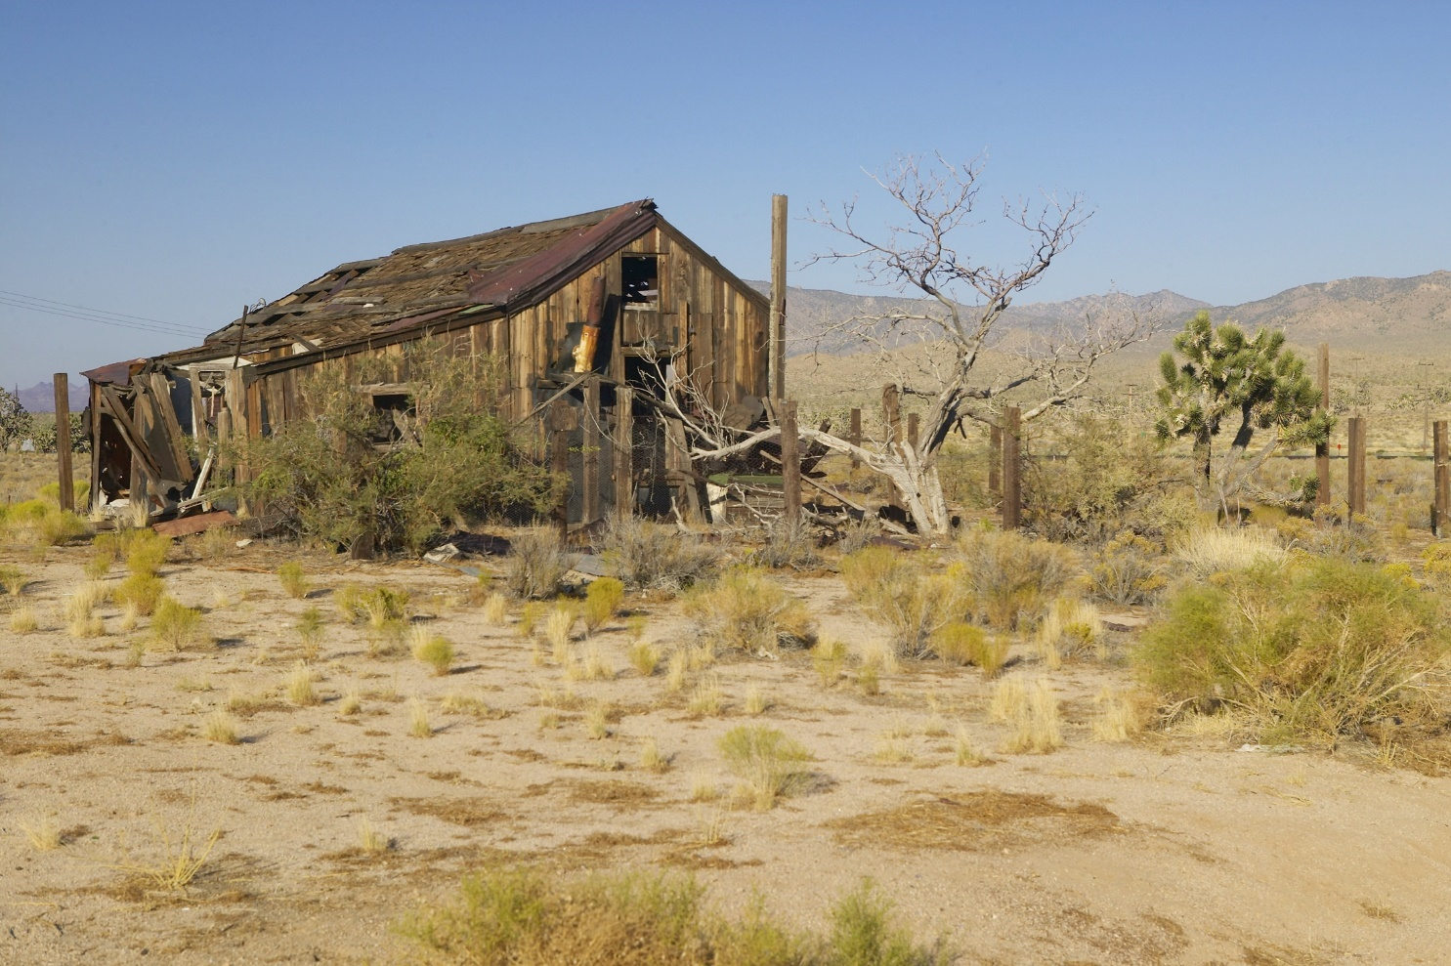
Though the flocks disappear from the fold
and there is no herd in the stalls,
© Joseph Sohm / Shutterstock.com

Slide 7
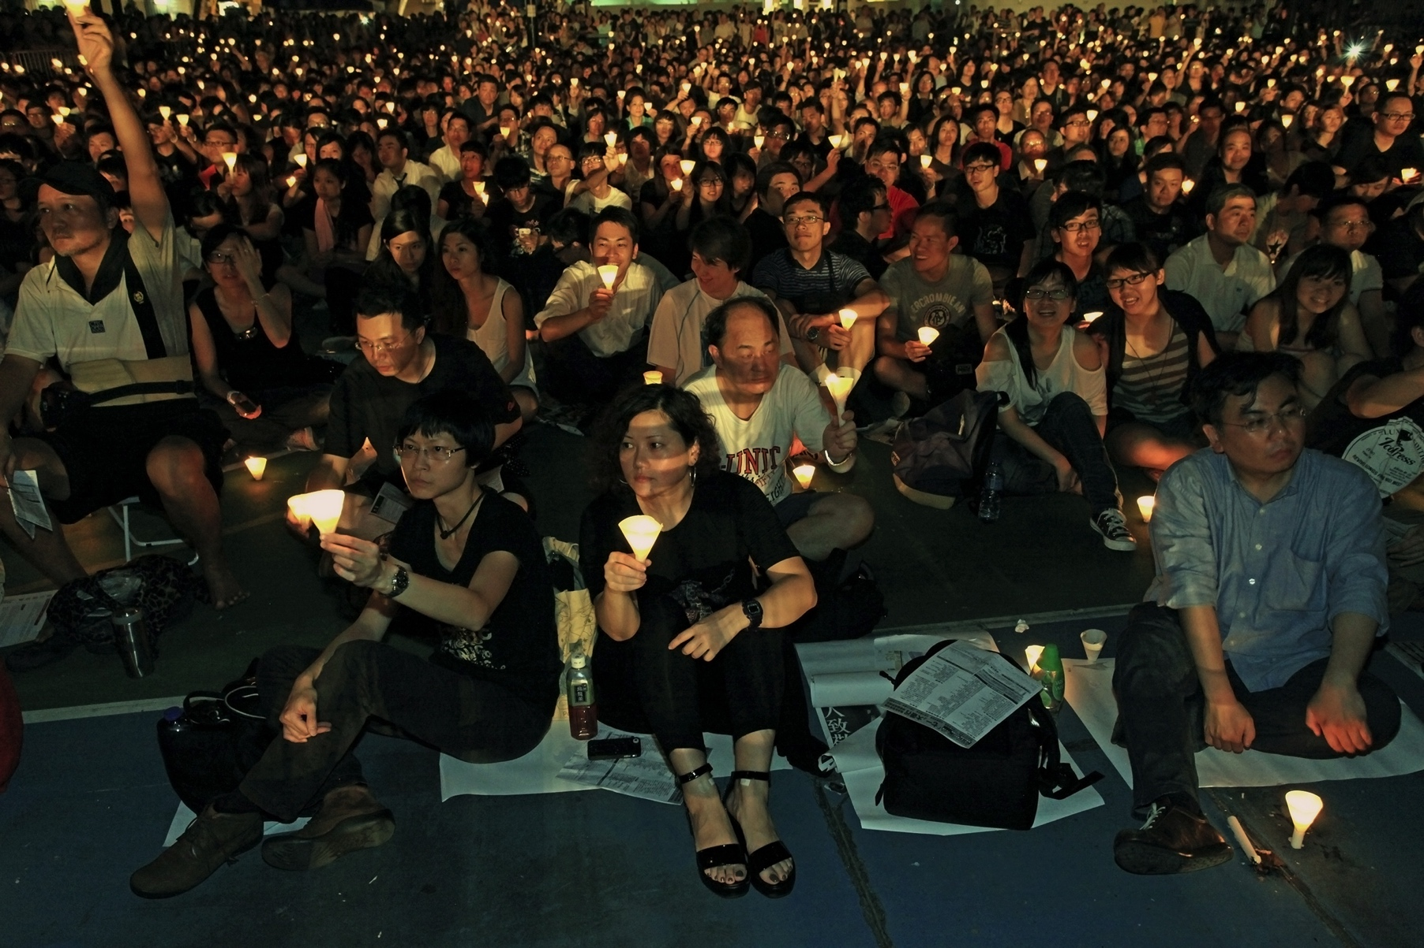
© Alex Brylov / Shutterstock.com

Slide 8
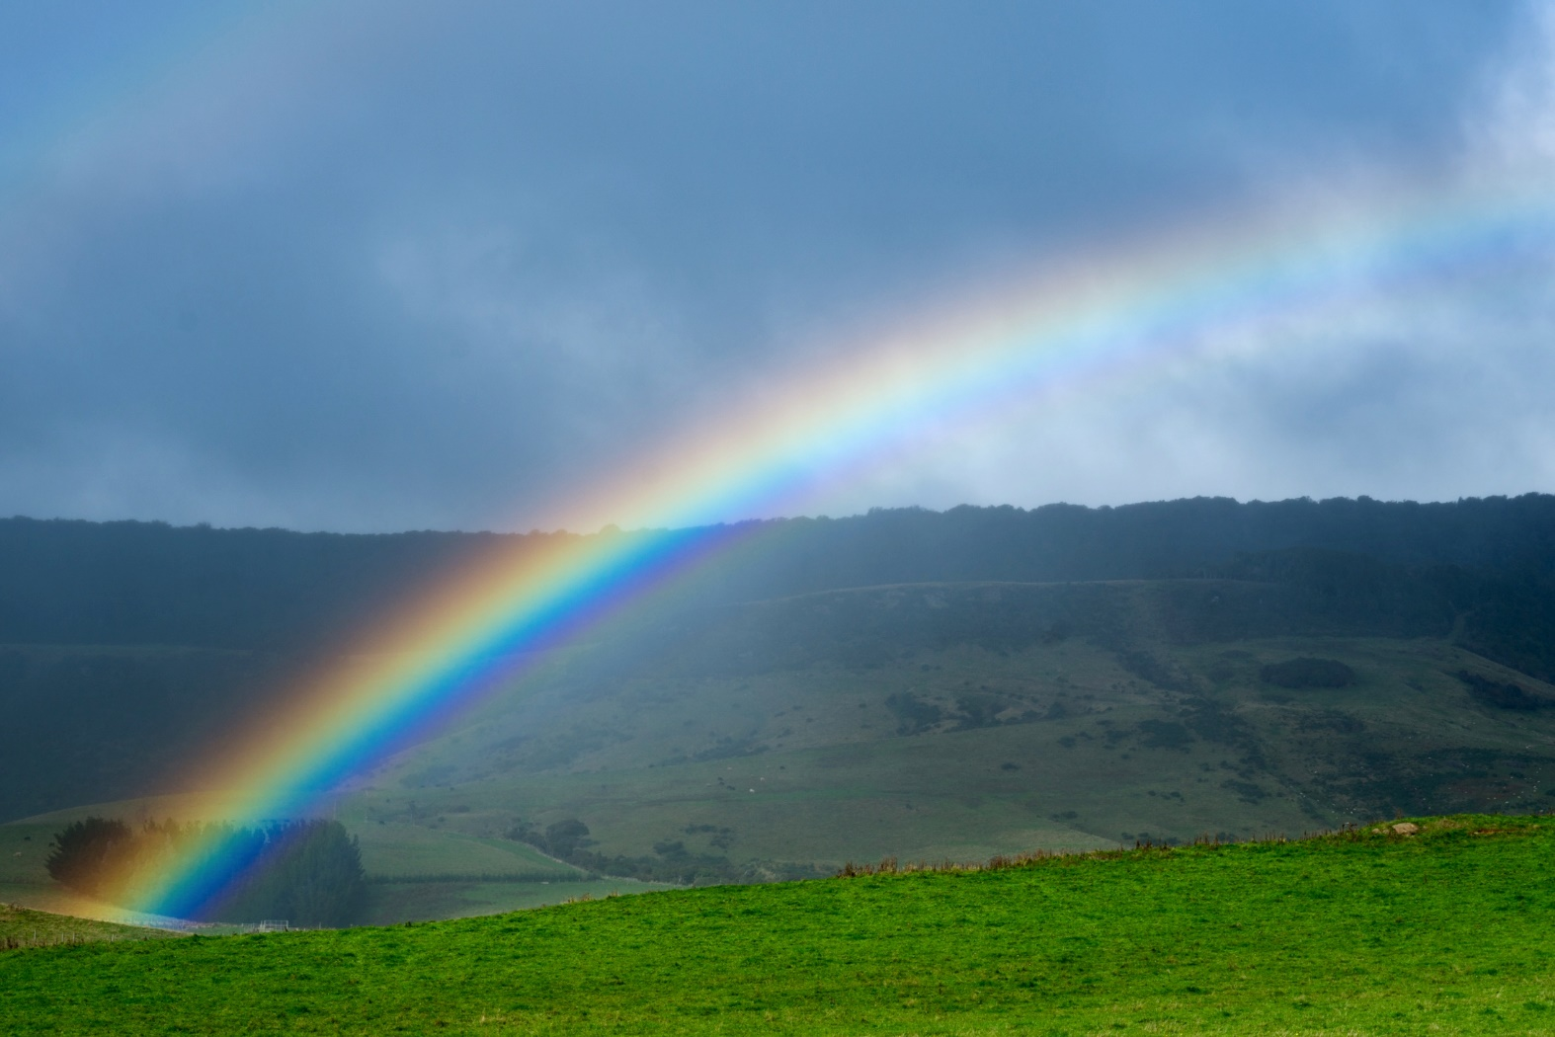
Yet I will rejoice in the Lord
and exult in my saving God.
© Deem Vermeulen / Shutterstock.com

Slide 9
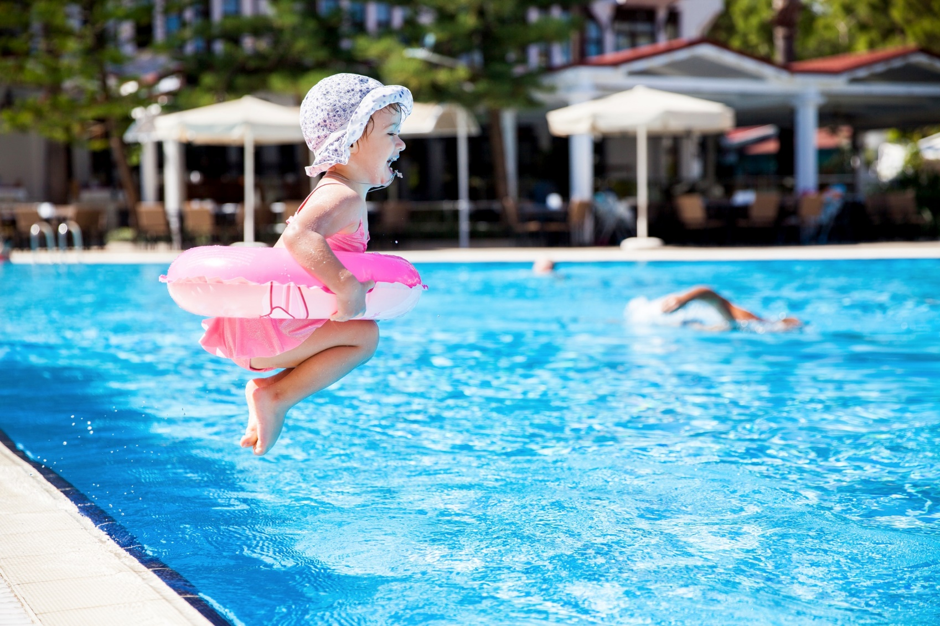
© Aleksandra Suzi / Shutterstock.com

Slide 10
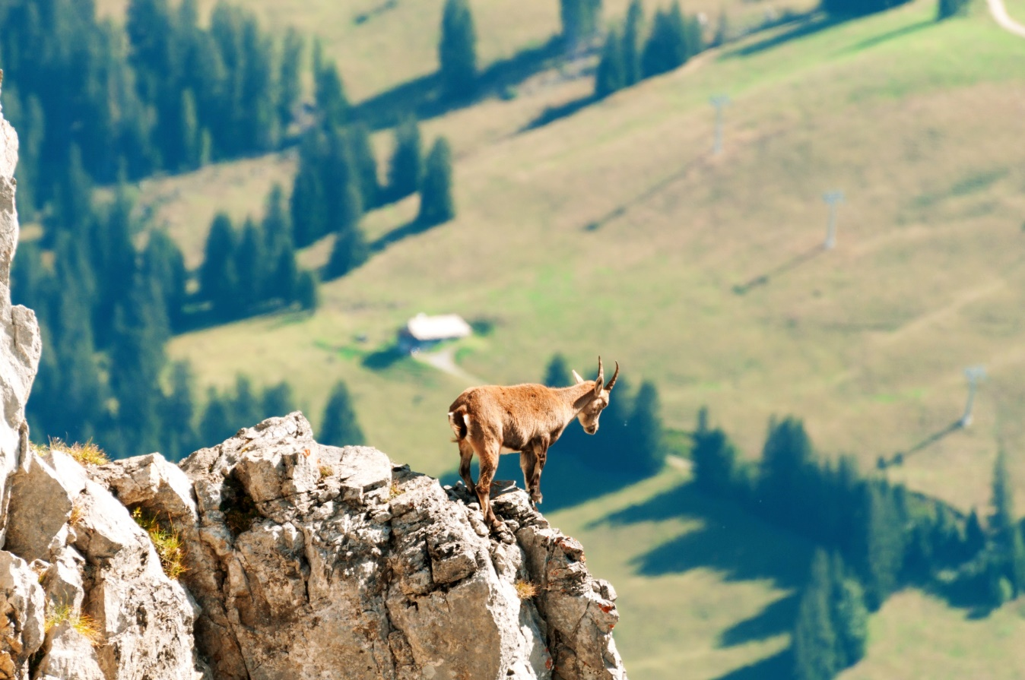
God, my Lord, is my strength;
he makes my feet swift as those of deer
and enables me to tread upon the heights.
© Ahuli Labutin / Shutterstock.com

Slide 11
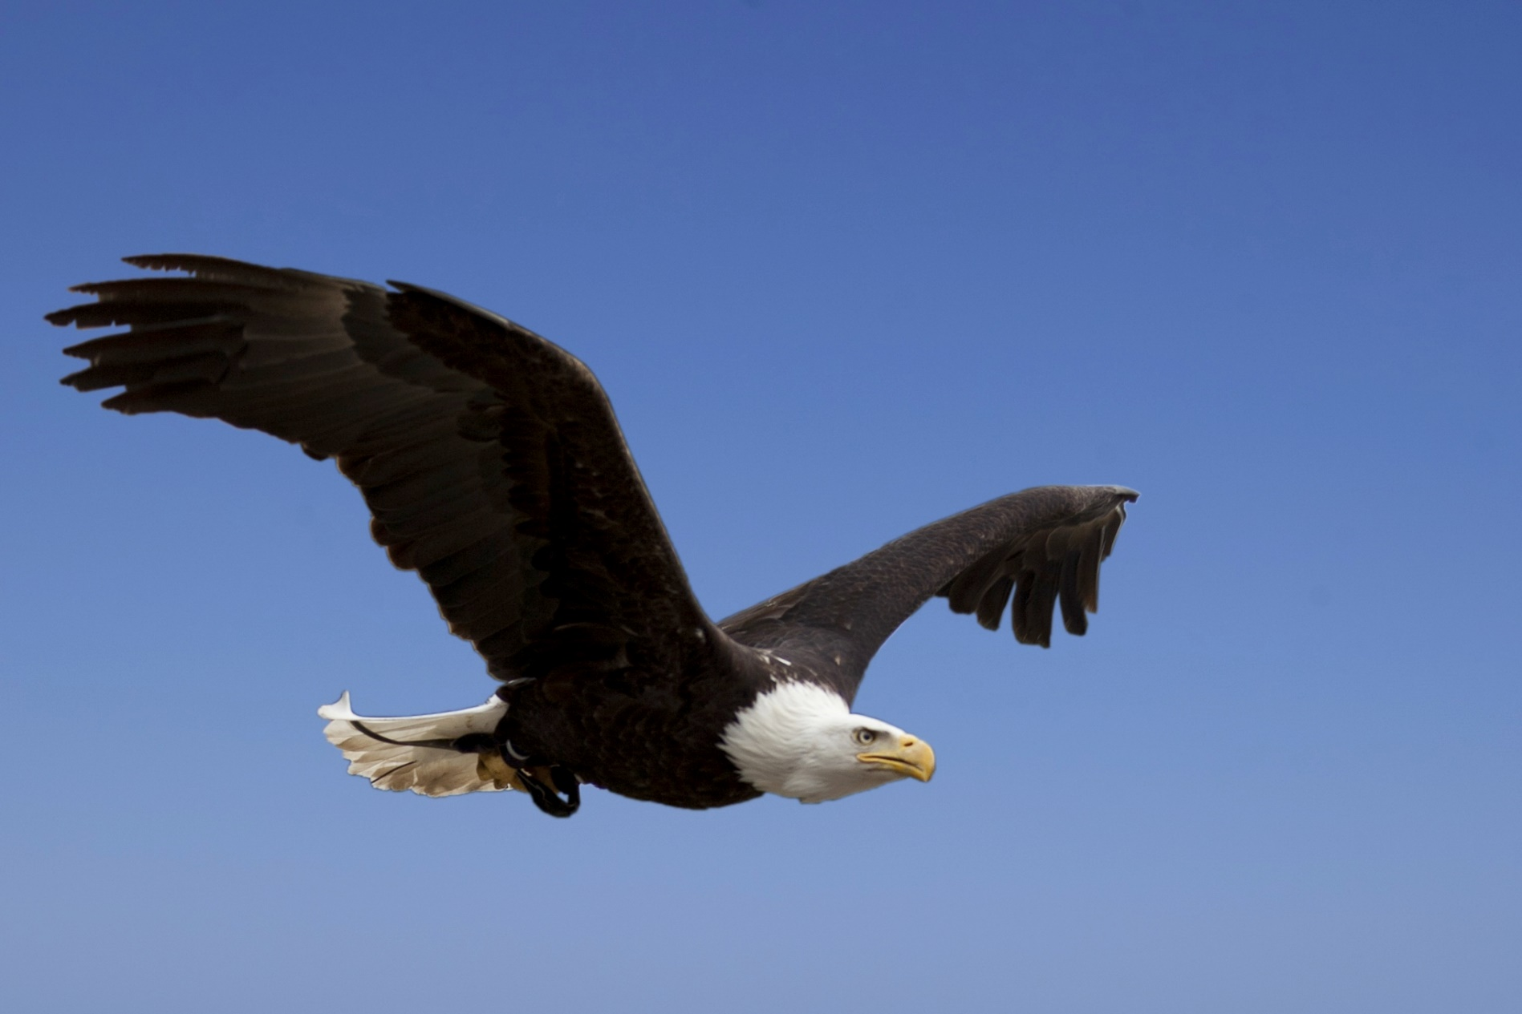
© schweingrubers / Shutterstock.com

