Slide 1
The Eucharist
The Catholic Faith Handbook for Youth, Third Edition
Chapter 20
Document #: TX003151
Notes:
Use this presentation to introduce or review the history and meaning of the Eucharist as covered in chapter 20.

Slide 2
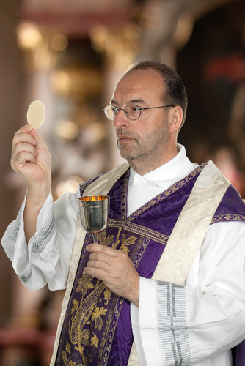
The Eucharist: Celebrate and Remember
God’s Revelation through history
The life, death, and Resurrection of Jesus Christ
Jesus’ presence with us today
Copyright: Lisa S. / www.shutterstock.com
Unity with all of the faithful, living and dead
Notes:
As each new statement appears, ask the students how the Eucharistic liturgy celebrates and makes real this aspect of our faith.

Slide 3
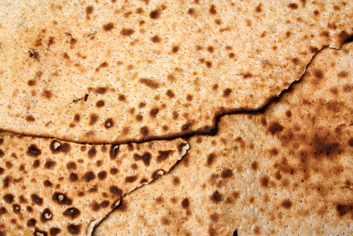
Rooted in the Exodus
God’s messenger killed the firstborn of the Egyptians.
To be spared, Israelites had to put the blood of a lamb on their doorways.
They were to eat the lamb with unleavened bread as their last meal in Egypt.
Copyright: vm / www.shutterstock.com
Notes:
Remind the students that the Israelites had been enslaved in Egypt, and the last plague was to convince Pharaoh to let them go. Tell the students that God commanded the Jews to observe the Passover feast every year.

Slide 4
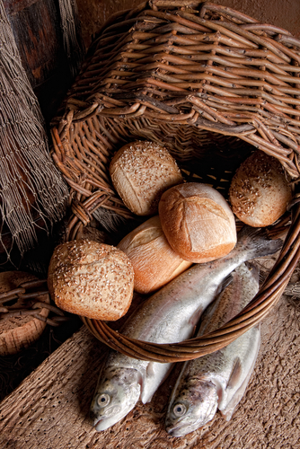
Recalling the Mission of Jesus
Jesus often taught during meals.
He fed large crowds miraculously.
He called himself the Bread of Life.
Copyright: Anneka / www.shutterstock.com
Notes:
Expand on the material on this slide, asking the students to recall the stories associated with each point. You may want to refer them to page 214 in the student handbook.

Slide 5
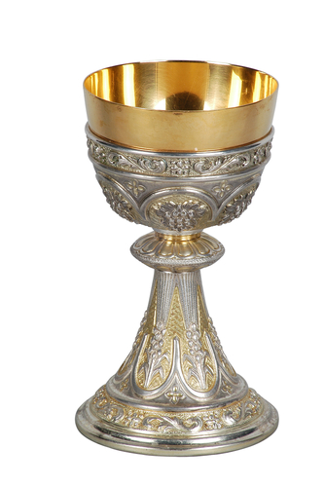
Instituted at the Last Supper
A Passover meal
“Take, eat; this is my body” (Matthew 26:26).
“. . . this is my blood of the covenant, which is poured out for many for the forgiveness of sins” (Matthew 26:28).
Copyright: alephcomo / www.shutterstock.com
Notes:
Remind the students about the concept of covenant, and tell them that the Sinai Covenant was sealed with blood from an animal sacrifice.

Slide 6
Christ, the Paschal Lamb
The sacrifice of the original Passover lamb saved the firstborn
from physical death.
Jesus’ sacrifice saves us all from the eternal death that is separation from God.
Notes:
Ask the students to comment on the meaning of this last statement on the slide. Point out the parallel between slavery in Egypt and slavery to sin.

Slide 7
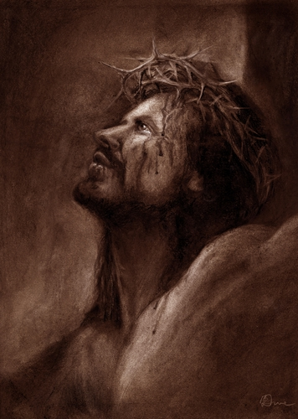
The Blood of the Lamb
The sacrifices by the Israelite priests could not overcome the damage caused by Original Sin.
Jesus’ sacrifice restored our relationship with God once and for all.
Copyright: Brian Dunne /www.shutterstock.com

Slide 8
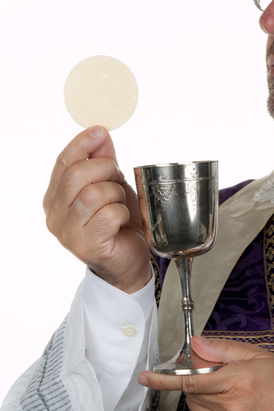
In the Eucharist . . .
we give thanks and praise to God, along with all the angels and saints.
the saving actions of Jesus are made present today.
Christ is present in the fullest possible way.
Copyright: Lisa S. / www.shutterstock.com

Slide 9
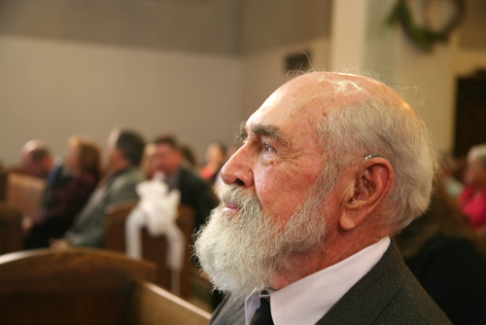
The Eucharistic Rite
Introductory Rites
Liturgy of the Word
Liturgy of the Eucharist
Concluding Rites
Copyright: Stacy Barnett / www.shutterstock.com
Notes:
Invite the students to look at the more detailed outline for the Eucharist on pages 220–221 of the student handbook. You might also consider having them take these pages to Mass at some point in order to follow the order of the liturgy.

Slide 10
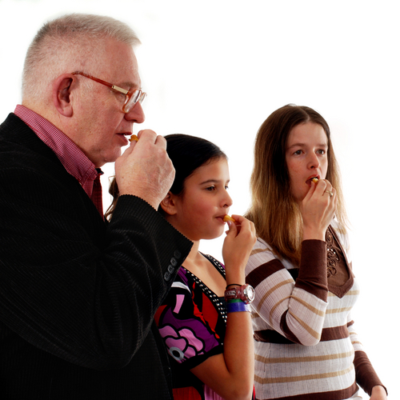
Receiving the Eucharist
Builds up our relationship with Jesus
Strengthens our relationship with the Church
Brings forgiveness for our venial sins
Strengthens us to resist serious sin
Copyright: Glenda M. Powers / www.shutterstock.com

