Slide 1
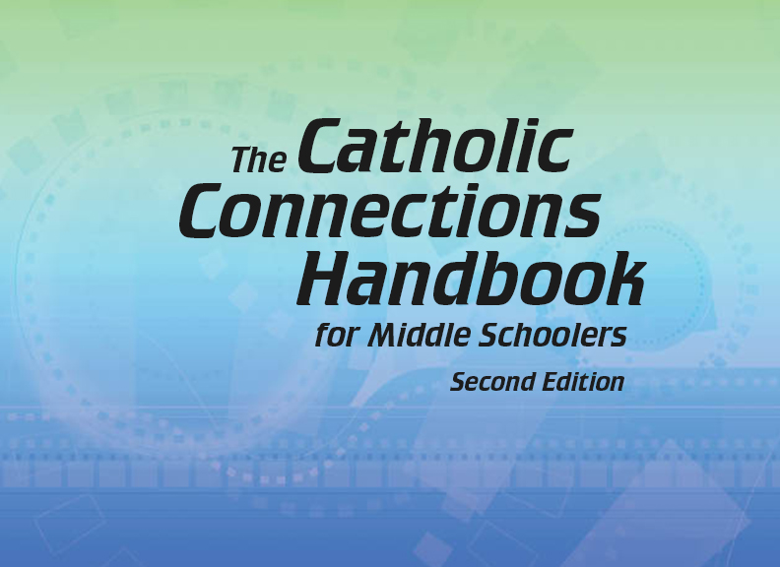

Document #: TX005843

Slide 2
Prayer and
Church History
Chapter J
The Church in Troubled Times

Slide 3
Chapter Summary
Modern society changed the nature of work and the manager/worker relationship.
The Church’s social doctrine reminded the world of human dignity.
In two world wars, there were Christians fighting on both sides.
The popes were challenged to deal with the aftermath of war, and Vatican Council II “opened the windows” to the world.

Slide 4

Introduction and
“The Church and the Worker”
(Church History, pages 104–108)
The social doctrine of
the Church began with
Pope Leo XIII’s
encyclical, On the
Condition of Labor,
and continues today.
© Andreas G. Karelias / Shutterstock.com

Slide 5
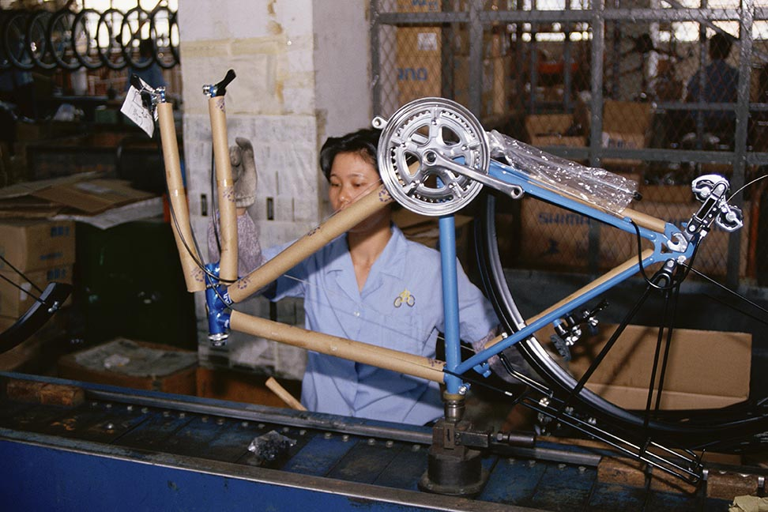
The Industrial Revolution
The Industrial Revolution began
in Europe in the mid-1800s and
spread quickly to America.
Machines were used to make
goods. What used to be made
by hand by one person began
to be mass-produced by many
people using machinery in factories.
Capitalism became the economic
system of countries affected by the Industrial Revolution.
© Joseph Sohm / Shutterstock.com

Slide 6
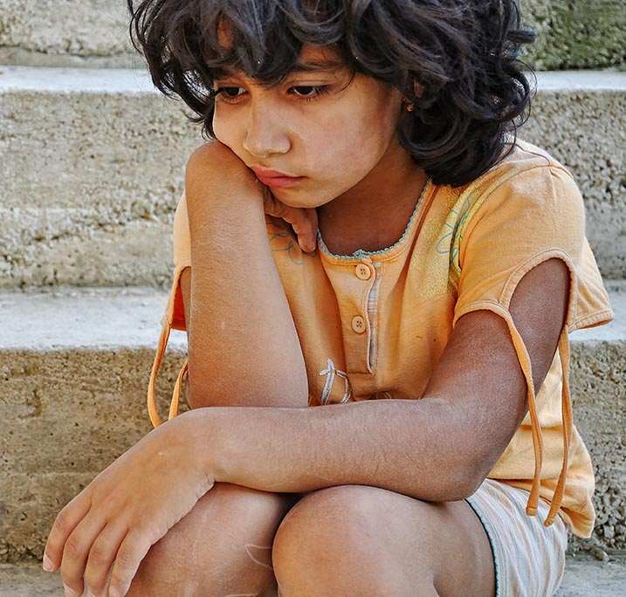
The Social Doctrine of the Church
Pope Leo XIII’s encyclical stated:
Workers have a right to work
with dignity, to earn a just
wage, and to work reasonable
hours in safe conditions.
Workers should be allowed
to form unions.
It is unjust for some people to
have more while others live in
poverty.
© Zurijeta/Shutterstock.com

Slide 7
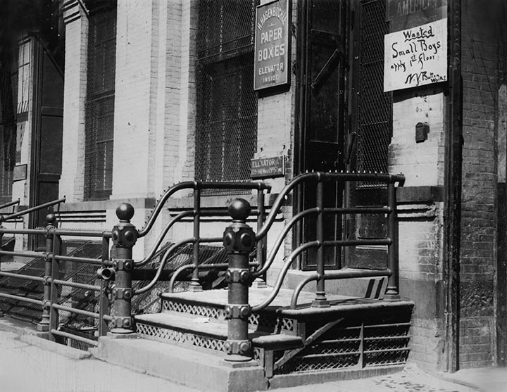
Journal It!
At this time, children in
destitute families took full-
time jobs to help buy food.
There were no food pantries
or financial aid, no laws
against child labor, and
school was optional.
Look at the ad on the door.
Write a letter to the factory
owner explaining why child labor
is wrong.
© Everett Historical / Shutterstock.com

Slide 8
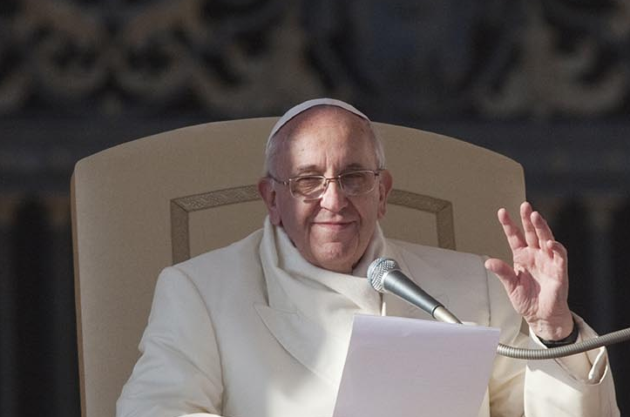
The Popes and Society
Recent popes have also carried the message of peace and justice. What did the following popes have to say about these issues?
Pope John XXIII
Pope Paul VI
Pope John Paul II
What is Pope Francis
saying in our own times?
© giulio Napolitano / Shutterstock.com

Slide 9
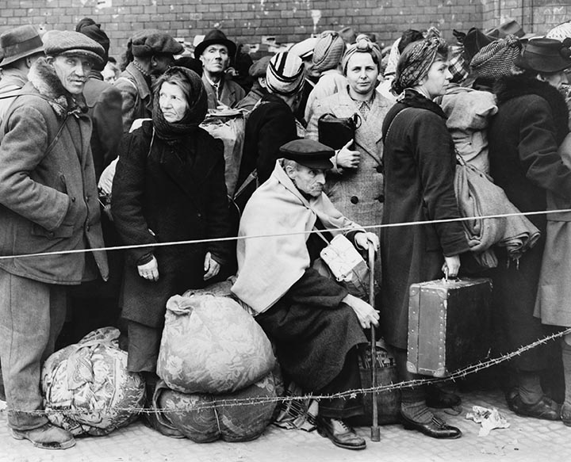
“The Church and World War I” and
“The Church and World War II”
(Church History, pages 109–115)
The world wars challenged
the Church to help all
peoples, both materially
and spiritually, especially
those who were targeted
for suffering and even death.
© Everett Historical / Shutterstock.com

Slide 10
“The Church and World War I”
World War I began in 1914. In that year, Pope
Benedict XV was elected.
Pope Benedict XV devoted his entire papacy to helping the victims of the war. The Pope championed the human rights of the victims on all sides.
Pope Benedict proposed a peace plan in 1917. It was officially ignored, but the “Fourteen Points” speech given by President Woodrow Wilson included points similar to Pope Benedict’s.
The war finally ended in 1918.

Slide 11
“The Church and World War II”
World War II began in 1939, when Germany illegally invaded Poland and took it over.
Pope Pius XII was elected early in 1939. He continually spoke out for the human rights of all, especially civilians.
During the war, Hitler built labor camps for Jews and other “undesirables.” By the end of the war, over 6 million Jews and other “undesirables” had been killed. Today this is known as the Holocaust.

Slide 12
Think About It!
Everyone has dignity! Gather in pairs and think about this verse from the Gospel of Matthew: “Whenever you did this for one of the least important of these . . . you did it for me!” (25:40). How is Jesus calling us to treat others we might think of as “undesirable”? Share your responses with your group.
The Holocaust was a crime of genocide—wiping out an entire people because they are considered undesirable. It still happens today.
Research the crime of genocide at the online sites of the United States Holocaust Memorial Museum and the Armenian Genocide Museum. (The Armenian genocide took place in 1915–1917 under the Ottoman Empire.)

Slide 13

“After the War” and
“Call for Renewal”
(Church History, pages 115–120)
After World War II, the Church was a reconciler of peoples and continued her inner renewal.
© Gustavo Frazao / Shutterstock.com

Slide 14
“After the War”
The Pax Christi (Peace of Christ) organization was established in Europe and later spread to the United States. Today it is still a voice of prayer and action for peace.
Communist governments were in power in the Soviet Union, China, and North Korea.
Nuclear arms grew, especially in the United States and in the Soviet Union.
Pope John XXIII called an ecumenical council to consider the Church’s response to the modern world.

Slide 15
Conflict and Peace
Learning to deal with conflict is an important skill. Gather in groups of three. Choose one person as a mediator.
Role play the following conflicts and come to a fair and peaceful solution:
Your sibling borrows your favorite clothes and wears them, then neglects to return them.
You only have one game device, and your older sibling keeps hogging it. You never get to play games you like.
As a group, make up a situation of conflict and identify a peaceful solution.

Slide 16
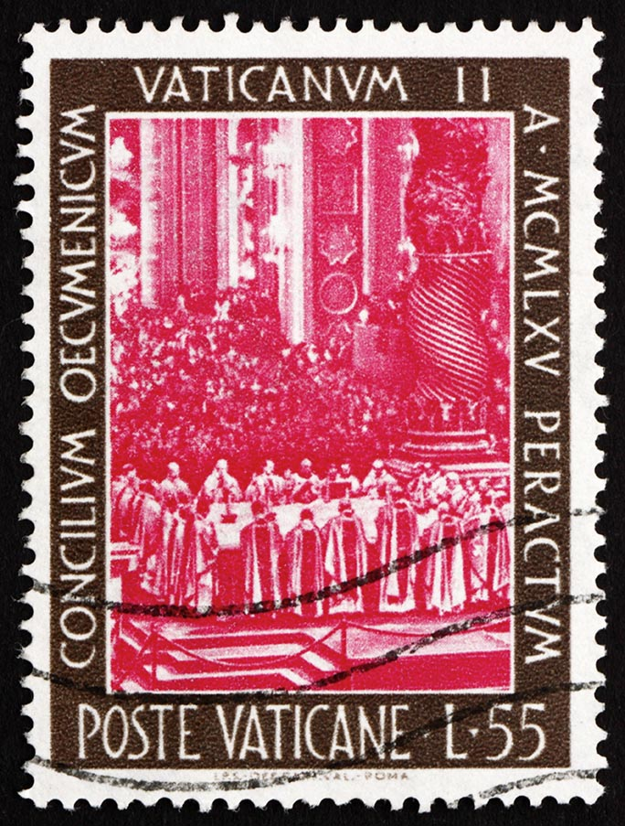
“Evaluating Vatican Council II”
(Church History Pages 121–122)
The work the Church began
during Vatican Council II
is ongoing.
(This stamp is from Vatican City, in 1966.
It shows the bishops at the Council celebrating Mass.)
© Boris15/Shutterstock.com

Slide 17
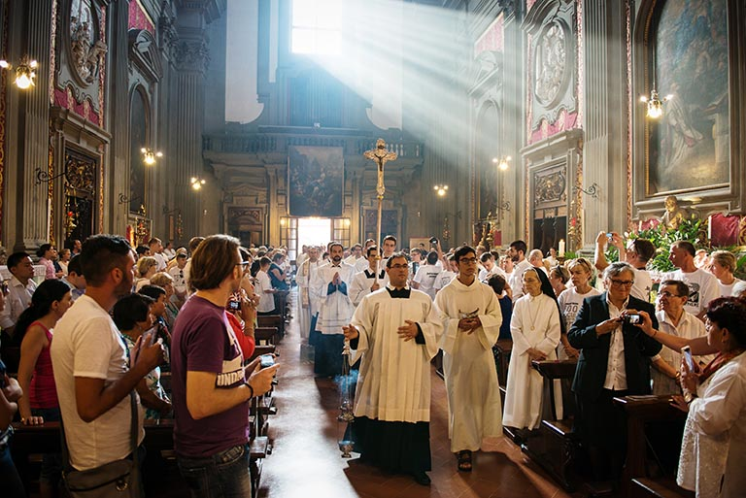
The Work Continues
In 1985, Pope John Paul II
called an Extraordinary
Synod to review the
outcomes and practices
recommended by Vatican
Council II.
The work of Vatican II
continues today in your
parish!
©futureGalore/www.shutterstock.com

Slide 18
Journal It!
Picture yourself 20 years from now. You are at least 30 years old. What are you doing to make a difference?
Write a short essay about yourself as you “are” 20 years from now. For example, “I am a biologist,” or “I am a construction worker.” What are you doing for God, for the Church, and for those who have less than you do?

