Slide 1
Personal Prayer
The Catholic Faith Handbook for Youth, Third Edition
Chapter 35
Document #: TX003166
Notes:
Use this presentation to explain how different expressions of personal prayer represent different aspects of our relationship with God.

Slide 2
Prayer as Personal Relationship
Our experience of building personal relationships can be a metaphor for our prayer life.
Deepening a relationship that leads to marriage is similar to building a committed relationship with God through prayer.
Copyright: lithian / www.shutterstock.com
Notes:
Remind the students that metaphors point out similarities, but are not perfect analogies. Ask the students to identify some qualities in a good marriage that would also be found in a good relationship with God. (Love, trust, happiness, honest communication, setting priorities together, and so on)

Slide 3
Vocal Prayer: Courtship
Early in a relationship, the focus is on conversation.
Speaking with a sincere heart is the foundation of courtship.
Copyright: Belushi / www.shutterstock.com
Notes:
Ask how the statements on the slide describe prayer. Remind the students that we may use written prayers, memorized prayers, or our own words in vocal prayer. Direct the students’ attention to the section Catholic Prayers and Devotions, beginning on page 447 of the student handbook, before moving to the next slide.

Slide 4
For Reflection
Copyright: Monkey Business Images / www.shutterstock.com
Which traditional prayers do you find most meaningful?
Do you have a preferred time of day, place, and posture for prayer?
How could scheduling prayer into your day be beneficial?
Notes:
Explain that while spontaneous prayer has value, committing to prayer requires discipline. Remind the students that building a prayer life builds our relationship with God.

Slide 5
Meditation: Engagement
Moving toward a deepened commitment requires considering various aspects of a shared life.
Active discernment is the heart of the engagement period.
Copyright: Darren Baker / www.shutterstock.com
Notes:
Explain that discernment, with its root meaning of “sifting,” is the practice of listening to God’s call in our lives. Ask how the statements on the slide describe prayer.

Slide 6
For Reflection
What prayer practice has helped you to become aware of God’s activity in your life?
How could spiritual reading help you to know God’s will?
Copyright: Jason Stitt / www.shutterstock.com
Notes:
Share methods or materials that you have found helpful for meditation, such as journaling, daily Scripture texts, music, and so on.

Slide 7
Contemplation: Marriage
In intimate relationships, silently enjoying the presence of the other is a joy.
Allowing the other to draw near is the essence of marriage.
Copyright: CandyBox Images / www.shutterstock.com
Notes:
Point out that we gradually drop our defenses as we grow closer to another, and that marriage requires, and encourages, complete trust. Ask how the statements on the slide describe prayer.

Slide 8
For Reflection
If you have tried centering prayer, what was the experience like?
Copyright: Glenda M. Powers / www.shutterstock.com
Is silently resting in God’s presence a form of prayer that appeals to you?
Notes:
Explain that opening oneself to contemplative prayer is a lifelong endeavor, and that centering prayer is a good first step. Invite the class to read about centering prayer in the Pray It! sidebar on page 387 of the student handbook, if they have not already done so.

Slide 9
Vocal Prayer, Meditation, Contemplative Prayer
The heart must be present and open to the beloved, who is God.
Each expression of prayer remains important as our prayer life deepens.
Copyright: Adrian Britton / www.shutterstock.com
Notes:
Reiterate that we don’t leave vocal prayer and meditation behind as we move more fully into our relationship with God, just as couples do not stop talking or discerning together when they marry.

Slide 10
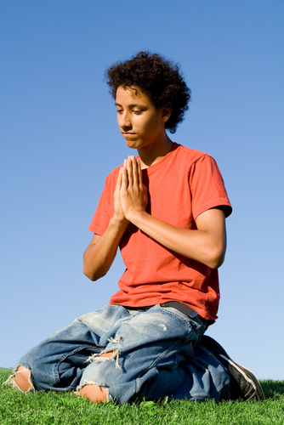
Challenges of Prayer
Misconceptions of Prayer
Prayer is just psychological activity.
Prayer is only saying memorized words.
Prayer requires expertise.
Difficulties in Prayer
Distractions
Dryness
Copyright: MANDY GODBEHEAR / www.shutterstock.com
Notes:
Encourage the students to share their own difficulties with prayer.

