Slide 1
Social Teaching in the Old Testament
Catholic Social Teaching
Document #: TX001945

Slide 2

1. Respect for Human Life
Social teaching in the Old Testament can be broken into
five major themes:
2. Respect for Property
Image in shutterstock
3. Honesty in Business
4. Just Distribution of Wealth
5. Special Concern for the Vulnerable

Slide 3
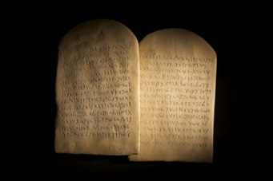
One must not cause another person physical harm.
Respect Human Life Principles Taught in the Old Testament
Image in shutterstock
If someone does injure or kill another human being, even accidentally or through negligence, a just recompense must be made for the harm done.

Slide 4

The right to private property is a basic human right necessary for a person’s or family’s survival.
Respect for Property Principles Taught in the Old Testament
By Infrogmation of New Orleans (Photo by Infrogmation) [GFDL (www.gnu.org/copyleft/fdl.html), CC-BY-SA-2.0 (www.creativecommons.org/licenses/by-sa/2.0), CC-BY-SA-2.5 (www.creativecommons.org/licenses/by-sa/2.5) or CC-BY-SA-3.0 (www.creativecommons.org/licenses/by-sa/3.0)], via Wikimedia Commons
Note: The right to private property is not an absolute right in the Old Law.

Slide 5

One must act fairly in financial affairs and must not profit from someone else’s misfortune.
Honesty in Business Principle Taught in the
Old Testament
Image in shutterstock
Notes:
Click to add notes

Slide 6

The natural resources that people need to survive must be fairly distributed.
Just Distribution of Wealth Principles Taught in the Old Testament
Image in shutterstock
When the ownership of natural resources becomes unbalanced, those resources must periodically be redistributed.
Notes:
Click to add notes

Slide 7
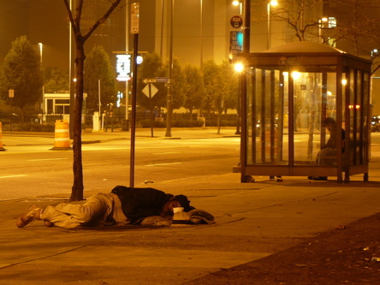
One must treat foreigners, widows, orphans, and other vulnerable people in society with compassion and generosity.
Special Concern for
the Vulnerable Principle Taught in the Old Testament
WikiMediaComons

Slide 8

The Old Law was a step in God’s plan, the first stage of the revealed law.
Image in shutterstock
The next step was the New Law, which emphasizes God’s love and mercy.

Slide 9
. . . what the Lord requires of you:
Only to do the right and to love goodness, and to walk humbly with your God.
(Micah 6:8)
.
“
”
Notes:
(The scriptural quotation in this presentation is from the New American Bible with Revised New Testament and Revised Psalms. Copyright © 1991, 1986, and 1970 by the Confraternity of Christian Doctrine, Washington, D.C. Used by the permission of the copyright owner. All Rights Reserved. No part of the New American Bible may be reproduced in any form without permission in writing from the copyright owner.)

