Slide 1
The Art of Iconography
Christian Morality
Document #: TX001836

Slide 2
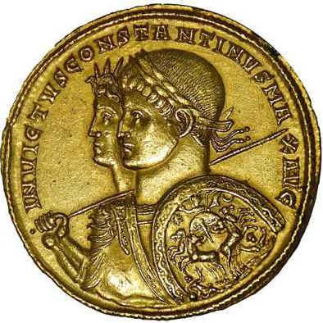
Image in public domain
The Roman Emperor Constantine issued the Edict of Milan in AD 313, allowing Christians to express their faith publicly. The way was opened for Christians to express their devotion to God. One of these ways was through art, especially iconography.

Slide 3
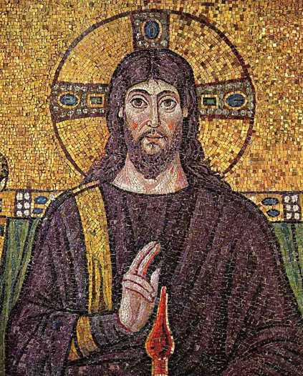
Icons are an art form that began in the early centuries of Church history.
Image in public domain

Slide 4
• Despite some opposition in the early Church over the veneration of portraits of Christ, Christians developed symbols of their faith, such as icons, as a means of teaching and of evoking the Spirit.
The use of icons was particularly popular in the eastern provinces of the Roman Empire.
Image in public domain

Slide 5
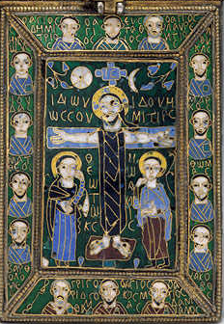
www.metmuseum.org
Reliquary of the True Cross, by Staurotheke—late eighth to early ninth century

Slide 6
However, in the sixth and seventh centuries, the use of icons began to be associated with cultic practices and superstition.
There was concern that the use of icons was a sin of idolatry.
This created the conflict that is referred to as the iconoclastic controversy.

Slide 7
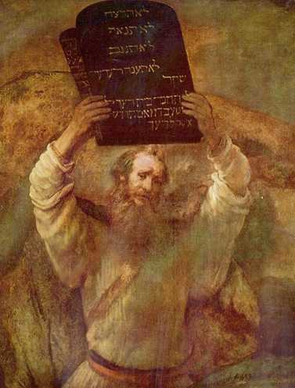
First Commandment:
“I, the Lord, am your God. . . . You shall not have other gods besides me” (Exodus 20:2).
Image in public domain

Slide 8
The iconoclasts claimed that the creation of religious images, such as icons, was a sin against the First Commandment. They believed that displaying icons in churches was the same thing as worshipping idols.
Christians were divided over this question.

Slide 9
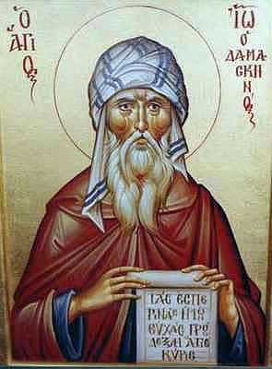
Many leaders such as Saint John of Damascus defended the veneration of icons.
These leaders taught that the veneration of sacred images leads believers to the adoration of God.
Image in public domain

Slide 10
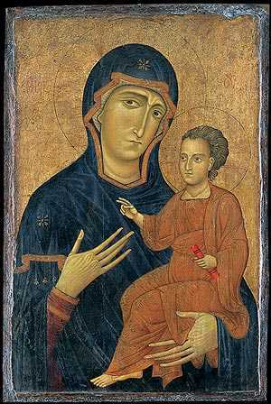
Madonna and Child, by Berlinghiero, thirteenth century
www.metmuseum.org

Slide 11
In her official teachings, the Church defended the creation and display of sacred art. The Second Council of Nicaea (AD 787) promulgated the following statement.
www.metmuseum.org

Slide 12
“We decree with full precision and care that, like the figure of the honored and life-giving cross, the revered and holy images, whether painted or made of mosaic or other suitable material, are to be exposed in the holy churches of God, on sacred instruments and vestments, on walls and panels, in houses and by public ways. These are the images of our Lord, God and Savior, Jesus Christ, and of Our Lady without blemish, the holy God bearer, and of the revered angels, and of any of the saintly holy men.” (Second Council of Nicaea, AD 787)

Slide 13
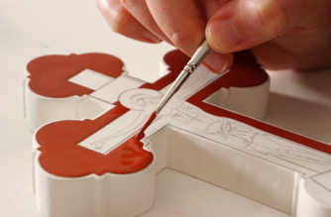
The creation of an icon is a spiritual process that is immersed in prayer at every step and is referred to as “writing an icon.”
The tradition of the Eastern Church is to write icons with an egg-tempera mixture on wood.
Icons used in liturgical settings depict Scripture passages and reflect the artist’s encounter with God in the living Word.
Every detail of the artist’s work has symbolic meaning and represents the artist’s engagement in prayer.
www.iconarts
Notes:
The scriptural quotation on slide 7 is from the New American Bible with Revised New Testament and Revised Psalms. Copyright © 1991, 1986, and 1970 by the Confraternity of Christian Doctrine, Washington, D.C. Used by the permission of the copyright owner. All Rights Reserved. No part of the New American Bible may be reproduced in any form without permission in writing from the copyright owner.

