Slide 1
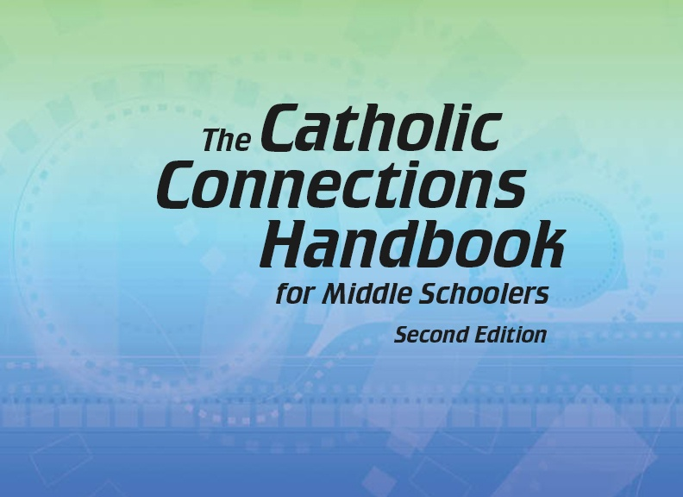


Slide 2
Christian Morality
and Social Justice
Chapter 41
Honoring Family

Slide 3

Chapter Summary
Honoring Family
In this chapter, you will consider what it means to honor your parents and other family members. Through the Fourth Commandment, we are called to honor not just our parents but legitimate authority as well. The discipline our families offer encourages discipleship and the creation of Heaven on earth, extending love and justice from the family to society as a whole.
© digitalskillet/www.istockphoto.com

Slide 4

Introduction and “The Fourth Commandment: Honor Your Parents”
(Handbook, pages 448–452)
The Fourth Commandment, “Honor your father and your mother,” requires us to honor, respect, and obey our parents and those in legitimate authority over us.
© Gizelka/www.istockphoto.com

Slide 5

Introduction and “The Fourth Commandment: Honor Your Parents”
(Handbook, pages 448–452)
Activity: “Jesus Loves the Little Children”
1. Your teacher will arrange the class into small groups and give each group one of the following Scripture passages:
Matthew 18:2–7; Matthew 21:15–16;
Mark 9:36–37; Mark 10:13–16;
Ephesians 6:1–4; 2 Timothy 3:14–15;
1 Peter 2:2–3.
2. In your group, choose a reader to read aloud the assigned passage and a recorder to write down and share the group’s responses to the following questions:
What did Jesus or the scriptural writer do for (or say about) children or young people?
What does this tell you about the kind of people, both adults and children, the
followers of Christ should be?
3. Share with the class.
© tiekiober/www.istockphoto.com

Slide 6
Introduction and “The Fourth Commandment: Honor Your Parents”
(Handbook, pages 448–452)
God loves us, and God sometimes says no. Sometimes parents show their love by saying no. Parents must answer to God for their parenting.
The Fourth Commandment helps us understand what it means to honor our parents and all adults in a position of authority.

Slide 7
Introduction and “The Fourth Commandment: Honor Your Parents”
(Handbook, pages 448–452)
The family is a school of virtues, and your parents are your first teachers.
Discipline is not a punishment but a way to learn the right or correct way.

Slide 8

“Being Family Is Hard Work”
(Handbook, page 453)
Being a family is hard work, and respect between children and parents is a two-way street.
© GuillermodelOlmo/www.shutterstock.com

Slide 9
“Being Family Is Hard Work”
(Handbook, page 453)
Parents have the Christian duty to raise their children to follow Jesus.
Children have the Christian duty to obey their parents.
Following Jesus is the most important Christian call for both parents and children.

Slide 10

“Being Family Is Hard Work”
(Handbook, page 453)
Activity
1. Your teacher will give a presentation that goes through the baptismal promises that parents make for their infant children at Baptism.
4. Make a list of ways you can work to better obey your parents, because it is what Jesus asks his children to do.
2. Share your thoughts about these promises that your parents made for you: What is so important about these promises made by your parents? What responsibility do your parents have because of these baptismal promises?
3. Journal about ways your parents have helped teach you to follow Jesus.
© maxphotography/www.istockphoto.com

Slide 11

“On Earth as It Is in Heaven” (Part 1)
(Handbook, pages 453–457)
We take our understanding of honoring our families into the world by living out the Fourth Commandment in the larger society.
© Ig0rZh/www.istockphoto.com

Slide 12
“On Earth as It Is in Heaven” (Part 1)
(Handbook, pages 453–457)
God wants us to build a society that values truth, justice, freedom, and solidarity.
Governments should respect human rights and people’s desire to live in freedom.
God’s Laws come first, and sometimes it is necessary to resist an unjust or immoral law to move society closer to God’s love and justice.
Citizens should take an active part in public life.

Slide 13

“On Earth as It Is in Heaven” (Part 1)
(Handbook, pages 453–457)
Journal It!
© RuslanDashinsky/www.istockphoto.com
Write two paragraphs that answer this question:
How can you honor your family by participating positively in society?

Slide 14

“On Earth as It Is in Heaven” (Part 2)
(Handbook, pages 453–457)
We take our understanding of honoring our families into the world by living out the Fourth Commandment in the larger society.
© iQoncept/www.shutterstock.com

Slide 15
“On Earth as It Is in Heaven” (Part 2)
(Handbook, pages 453–457)
God wants us to build a society that values truth, justice, freedom, and solidarity.
Citizens should take an active part in public life.
Our Baptism, our membership in the Catholic Church, makes us citizens of the world.

Slide 16
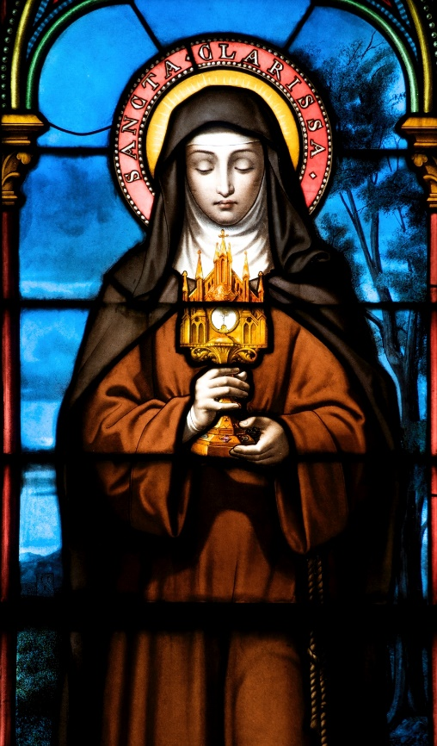
“On Earth as It Is in Heaven” (Part 2)
(Handbook, pages 453–457)
Activity: “Saintly Lawyers and Government Officials”
1. Your teacher will arrange the class into small groups.
2. Each group will be assigned one of the following saints: Saint Thomas More, Saint Louis IX of France, Saint Ives, Saint Thomas Becket, or Saint Raymond of Peñafort.
3. Research your assigned saint (each member of the group taking notes on the information you find).
4. Present on the saint you researched!
© rcyoung/www.istockphoto.com

