Slide 1
Levels of Authority in Church Teaching
The New Testament
Document #: TX002187

Slide 2
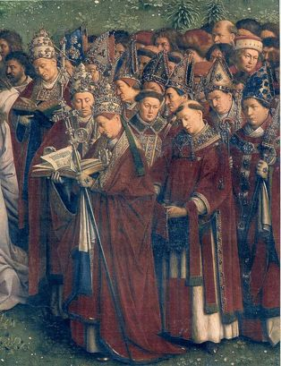
Definition of Magisterium: The Church’s living teaching office, which consists of all bishops, in communion with the Pope.
Notes:
Notes: All the bishops, together with the Pope (who is Bishop of Rome), are part of the Magisterium. The bishops are the successors of the Apostles, those followers of Jesus to whom he first entrusted the truth of Revelation. When any bishop alone, or as a member of a group of bishops (such as a national conference of all the bishops of a particular country), issues a statement on a matter of Church teaching, that statement is considered to have the authority of the Magisterium behind it. However . . .

Slide 3
Not all statements are created equal! There are levels of authority in documents that the Magisterium issues.
Notes:
Notes: In general, statements issued by the Pope or by the entire Magisterium—that is, all bishops collectively—are considered to have greater authority than statements issued by smaller groups of bishops or by individual bishops. However, even within these broad categories, not every statement is given equal weight. This raises an important question: how do we know which statements of the Magisterium are most authoritative?

Slide 4
Levels of Authority in Church Teaching
Ex cathedra
Conciliar documents
Papal encyclicals
Apostolic exhortations, constitutions, and letters
Pastoral letters issued by national bishops’ conferences
Notes:
Notes: This slide illustrates five major levels of Church teaching. We will examine each of these levels in turn, beginning with the one that is most authoritative.

Slide 5
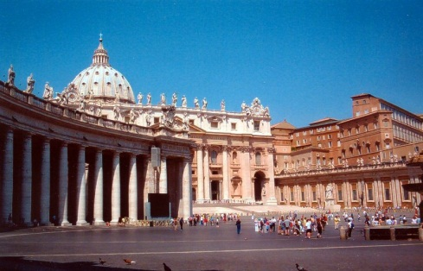
The most authoritative teachings of the Magisterium: statements issued by the Pope, the Bishop of Rome, ex cathedra, “from the chair.”
Image from Public Domain
Notes:
Notes: Catholics consider these statements to be matters of dogma that are infallible—without error.

Slide 6
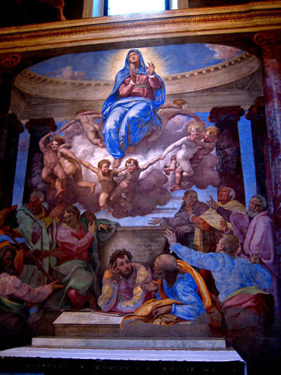
Examples of dogma issued ex cathedra: the Immaculate Conception of Mary (declared in 1854) and the Assumption of Mary (declared in 1950).
Notes:
Notes: Although formal statements ex cathedra are rare—these two examples are the only ones in recent memory—many core matters of Catholic Christian belief are also considered to be dogma: for example, the dual nature of Jesus (human and divine), the Resurrection of Jesus, and the Trinity. These matters are so fundamental to Christian belief that there has never been a need to issue a formal statement about them.

Slide 7
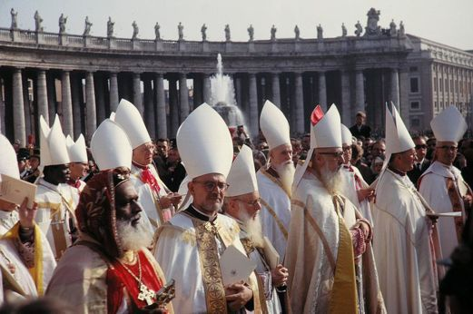
Next (second) level of Magisterial teachings: conciliar documents.
Issued by an Ecumenical Council
The collective work of the entire Magisterium
Image from Public Domain
Notes:
Notes: Ask the students to remember the Ecumenical Council discussed in the previous learning experience—Vatican Council II—and the document they studied as part of that process: Dogmatic Constitution on Divine Revelation (Dei Verbum, 1965). You may wish to note that even within conciliar documents, there are different levels of authority: constitutions are highest, followed by decrees, followed by declarations. Vatican Council II issued several examples of each of these.

Slide 8
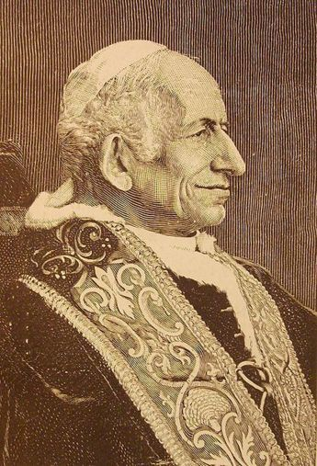
Next (third) level of Magisterial teachings: papal encyclicals.
Notes:
Notes: These are documents issued by the Pope either to all people, to the whole Church, or to some particular subgroup of people. They address a topic the Pope believes to be important or some problem the world is facing. For example, in 1891, as the Industrial Revolution was dramatically changing the workplace, Pope Leo XIII issued the encyclical Rerum Novarum, which is now considered to have been the founding document of Catholic social teaching. Pope Benedict XVI has issued three encyclicals since his election as Pope in 2005.

Slide 9
Next (fourth) level of Magisterial teachings: apostolic exhortations, constitutions, and letters.
Notes:
Notes: These are listed in descending order of authority. The Pope issues all of these for some particular occasion (for example, to open or close a meeting of a group of bishops) or to establish some particular celebration (for example, to announce a holy year or year of Jubilee). Note that the students should not confuse an apostolic constitution (issued only by the Pope) with a constitution issued by an Ecumenical Council. The latter enjoys a higher level of authority.

Slide 10
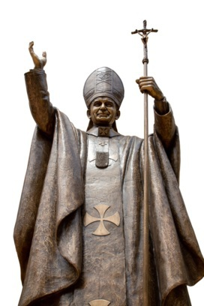
Next (fifth) level of Magisterial teachings: Pastoral letters issued by national bishops’ conferences.
© thaagoon/shutterstock.com
Notes:
Notes: Two well-known examples issued by the U.S. bishops are The Challenge of Peace: God’s Promise and Our Response (1983) and Economic Justice for All: A Pastoral Letter on Catholic Social Teaching and the U.S. Economy (1986).

Slide 11
A few additional notes:
Remember that the general term used to refer to Church teaching, at any level, is doctrine.
These five levels of Church doctrine are not exhaustive.
Notes:
Notes: There are other types of papal statements and other statements issued by various Vatican offices, as well as other types of pastoral messages issued by national bishops’ conferences.

Slide 12
A few additional notes:
These levels of authority in Church doctrine help us to understand a teaching of the Second Vatican Council, stated in its Decree on Ecumenism: the hierarchy of truths.
Notes:
Notes: Read this quotation from the Decree on Ecumenism to the students: “In Catholic doctrine there exists an order or ‘hierarchy’ of truths, since they vary in their relation to the foundation of the Christian faith” (Unitatis Redintegratio, 11). This does not mean the material in apostolic exhortations or pastoral letters, for example, is not important, but rather that it is less foundational to our faith than dogmatic truths.

Slide 13
A few additional notes:
Scripture informs every doctrine of the Church, at every level of authority.
Notes:
Notes: However, as previously stated, the relationship between Scripture and the doctrine of the Church is complex. It is not as simple as taking Scripture literally; nor do we simply make up doctrine with no basis in Scripture whatsoever.

Slide 14
Small-group work: exploring Scripture in the doctrine of the Church, at various levels of authority.
Notes:
Notes: Explain that each group will receive an excerpt from a Magisterial document and examine its content, especially its use of Scripture.

