Slide 1
The Parables of Jesus
Document # TX004832

Slide 2
The Parables of Jesus
The first ten slides will show an artistic depiction of Jesus’ parables.
Quietly study the image.
Use your memory or a Bible to determine what parable is being presented.
After some quiet reflection, name the parable.
As a class, recall as much of the parable as you can while still viewing the image.
What is the message of the parable? How does the artist portray the message of the parable?
What are some common elements between the images and the parables depicted?

Slide 3
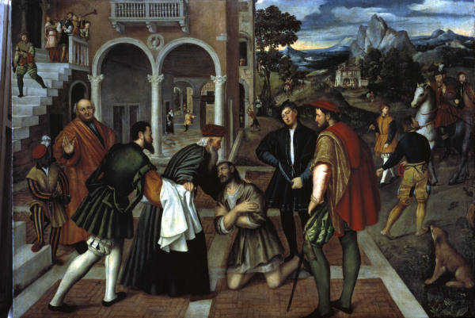
Public domain
Notes:
The Parable of the Lost Son
Luke 15:11–32

Slide 4
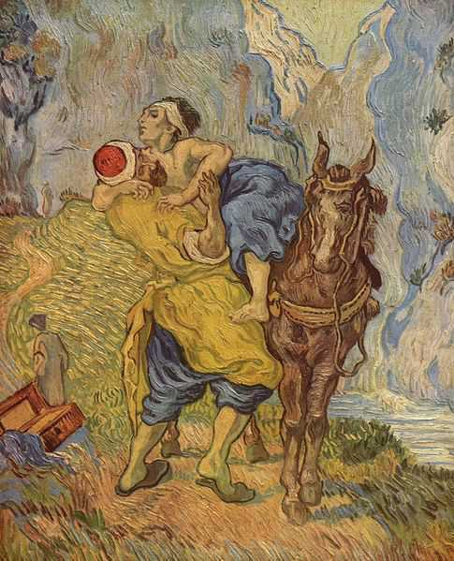
Public domain
Notes:
The Parable of the Good Samaritan
Luke 10:29–37

Slide 5
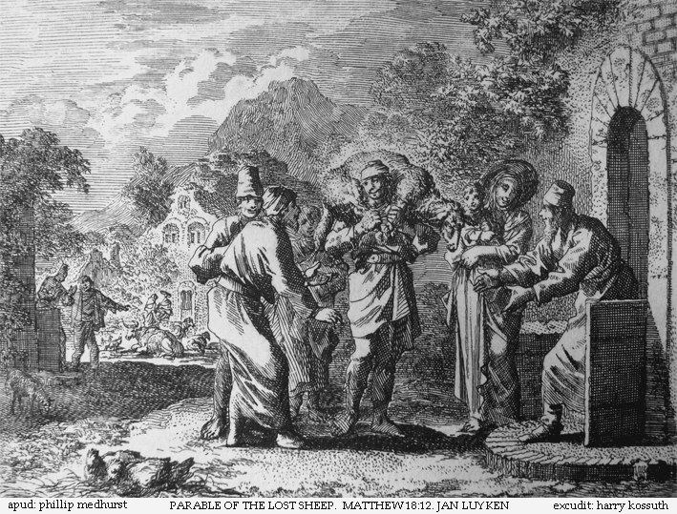
Public domain
Notes:
The Parable of the Lost Sheep
Matthew 18:10–14
Luke 15:1–7

Slide 6
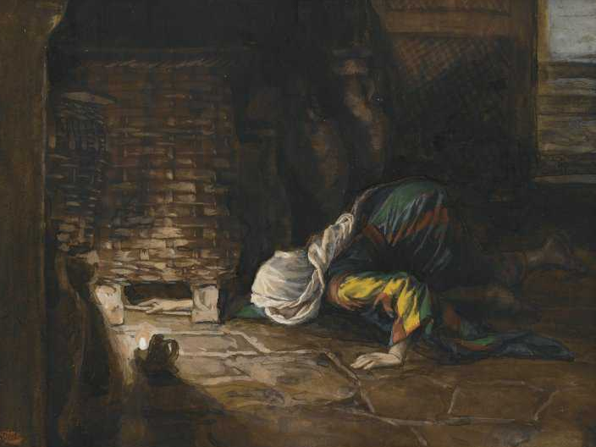
Public domain
Notes:
The Parable of the Lost Coin
Luke 15:8–10

Slide 7
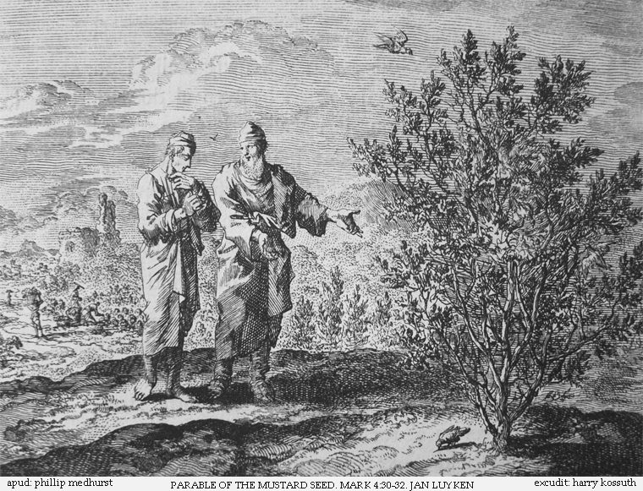
Public domain
Notes:
The Parable of the Mustard Seed
Matthew 13:31–32
Mark 4:30–34
Luke 13:18–19

Slide 8
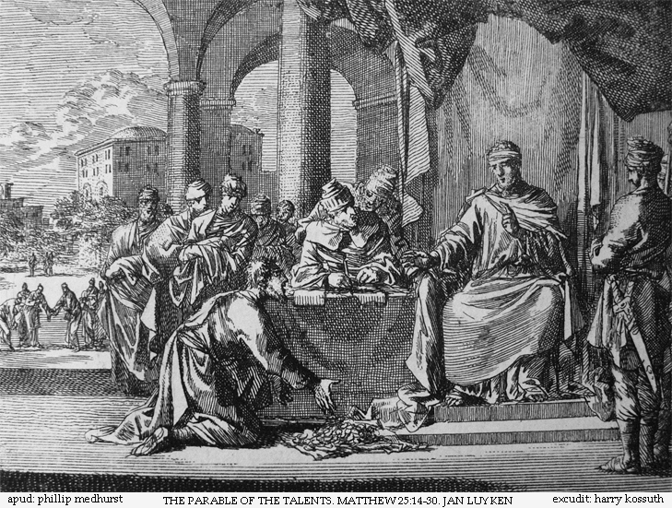
Public domain
Notes:
The Parable of the Talents
Matthew 25:14–30

Slide 9
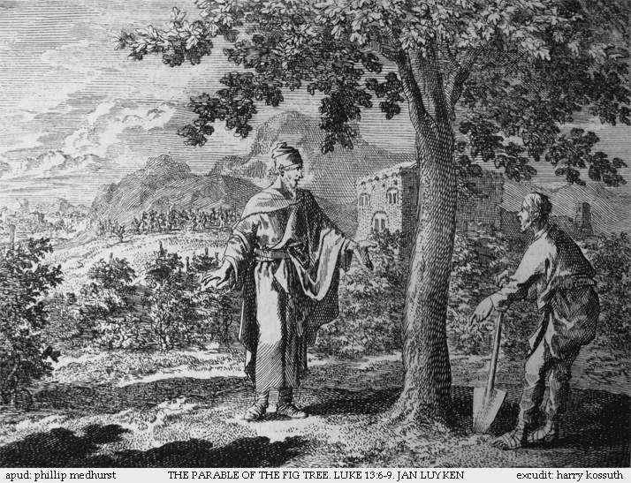
Public domain
Notes:
The Lesson of the Fig Tree
Matthew 24:32–35
Mark 13:28–31
Luke 21:29–33

Slide 10
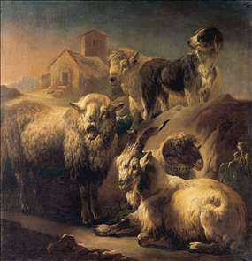
httpwww.free-stories.netimagessheepandgoatparable.jpg
Notes:
The Judgment of the Nations
Matthew 25:31–46

Slide 11
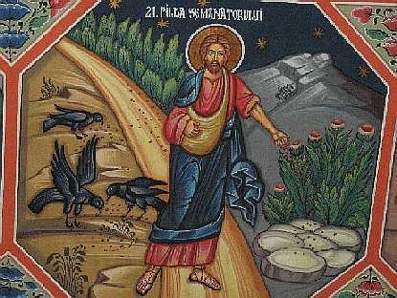
Public domain
Notes:
The Parable of the Sower
Matthew 13:1–9,18–23
Mark 4:1–9,13–20
Luke 8:4–8,11–15

Slide 12
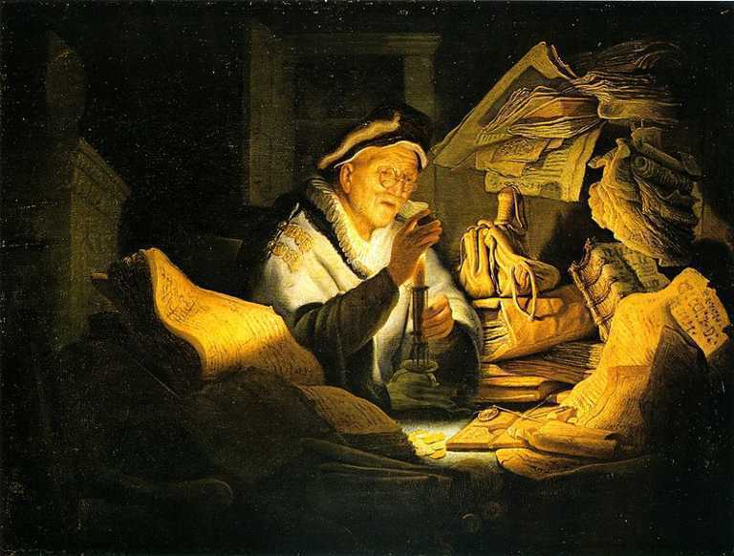
Public domain
Notes:
The Parable of the Rich Fool
Luke 12:16–21

Slide 13
Definition of a Parable
A story that uses metaphors based on daily life to convey religious truths.
Comes from the Greek word parabole, meaning “comparison.”

Slide 14
Core Elements of Parables
What are the core elements of Jesus’ parables?
Compare things.
Use elements from everyday life to relate to audience.
Contain a surprise twist to engage audience.
Describe God—God’s nature, qualities, or attributes.
Give examples of people’s relationships with one another.
Explain how God wants people to act, especially if they want to be a part of the Kingdom of Heaven.
Describe the Kingdom.

Slide 15
The Parables of Jesus
Closing discussion:
Which parable is your favorite, or which parable is most memorable to you?
What character in your favorite parable do you most relate to? Why?
Describe the overall message of the parable in your own words.
Notes:
If you do not have time, or if you wish to skip the closing discussion, consider using these questions as an exit handout for the students to complete before they leave class.

