Slide 1
Chapter 7: Confucianism
World Religions: A Voyage of Discovery
DOC ID #: TX003944

Slide 2
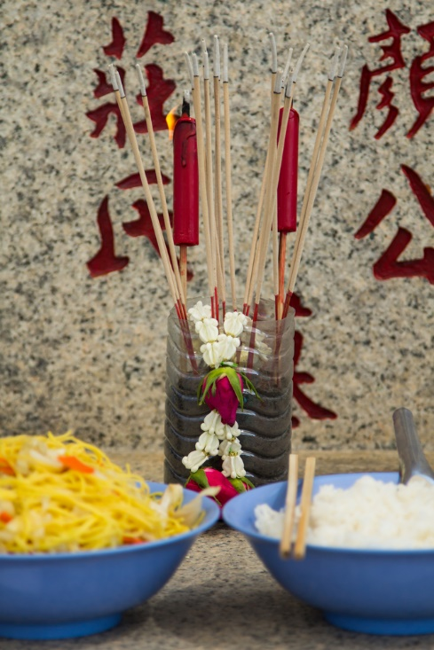
Ancestor Veneration
Ancestor veneration is an ancient Chinese tradition.
Confucius supported it by condoning filial piety.
Like other Confucian ideas, ancestor veneration is prominent throughout East Asia.
© tiverylucky / www.shutterstock.com
Notes:
Notes: Ancestor veneration had been established long before the time of Confucius (551 to 479 BC) and has endured to the present. One of China’s most important holidays is qingming, occurring 105 days after the winter solstice. On this day, all Chinese families are to publicly honor their deceased ancestors. Graves are swept and offerings—food, flowers, incense, candles—are left.

Slide 3
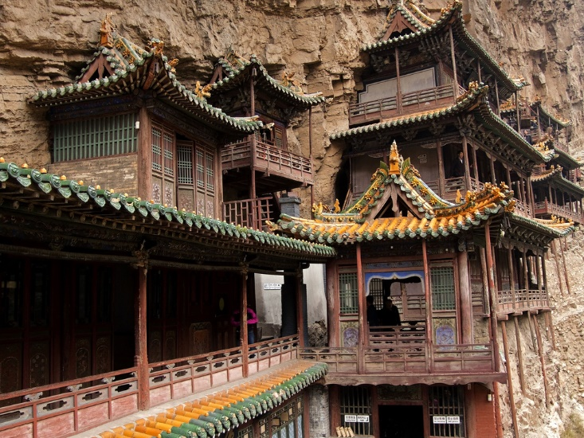
Hanging Temple
The Hanging Temple was built some fifteen hundred years ago.
It combines elements of Confucianism, Taoism, and Buddhism.
Chinese religion is a tapestry that includes the threads of all three traditions.
© Ryszard Stelmachowicz / www.shutterstock.com
Notes:
Notes: The Hanging Temple, or Hanging Monastery, is located near Datong, China. In at least one Chinese painting, Confucius, Lao Tzu, and a Buddhist arhat are depicted together: http://commons.wikimedia.org/wiki/File:Confucius_Lao-tzu_and_Buddhist_Arhat_by_Ding_Yunpeng.jpg. In the Chuang Tzu, one of the classic texts of philosophical Taoism, Confucius is depicted on one hand as something of a Taoist sage, and on the other hand as being all too Confucian, insisting on the relevance of social propriety in the face of the natural way of nature.

Slide 4
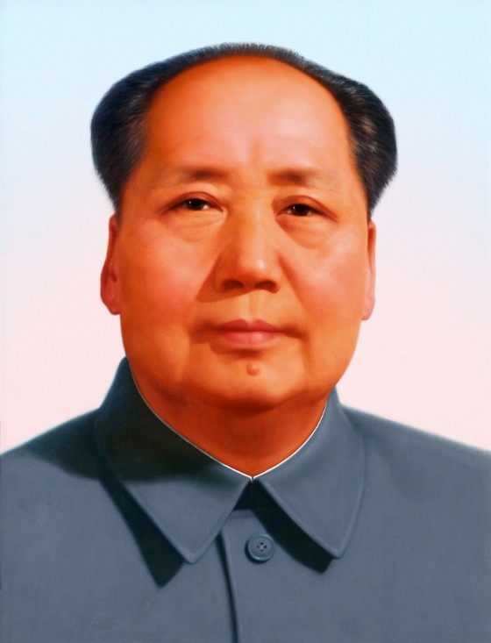
Mao Tse-tung (1893 to 1976)
Mao Tse-tung was the Chairman of the People’s Republic of China from 1949 to 1976.
Mao supported the assertively anti-Confucian Cultural Revolution campaign of 1966 to 1976.
True to Marxist teachings, Mao tried to eliminate religion.
© Hung Chung Chih / www.shutterstock.com
Notes:
Notes: The decline in China of Confucius’s relevance had begun early in the twentieth century, and by the end of Mao’s life, the explicit influence of Confucius or Confucianism was hardly noticeable. Along with seemingly stifling Confucianism, the Cultural Revolution marked the resurgence of Mao Tse-tung (or Mao Zedong) as a political leader. The Cultural Revolution (the full title of which is the Great Proletarian Cultural Revolution) sought to eliminate not only traditional and cultural elements like Confucianism, but also any hint of capitalist economy.

Slide 5
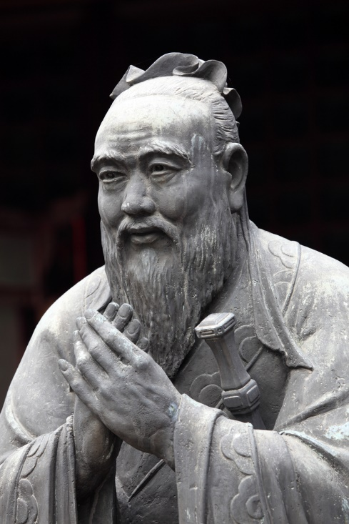
Statue of Confucius
In recent years, Confucius’s popularity and relevance has increased.
It was spurred in large part by the Chinese government.
Confucian emphasis on filial piety and ethical uprightness is attractive to the government.
© Philip Lange / www.shutterstock.com
Notes:
Notes: The statue of Confucius shown on this slide is located in the Confucian Temple in Shanghai. It is backed by a banner that reads as follows: “The role model of teacher over the past/present/future.” Much has been made recently of the resurgence of Confucius and Confucianism in Chinese society, discussed in articles like this one in the Economist: http://www.economist.com/node/9202957.

Slide 6
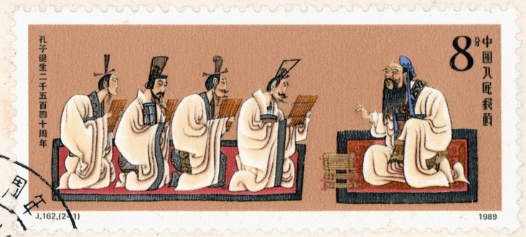
Chinese Stamp with Confucius
China’s government has once again embraced Confucius as a cultural hero.
Chinese school children are now routinely expected to learn Confucius’s teachings.
For the first time in over a hundred years, students are required to memorize passages from the Analects.
© YANGCHAO / www.shutterstock.com
Notes:
Notes: CNN did a short piece on the recent “resurrection” of Confucianism in China: http://edition.cnn.com/video/?/video/world/2011/03/08/yoon.npc.confucius.resurrection.cnn.
Viewed with the twenty-twenty vision of hindsight, Confucian ideas seem to have been too deeply ingrained all along in the ethos of China to have been vanquished by the Cultural Revolution.

Slide 7
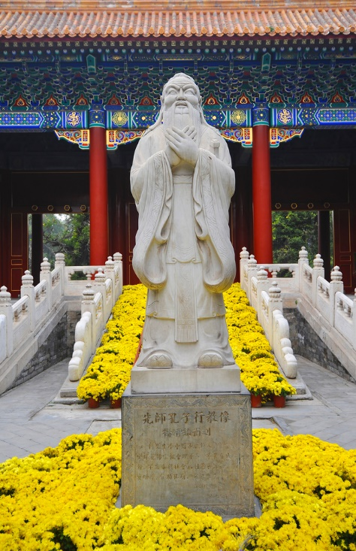
Confucius with Altar
Until the beginning of the twentieth century, Confucius was venerated as the ultimate sage.
Rituals honoring Confucius were practiced at altars.
Today’s Chinese government likely does not intend for the veneration of Confucius to be so explicitly religious.
© Hung Chung Chih / www.shutterstock.com
Notes:
Notes: It’s a longstanding scholarly tradition to dispute whether Confucianism is a religion, with many insisting it’s a form of philosophy, or at most a “humanistic” religion. Some scholars, however, assert that Confucianism is quite obviously a religion. The emphasis in Confucius’s Analects on Tian, “the force above” (though commonly translated as “heaven”), strongly suggests that Confucius was indeed a religious thinker whose entire system was grounded in this notion of transcendence. This doesn’t necessarily correspond with the tendency to revere Confucius as a quasi-divine figure.

Slide 8
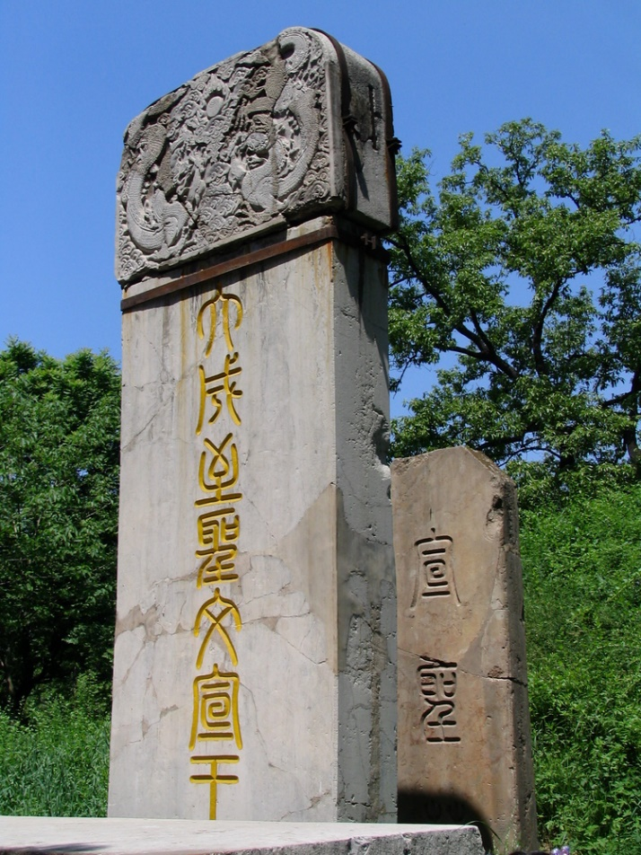
Confucius’s Tomb
Confucius’s tomb is located in his hometown of Qufu, in eastern China.
The inscription says “Ultimate Sage of Greatest Accomplishment, King of Manifest Culture.”
Some of his disciples and many of his descendants are buried in the cemetery.
© Luisa Fernanda Gonzalez / www.shutterstock.com
Notes:
Notes: Qufu is in the eastern coastal province of Shandong. Graves in the Confucian cemetery now include descendants of the seventy-sixth to seventy-eighth generations. This might provide a good opportunity to explore with the students the wide-ranging effects of Chinese veneration of ancestors, something that is relatively much less prevalent in most Western societies.

Slide 9
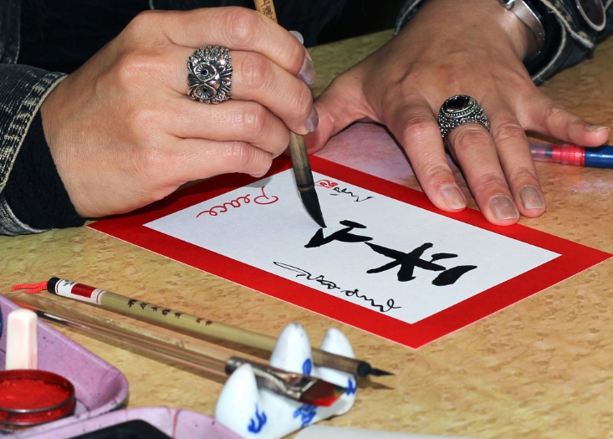
Calligraphy
Wen, the cultural arts, is beneficial for a person’s moral development.
Calligraphy is one such art.
Other Confucian arts include poetry, archery, and music.
© Alex Brylov / www.shutterstock.com
Notes:
Notes: Confucius emphasized in his teachings the importance of wen. In the Analects (8.8), he specifically integrates appreciation of poetry and music with adherence to li, proper behavior. The Confucian tradition advocated the development of six traditional art forms: rites (ethical conduct), music, archery, charioteering, calligraphy, and mathematics.

Slide 10
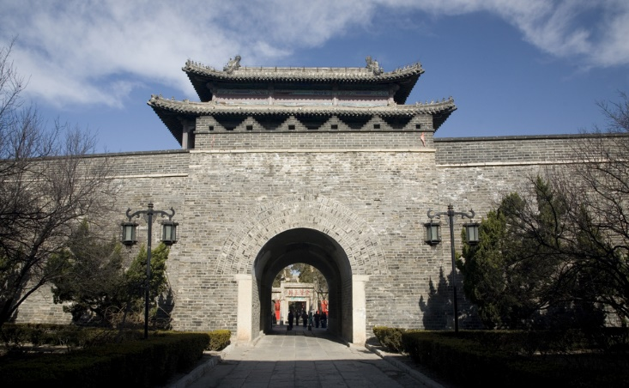
Temple of Confucius, Qufu
The largest temple of Confucius is in his hometown of Qufu.
The temple is a short distance from his tomb.
It is the largest historical building complex in China.
© Bill Perry / www.shutterstock.com
Notes:
Notes: A formally consecrated temple of Confucius has existed in Qufu almost since the time of his death; over the centuries, much larger and more elaborate temple buildings were constructed. For reliable information on the temple and other aspects of the cult of Confucius, see http://academics.hamilton.edu/asian_studies/home/CultTemp/index.html.

Slide 11
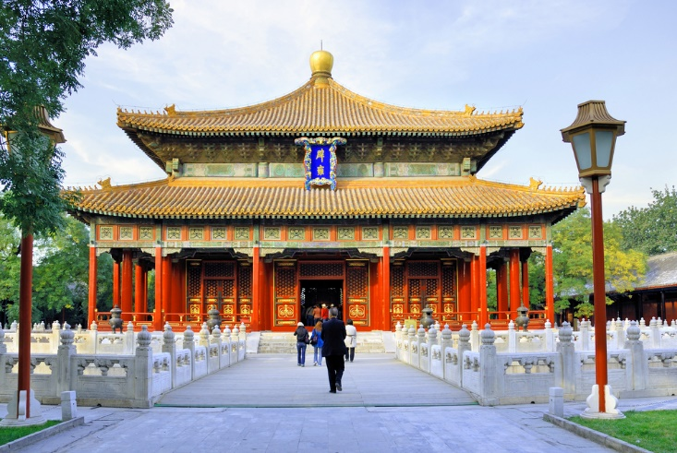
Temple of Confucius, Beijing
This is the second largest Confucian temple in China.
Chinese officials offered sacrifices to Confucius at the temple.
Temple inscriptions list the names of over fifty thousand scholars dating from 1313.
© claudio zaccherini / www.shutterstock.com
Notes:
Notes: Originally completed in 1302, the temple shown on this slide, with its great emphasis on academic learning, exemplifies the place of Confucius in Chinese culture. The scholars whose names are inscribed passed the most demanding examination on Confucian teachings. At some times and to some people a worthy recipient of religious veneration, to others a “secular” philosopher, Confucius profoundly influenced China and East Asia generally. Herbert Fingarette’s The Secular as Sacred, a modern classic, endeavors to establish the relevance of Confucian teachings for modern Western society.

