Slide 1
Introduction to the Sacraments
The Catholic Faith Handbook for Youth, Third Edition
Chapter 17
Document #: TX003148
Notes:
Use this presentation to explain the roles of symbols and grace in the Sacraments.

Slide 2
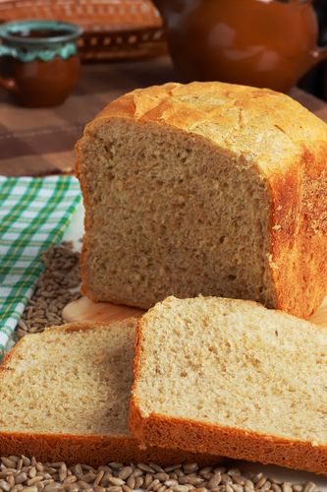
Symbol
A symbol is the comparison of something concrete and something abstract or invisible.
What are some things a bridge could symbolize?
What are some things bread could symbolize?
Copyright: Ramon Espelt Photography / www.shutterstock.com
Copyright: Ivan Majtan / www.shutterstock.com
Notes:
Encourage the students to list as many meanings for a bridge as possible (a new phase of life, graduation, death, overcoming a challenge, and so on). Do the same for bread (nourishment, basic human needs, loving care for others, transformation, manna from Heaven, Jesus’ sacrifice). State that the Eucharistic bread is clearly symbolic, but also more than that. The remaining slides support that concept.

Slide 3
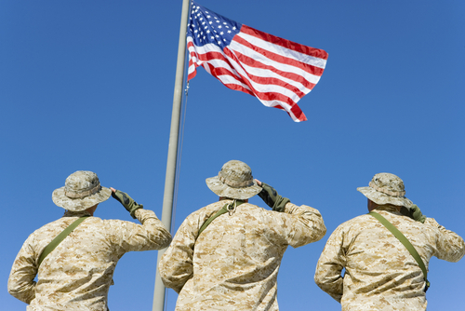
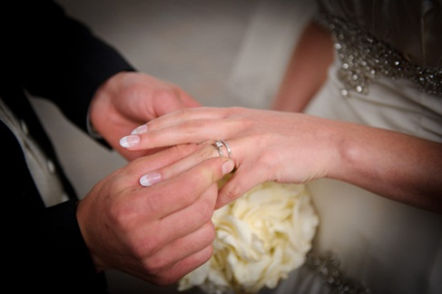
Ritual
A ritual is a symbolic action.
What could the action of saluting the flag symbolize?
What could the action of giving a spouse a wedding ring symbolize?
Copyright: bikeriderlondon / www.shutterstock.com
Notes:
Pause for answers to the questions: saluting the flag (patriotism, allegiance, military strength, unity); giving a wedding ring (faithfulness, love, unity). State that the Eucharistic rituals are symbolic too, but also more.

Slide 4
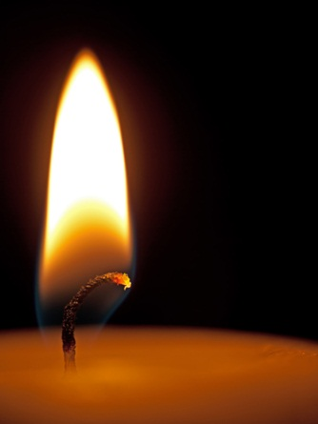
In your various experiences of the Church’s worship, what symbol or ritual means the most to you? Why?
Copyright: sarah2 / www.shutterstock.com
Notes:
Invite the students to share their answers, prompting them to think of events throughout the Liturgical Year. You might also share symbols and rituals that are particularly meaningful for you.

Slide 5
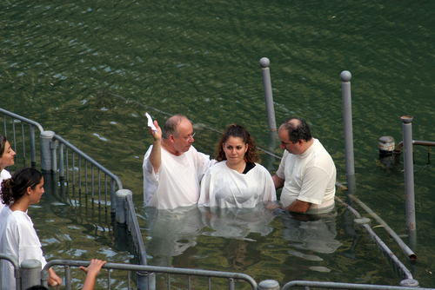
Sacraments Are More Than Symbols
Sacraments are not simply human-made symbols or rituals.
Jesus himself acts in the Sacraments.
The Sacraments effect change in us and in the world.
Copyright: Zvonimir Atletic / www.shutterstock.com
Notes:
Introduce the term efficacious. Explain that the Sacraments will only change us if we are ready to be changed, if we have the proper disposition.

Slide 6
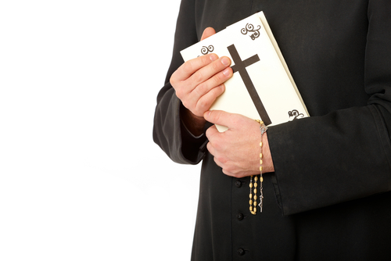
Grace
The free and undeserved gifts we receive from God
The experience of being loved as a child of God
Grace empowers us to live lives of love in service to God and others.
Copyright: Monika Wisniewska / www.shutterstock.com
Notes:
Invite the students to read the Did You Know? sidebar about the different kinds of grace, on page 183 of the student handbook.

Slide 7
Seven Ways God’s Grace Is Active
We are brought to new life.
We are strengthened by the Holy Spirit.
We share in Jesus’ sacrifice, death, and Resurrection.
Our sins are forgiven.
We are healed of illnesses.
We may serve others through a special call to minister in the Church.
We may share love and the creation of new life in marriage.
Copyright: bikeriderlondon / www.shutterstock.com
Notes:
Ask the students to identify the Sacraments associated with each grace. Then have them turn to page 189 to read about the essential sacramental symbol in each Sacrament.

Slide 8
Copyright: bikeriderlondon / www.shutterstock.com
Baptism, Confirmation, and the Eucharist = Sacraments of Christian Initiation
Penance and Reconciliation and Anointing of the Sick = Sacraments of Healing
Holy Orders and Matrimony = Sacraments at the Service of Communion

Slide 9
How do you prepare for and actively participate in the Sacraments?
Copyright: Patryk Kosmider / www.shutterstock.com
Notes:
You may wish to refer the students to the statement on page 186 in the student handbook: “You must be prepared for and actively participate in the Sacraments if the grace given by God in them is to have an effect in your life.” Invite them to reflect on the question, and then ask them to journal on this question.

