Slide 1
The Bible’s Big Picture
The Catholic Faith Handbook for Youth, Third Edition
Chapter 3
Document #: TX003134
Notes:
Use this presentation to provide an overview of salvation history as outlined in chapter 3 of the student handbook.

Slide 2
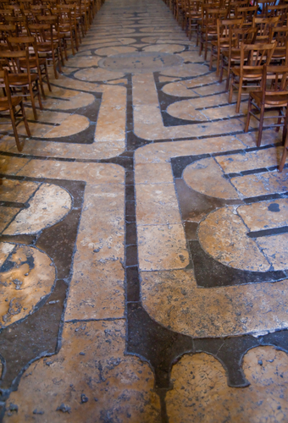
Salvation History
God works within the people and events of human history.
God’s goal is to restore our lost union with him.
Each one of us is an active participant in God’s plan.
Copyright: Jaime Pharr / www.shutterstock.com
Notes:
Comment that salvation history is commonly divided into different periods, which you will be covering.

Slide 3
Primeval History
God creates the world and all that is in it.
All God’s creatures are good and live in harmony with one another and with him.
Our first human parents, Adam and Eve, sin.
Original Sin is passed on to all human beings.
Without God’s help, sin leads to death and destruction.
Copyright: James Steidl / shutterstock.com
Notes:
Explain that the sin of Adam and Eve injured their perfect relationship with God.

Slide 4
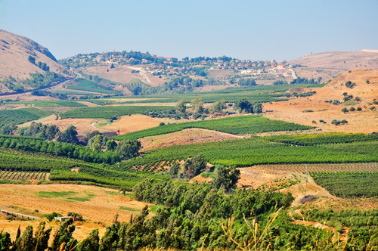
The Patriarchs
God begins to form a special relationship with a chosen race of people.
God makes a covenant with Abraham.
Copyright: Lara65 / www.shutterstock.com
Through Abraham and Sarah’s children, grandchildren, and great-grandchildren, we can see a repeating pattern of crisis and God’s faithfulness.
Notes:
Explore with the students some of the ways Abraham’s descendants ultimately became a blessing for the entire world, as God had promised. (The Jewish people gave the world knowledge of the one true God, the Ten Commandments, the Bible, and of course Jesus, the Savior of the world.)

Slide 5
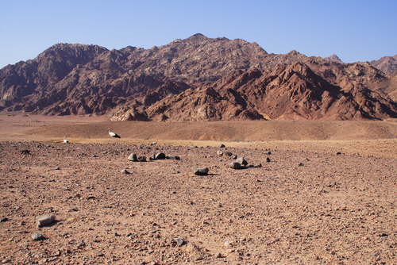
Egypt and the Exodus
God’s people are enslaved in Egypt.
God chooses Moses to lead the Exodus.
God gives Moses the Ten Commandments.
The people wander the desert for forty years.
Copyright: VIZE / www.shutterstock.com
Notes:
Explain that God was leading the Israelites to the land he had promised to give to Abraham’s descendants, but the people kept losing faith in God. Explore the metaphor of desert wandering with the students. Ask for examples of people who have kept their faith in God while God led them through “a desert,” or a difficult time.

Slide 6
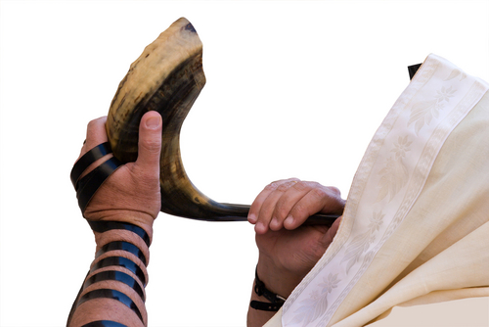
Settling the Promised Land
Joshua leads the people into the Promised Land.
Only when the Israelites trust God are they successful in battle.
God calls judges, or warrior-leaders, to secure and defend the land.
Copyright: Mikhail Levit / www.shutterstock.com
Notes:
Explain that when people forget the covenant, or disobey God, their enemies defeat them.

Slide 7
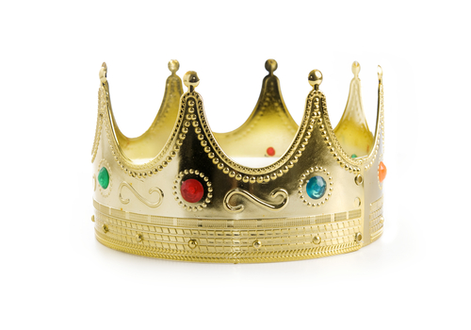
The Kingdoms of Judah and Israel
The first kings unite the Twelve Tribes into one kingdom.
After Solomon’s death, the kingdom splits into Israel and Judah.
God calls prophets to be “covenant reminders.”
The people continue to turn away from the covenant, so their kingdoms are conquered by enemies.
Copyright: Paul Matthew Photography / www.shutterstock.com
Notes:
Explain that God is the true leader of the Israelites and that the kings are able to lead well only when they lead according to God’s laws.

Slide 8
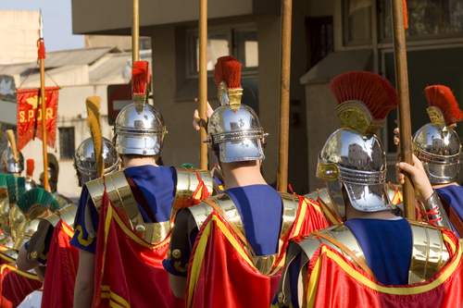
The Exile and Return
Following the Babylonian conquest, the nation of Israel was no more, and many of the Israelites were taken into captivity.
Copyright: Carme Balcells / www.shutterstock.com
A new king allowed the Jews to return and rebuild.
Alexander the Great invades, but eventually the Jews regain independence.
Soon another conquering nation arrives, the Romans.
Notes:
Explain that during the Exile, when many Jews lived far from their own land, the words of God’s prophets provided comfort and hope.

Slide 9
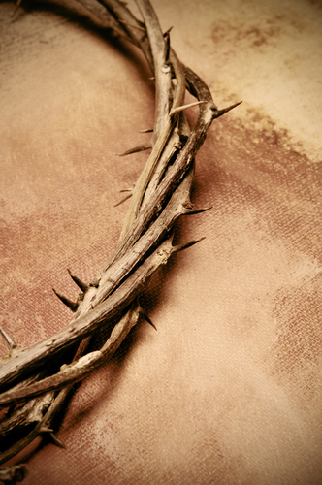
The Life of Jesus Christ
God sent Jesus into the world as the ultimate event in salvation history.
Jesus is the anointed Messiah, but his kingdom is not of this world.
After Jesus’ execution, he is raised from the dead.
Copyright: nito / www.shutterstock.com
God established a New Covenant with all of humanity through Jesus’ sacrifice.
Notes:
Explain that some of the Jews, after having been conquered so many times, hoped for a warrior and king who would set them free from Rome.

Slide 10
The Early Church
God sends the Holy Spirit to empower Peter and the other followers of Christ.
The missionary Paul preaches the Good News to Jews and non-Jews.
Christianity spreads throughout the Roman Empire.
Copyright: Dmitry Naumov / www.shutterstock.com
Notes:
Explain that Jesus’ followers received the Holy Spirit at Pentecost, and it enabled them to do the work that the Risen Jesus had given them: to spread the Gospel to all people and to baptize.

Slide 11
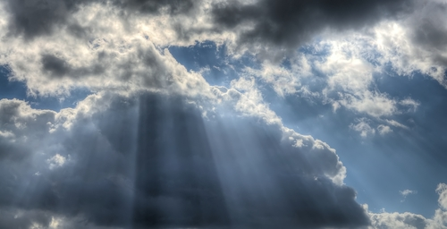
The Last Things
The Church spreads the Good News of salvation.
God calls us all to be part of his Kingdom.
Jesus taught about a Final Judgment at the end of time.
The Bible assures us that good will overcome evil.
Copyright: Lion_&_Croc / www.shutterstock.com
Notes:
Explain that throughout the Bible human disobedience gets in the way of the fulfillment of God’s plan, but that Scripture assures us that God’s goal will ultimately be fulfilled. Ask the students to recall what God’s ultimate plan is. (Restoring humanity’s lost union with God, to save all of humanity, or to allow all people to enjoy the joy of God’s eternal Kingdom.)

