Slide 1
The Sacrament of Pardon and Peace: Parts I and II
The Sacraments
Document #: TX002171
Notes:
Notes: This first part will be a discussion of disorder and sin. In the following slides, we’ll discuss what disorder or sin each image represents. (You may ask the students to comment, use the comments below each picture, or show the pictures once in silence and then go back for discussion.) The question is this: Do we participate in these sins to any degree? Remember, our complacency and inaction can be just as clearly a sin as our actions.

Slide 2
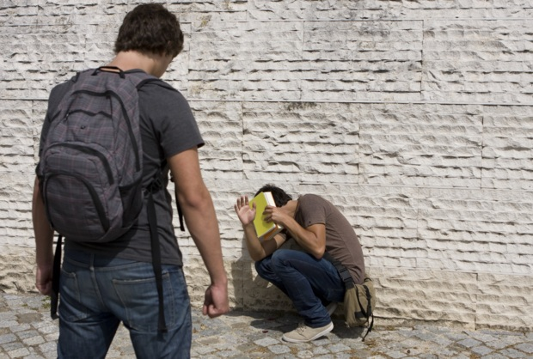
© pjcross/shutterstock.com
Notes:
Teacher Notes: Anger begins in the heart. If not dealt with (sometimes simply by counting to ten or walking away), angry feelings (which are not in themselves sinful unless cultivated and encouraged) spill into violence.

Slide 3
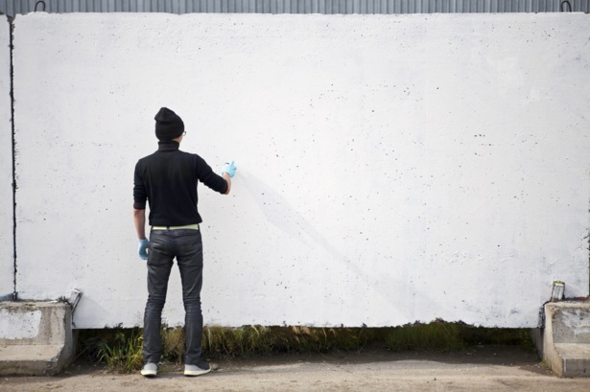
© Lena Sergeeva /shutterstock.com
Notes:
Do graffiti artists have the right to mark up private property—homes, garages, fences, walls, or other buildings that people have worked to maintain? Should art be invited into our lives or imposed on us by others?

Slide 4
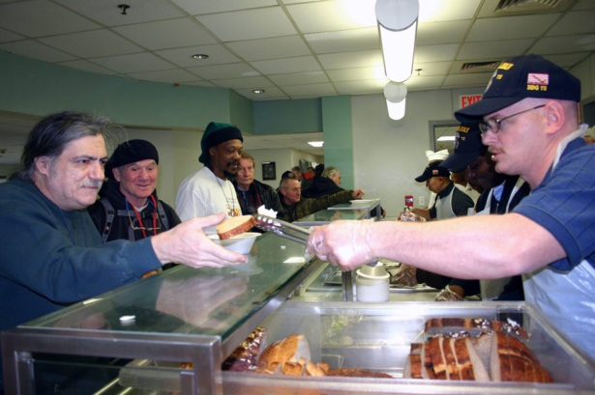
Image from Public Domain
Notes:
Teacher Notes: Homelessness is a sin because it does grave harm to the dignity of the human being, and to human physical and mental health. Children who are victims of homelessness often suffer both emotionally and physically, and in ways that jeopardize a happy future (i.e., falling behind in school, not making lasting friends, etc.).

Slide 5
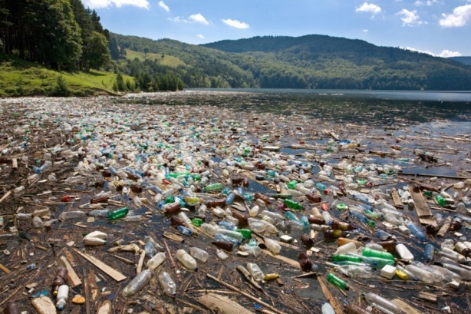
© Stéphane Bidouze /shutterstock.com
Notes:
Pollution: Do we care for our immediate environment at school and at home? What is our role in the greater environment of our region, our country, our world?

Slide 6

© Vadym Drobot /shutterstock.com
Notes:
“Sex sells” in our society—whether it is tea, coffee, blue jeans, or cars. Can you think of instances where advertising has crossed the line into sexual exploitation? How do we contribute to this atmosphere?

Slide 7
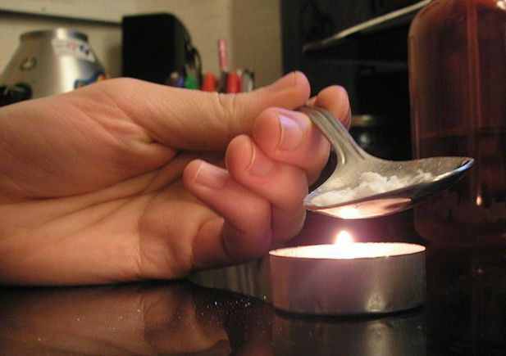
Image from Public Domain
Notes:
Our culture is heavily influenced by drugs and alcohol, and often these substances destroy lives and families.

Slide 8
Image from Public Domain
Notes:
Poverty is still a reality for many people in our country, as well as in other places in the world. What do you know about poverty? What can you do about helping to bring about better living conditions for people caught in the web of poverty?

Slide 9
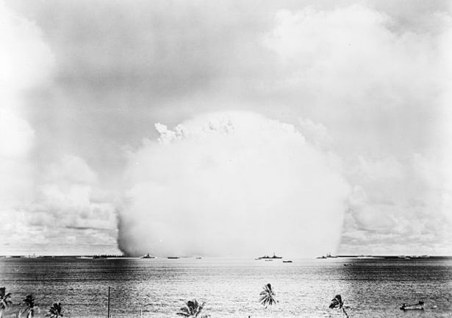
Image from Public Domain
Notes:
Nuclear destruction is a terrible possibility for the human race. How can we resolve our conflicts—in our own lives as well as between nations?

Slide 10
The Sacrament of Pardon and Peace: Part II
Notes:
Notes: This second part will be a discussion of sin and its consequences.

Slide 11
What Is Sin?
An utterance, a deed, or a desire contrary to the eternal law.
Notes:
Notes: In order for us to understand the power of forgiveness in the Sacrament of Penance and Reconciliation, we must understand the nature of sin. Invite a couple students to put this definition from the Catechism of the Catholic Church (see 1849) into their own words.

Slide 12
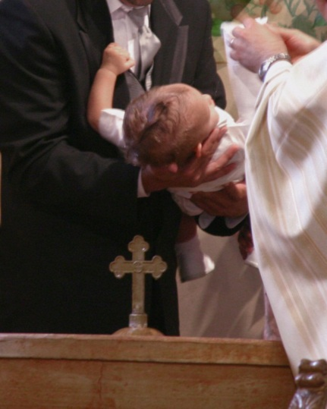
How Does Sin Affect Our Lives?
Isn’t Baptism enough to overcome sin?
© J. McPhail /shutterstock.com
Notes:
Notes: Allow students to respond. Use the following information as needed:
• When I sin I have not acted in genuine love for God, myself, and my neighbor.
• I may have chosen selfishly for my own pleasure, or I may have failed to act because I was afraid of what someone else would think.
• Either way, I have exercised my freedom in a way that is contrary to God’s Law of Love.
• Sometimes we are more aware of the effects of other people’s sins on us than of our own sins, because sin, paradoxically, blinds us to our own faults.
• Even if we have been baptized, we have a tendency to sin. We need God’s grace continuously to overcome sin.
• That is why the student book describes the Sacrament of Penance and Reconciliation as “the second plank.”

Slide 13

Invitations To Do Wrong
“What if everybody does it?”
© Kurhan /shutterstock.com
Notes:
Notes: Why is it important to respond to the subtle or sometimes not so subtle “invitations” to do things that you know are wrong but that “everybody” does anyway?
Discuss ways to resist peer pressure, and encourage responses from the students.

Slide 14
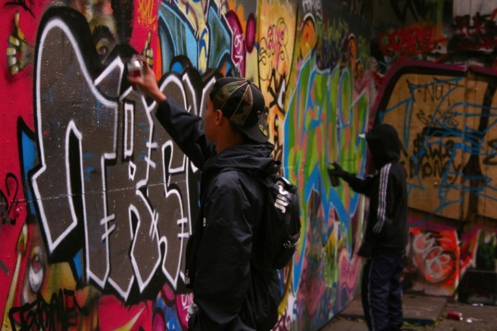
Are Actions in a Group Less Sinful?
Are you in?
© Sam Cornwell /shutterstock.com
Notes:
Notes: Why do actions taken by a group often seem less sinful than choices you would simply make on your own?
A type of blindness that we experience sometimes is to think that things that are done by many people, even though they are wrong, are somehow justified. This attitude is pervasive in popular culture, and can readily be seen in television series, movies, and on many Internet sites.

Slide 15

Everybody Does It
Sin and Technology
© cobalt88/shutterstock.com
Notes:
Notes: Have the students name some things that “everybody” supposedly does. You may want to discuss sins and the Internet—cyberbullying, gossiping, plagiarism, and so on. Remind the students that a lie via social media is still a lie, and even telling the truth about someone and thus damaging their reputation is also a sin—the sin of detraction. This sin makes it impossible for someone to put the past behind and maintain a good reputation in the future. You may want to discuss the concept of intellectual property, the ownership of ideas, and why this is important in our society.

Slide 16

Does a Group Have a Conscience?
© Kirsty Pargeter/shutterstock.com
Notes:
Notes: Allow the students to answer. Use the following information as needed:
• The answer is no. Only individuals have a conscience.
• Doing something that is wrong because a group is doing it only compounds the harm that is done.
• There is no such thing as “everybody” in the sense of a “collective sinner.”
• The reality is that we are social beings; we have to be as fully conscious and attentive as possible to what is going on around us because we are influenced by what other people do and think.
• If we are not attentive, we may end up abdicating our freedom, little by little.

Slide 17

Is Social Sin a Reality?
© blinkblink/shutterstock.com
Notes:
Notes: Social sin does exist. However, the phrase “social sin” is used to describe the collective sins in which many people participate, and their effect. For example, the widespread use of expletives in everyday language is a social sin. Consumerism is a social sin.

Slide 18

Everyday Sin
© vectomart/shutterstock.com
Notes:
Notes: What is the theological name and definition of the sins we commit practically every day that are harmful and that weaken but do not rupture our relationship with God and one another? Allow the students to answer.

Slide 19

Venial Sin
Still in God’s Embrace
© beboy/shutterstock.com
Notes:
Notes: Use the following information as needed: Venial sins are slight sins that do not break our friendship with God, though they do injure it. Venial sins diminish our personal character and weaken but do not rupture our relationship with God.
What might the results be if you commit the venial sin of gossiping a bit day after day about one of your friends?
Notes: Allow students to answer. Use the following as needed:
• Perhaps point out that the danger of less serious sins repeated over and over is that they do, as a matter of fact, weaken our character. We are then more vulnerable to committing a more serious sin. Even the cumulative effect of venial sins may become a serious situation.

Slide 20
Serious Sin
Notes:
Notes: What is the theological name and definition of a sin that is so contrary to God’s Law that it actually separates us from God?

Slide 21

Mortal Sin
Willful Separation from God
© ducu59us/shutterstock.com
Notes:
Notes: Use as needed: Mortal sin is the knowing and willful violation of God’s Law in a serious manner. Mortal sin is called mortal because it is the spiritual death of the soul (separation from God). If we are in the state of grace, it loses this supernatural life for us. If we die without repenting, we will lose God and his life for all eternity. However, by turning our hearts back to God and receiving the Sacrament of Penance and Reconciliation, we are restored to his friendship.
We may not receive Communion if we have unconfessed mortal sins.
What are the three conditions for a sin to be mortal?

Slide 22
Mortal Sin: Three Conditions
A grave matter
Full knowledge
Full consent
Notes:
Notes: Use as needed: For a sin to be a mortal sin, three conditions must be met: the act must involve grave matter, the person must have full knowledge of the evil of the act, and the person must give his or her full consent in committing the act.
Note: Avoid a lengthy or argumentative discussion about what constitutes a grave matter. Suffice it to say that certain actions are grave by definition, such as murder.

Slide 23
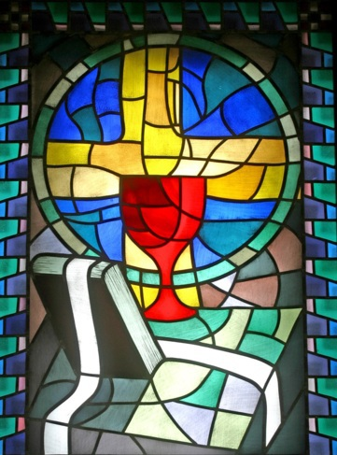
Forgiveness of Sins
Indulgences
© Zvonimir Atletic/shutterstock.com
Notes:
Notes: Besides the Sacraments of Baptism and Penance and Reconciliation, there are other forms of forgiveness that come through the Church.
It is important to know that the Church offers indulgences, which are the means by which the Church takes away the punishment that a person would receive in Purgatory. Indulgences may be given as part of a special devotion, and at times they are granted by the Pope.

Slide 24
Consider This:
Which sin do you think you would have to commit to be totally separated from God?
Notes:
Notes: This is a rhetorical question and not to be answered. But remind the students that they are not likely to sin heinously; however, it is possible, because they do have free will.

Slide 25
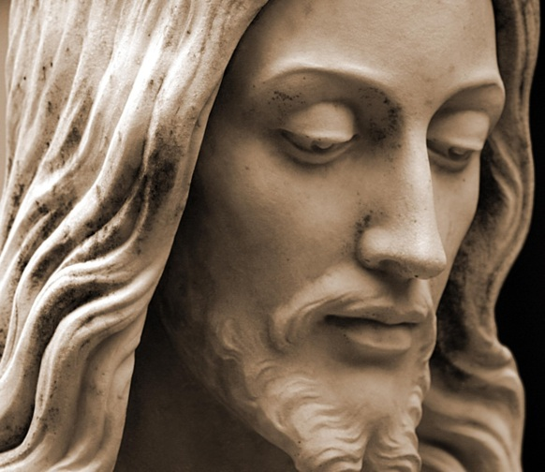
Fundamental Option
© Richard Paul Kane /shutterstock.com
Notes:
Notes: The notion of a “fundamental option” proposed by theologians such as Fr. Avery Dulles, SJ, may be helpful here. Essentially this means that many Christians make a fundamental choice to follow Christ and to live their lives according to Christian values. Even though such people may have moral lapses, the fundamental direction of these people’s lives is not altered.

Slide 26
Why Is the Church’s Teaching on Mortal Sin Important?
Notes:
Notes: Invite student answers. Use the following information as needed:
• To claim that we have free will must be to admit the possibility that one could turn totally away from God.
• Therefore, developing a formed conscience, which is a lifelong process, is important for all of us.

Slide 27
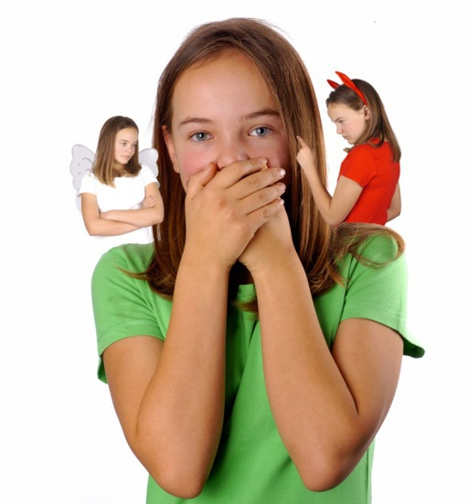
Why Do Good and Avoid Evil?
© Belinda Pretorius/shutterstock.com
Notes:
Notes: What is the ultimate purpose of doing good and avoiding evil? Is it to avoid Hell, or is it to grow in union with God and our fellow human beings?

Slide 28
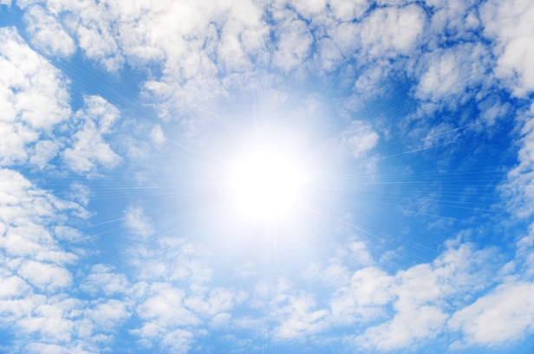
Heaven
© Galushko Sergey/shutterstock.com
Notes:
Notes: A person must be in a state of grace to attain the state of Heaven (see CCC, 1023). Also note that we do not know what Heaven “looks like,” and any image will be lacking. An image is only an attempt to portray perfect happiness.
Definition: Heaven is a state of eternal life and union with God in which one experiences full happiness and the satisfaction of the deepest human longings.

Slide 29
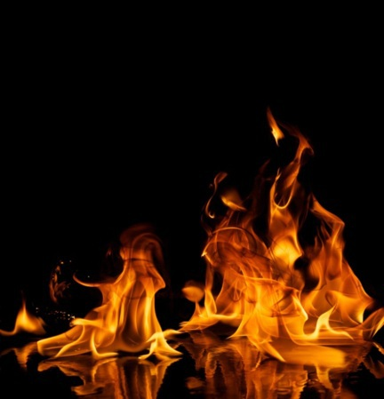
Hell
© Nejron Photo/shutterstock.com
Notes:
Notes: A person must be in a state of mortal sin to reach the consequences of Hell (see CCC, 1033). Heaven or Hell are not so much rewards or punishments, but choices!
Definition: Hell is the state of permanent separation from God, reserved for those who freely and consciously choose to reject God to the very end of their lives. The existence of Hell is consistent with divine justice, as God respects human freedom, and those who are lost actually condemn themselves by their resistance to the grace of God.
Again, note that we do not know what Hell really is or looks like. The symbolic image of flames is often used to portray the pain and agony of separation from God and separation from perfect love and happiness.

Slide 30
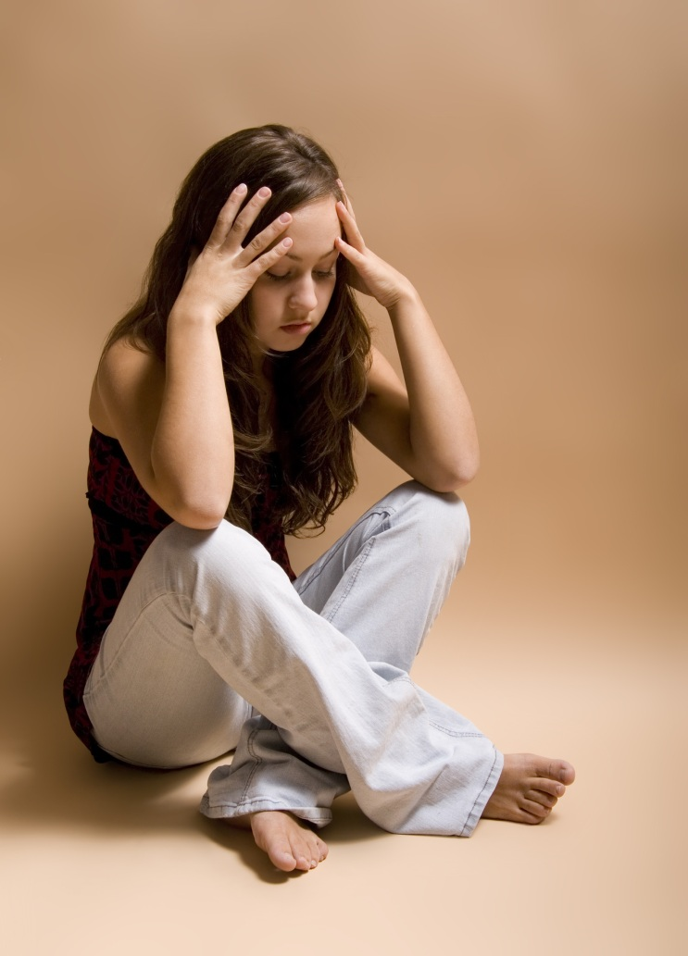
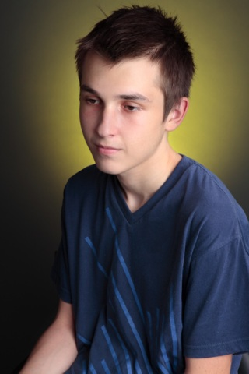
Sacrament of Penance and Reconciliation
When Baptism Isn’t Enough
© @erics/shutterstock.com
© Leah-Anne Thompson/shutterstock.com
Notes:
Notes: This brings us full circle to where we began: Do we need the Sacrament of Penance and Reconciliation? Isn’t our Baptism enough? Use the following information as needed:
• You have already studied, in a previous course, the relationship between grace and free will.
• We have been given the gift of free will, but we are affected by Original Sin, which means that we have a tendency toward sin.
• Most of us know, almost instinctively, that we need God’s grace. The reality is that we continue to sin.
• As we continue exploring the meaning of the Sacraments of Healing, we will also continue to consider their value in our lives.

Slide 31
Questions or Comments?
Notes:
Notes: Invite the students to ask questions or make comments. Encourage them to ask questions to see how clearly they understand that all people sin but that not all sins are of equal gravity. God is always ready to forgive those who are sincerely sorry and want to do better.

