Slide 1
God’s Presence in Nature
Document #: TX004697
Notes:
Notes:
This PowerPoint is designed for teachers who would like to provide a reflective, scripturally-based prayer experience in conjunction with learning experience 6.
You may wish to create an atmosphere in your classroom that is conducive to reflection by playing soft music and/or by lighting a candle. In addition, if your school community has a tradition of beginning and/or ending times of prayer in a particular fashion—such as making the Sign of the Cross or invoking the name of your school’s patron saint—then follow those procedures at the beginning and/or ending of this presentation. This will help the students to understand that this is meant to be a time of prayer.
As you proceed through the slides, have the students take turns reading aloud the Scripture passages that appear there.
Do not allow conversation or discussion during the presentation—simply invite the students to enjoy the images and to reflect prayerfully on the interplay of the images with the passages.
Following the presentation, you may wish to invite students to share and discuss which image was most striking to them and/or which Scripture passage stood out to them the most.

Slide 2

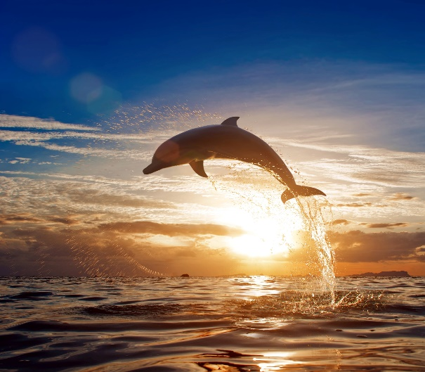
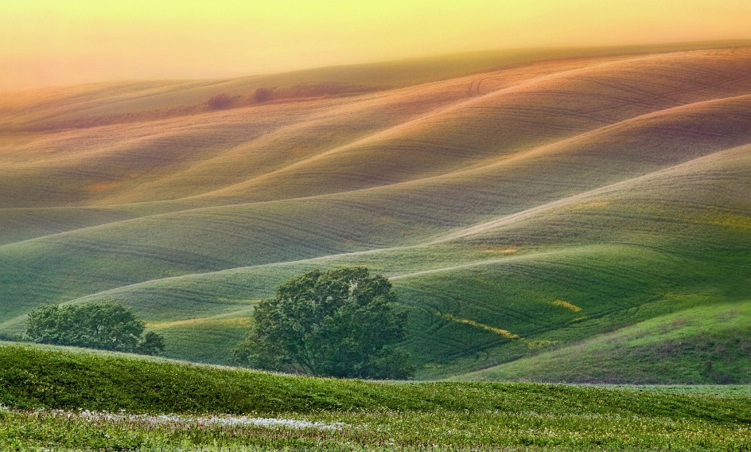
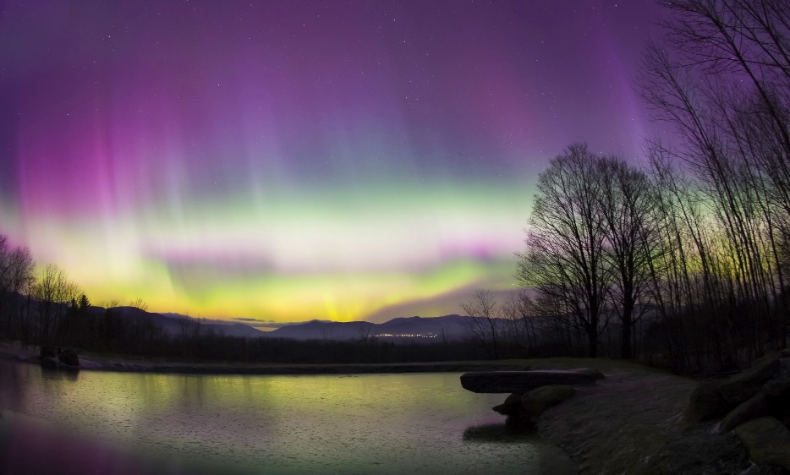
God, Creator of the Universe
“God looked at everything he had made, and found it very good.”
‒ Genesis 1:31a
© Willyam Bradberry / Shutterstock.com
© Petr Jilek / Shutterstock.com
© Don Landwehrle / Shutterstock.com

Slide 3
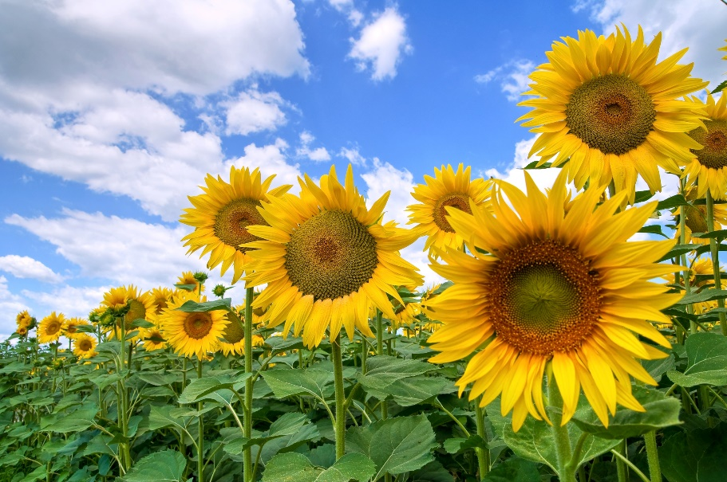
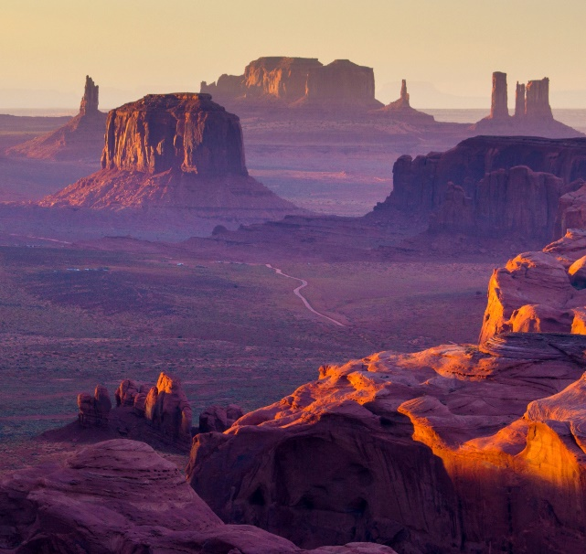
God Created All Living Beings
“Then the Lord looked upon the earth,
and filled it with his blessings.
Its surface he covered with every kind of living creature. …”
‒ Ben Sira 16:29‒30
© Petr Jilek / Shutterstock.com
© Mi.Ti. / Shutterstock.com
© Francesco R. Iacomino / Shutterstock.com

Slide 4

Human Beings Reflect God’s Glory
“The Lord created human beings from the earth, and makes them return
to earth again. …
He endowed them with strength like his own.”
‒ Ben Sira 17:1,3a
© Steve Debenport / iStockphoto.com

Slide 5

God Created Human Diversity
“The God who made the world and all that is in it, the Lord of heaven and earth. … He made from one the whole human race to dwell on the entire surface of the earth.”
‒ Acts of the Apostles 17:24a,26a
© Rawpixel / Shutterstock.com

Slide 6


God Created the Heavens
“When I see your heavens, the work of your fingers,
the moon and the stars that you set in place—
What is man that you are mindful of him,
and a son of man that you care for him?
Yet you have made him little less than a god,
crowned him with glory and honor.”
‒ Psalm 8:4‒6
© Somchai Som / Shutterstock.com
© blvdone / Shutterstock.com

Slide 7
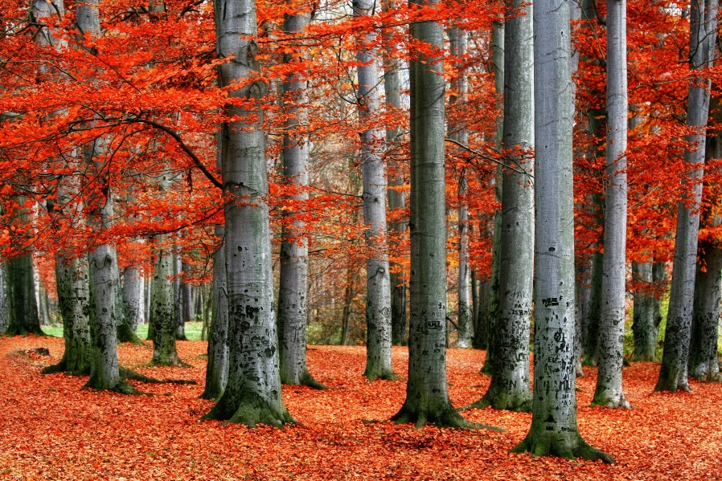
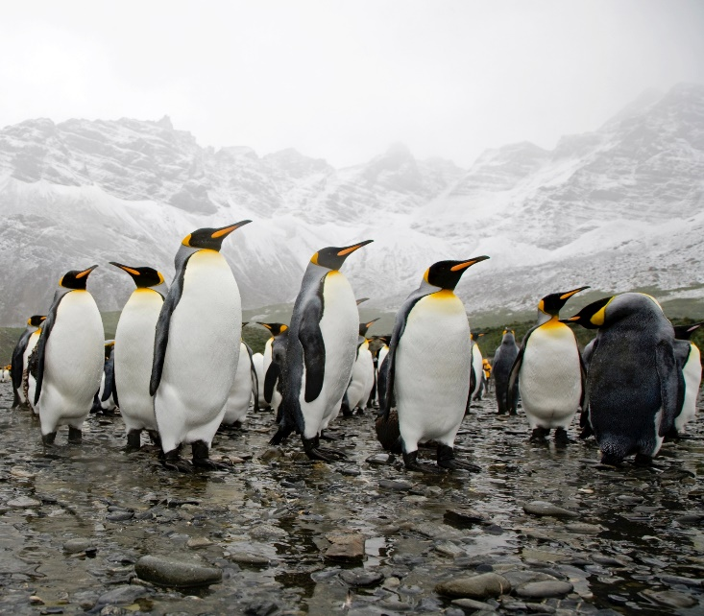

All Creation Speaks of God’s Glory
“The heavens declare the glory of God;
the firmament proclaims the works of his hands.”
‒ Psalm 19:1
© Robsonphoto / Shutterstock.com
© Mlenny / iStockphoto.com
© Ethan Daniels / Shutterstock.com

Slide 8


God’s Wisdom in Creation
“The Lord by wisdom founded the earth,
established the heavens by understanding;
By his knowledge the depths are split,
and the clouds drop down dew.”
‒ Proverbs 3:19‒20
© Kichigin / Shutterstock.com
© Olena Savytska / iStockphoto.com

Slide 9



We See God in Natural Beauty
“From the greatness and the beauty of created things
their original author, by analogy, is seen.”
‒ Wisdom 13:5
© Joe Ferrer / Shutterstock.com
© PHOTOCREO Michal Bednarek / Shutterstock.com
© Nitr / Shutterstock.com

Slide 10
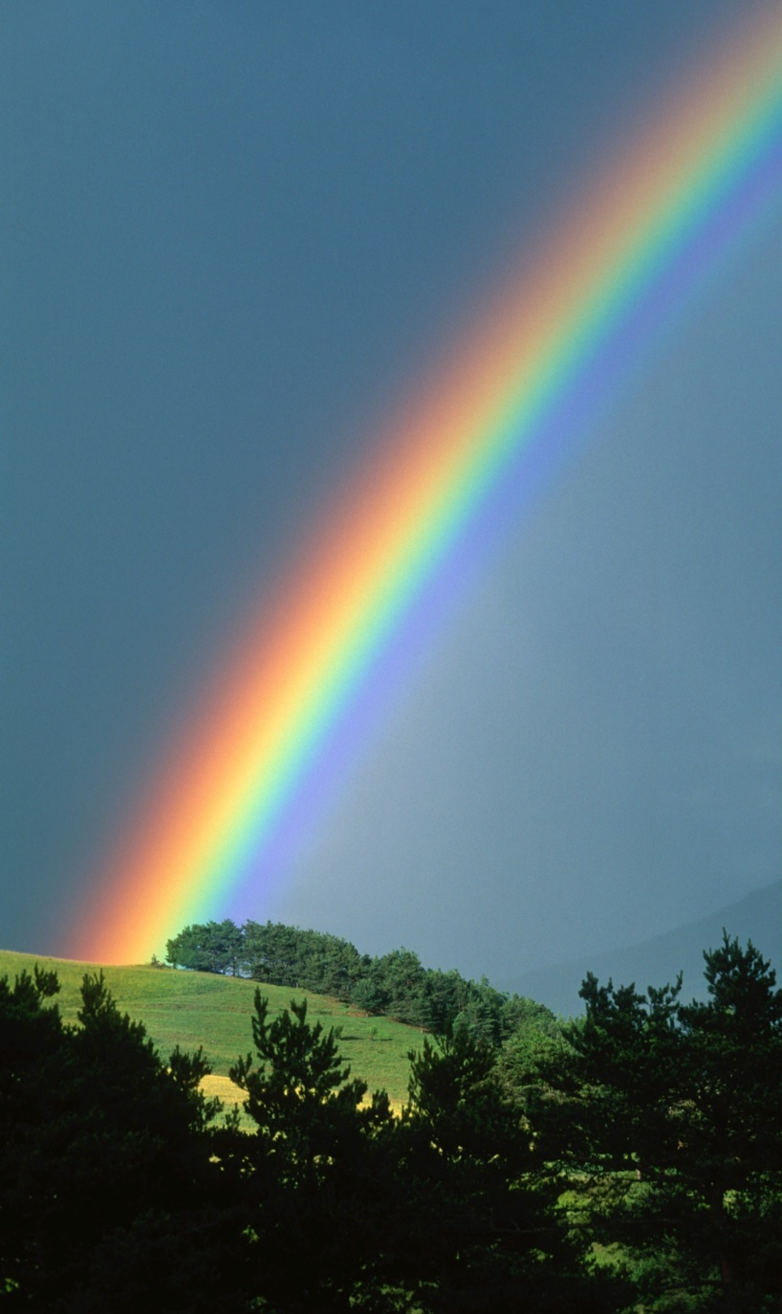

Seeing God
through Visible Creation
“Ever since the creation of the world, his invisible attributes of eternal power and divinity have been able to be understood and perceived in what he has made.”
‒ Romans 1:20
© Im Perfect Lazybones / Shutterstock.com
© gui00878 / iStockphoto.com

Slide 11

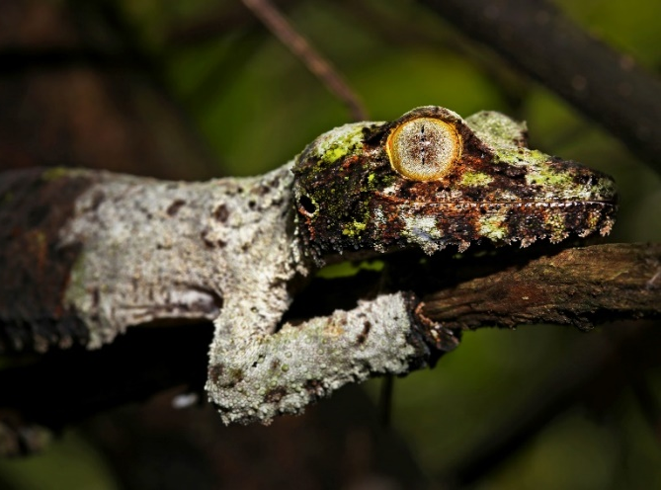

God Our Creator Will Always Be Our Help
“I raise my eyes toward the mountains.
From whence shall come my help?
My help comes from the Lord,
the maker of heaven and earth.”
‒ Psalm 121:1‒2
© Johnny Lye / Shutterstock.com
© Ryan M. Bolton / Shutterstock.com
© James Wheeler / Shutterstock.com

Slide 12
Acknowledgment
Scripture texts used in this presentation are taken from the New American Bible, revised edition © 2010, 1991, 1986, 1970 Confraternity of Christian Doctrine, Inc., Washington, DC. All Rights Reserved. No part of this work may be reproduced or transmitted in any form or by any means, electronic or mechanical, including photocopying, recording, or by any information storage and retrieval system, without permission in writing from the copyright owner.

