Slide 1
Images of Church
The Church Course
Document # TX001503

Slide 2
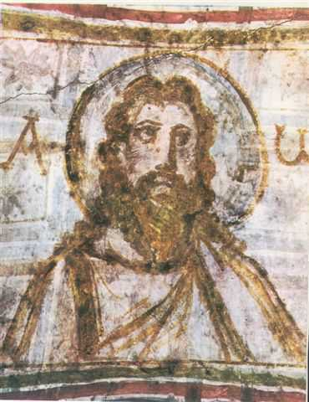
Body of Christ
Together, we form the Body of Christ. If one suffers, all parts suffer. If one part is honored, all the parts share its joy.
Image in public domain
Notes:
(Notes: 1 Corinthians 10:16–17; 12:12–13,20)

Slide 3
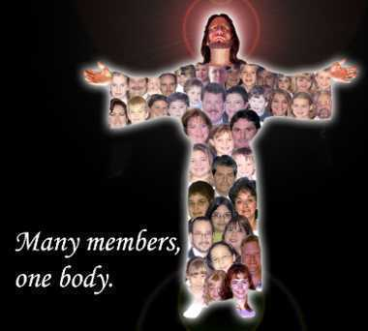
Body of Christ (continued)
This is the most prominent image in Paul’s letters and the only one with no Old Testament equivalent.
Christ the Head rules and
nourishes the Body. He is
the only Head, and the
Holy Spirit is the breath
that animates the Body.
©maristlaityaustralia.com
Notes:
(Notes: Emphasize the relationship of all the members of the body, diversity, and equality within unity. Every member is to be a functioning member.)

Slide 4
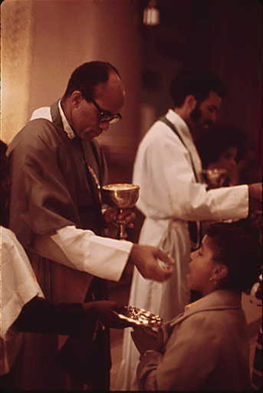
Body of Christ (continued)
In the letters of Paul, the expression “the body of Christ” refers to:
  the human body of Jesus Christ
  his presence in the Sacrament of the Eucharist
  his body, which is the Church.
Image in public domain

Slide 5
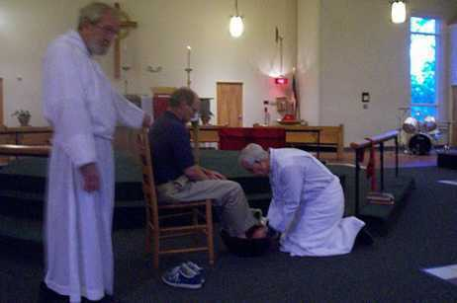
Body of Christ (continued)
“Now you are Christ’s body, and individually parts of it” (1 Corinthians 12:27).
“We, though many, are one body in Christ” (Romans 12:5).
Image in public domain

Slide 6
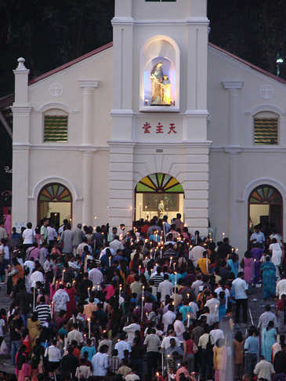
Body of Christ (continued)
“Grow in every way into him who is the head, Christ, from whom the whole body, joined and held together . . . , brings about the body’s growth and builds itself up in love” (Ephesians 4:15–16).
Image in public domain

Slide 7
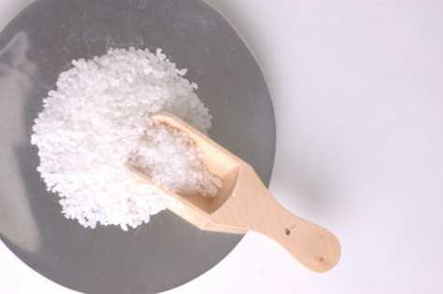
Salt and Light
When Jesus said to his disciples, “You are the salt of the earth” (Matthew 5:13), why did he compare his disciples to salt rather than to another spice?
Shapeshifters.co

Slide 8
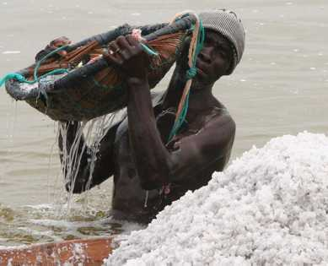
Salt
Of all the spices, salt may be the most necessary (every body must have salt) and the tastiest.
On its own, salt has a
strong bite, but when
mixed with other foods,
it enhances the other
flavors in the food.
Image in public domain

Slide 9
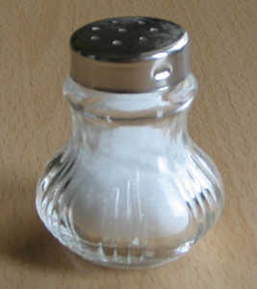
Salt
You are the salt of the earth. But if salt loses its taste, with what can the earth be seasoned? It is no longer good for anything but to be thrown out and trampled underfoot.
Jesus calls us to bring out the true flavor and goodness of the world, not only in ourselves but also in others.
Image in public domain

Slide 10
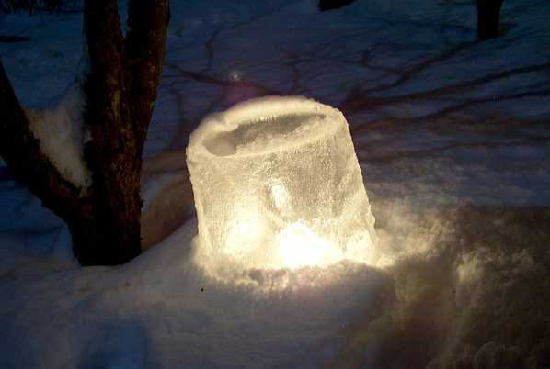
Light
Why would Jesus tell his disciples, “You are the light of the world” (Matthew 5:14)?
Image in public domain

Slide 11
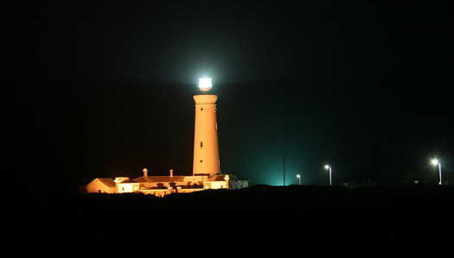
Light
Jesus explained that people do not hide light under a bushel basket, for then the light would be wasted. Instead, people put a light on a lampstand, “where it gives light to all in the house”
(Matthew 5:15).
Image in public domain
Notes:
(Notes: In this way, Jesus told us that we each have talents and gifts to share with others and that we should not hide them or keep them to ourselves.)

Slide 12
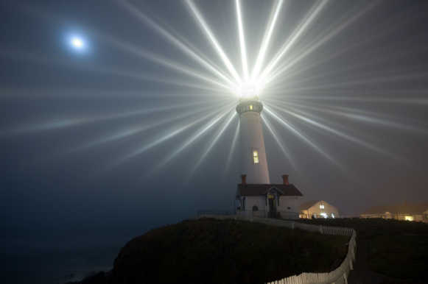
Light (continued)
“Just so, your light must shine before others, that they may see your good deeds and glorify your heavenly Father” (Matthew 5:13–16).
Image in public domain

Slide 13
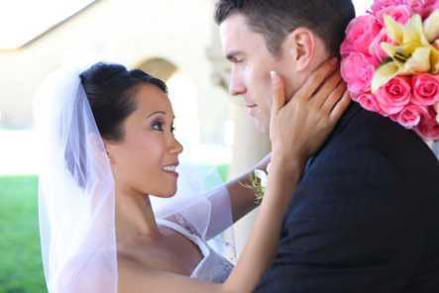
Bride of Christ
The Church is the Bride and, therefore, Christ is the Groom, to whom the Church is promised and given.
This metaphor speaks of Christ’s great love for the Church.
©Shutterstock/Stephen Coburn

Slide 14
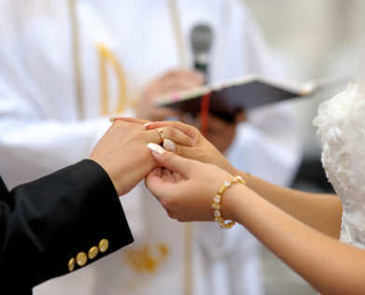
Bride of Christ (continued)
The unity of Christ, the Groom, and the Church, the Bride, reveals something of the intimate relationship God intends for husband and wife, as Christ and the Church can be described as two becoming one flesh.
At Christ’s return, God’s
People are described as
a bride beautifully dressed
for her husband (Christ).
©Shutterstock/MNStudio
Notes:
(Notes: 2 Corinthians 11:2; Ephesians 5:25–27; Revelation 19:7–9, 21:1–2)

Slide 15
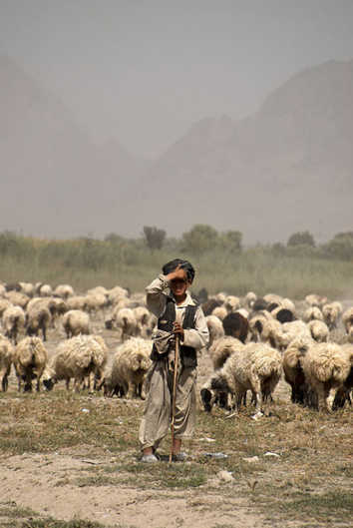
Christ’s Flock
Jesus is the Good Shepherd, the Great Shepherd, and the Chief Shepherd, who knows and watches over his sheep and gives his life for them.
They know his voice and follow him.
Image in public domain
Notes:
(Notes: John 10:11, Hebrews 13:20, 1 Peter 5:4, Luke 12:32)

Slide 16
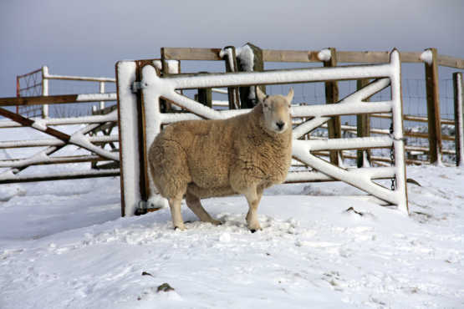
Christ’s Flock (continued)
To describe his relationship to his disciples, Jesus says he is the gate by which the sheep (his disciples) enter the fold.
©Shutterstock/Gail Johnson

Slide 17
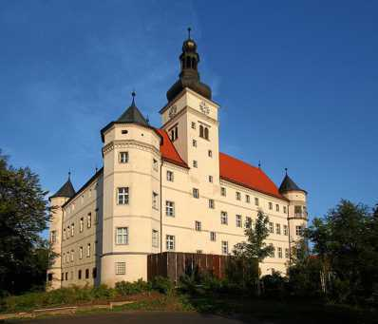
Kingdom
It is the Kingdom of God’s beloved Son, a Kingdom of “righteousness, peace, and joy in the holy Spirit” (Romans 14:17) in which he exercises his rule in his People through the Spirit.
Image in public domain
Notes:
(Notes: Colossians 1:13)

Slide 18
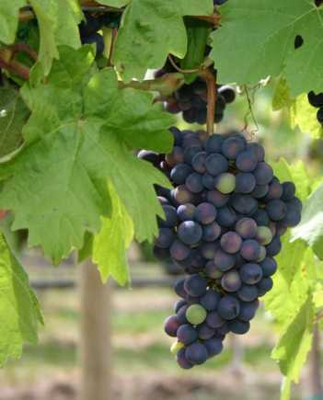
Vine and Vineyard
Jesus uses the metaphor of the vine and the branches to describe the intimate relationship he has with his disciples.
Image in public domain

Slide 19
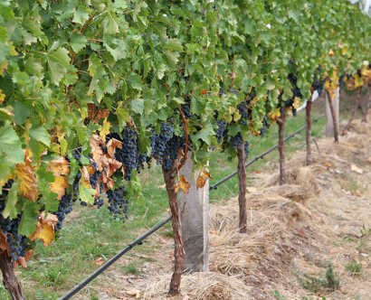
Vine and Vineyard (continued)
He is the true vine, his Father the vine grower, and his disciples the branches.
Only if they abide in him, and he abides in them, will they bear fruit.
Image in public domain
Notes:
(Notes: John 15:1–8)

Slide 20
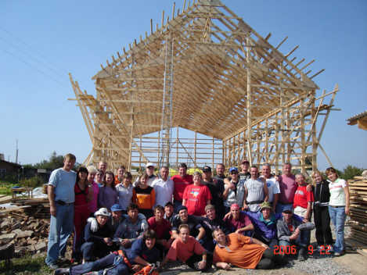
Temple of the Holy Spirit
God’s People are a building “not made with hands” (2 Corinthians 5:1), which God is constructing.
Thechildrensvoice.org

Slide 21
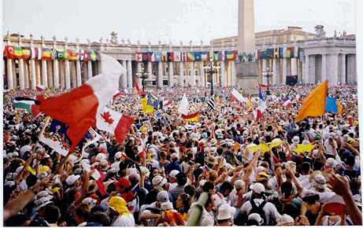
Temple of the Holy Spirit (continued)
The Old Testament temple has become the people in whom he now dwells by his Spirit, Jesus Christ being the foundation or cornerstone.
Individual Christians are stones built into this temple.
Image in public domain
Notes:
(Notes: 1 Corinthians 3:11,16; Ephesians 2:20–22; 1 Peter 2:4–8)

Slide 22
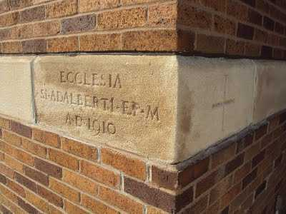
Temple of the Holy Spirit (continued)
Peter refers to Christians as “living stones.”
The structure of the temple of the Holy Spirit depends on Jesus Christ as the “cornerstone” for its coherence and stability.
©orbiscatholicussecundus.blogspot.com

Slide 23
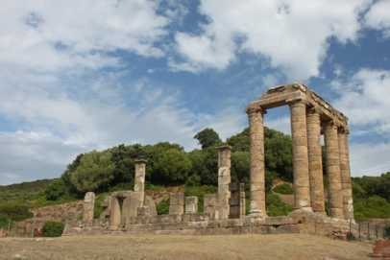
Temple of the Holy Spirit (continued)
Paul gives a severe warning to any who would cause division in the fellowship, as was happening in the Corinthian Church: “If anyone destroys God’s temple, God will destroy that person; for the temple of God, which you are, is holy” (1 Corinthians 3:17).
mikeandaviva.blogspot.com
Notes:
(Notes: Emphasize that we are to take care of our bodies, gifts given to us by God, to help us to serve him and his Church by all means possible.)

Slide 24
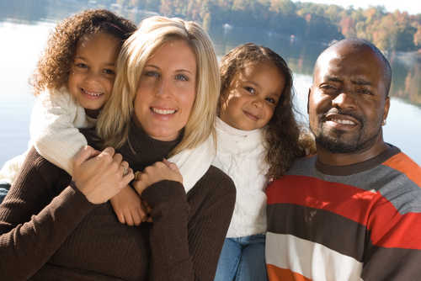
Family
This is the most pervasive metaphor for the Church in the New Testament.
©Shutterstock/JHogan

Slide 25
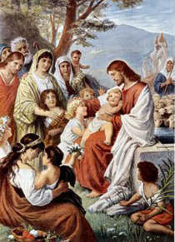
Family (continued)
We become children of God
the Father by having faith
in Jesus Christ, the Son,
and by receiving the
Holy Spirit.
Baptism is the symbol
of our adoption into
the family of the
triune God.
Jesus is our
elder brother.
Image in public domain
Notes:
(Notes: Galatians 3:26, 4:6–7; Romans 8:29; Hebrews 2:10–18)

Slide 26
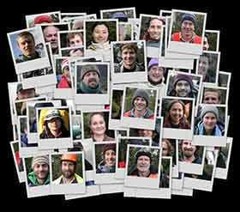
People of God
This image is rooted in the Old Testament covenants, where God accompanies and loves the Israelites.
The New Covenant,
sealed in the Lord’s blood,
invites all people
everywhere to unite.
God calls the Church into
existence, forming a
community of faith, hope,
and love centered in Christ
and empowered by the Holy Spirit.
©mikeandaviva.blogspot.com

Slide 27
Common Theme
The common theme of these images of the Church is relationships:
  God’s relationship with his People as Husband, King, Father, Builder
  the People of God’s relationship with God as Bride, Flock, Family, Body
  our relationship with one another as branches of the same vine, sheep in the same flock, children in the same family, members of the same body

