Slide 1
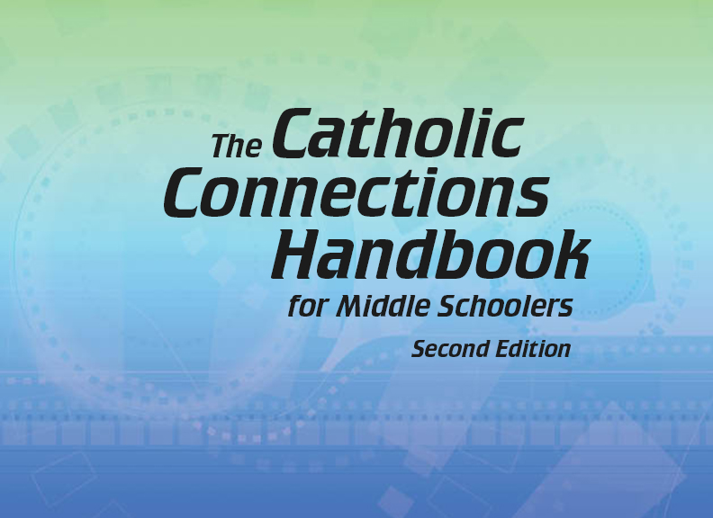

Document #: TX005842

Slide 2
Prayer and
Church History
Chapter I
An Age of New Ideas

Slide 3
Chapter Summary
With the Age of Reason, or the Enlightenment, the Church was challenged not only with persecution but with new political and scientific ideas.
These new ideas affected the Church in both Europe and North America.
For the Church, the new land of the United States was a fertile missionary field, and holy men and women had a great impact on the growth of this new country.

Slide 4
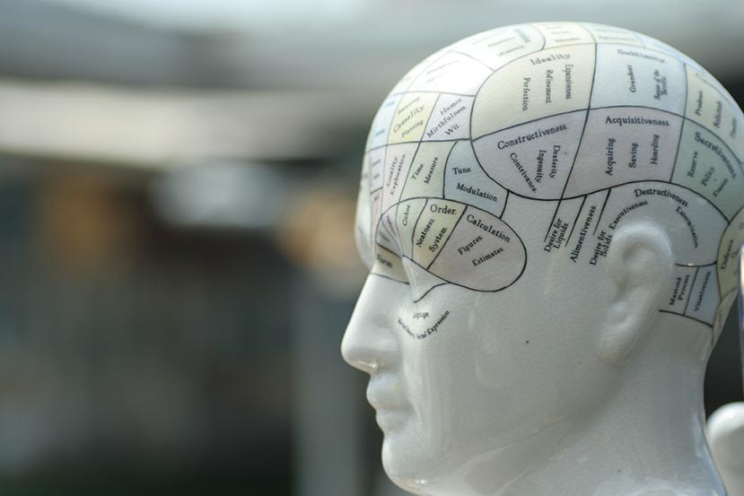
Introduction and
“Reason Rules”
(Church History, pages 86–89)
The Enlightenment
focused on reason
and rational thought.
Often Enlightenment
thinkers challenged the
role of God and of the
Church in the world.
© life_in_a_pixel/Shutterstock.com

Slide 5

The Age of Reason
The Age of Reason led to
a revolution in France.
This era also shaped how
American settlers
organized their new
life and their new nation.
The Age of Reason
helped the Church clarify
and strengthen her own teaching.
© phoenixman/Shutterstock.com

Slide 6
Reason Rules
The Enlightenment led to new ways of thinking.
Rationalism was a belief that the universe, even human behavior, was run by natural laws that could be fully explained by science.
Empiricism believed that all knowledge came only through human senses.

Slide 7

Is Religion At Odds with Science?
In the 1600s, the Pope
had the astronomer
Galileo put under house
arrest for his statement
that the earth revolved
around the sun.
In 1992, Pope Saint
John Paul II stated that
there is no real conflict between science and faith.
We can use our reason to know God.
© Romolo Tavani / Shutterstock.com

Slide 8
Search It!
Gather in groups of two or three.
Explore the web site of the Vatican Observatory in Tucson, Arizona. Gather information on its history and other facts that interest you.
Present your findings to your group.

Slide 9
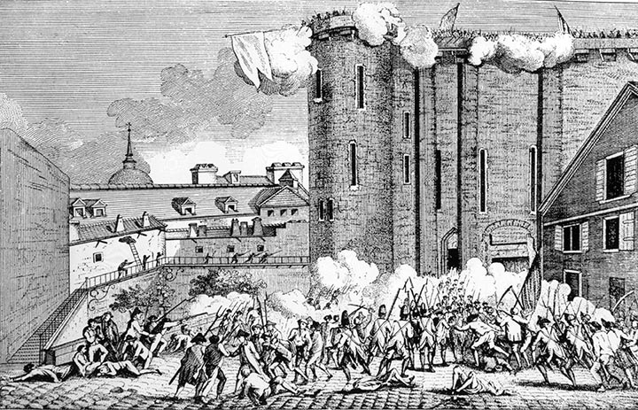
“The French Revolution”
(Church History, pages 90–92)
The Enlightenment encouraged people to challenge civil authority and led to the French Revolution.
(This engraving shows the “storming of the Bastille,” which began the revolution.)
© Everett Historical / Shutterstock.com

Slide 10
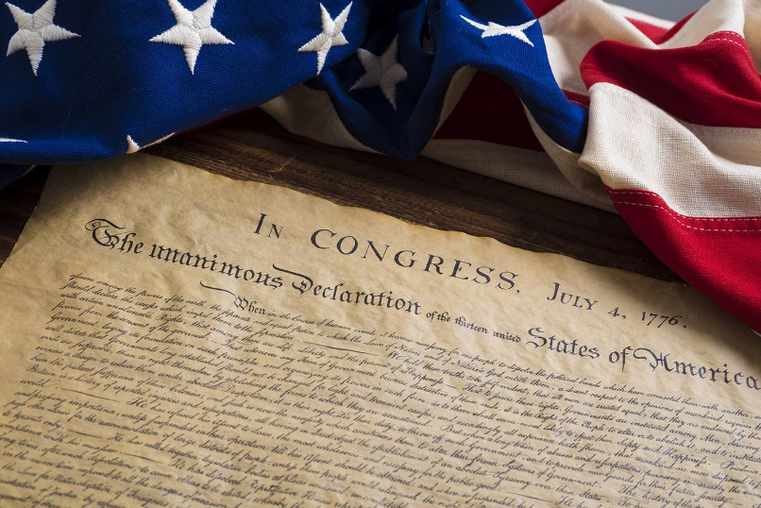
Two Revolutions
July 4, 1776: the date of the American Declaration of Independence and the beginning of the American Revolution
July 14, 1789: the date of the
beginning of the
French Revolution
What did these two revolutions,
13 years apart, have in common?
How did they differ?
© Janece Flippo / Shutterstock.com

Slide 11
“Effects of the Enlightenment and the French Revolution”
(Church History, pages 92–93)
Positive effects:
Equality, fraternity, and liberty are also Gospel ideals.
Nations have a right to govern themselves.
In the early 1800s, France experienced a renewal of faith. This renewal resulted in missionaries sent to the United States.

Slide 12
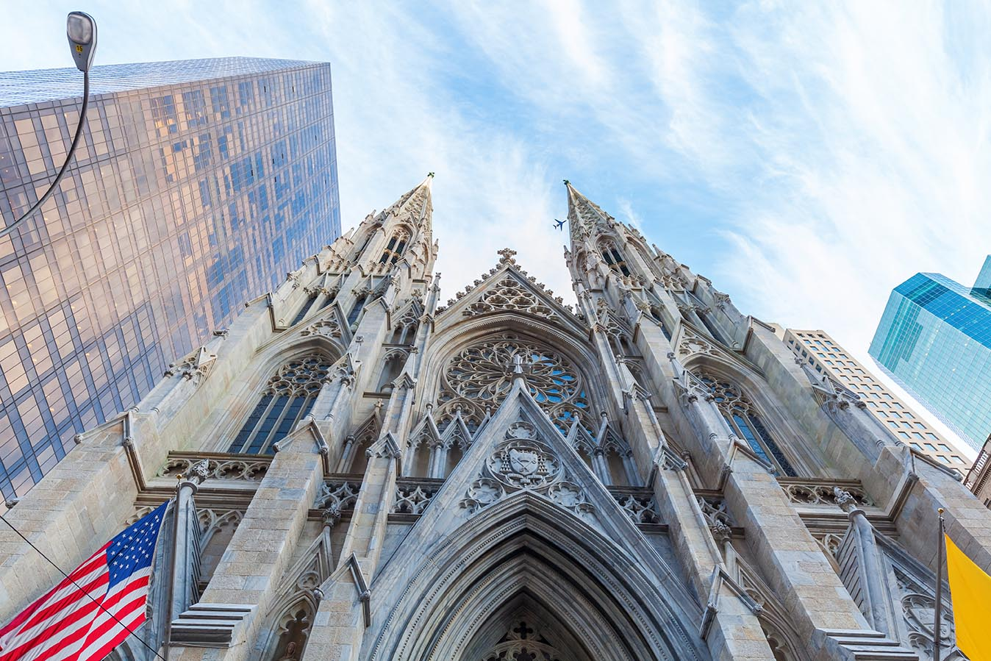
“The Church in America”
(Church History, pages 93–99)
Establishing the Catholic
Church in America involved
challenges such as building
churches, providing clergy,
and accommodating
immigrant populations.
(St. Patrick’s Cathedral, New York City)
© Christian Mueller / Shutterstock.com

Slide 13
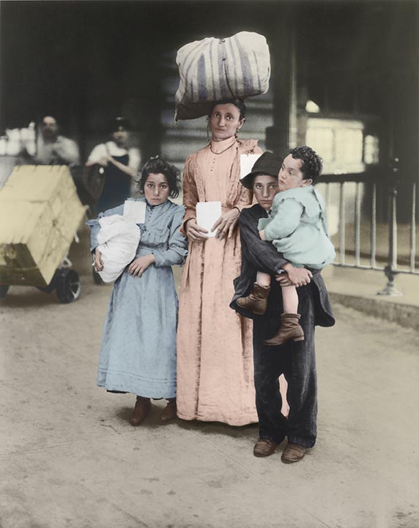
An Immigrant Church
Among the millions of immigrants
to America in the 1800s, many
were Catholic.
Some Catholic immigrants
faced bigotry from “nativist”
groups. Catholic schools were
established so that Catholic
children could learn their faith
and skills for life while living in
a society that was sometimes
prejudiced against them.
© Everett Historical / Shutterstock.com

Slide 14
Journal It!
Why did your parents choose a Catholic school for your education?
What do you find good and helpful about being in
your school? What do you find more of a challenge
at your school?
What can you do to get more out of your educational opportunity at your school?

Slide 15
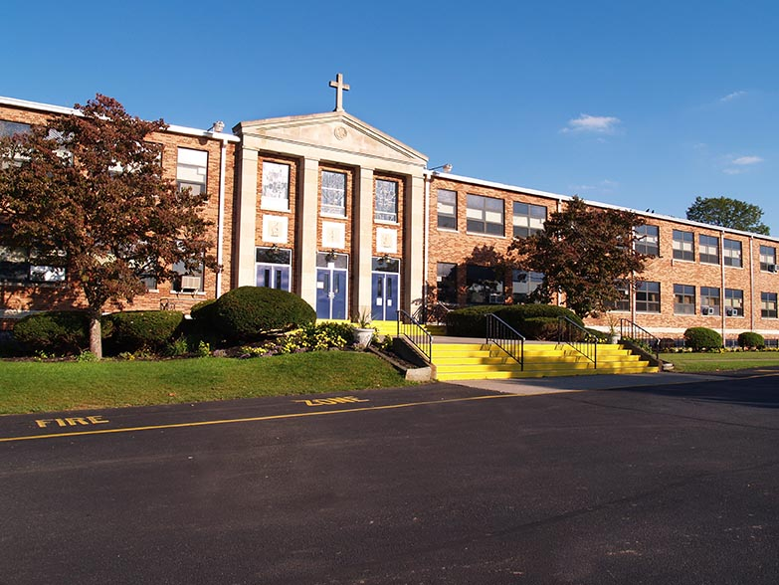
“American Missionaries and Saints”
(Church History, pages 99–103)
Many holy men and
women worked tire-
lessly to found new
religious orders and
schools in America.
© Cynthia Farmer / Shutterstock.com

Slide 16
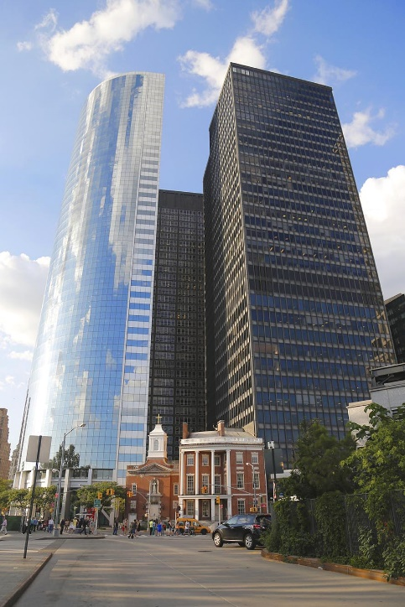
American Saints
These holy American men and women made a difference in the American Church and in American society:
Saint Elizabeth Ann Seton
(Her red brick home in New York City still stands, shown here.)
Saint Rose Philippine Duchesne
Saint Frances Cabrini
Saint Theodora Guerin
Saint John Neumann
Saint Katharine Drexel
Father Augustus Tolton
© Leonard Zhukovsky / Shutterstock.com

Slide 17
Share It!
Gather in groups of two or three. Choose a saint from the previous slide. Research the life of this saint.
Illustrate the life of this saint using one of these methods:
  A “comic book biography” (a few frames or several)
  A PowerPoint presentation

