Slide 1
Joshua and Judges
The Bible Course
Document#: TX001078

Slide 2
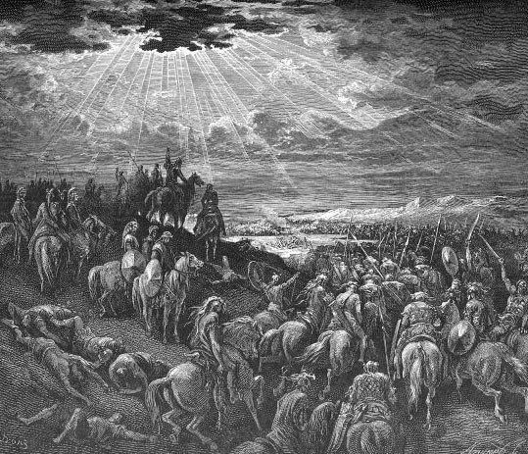
Joshua
Joshua was the successor to Moses who led the Israelites into Canaan, the Promised Land.
Canaan was promised by God to Abraham.
The Canaanites held polytheistic beliefs and refused to hand over their land to the Israelites.
Image in public domain
Notes:
Notes: Moses, whom God does not permit to enter the Promised Land, lifts up Joshua to be the leader to succeed him. Joshua leads the people across the River Jordan and quickly faces hostility and resistance from the native Canaanites.

Slide 3
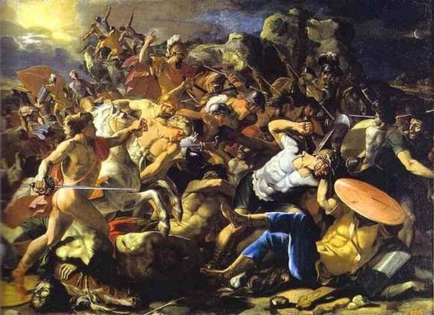
“Joshua: God Is on Our Side”
Joshua and the Israelite army swiftly conquer the land of Canaan. A pivotal moment is the taking of the small town of Jericho.
In the Book of Joshua, God is presented as a warrior waging a holy war.
The Israelites believed God was on their side.
static.artbible.info/large/jozua_amorieten.jpg
Notes:
Notes: Joshua wins many battles and is blessed with military success. Understanding how this “god of war” is reconciled with the Christian understanding of a “god of love” can be tricky for the students. This “god of war” perspective flows directly from the Israelites’ cultural experience of being warriors themselves during this time period. They believed God fought for and with them and thus their victories were ordained. Echoes of this theology can be heard today in arguments that “God is on our side in this or that conflict.” God is often perceived with a balance of justice and mercy. Images of God of this type fall strongly on the “justice” side, to the point of “God’s justice” being displayed on the battlefield.

Slide 4
How can a God of love wage such a savage and brutal war?
It is important to remember that the words in the Sacred Scriptures are conditioned by the language and culture of the Israelites.
The metaphor of God as a warrior provided the Israelites with a sense of security.
God freed them from the clutches of Pharaoh and would lead them into battle in the Promised Land.
For the Israelites, war was a holy act to fulfill the promise God made to the fathers and mothers.

Slide 5
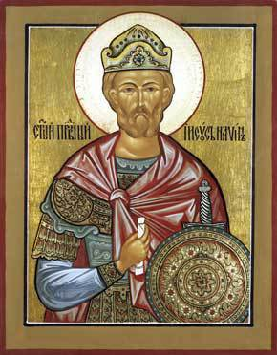
Joshua’s Undying Devotion to God
Joshua models a true commitment to the Covenant with God.
He demonstrates to the Israelites that when they remain true to the Covenant, God will abundantly bless them.
“As for me and my household, we will serve the Lord.”
(Joshua 24:15)
Image in public domain

Slide 6

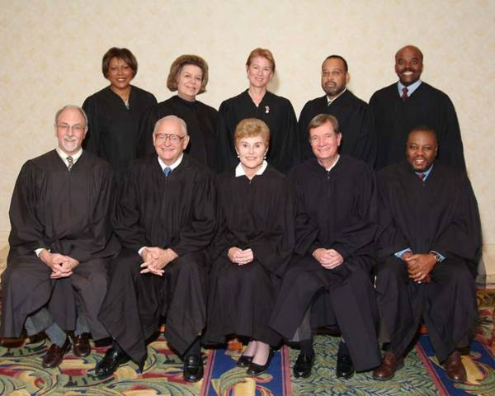
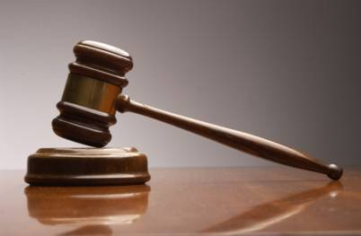
What is the role of a judge or someone passing judgment today?
blogs.pioneerlocal.com\
blogs.sfweekly.com/thesnitch/gavel.jpg
www.co.dekalb.ga.us/superior/images/Judges_Bench.jpg
Notes:
Notes: Begin by asking students to answer the question and give examples of judges in our society today. Then explain that the role of a U.S. judge today is specialized to a specific arena of law. Unlike in the past, it is not an inherited position; rather, people are appointed or democratically elected to oversee a specific municipality, county, state, or region. There are also many others who act as judges outside of courtrooms. These include referees and umpires, arbiters in disputes, ombudsmen, and professional boards. There are a few in religious arenas who act as judges, but generally judges are concerned with secular affairs.

Slide 7
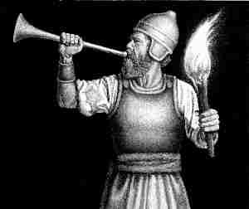
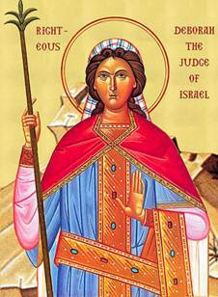
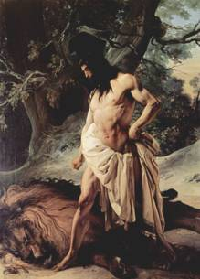
Biblical Judges
www.temkit.com
After Joshua’s death, the Israelites fall into a cycle of sin, calamity, repentance, and deliverance.
The Book of Judges is a series of short stories about human leaders’ accomplishing God’s will.
The time of the Judges was from 1200 to 1000 BC.
There are twelve heroic yet flawed leaders in the Bible who are considered judges.
www.uncutmountainsupply.com
Image in publiv domain
Notes:
Notes: The twelve biblical judges are Othniel, Ehud, Shamgar, Deborah, Gideon, Tola, Jair, Jepthah, Ibzan, Elon, Abdon, and Samson. Bold names are the ones who are given longer narratives. These figures occupy an important role in the transition between the leadership of the Exodus (under Moses) and the later rise of the Kingdom (under Saul and David).

Slide 8
The Role of the Biblical Judges
Settle disputes with their own tribe and between tribes
Lead the military defense against outside invaders
Challenge Israel to remain faithful to God
Gideon
Deborah
Samson
www.temkit.com
www.uncutmountainsupply.com
Image in public domain
Notes:
Notes: This slide introduces three of the more memorable judges and describes the religio-political role of the judges as described in the Book of Judges.

Slide 9
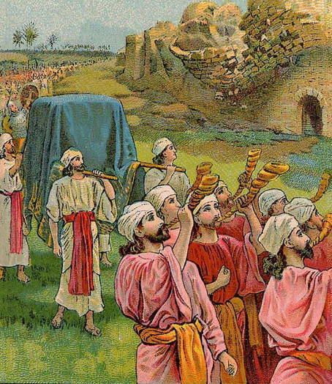
Success and Failure in the
Books of Joshua and Judges
When the Israelites were faithful to their Covenant with God, they experienced military success.
When the Israelites were disobedient to the Covenant, they experienced military defeat.
Image in public domain
Notes:
Notes: This slide gives a summary of what is contained in these books. It is important to note the concept that the Israelites experienced military success when they followed God’s Covenant and, conversely, suffered failures when they did not.

Slide 10
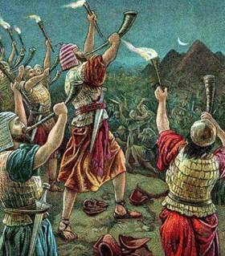
The Israelites worship
other gods.
God raises a judge to deliver the Israelites.
The judge frees the Israelites from their enemies.
The land has peace while the judge lives.
The judge dies and the cycle begins again.
God becomes angry and gives the Israelites over to the power of their enemies.
The Israelites cry
out to God.
www.classicalhebrewblog.com
Book of Judges has
the Judges cycle
Notes:
Notes: This seven-part cycle expands on the “Following Covenant = Success; Rejecting Covenant = Failure” formula. This same idea will be seen again in unit 6. It is important to emphasize that God does not directly cause the Israelites to fail. Rather, this failure is a result of the moral / spiritual / social / political weakness that befalls the community when the people start worshiping gods other than the God of Abraham.

