Slide 1



Slide 2
Christian Morality
and Social Justice
Chapter 43
Respecting Truth and Property

Slide 3
Chapter Summary
Respecting Truth and Property
In this chapter, you will consider the Seventh, Tenth, and Eighth Commandments (in that order). The review of the Seventh Command-ment includes the topic of theft but also adds two contemporary matters: digital piracy and sharing the earth’s resources. The Tenth Commandment themes encourage us to be grateful for God’s gifts to us and to see that God provides for all of our needs. Finally, under the Eighth Command-ment, the text reminds us that words are power-ful, whether they lift up or pull down.
© RonandJoe/www.shutterstock.com

Slide 4

“The Seventh Commandment: Take It to the Limit”
(Handbook, pages 469–472)
Stealing doesn’t involve taking just material possessions; it can involve taking intangible things as well.
© Pretty Vectors / www.shutterstock.com

Slide 5
“The Seventh Commandment: Take It to the Limit”
(Handbook, pages 469–472)
Stealing may include both physical objects and intangible ideas.
To make the situation right, a person who steals needs to make restitution, and a person who damages someone else’s property needs to make reparation.
Wasting or hoarding the earth’s resources can also be considered stealing.

Slide 6
“The Seventh Commandment: Take It to the Limit”
(Handbook, pages 469–472)
Activity: “Mine or Not?”
1. Your teacher will arrange the class into pairs.
2. You and your partner will be assigned two or three of the following Scripture verses: Exodus 20:15,
Exodus 22:1–4, Leviticus 19:11–13, Psalm 62:10, Matthew 6:19, Luke 19:8, John 10:10, Romans 2:21, Ephesians 4:28.
3. Read and reflect on the verses. Prepare to share the messages of your assigned scriptural passages and how the passages apply to your lives.
4. Discuss the passages as a class. Answer this question: What is stealing?
5. Your teacher will read aloud paragraph 2409 from the Catechism of the Catholic Church.
6. Journal about the repercussions of stealing.
© AinMikail/www.shutterstock.com

Slide 7

“The Tenth Commandment
The Danger of Envy”
(Handbook, pages 472–474)
Envy is wanting what others have, and it is one of the seven Capital Sins.
© Sam72/www.shutterstock.com

Slide 8
“The Tenth Commandment
The Danger of Envy”
(Handbook, pages 472–474)
It is wrong to envy what belongs to others. We should be thankful for what we have.
As Christians, we are asked to understand that we all have different gifts and material possessions. Those who have more should share with those who have less.
Jesus asks us to travel light and not be overly attached to material possessions.

Slide 9

“The Tenth Commandment
The Danger of Envy”
(Handbook, pages 472–474)
Journal It!
© RuslanDashinsky/www.istockphoto.com
Why is it wrong to be envious of someone or someone’s possessions?
How can you work to avoid being envious?

Slide 10

“The Eighth Commandment: What’s in a Name?”
(Handbook, pages 474–476)
Words are incredibly powerful and can harm as well as praise.
© StephanieZieber/www.shutterstock.com

Slide 11
“The Eighth Commandment: What’s in a Name?”
(Handbook, pages 474–476)
The Eighth Commandment asks us to practice the virtue of truthfulness.
The Sacrament of Penance and Reconciliation always restores our relationship with God.
Telling the truth does not mean talking about personal, private information, but it is our duty to tell secrets that could harm or hurt someone.

Slide 12

“The Eighth Commandment: What’s in a Name?”
(Handbook, pages 474–476)
Activity: “Speak Wisely”
1. Your teacher will arrange the class in groups of three.
2 . Each group will be assigned one of the following
Scripture verses: Leviticus 19:16; Proverbs 11:1,3,5–6;
Proverbs 11:13.
3. Read and discuss the meaning of your assigned verse. Answer this question: How does it apply to today’s world and your own lives?
4. Group members will switch for discussion of a different verse.
© Pavlen/www.istockphoto.com

Slide 13
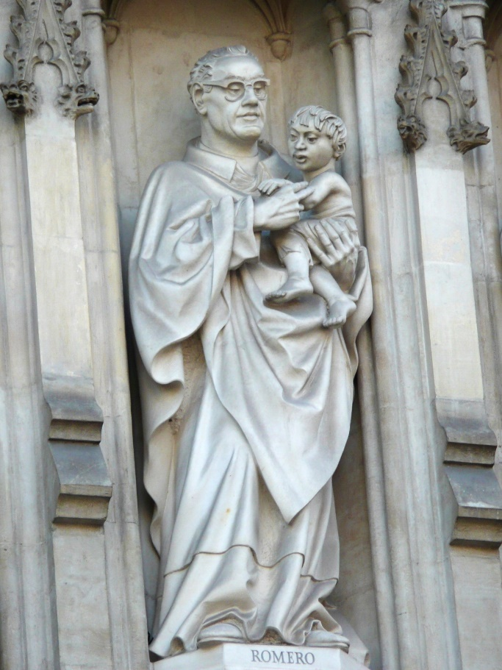
“People of Faith: Archbishop Oscar Romero”
(Handbook, page 477)
Archbishop Oscar Romero was a powerful witness to God in the world.
© Hakne1/www.shutterstock.com

Slide 14
“People of Faith: Archbishop Oscar Romero”
(Handbook, page 477)
Oscar Romero was appointed archbishop of San Salvador during difficult and dangerous times in El Salvador.
When his friend Fr. Rutilio Grande was killed, the archbishop realized his friend was killed because he lived the Gospel of Jesus and spoke out on injustice toward the poor.

Slide 15
“People of Faith: Archbishop Oscar Romero”
(Handbook, page 477)
Archbishop Romero continued to speak out, despite the danger, and was killed while celebrating Mass on March 24, 1980.
In 1997, Pope Saint John Paul II gave Archbishop Romero the title Servant of God, which is the first step in the process of canonization as a saint.

Slide 16
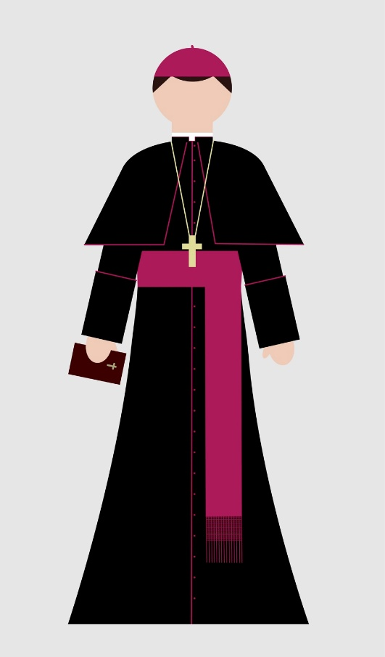
“People of Faith: Archbishop Oscar Romero”
(Handbook, page 477)
Activity: “Who Is Your Bishop?”
Read this statement:
The bishop is the leader of our diocese. He is our chief teacher of the faith. Just as we have gotten to know Archbishop Romero today, we can get to know our own bishop a little better.
2. Your teacher will arrange you into small groups. Each group will search online for background on the bishop of your diocese or archdiocese.
3. Answer the questions on the following slide about your bishop.
© Telia/www.shutterstock.com

Slide 17
“People of Faith: Archbishop Oscar Romero”
(Handbook, page 477)
Where and when was the bishop born?
Where did he go to grade school, high school, and college?
Is he a member of a religious order, or was he ordained as a diocesan priest?
Where did he go for his seminary training?
When and where was he ordained as a priest?
by which bishop?
Did he receive any further education after being ordained as a priest?
Where was his first assignment as a priest?
When and where was he ordained as a bishop? by whom?
What diocese did he serve after being ordained as a bishop?
If the bishop writes for the diocesan paper, give the titles of three articles he has written.
Name three visits the bishop has made to parishes or other places in the diocese. What were the reasons for these visits?
Does the bishop serve now, or has he previously served, on any committees for the United States Conference of Catholic Bishops?
What are the titles of some of the bishop’s pastoral letters?
For a Cardinal: When was he appointed to the archdiocese? When was he made a cardinal? Under which Pope was he made a cardinal?

