Slide 1
The Church Is One
The Church
Unit 2, Chapter 4
Document #: TX005554
© 2016 Saint Mary’s Press
Living in Christ Series

Slide 2

The Four Marks of the Church
“I believe in one, holy, catholic
and apostolic Church.”
This statement professes
the four Marks of the Church.
Mark is another word for
“essential feature.”
© TSHIRT-FACTORYdotCOM / Shutterstock.com
© 2016 Saint Mary’s Press
Living in Christ Series
Notes:
Notes: Ask what is being quoted in the first bullet point (the Nicene Creed). Explain that we have been praying this creed for more than 1,600 years. Tell the students that the opening line of our creed sums up the four Marks of the Church; each chapter in unit 2 of the student book addresses one of these marks.

Slide 3
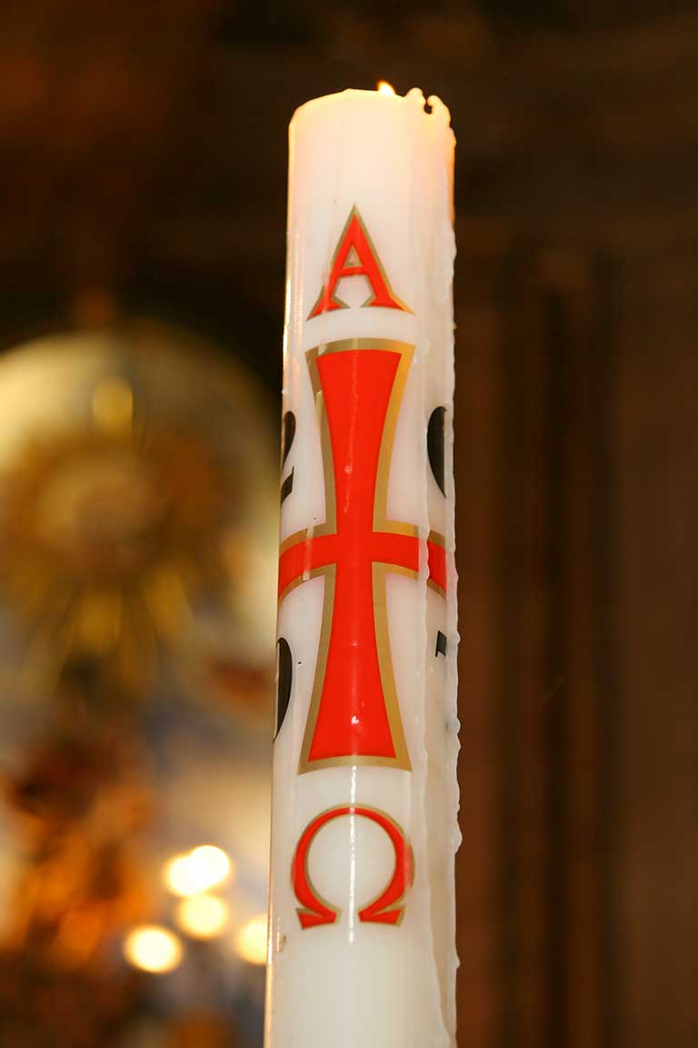
The First Mark of the Church
There is only one Church, one Body of Christ, characterized by oneness or unity.
Christ gave the Church the gift of unity.
Members of the Church need to pray for and work to keep that unity, and perfect it.
© Francisco Amarai Leitao / Shutterstock.com
© 2016 Saint Mary’s Press
Living in Christ Series
Notes:
Notes: Read aloud 1 Corinthians 12:13, quoted in article 14 of the student book.

Slide 4
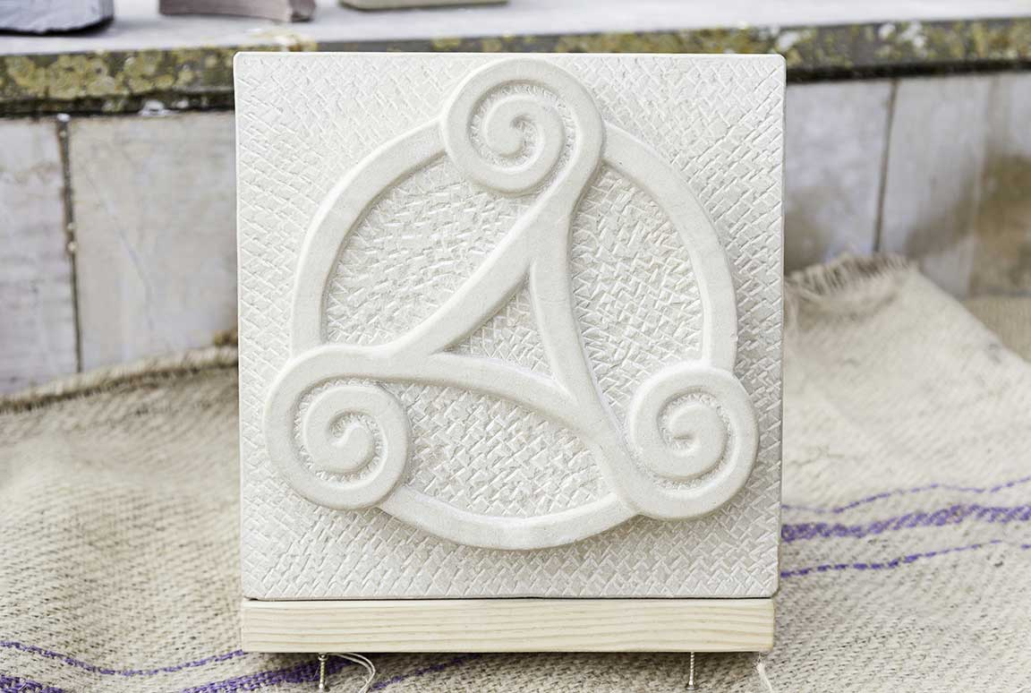
The Source of the Church’s Unity
The ultimate example of the Church’s unity is also its source: the eternal unity of the three Divine Persons of the Trinity.
© Sergio Foto / Shutterstock.com
© 2016 Saint Mary’s Press
Living in Christ Series
Notes:
Notes: Read aloud John 17:20–21, and discuss the unity that Jesus wants us to have.

Slide 5

Diversity within the Church’s Unity
Unity should not be confused with uniformity.
People are diverse, and so are the gifts God has given us.
© anmo / Shutterstock.com
© 2016 Saint Mary’s Press
Living in Christ Series
Notes:
Notes: Discuss the various gifts contributing to the spirit and success of your school community. Draw parallels between your school and the Church.

Slide 6
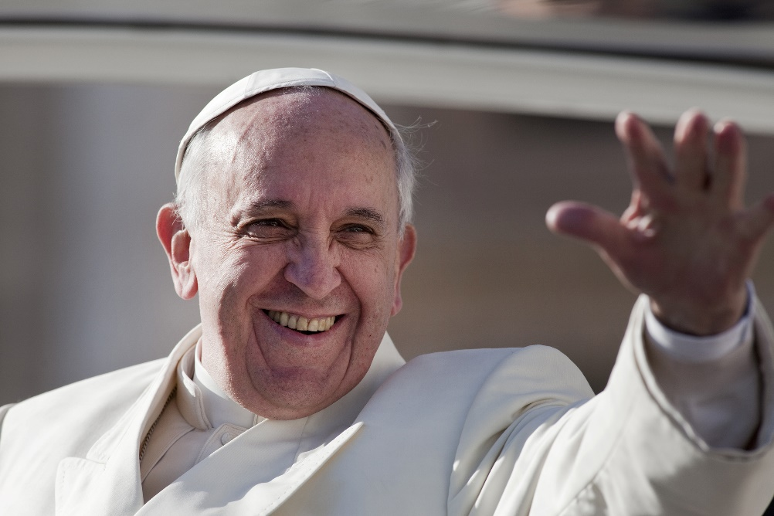
The Pope as a Symbol of Unity
The Pope is the successor to Saint Peter, whom Jesus called to lead his Church.
He is the visible
principle of the
unity of the whole
Church . . .
the visible
representative of
Christ on earth.
© giulio napolitano / Shutterstock.com
© 2016 Saint Mary’s Press
Living in Christ Series
Notes:
Notes: Ask what term we use to denote that the Pope is Christ’s representative (Vicar of Christ). Discuss what it means to say that the Pope is the “servant of the servants of God.”

Slide 7

Unity of Faith
People all over the world profess the one faith by praying two creeds:
the Apostles’ Creed
the Nicene Creed
© 2016 Saint Mary’s Press
Living in Christ Series
©Alex_F / Shutterstock.com
Notes:
Notes: Ask for the definition and origin of the term creed. (See article 14 of the student book.) Explain that both creeds developed in the early centuries of the Church. Ask when each is most commonly used (Apostles’ Creed: during Advent and Easter; Nicene Creed: at most Sunday Masses).

Slide 8
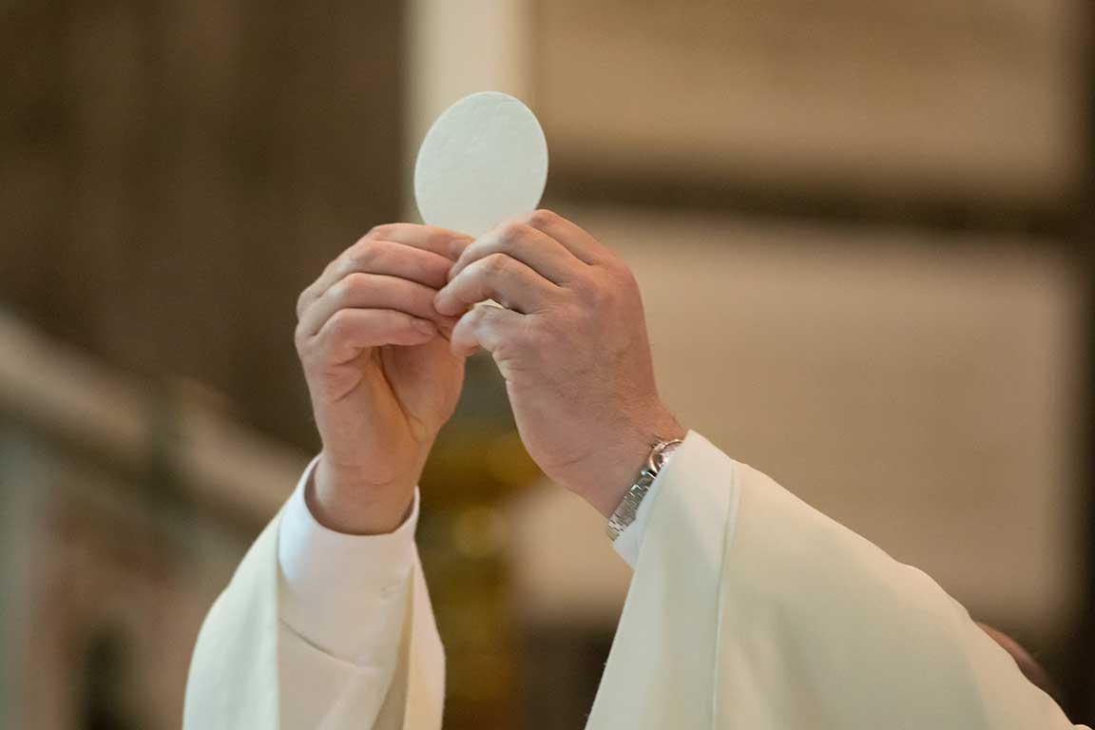
Unity of Worship
The Eucharist is both a
sign of the unity of the
Church and a way to
create that unity.
The essential elements
of the Mass are the
same across the world . . .
but aspects of the Church’s liturgy can be adapted to fit different cultures.
© Fabio Lotti / Shutterstock.com
© 2016 Saint Mary’s Press
Living in Christ Series
Notes:
Notes: Ask the students if they have taken part in a Catholic liturgy adapted to an ethnicity or culture different from their own. Discuss their experience, or your own.

Slide 9

Unity of the Apostolic Succession
We are united by recognizing the authority of the bishops and the Pope.
They guarantee that we are following the same faith and sacramental worship . . .
that was passed
down from Jesus
and the Apostles.
© William Perugini / Shutterstock.com
© 2016 Saint Mary’s Press
Living in Christ Series
Notes:
Notes: Review the definitions of Apostolic Succession and Holy Orders in article 15 of the student book.

Slide 10
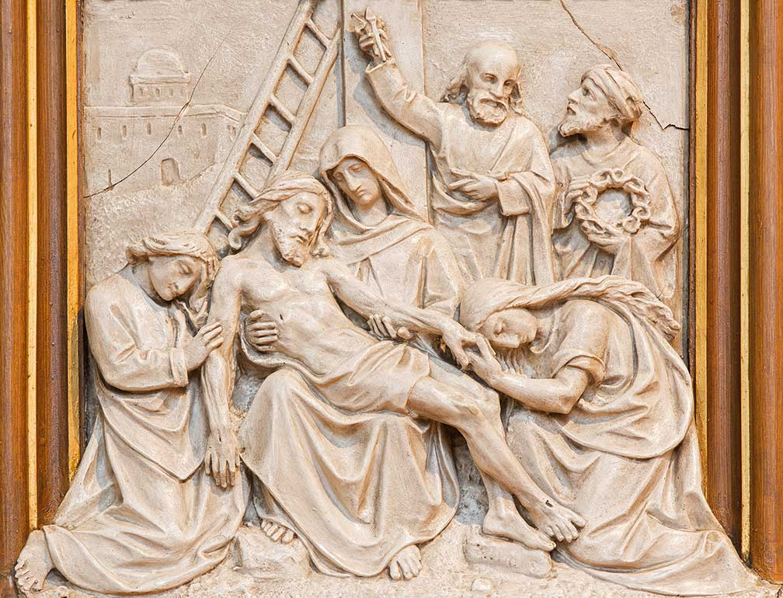
The Unity of the Martyrs
We are united by our reverence for the martyrs who died for Christ.
We recognize martyrdom as the truest communion with Christ.
© Renata Sedmakova / Shutterstock.com
© 2016 Saint Mary’s Press
Living in Christ Series
Notes:
Notes: Ask the question that concludes article 15 of the student book, “How can martyrs be an example of faith for you today?”

Slide 11

Heresy: A Wound to Christian Unity
Heresy results when a person or group deliberately rejects a dogma of the Church.
Heresies have often led to the establishment of opposing groups within the Church.
© Thomas Zsebok / Shutterstock.com
© 2016 Saint Mary’s Press
Living in Christ Series
Notes:
Notes: Review the definition of dogma, found in article 16 of the student book. Use examples of early heresies to emphasize that they represented the rejection of an essential belief.

Slide 12
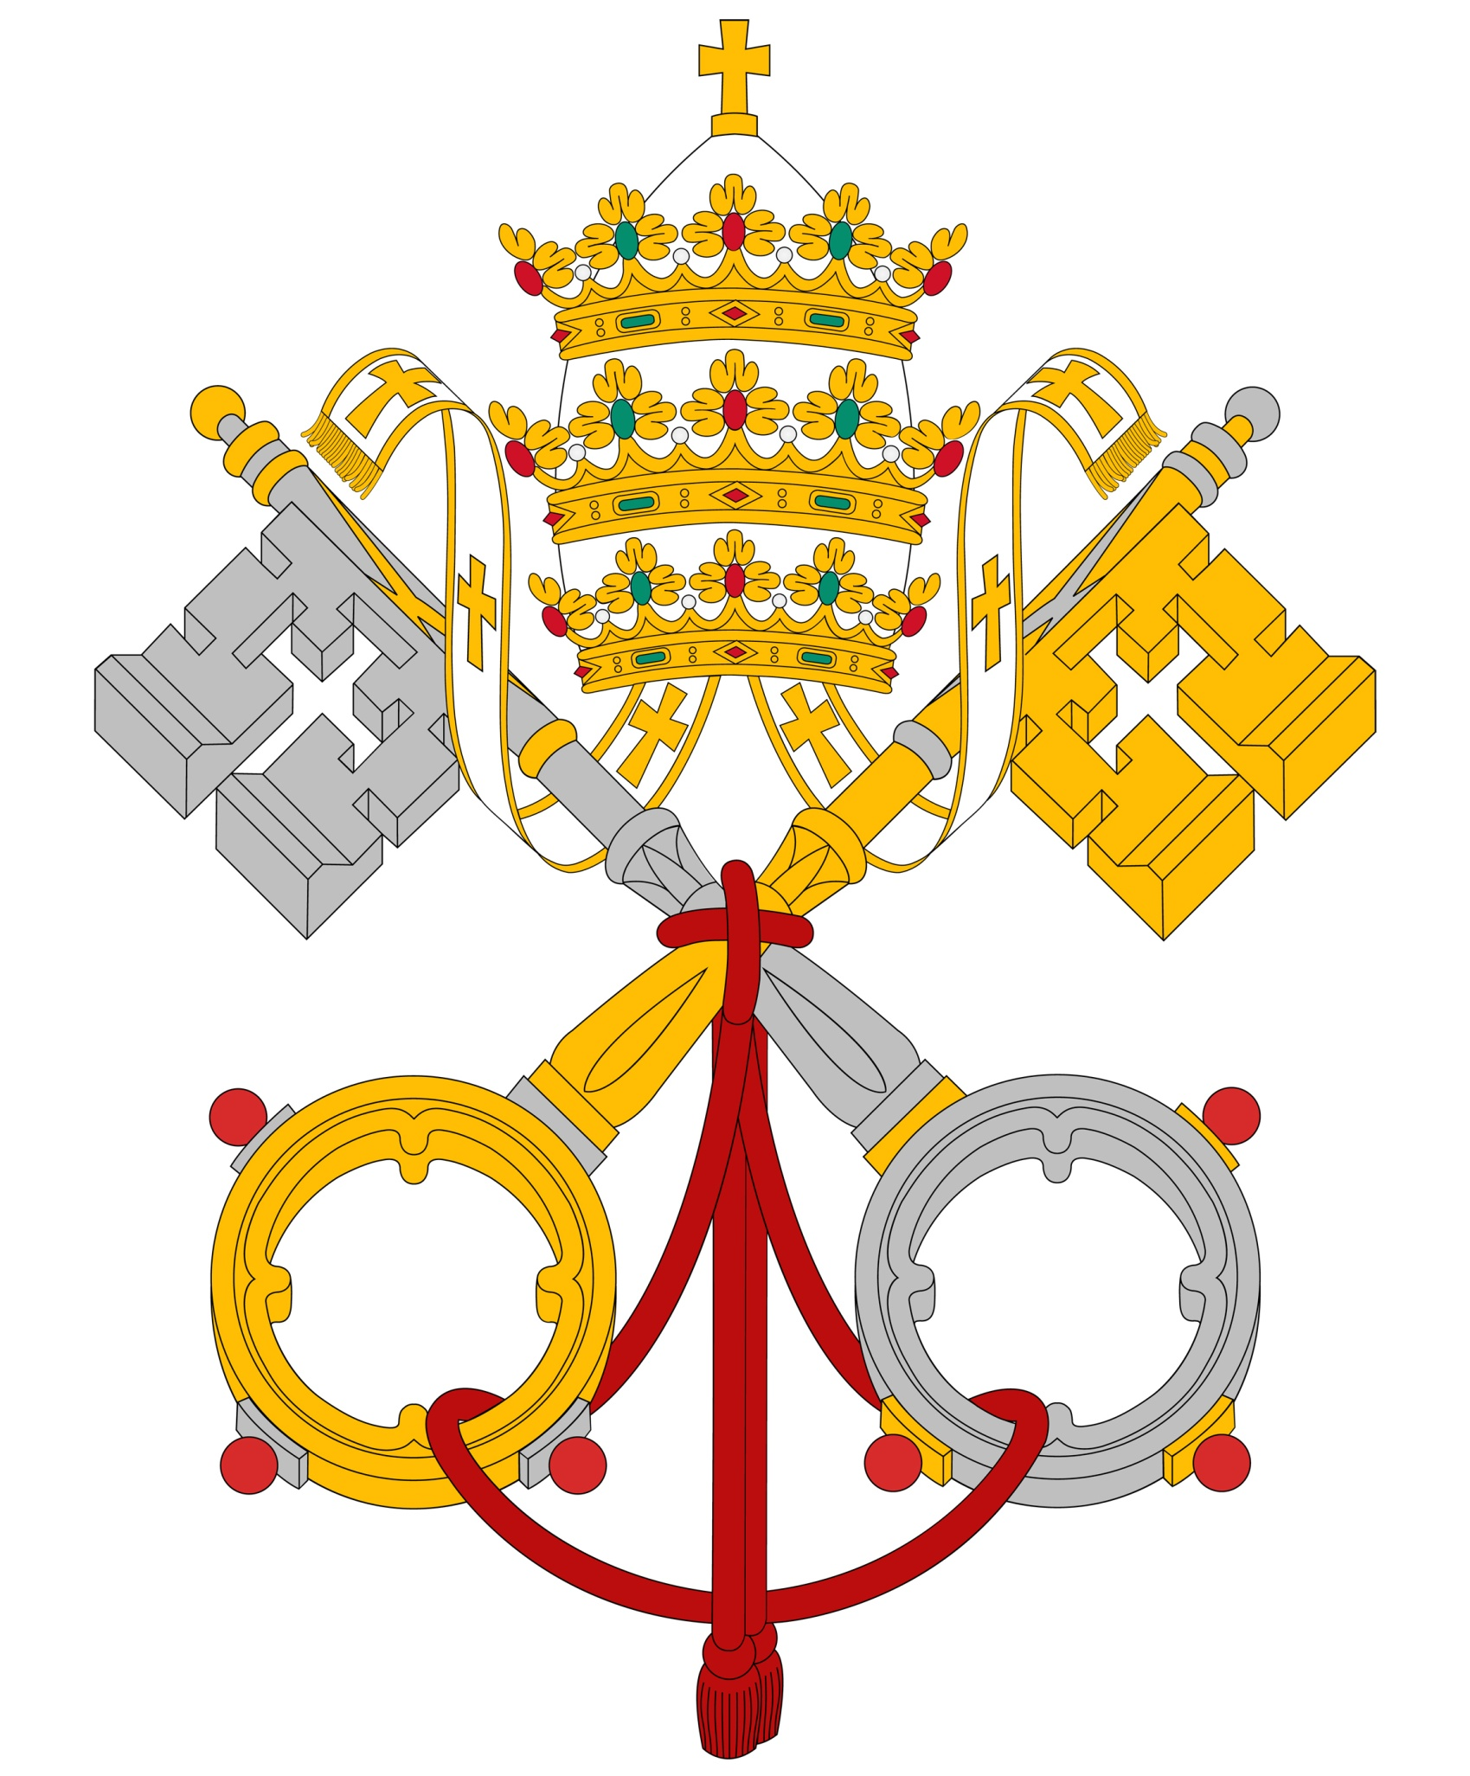
Schisms: A Wound to Christian Unity
A schism in the Church results when a community does not recognize the supreme authority of the Pope . . .
or otherwise is not in communion with the Church.
© cobalt88 / Shutterstock.com
© 2016 Saint Mary’s Press
Living in Christ Series
Notes:
Notes: Review the history of the schism between the Churches of the East and the West, as in article 16 of the student book, emphasizing recent advancement toward full communion.

Slide 13
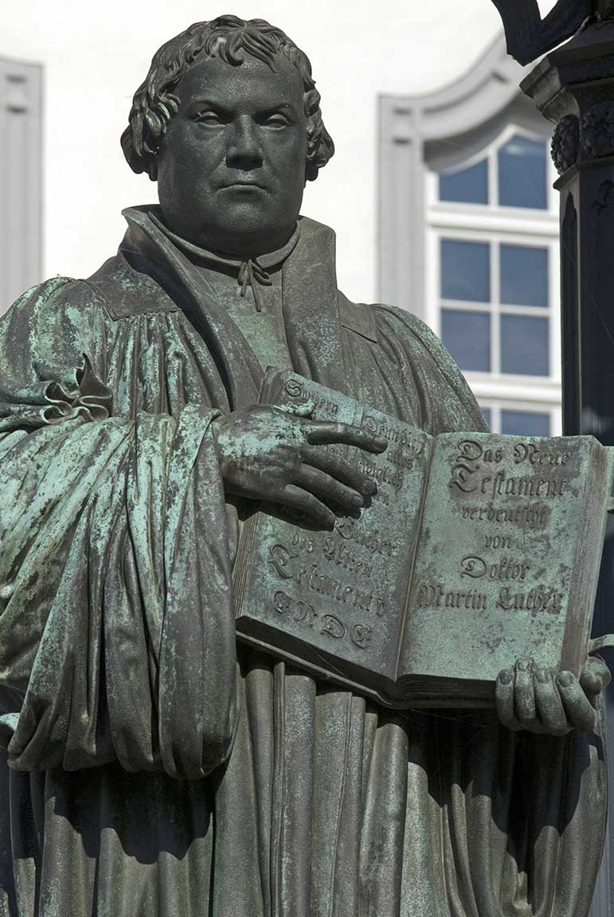
The Protestant Reformation:
A Wound to Christian Unity
In the early sixteenth century, the Protestant Reformation divided Christians.
A key figure was Martin Luther, a monk, priest, and Scripture scholar.
© Ralf Gosch / Shutterstock.com
© 2016 Saint Mary’s Press
Living in Christ Series
Notes:
Notes: Ask the questions that conclude article 16 of the student book: “Do you have a friend or relative who belongs to a Protestant church? What do his or her worship and beliefs have in common with your own?”

Slide 14

Non-Catholic Churches
All Catholics are Christians—but not all Christians are Catholic.
All who are baptized can be called brothers and sisters in Christ.
The Church dialogues
with other Christian
communities to work
toward Christian unity.
© L. Kragt Bakker / Shutterstock.com
© 2016 Saint Mary’s Press
Living in Christ Series
Notes:
Notes: Explain and discuss the sidebar in article 17 of the student book, “Sharing the Eucharist.”

Slide 15
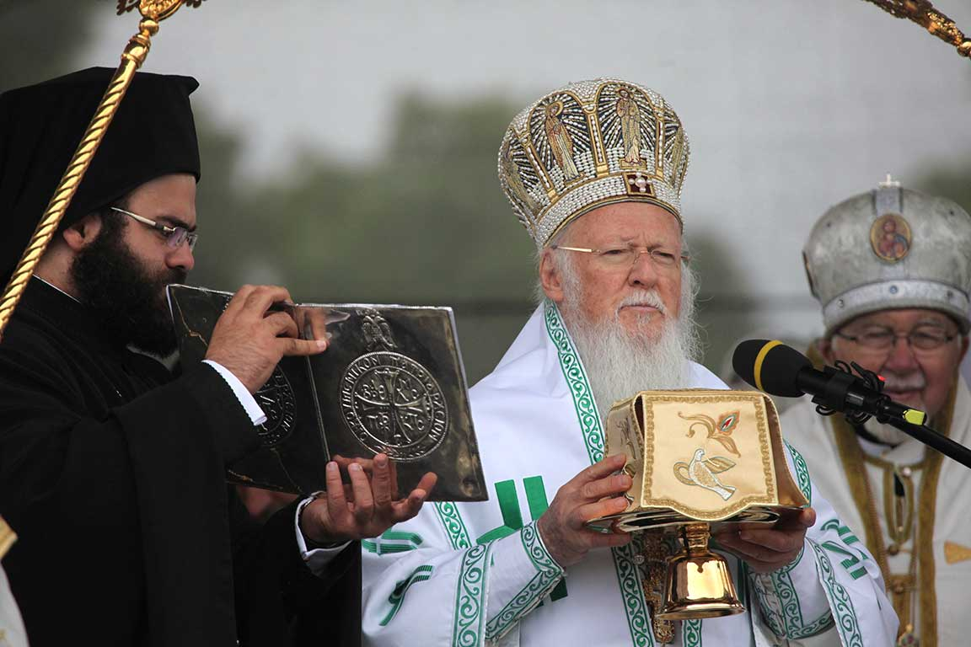
The Ecumenical Movement
Ecumenism is an effort by Christians from different Churches and ecclesial communities to be more open to one another . . .
and to work to
restore unity
among all
Christians.
© Vladimir Wrangel / Shutterstock.com
© 2016 Saint Mary’s Press
Living in Christ Series
Notes:
Notes: Point out that an essential part of the ecumenical movement is dialogue between leaders of the Catholic Church and of other communities. Explain that we too have a part to play because we frequently interact with Christians who are not Catholic. Ask volunteers to read aloud “Essential Elements of the Movement toward Unity,” in article 17 of the student book. Ask the question at the end of article 17, “What is one concrete thing you can do today to help promote Christian unity?”

