Slide 1
Jesus’ Resurrection
The Catholic Faith Handbook for Youth, Third Edition
Chapter 11
Document #: TX003142
Notes:
Use this presentation to review evidence for belief in the Resurrection. The PowerPoint presentation includes material on pages 114–123 of the student handbook.

Slide 2
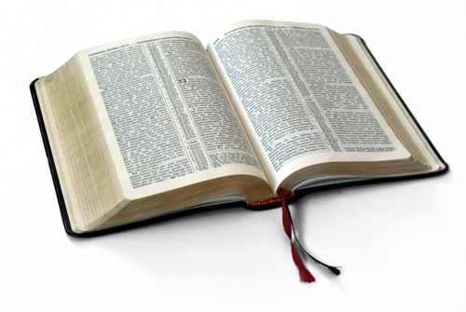
Mark 14:1—15:46
Matthew 26:1—27:66
Luke 22:1—23:56
John 18:1—19:42
Copyright: Luti / www.shutterstock.com
Notes:
Have the students gather in four separate groups, and assign each group one of the Resurrection accounts. After the groups have read their accounts, invite them to present the details (in their own words) of each account.

Slide 3

The Gospel Accounts
Copyright: Anneka / www.shutterstock.com
Christ’s Resurrection is the single most important event in all history.
Each Gospel has a slightly different account of the Resurrection of Jesus.
Despite their differences, all four Gospels have several points in common.
Notes:
Remind the students that each Gospel writer drew on the stories circulating in his own community during the first years after the Resurrection, and each writer chose which points to include.

Slide 4
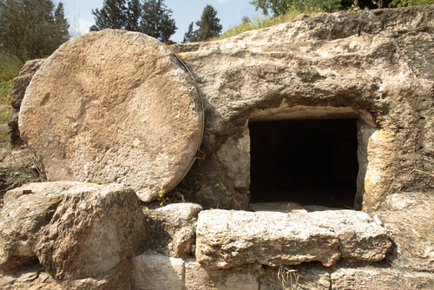
Common Points
Copyright: Mordechai Meiri / www.shutterstock.com
First the women disciples, and then the men, go to
the tomb and discover the body of Jesus is no longer there.
Angels tell those seeking Jesus that he is alive and will reveal himself soon.
Jesus appears to groups of disciples to wish them peace and charge them with continuing his mission.
Notes:
Explain that the women brought spices to the tomb early in the morning to prepare the body for burial. The men were hiding; only one of them was present when Jesus died.

Slide 5

What Was the Resurrected Jesus Like?
Ordinary language couldn’t easily explain his appearance.
Jesus appeared and disappeared suddenly.
The disciples could touch him, and they ate with him.
Some people didn’t recognize him at first.
Copyright: Pavelk / www.shutterstock.com
Notes:
Explain that these points show that Jesus was not a reanimated corpse. He was somehow transformed by the Resurrection, yet was still himself.

Slide 6

Evidence for the Resurrection
We have great proof for the authenticity of the
New Testament books.
The Resurrection was a consistent belief in the
early Church.
No evidence has been found to show that the
Romans or Jewish religious leaders produced
a corpse to put to rest the rumors of Jesus’
Resurrection.
Copyright: isak55 / www.shutterstock.com
Several of the disciples died as martyrs rather than deny their faith in the resurrected Jesus.
The Resurrection appearances of Jesus caused a profound change in his followers.
Notes:
Make sure the students understand the difference between proving something and presenting evidence for it. Direct the students to look over the evidence for the Resurrection presented on pages 116–118 of the student handbook. The points are outlined in the next three slides. Ask volunteers to explain each point to the class as you move through the next slides.

Slide 7
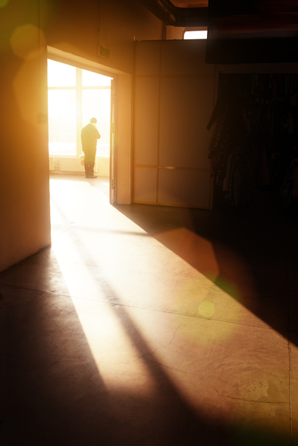
The Religious Meaning of the Resurrection
Jesus Is Confirmed as the Son of God
All Jesus’ Teachings Are True
The Paschal Mystery: Death is the doorway into new and eternal life
Copyright: Konstantin Sutyagin / www.shutterstock.com

Slide 8

Jesus’ Ascension
Copyright: LiliGraphie / www.shutterstock.com
The Gospel authors had a hard time putting this event into words.
After spending time with some of his followers after his Resurrection, Jesus left this world to be with his Father in Heaven.
This means all humanity now has the possibility of spending eternity with God in Heaven.
Jesus can be more present to us now than before his Ascension.

Slide 9
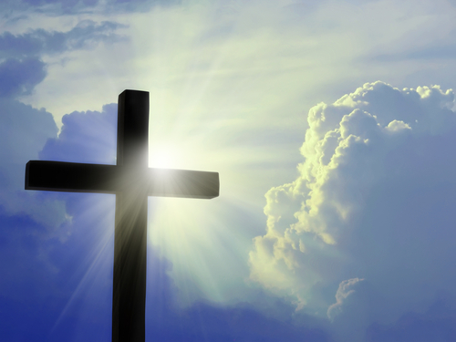
What reasons for believing in Jesus’ Resurrection would you give to someone who is struggling to believe that it really happened?
Copyright: rangizzz / www.shutterstock.com
Notes:
Ask the students to share which points they think would most help someone to believe in the Resurrection.

