Slide 1
Jesus Reveals a Vision of Authentic Humanity
Jesus Christ: God’s Love Made Visible, Second Edition
Unit 4, Chapter 9
Document#: TX004814

Slide 2


Jesus Teaches Us How to Be Human
Jesus invites us to follow his example of a humble life of prayer and service.
He calls us to love all people and to care responsibly for all creation.
© hannahgleg / iStockphoto.com
Notes:
Ask the students if they know about the WWJD? movement popular in the 1990s. Explain that Jesus has been a model for Christians throughout history and continues to be a model today.
This slide corresponds to content in article 41, “Jesus Teaches Us How to Be Authentically Human,” in the student book.

Slide 3
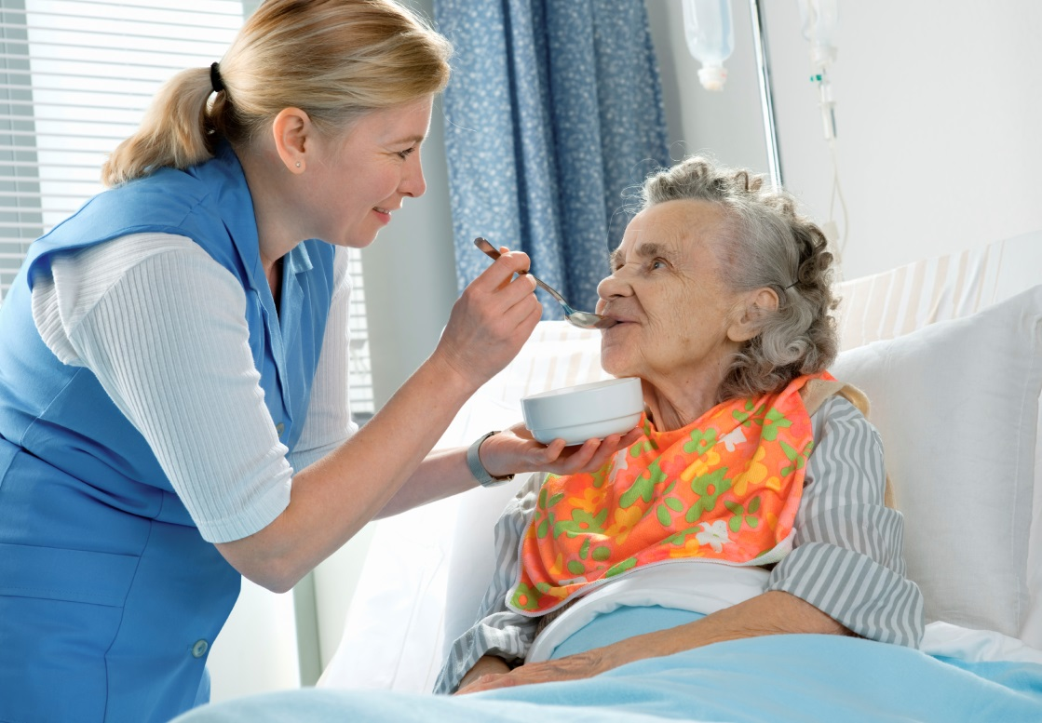
We Are Made in the Image of God
Being made in God’s image means we have a fundamental dignity.
Jesus always treated others as individuals made in God’s divine image.
© AlexRaths / iStockphoto.com
Notes:
Ask, “Who are some of the people Jesus ministered to whose dignity was not recognized in his day?” (See article 41 in the student book.) Brainstorm ways that a modern person could follow Jesus’ example.
This slide corresponds to content in article 41, “Jesus Teaches Us How to Be Authentically Human,” in the student book.

Slide 4
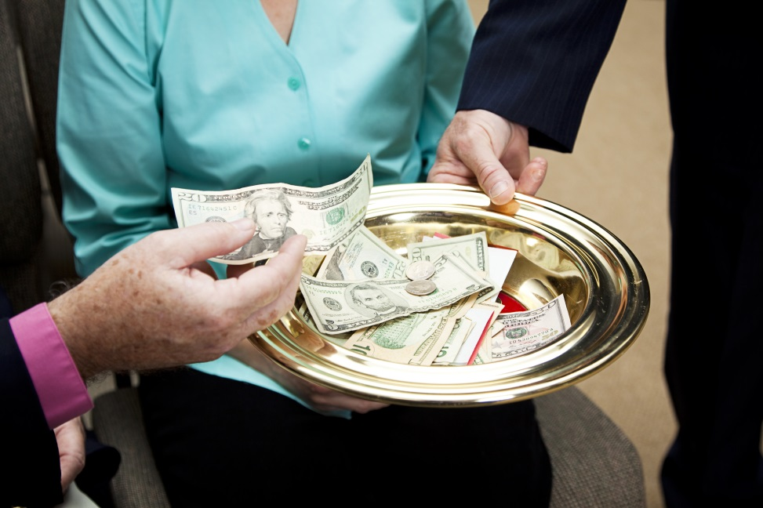
Jesus, The Perfect Man
At the Last Supper, Jesus washed the disciples’ feet, demonstrating humility.
Jesus’ prayer life reveals he was firmly grounded in a relationship with the Father.
Jesus lived and died in
material poverty.
© Lisa F. Young / Shutterstock.com
Notes:
Share examples of Christian saints who have embraced humility, prayer, and poverty (Saint Thérèse of Lisieux, Saint Francis of Assisi). Ask for modern examples (Maryknoll missionaries, Catholic Workers) and everyday applications.
This slide corresponds to content in article 41, “Jesus Teaches Us How to Be Authentically Human,” in the student book.

Slide 5
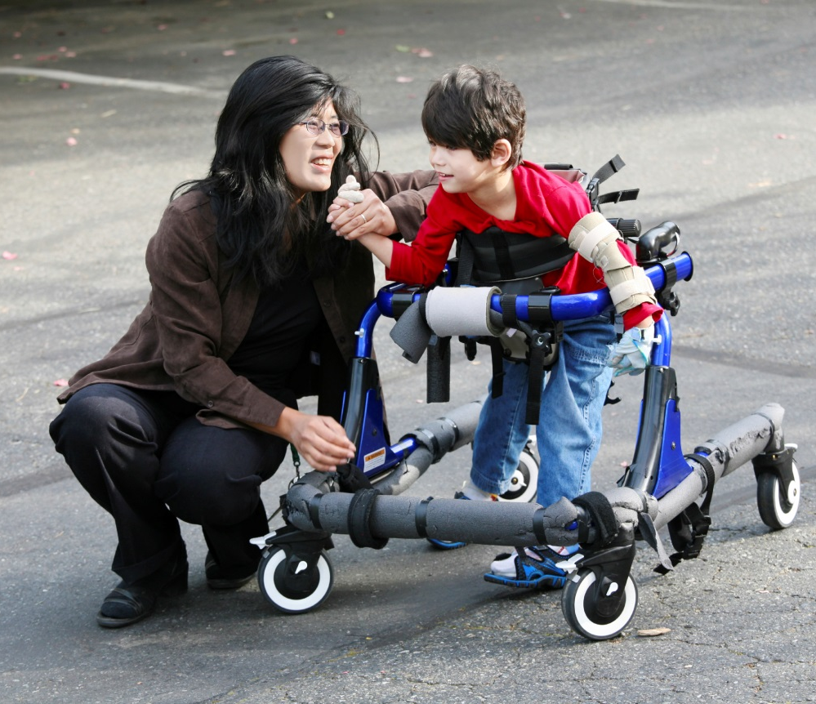
The Gifts of Intellect and Free Will
Jesus demonstrated perfect obedience to the Father when he accepted death.
Jesus struggled, knowing the consequences of his actions.
He had free will, and he used it wisely.
© jarenwicklund / iStockphoto.com
Notes:
Point out that our God-given intellect and conscience help us to use our free will wisely, as does the Holy Spirit. Ask for modern examples of people choosing obedience to God over their own wants.
This slide corresponds to content in article 42, “The Gifts of Intellect and Free Will,” in the student book.

Slide 6

Created to Love
Jesus revealed that we were created to love.
We have been created to love God.
Because we love God, we should also love our neighbor.
© Steve Debenport / iStockphoto.com
Notes:
Brainstorm ways that Christians today show their love for God and neighbor. Encourage each student to contribute an idea.
This slide corresponds to content in article 43, “Created to Love,” in the student book.

Slide 7
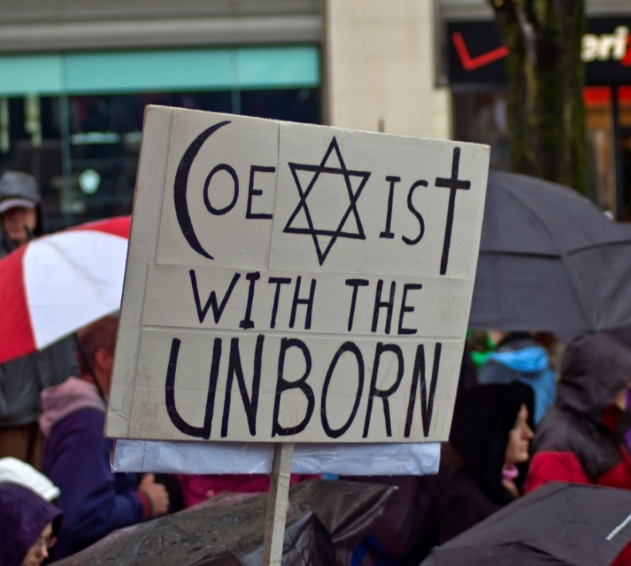
How Jesus Loved
As a teacher, Jesus spoke the truth.
He demonstrated his love for humanity as a healer.
Jesus sought out those whom society had excluded.
Most of all, Jesus gave us his love through his Death on the cross.
© dairygabriel / iStockphoto.com
Notes:
Discuss the first bullet point, exploring how speaking the truth can be an act of love. Give a modern example, and solicit further examples (e.g., public figures who speak the truth, family members in an intervention, being our true selves in friendship).
This slide corresponds to content in article 43, “Created to Love,” in the student book.

Slide 8
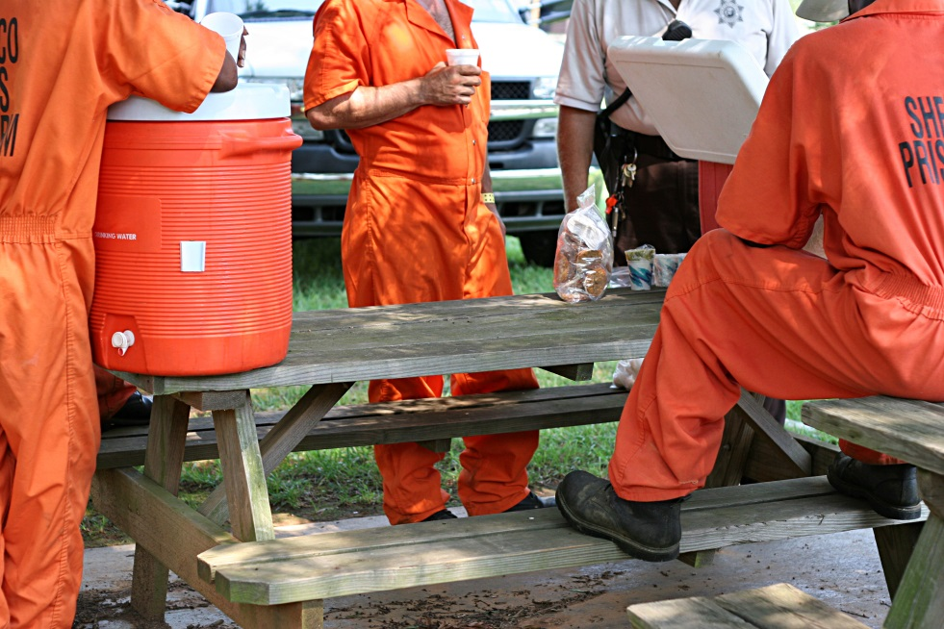
Loving Others as Jesus Did
We are to love one another just as God loves Jesus and as Jesus loves us.
Jesus showed his love for us by laying down his life.
We are to love others even at the expense of our own comfort.
© ftwitty / iStockphoto.com
Notes:
Discuss love of enemies, pointing out the last sentence, “If we could only see our enemies as God does, how differently would we treat one another?” at the conclusion of article 43 in the student book.
This slide corresponds to content in article 43, “Created to Love,” in the student book.

Slide 9
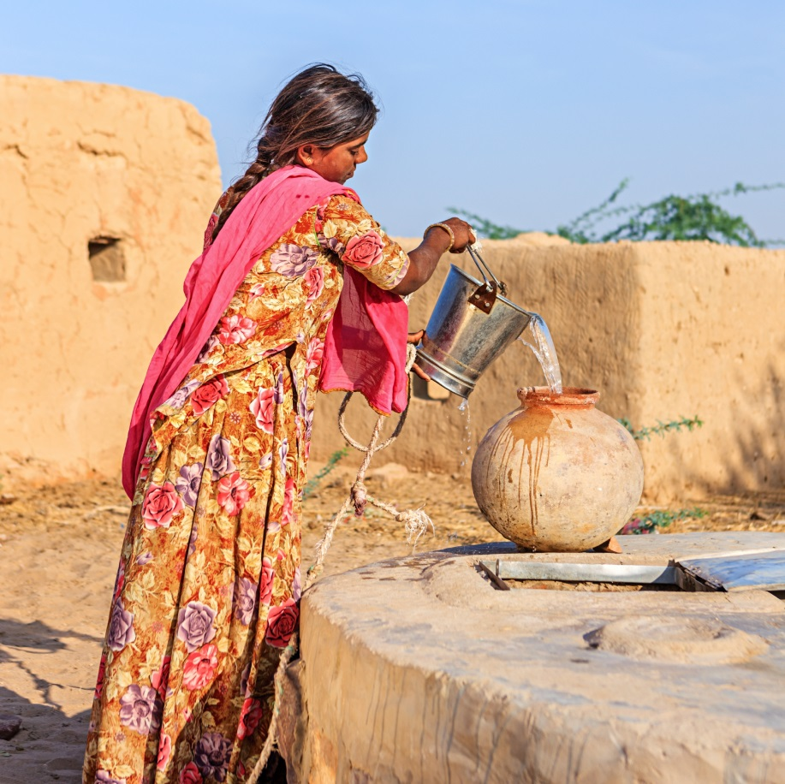
The Call to Be Stewards of Creation
Jesus knew that humanity and the natural world are interconnected.
We must use the earth’s resources for the benefit of all people.
We must safeguard the earth’s resources for future generations.
© hadynyah / iStockphoto.com
Notes:
Ask for examples of modern concerns being discussed by those who are committed to the care of creation.
This slide corresponds to content in article 44, “The Call to Be Stewards of Creation,” in the student book.

