Slide 1
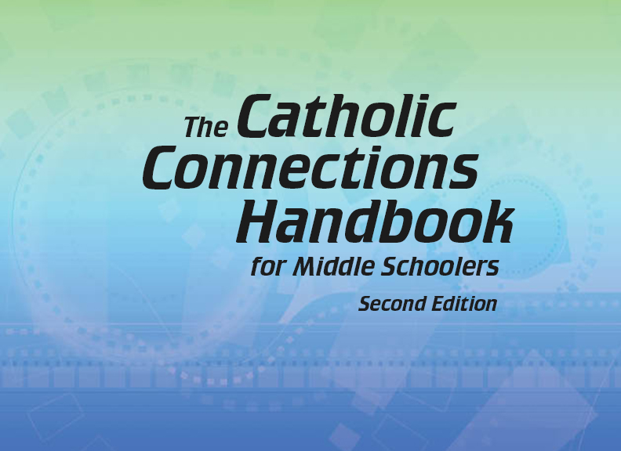

Document #: TX005815

Slide 2
Liturgy
and Sacraments
Chapter 28
Sacraments:
Celebrating Christ’s Presence

Slide 3
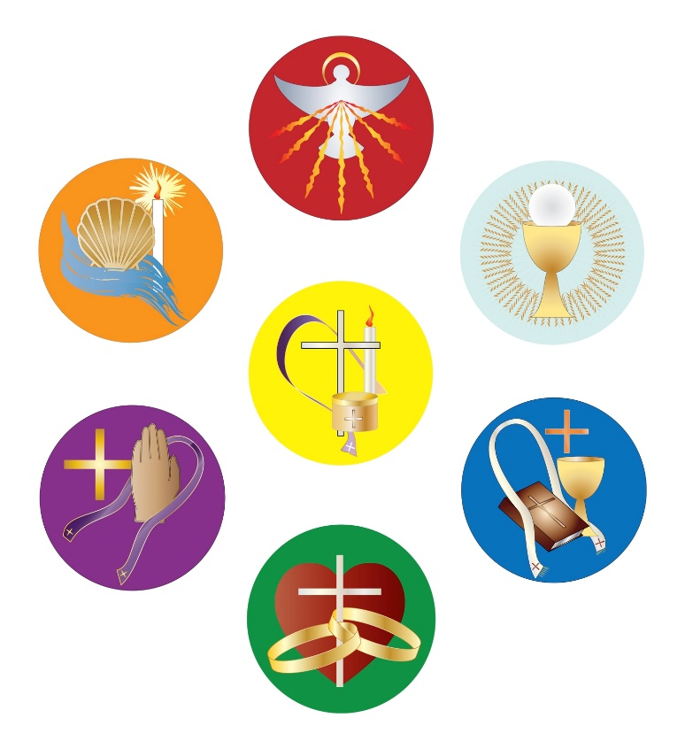
Chapter Summary
In this chapter, we will explore the Seven Sacraments and how they are grouped into three categories:
Sacraments of Initiation
Sacraments of Healing
Sacraments at the Service
of Communion
© Thoom/Shutterstock.com

Slide 4
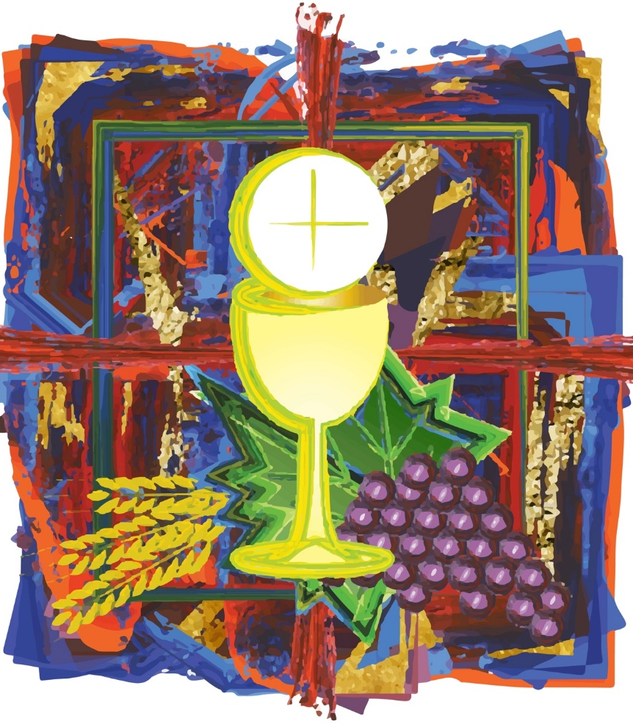
Chapter Summary
We will learn that we encounter God through
the Sacraments and that through the work of the Holy Spirit, the ordinary works of the Church become the presence
of Christ in the world.
© Thoom/Shutterstock.com

Slide 5
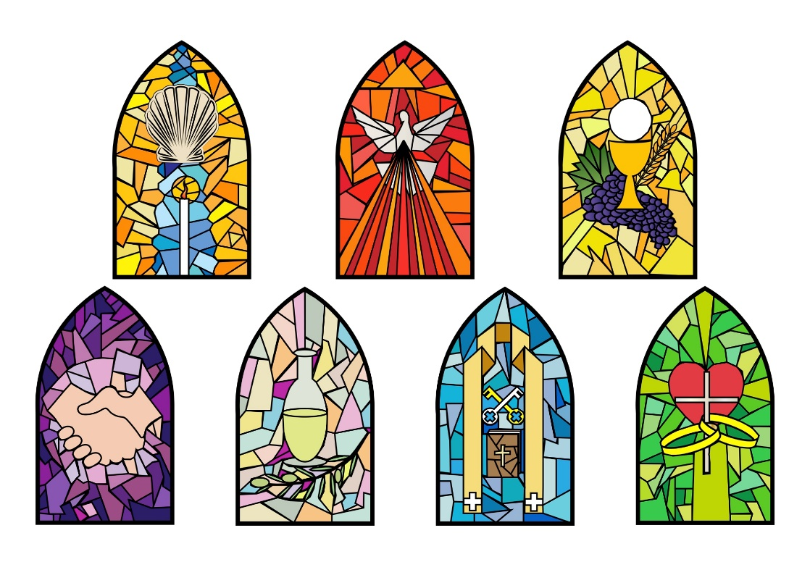
Introduction
(Handbook pages 298–300)
The Catholic Church recognizes Baptism, Confirmation, and the Eucharist as the Sacraments of Initiation, Penance and Reconciliation and Anointing of the Sick as Sacraments of Healing, and Matrimony and Holy Orders as Sacraments at the Service of Communion.
© Thoom/Shutterstock.com

Slide 6

Journal It!
Write in your journal about the things you remember regarding Sacraments your received in the Church.
What did you do?
Who was there?
What did it look like?
How did you feel?
© A.andI.Kruk/Shutterstock.com

Slide 7
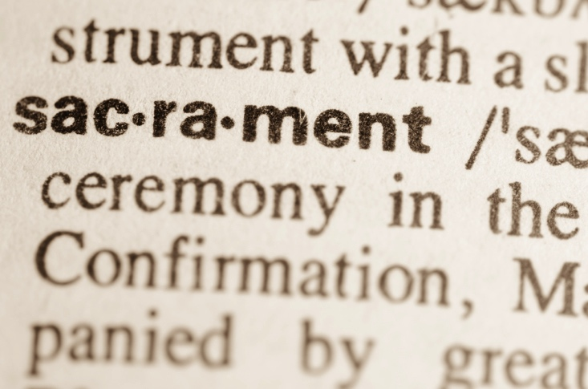
“Encounters with Christ”
and “God with Us”
(Handbook, pages 300–302)
Sacraments are encounters with Christ, the original sacrament. As we celebrate the Sacraments, we experience God with us and become a sign of Christ for the world.
© Aga7ta/Shutterstock.com

Slide 8

Share It!
Think about the Sacraments and how you encounter Christ through them.
Share with the person next to you how you currently experience the Sacraments—with passion? awe? nonchalance?
How does this knowledge of Sacraments as an encounter with Christ change the way you will approach the Sacraments in the future?
© Gajus/Shutterstock.com

Slide 9
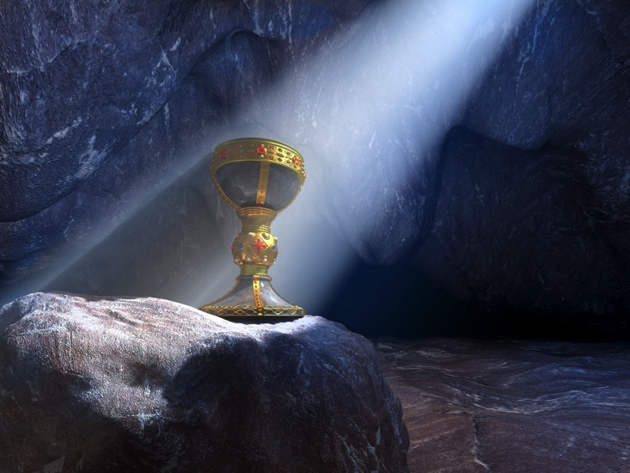
“Sacred Mysteries”
(Handbook, pages 303–304)
The Sacraments are sacred mysteries, instituted by Christ and entrusted to his Church to give grace.
© EstebanDeArmas/Shutterstock.com

Slide 10
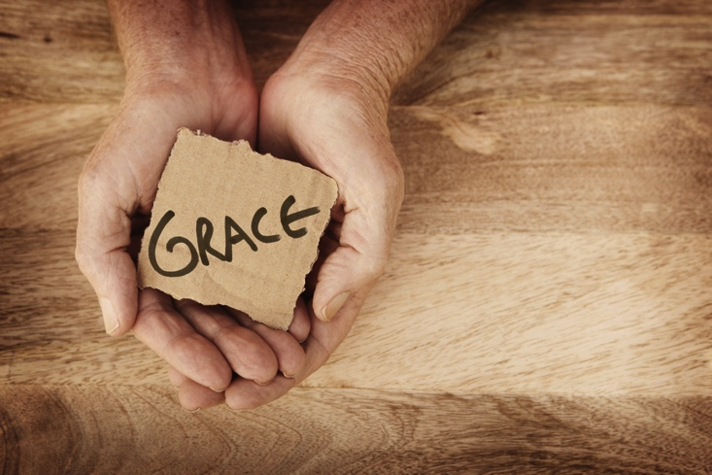
Journal It!
Write in your journal about the graces you have experienced from receiving the Sacraments. How do they connect you to the Church and help you to be
a better person?
© Hidesy/Shutterstock.com

Slide 11
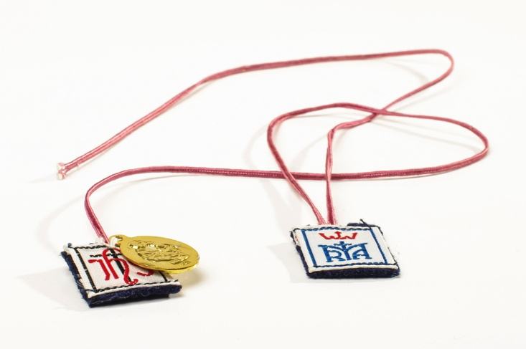
“Signs of Grace” and
“Living a Changed Life Every Day”
(Handbook, pages 304–307)
Grace comes from, but is not limited to, the Sacraments. Sacramentals, or sacred signs, also help prepare us to receive grace and to come to know God in our lives.
© AudriusMerfeldas/Shutterstock.com

Slide 12
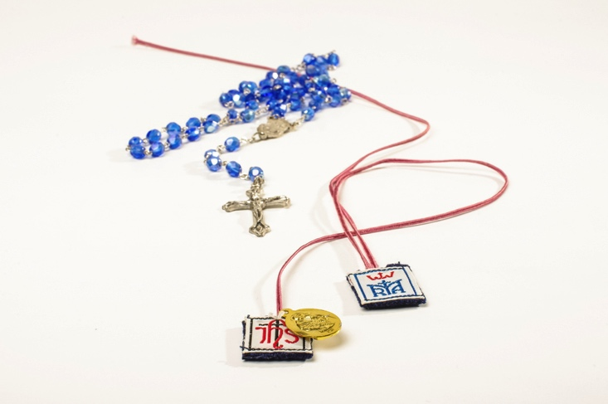
Post It!
Take a sticky note.
Write down the name
of a sacramental.
Post your sticky note
to the board.
© AudriusMerfeldas/Shutterstock.com

