Slide 1
Discipleship
The Church Course
Document # TX001513

Slide 2
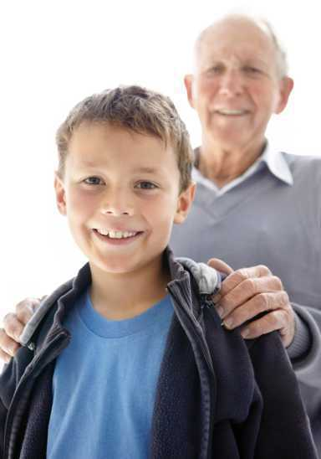
We Are Called
Through our Baptism we are called to the Church and to Christ.
Discipleship is our response to being called.
© shutterstock/Yuri Arcurs
Notes:
(Notes: Emphasize that we are called today, now, where we are at this moment. It isn’t a call only for adults and parents but for every member of the Body of Christ.)

Slide 3
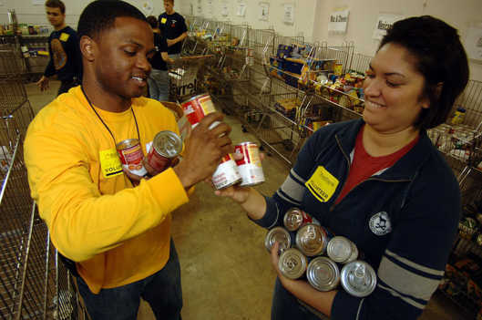
In Deed and Truth
The Apostle John wrote to the earliest Christian disciples:
“Children, let us love not in word or speech but in deed and truth” (1 John 3:18).
Image in public domain
Notes:
(Notes: Discuss what John means by this statement.)

Slide 4

Counterculture
Discipleship is counterculture.
Modern culture often says, “Me first!”
But in the Church, we serve one another.
Modern culture often says, “You are on your own.”
But in the Church, we are one in Jesus.
© shutterstock/Jason Stitt

Slide 5
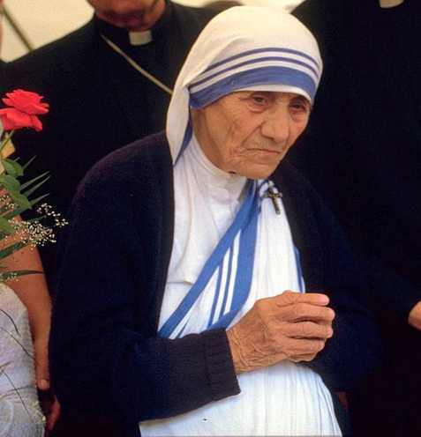
One Rule
In the Church, we are called to follow this simple rule: Do to others whatever you would have them do to you.
Image in public domain

Slide 6

Salt and Light
Discipleship means being
“salt and light” for the world.
We do this by contributing our gifts to the Church and to the human community.
© gloscitymission.org.uk
Notes:
(Notes: Perhaps ask the students what gifts they have that they can share.)

Slide 7
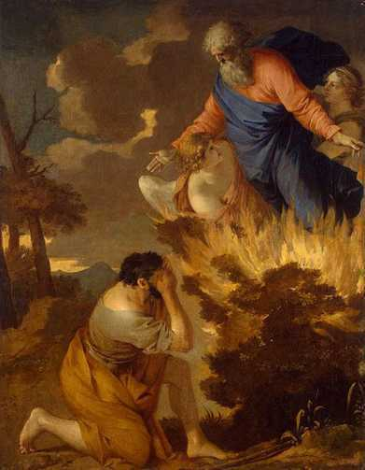
Called by God
People think that being called by God involves a dramatic, startling experience with an angel or a cloud or a trumpet in the background, followed by God’s instructions about what to do next.
Image in public domain

Slide 8
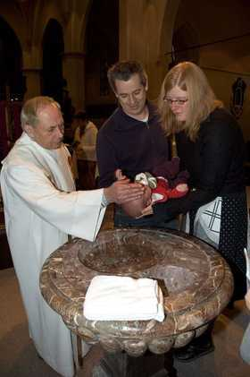
Your Call
Through the Sacrament of Baptism, you were incorporated into the Church.
As you were immersed in the waters of Baptism, or the waters were poured over your head, you died and rose with Christ and were freed from Original Sin . . . in the name of the Father, and of the Son, and of the Holy Spirit.
Image in public domain

Slide 9
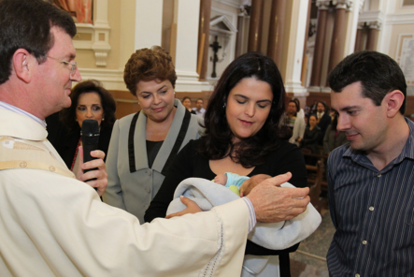
Anointed
With Sacred Chrism, you were anointed and incorporated into the Body of Christ as priest, prophet, and king.
You “put on Christ” and welcomed Christ’s light into your life.
Image in public domain

Slide 10
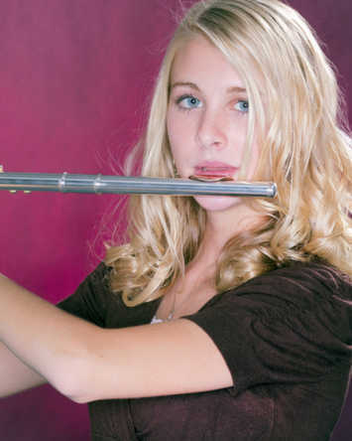
Sent as a Disciple
You have particular talents that give joy to others. These gifts are meant to be shared.
Don’t hide your gifts under a bushel basket, but take them as far as they will go.
© shutterstock/mkm3

Slide 11
Jesus Shows the Way
To be a disciple, we are called to:
keep holy the Lord’s Day
lead a sacramental life: receive Holy Communion frequently and the Sacrament of Penance and Reconciliation regularly
study Catholic teaching and be confirmed
observe the Marriage laws of the Church
strengthen and support the Church

Slide 12
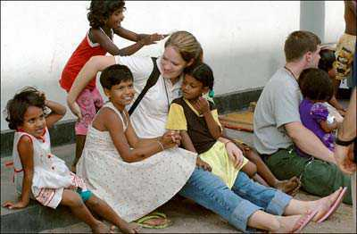
Act
Join in the missionary spirit and apostolate of the Church:
Parish ministries (lector or Eucharistic minister)
Diocesan activities (youth groups and diocesan Masses)
Service organizations (parish, school, local, global)
© inminds.com

Slide 13

Corporal Works of Mercy
To feed the hungry
To give drink to the thirsty
To clothe the naked
To visit the imprisoned
To shelter the homeless
To visit the sick
To bury the dead
© stmarysterling.com

Slide 14
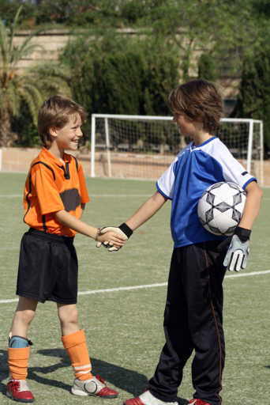
Spiritual Works of Mercy
To admonish the sinner
To instruct the ignorant
To counsel the doubtful
To comfort the sorrowful
To bear wrongs patiently
To forgive all injuries
To pray for the living and the dead
© shutterstock/MANDY GODBEHEAR

Slide 15
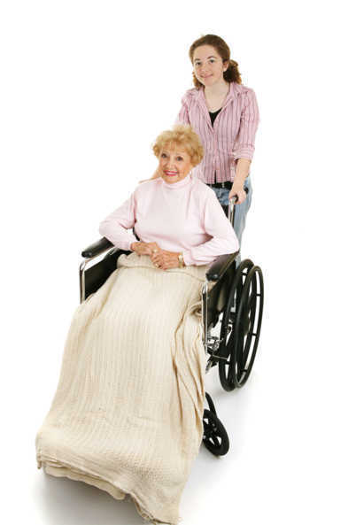
Put Christ First
God calls us to live a discipleship of
putting Christ first, living sacrificially
out of love, and putting everything
we have at God’s service in our
ordinary life.
© shutterstock/Lisa F. Young

Slide 16

The Word
To be a disciple of Christ means you must study his Word―and live the Word.
As a disciple of Christ, you will be asked to spread his Word, regardless of the sacrifices and personal difficulties you may have to endure.
© shutterstock/Jacob Gregory
Notes:
(Notes: Attest to the fact that not everyone wants to hear the Word, but that some will ask what guides their lives. They will need to be able to give a reasoned answer regarding their faith.)

Slide 17
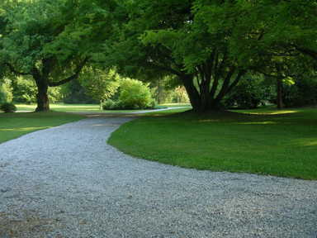
Path to Salvation
Jesus wants us to help as many people as possible to find salvation in him.
Christian discipleship is the process by which disciples grow in Christ and are equipped by the Holy Spirit to lead others to walk on the path to salvation.
Image in public domain

Slide 18
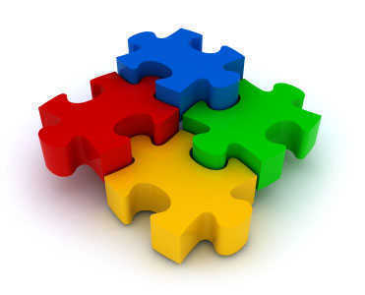
Part of the Puzzle
We are part of the divine puzzle, part of God’s plan.
Jesus wants us to be part of his ministry to the world. It is a high calling.
“Go, therefore, and make disciples
of all nations. . . . I am with
you always, until the end of
the age.” (Matthew 28:19–20)
Image in public domain

Slide 19
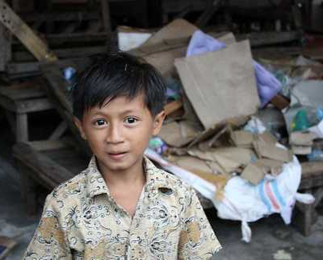
Service Groups
Catholic Relief Services
Catholic Campaign for Human Development
Operation Rice Bowl
Catholic Charities
Saint Vincent de Paul
Society
Local charities and
outreach
Peter’s Pence
© crs.org
Notes:
(Notes: Invite the students to name other groups if they can, for example, Special Olympics, children’s hospitals, retirement homes.)

Slide 20
It’s Up to You
Being a disciple is up to you:
Participate in the Sacraments.
Take time to pray.
Read the Scriptures.
Make choices to follow Christ.
Lead by example.
NEVER FORGET THAT CHRIST IS WITH YOU AT ALL TIMES.

