Slide 1

God’s Existence
Jesus Christ Course
Document #: TX001169

Slide 2


How Do We Know?
  Have you ever felt doubts about your faith?
  Have any of those doubts centered around God’s existence?
  How have you handled the doubts you have come across?
  What makes it hard for someone to believe in God?
© Veronika Rumko/Shutterstock
Do you have any further comments?
Notes:
The first slide can be used to begin a class discussion about whether the students have ever doubted God’s existence. It would be good to pause after each of the questions and allow for student feedback. The final question about further comments allows the students to express ways they have doubted their faith that may not have been voiced in the discussion of the bulleted questions.

Slide 3
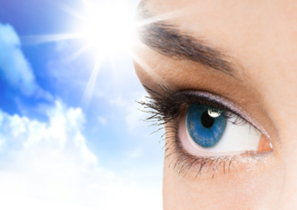
Is Seeing Believing?
  Many people feel they can believe only what they can see.
© Yuganov Konstantin/Shutterstock.com
  It is natural to accept as true the things we can see.
  It can be difficult to accept something we can’t see with
  our eyes.
  How can we come to believe in what we cannot see?
Notes:
3
The title of this slide can be used for discussion in class if time allows. When the last bullet point comes on the screen, you may find that some students would like to answer this question. If time allows, open this up for discussion.

Slide 4
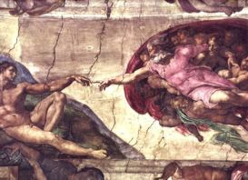
The Supernatural Order
When we believe something without the
use of our senses, we are challenged
to surrender to the supernatural.
Image in public domain.
What does supernatural mean?
  From the Latin super, meaning “above,” and natural meaning “nature.”
  Used when describing a phenomenon that is completely above the
  laws of nature.
  The supernatural is beyond the powers of creation and is the result of
  God’s gratuitous action.
Thought from the Catechism: We don’t believe in God because it makes good sense to do so; rather, we believe because God is trustworthy.
Notes:
4
The material on this slide is straightforward and informational. You may want to allude to the prayer “The Act of Faith” when the “Thought from the Catechism” comes on the screen. This prayer is on the final slide for the class to pray together.

Slide 5
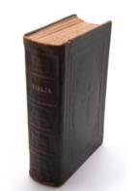
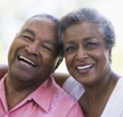
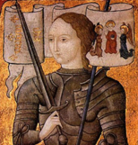
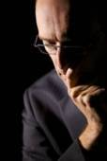
Reliable Sources
Several sources of information can help to assure us of God’s reality:
  The Scriptures provide the witness
  of the very early
  followers of Jesus.
  The witness of the faith-filled lives of other believers.
© Markus Unger/Shutterstock.com
© Monkey Business Images/Shutterstock.com
The witness
of martyrs.
  Our reason
  and intellect.
Image in public domain.
© Lichtmeister/Shutterstock.com
Joan of Arc
Knowing about these sources of information does not mean you will never doubt God’s existence again.
Notes:
5
When the bullet on the witness of the martyrs comes on the screen, you may want to have an account of a saint’s martyrdom to share with the class. A cross-discipline (theology / fine arts) example can be showing the students the final scene of the Dialogue of the Carmelites. This French opera tells of the Carmelite nun-martyrs in Compiègne, France, who were sentenced to the guillotine. Other possibilities could be the martyrdom scene of the movie Becket or A Man for All Seasons. When the bullet on our reason and intellect comes on the screen, take time to remind the students of Saint Thomas Aquinas’s five proofs for the existence of God that were studied in the previous course (see the PowerPoint “Finding God and Being Found by God” [Document #: TX001070]).

Slide 6
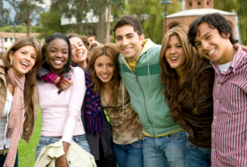
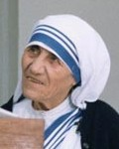
A Faith-Filled Person
Take a moment to think
of someone you admire as a person of great faith.
© Andresr/Shutterstock
Image in public domain.
1. Whom did you pick and why did you pick that particular person?
2. Based on the examples provided, let us list some common characteristics of faith-filled people.
Notes:
6
When you begin the discussion on the characteristics of a faith-filled person, help the students to recognize that a faith-filled person can be someone who does ordinary things in extraordinary ways. You may need to lead the student discussion by asking questions such as, “Who in your family is a faith-filled person?”

Slide 7
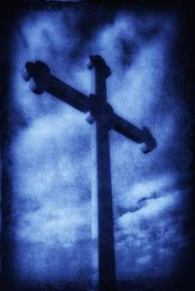
Review
What is meant by the notion that believing
in God is part of the supernatural order?
2. Name some reliable sources that can help us to believe in God’s existence.
3. What are some of the characteristics of a faith-filled person that our class came up with?
© Anatema/Shutterstock.com
Notes:
7
This slide helps the students to review what has been covered in this class. This slide can also serve to identify any areas where students are having difficulty grasping the concept presented.

Slide 8
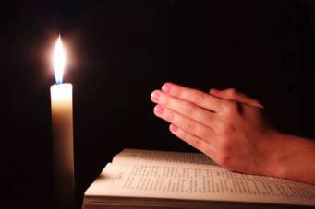
Act of Faith
O my God, I firmly believe that you are one God in three Divine
Persons, Father, Son, and Holy Spirit. I believe that your Divine Son became man and died for our sins, and that he will come to judge the living and the dead. I believe these and all the truths which the Holy Catholic Church teaches, because in revealing them, you can neither deceive nor be deceived.
© irin-k/Shutterstock.com
Notes:
8

