Slide 2
The Old Testament
and the Trinity
Chapter C
The Bible: Joshua and Judges

Slide 3
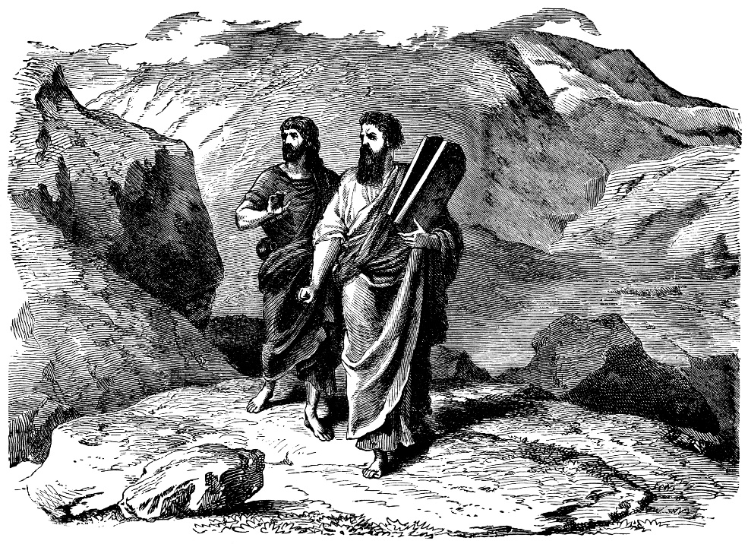
Chapter Summary The Bible: Joshua and Judges
In the readings from the Books of Joshua and Judges, we will see the Israelites entering the Promised Land and conquering Jericho, as well as pledging their allegiance to God through Shechem. We will also encounter Deborah leading the defeat of the Canaanites, and Samson’s deliverance from the Philistine kings—all with the help of God. We will discover the power of God working in those who place their hope and trust in him.
© traveler1116/www.istockphoto.com

Slide 4
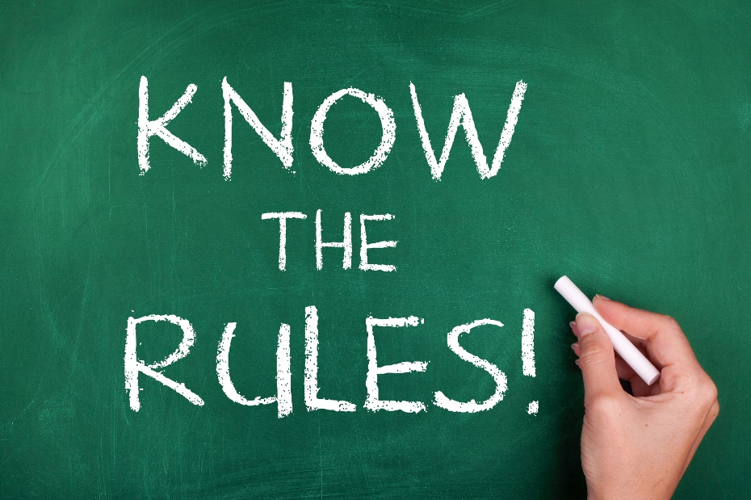
“The Walls Come Tumbling Down” (Joshua, Chapter 6)
Obedience in every detail to God’s commands assured the Israelites victory over Jericho.
© Oko_SwanOmurphy/www.istockphoto.com

Slide 5
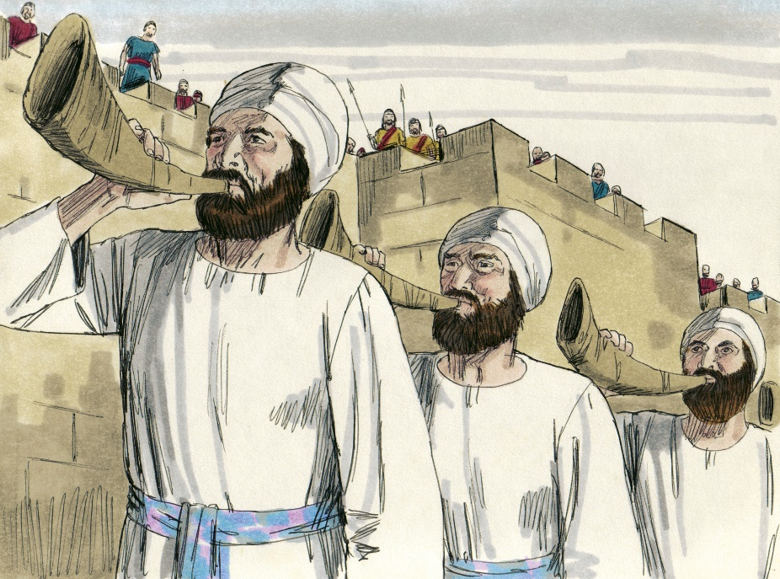
“The Walls Come Tumbling Down” (Joshua, Chapter 6)
God gave very clear instructions to Joshua about how Jericho would fall to the Israelites.
Joshua and the Israelites did as they were told and conquered the city.
© BibleArtLibrary/www.istockphoto.com

Slide 6
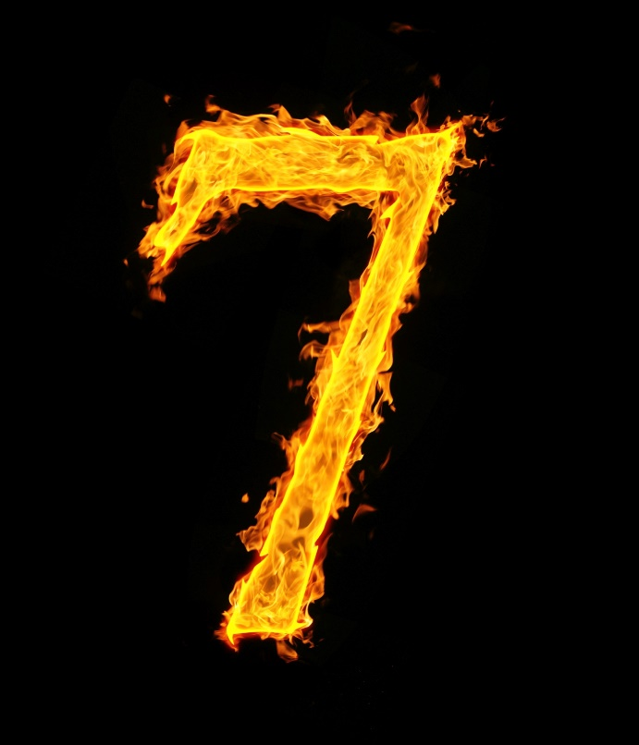
“The Walls Come Tumbling Down” (Joshua, Chapter 6)
The story is highly symbolic and repeatedly uses the number seven, a number symbolizing God’s perfection, to indicate that victory comes from God.
Joshua spared the lives of Rahab and all her relatives, because she had hidden the two spies that Joshua had sent to Jericho.
© loskutnikov/www.istockphoto.com

Slide 7
“People Vow to Serve the Lord” (Joshua 24:1–28)
Every good thing that happens has God as its origin.
© Andrew_Mayovskyy/www.istockphoto.com

Slide 8
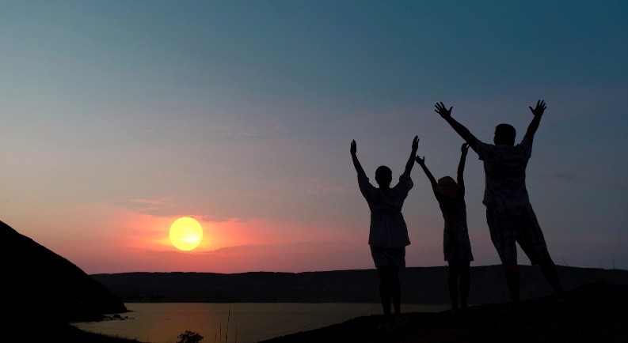
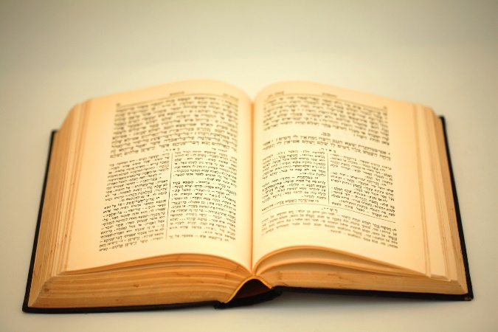
“People Vow to Serve the Lord” (Joshua 24:1–28)
Every good thing that happened to the Israelites, from the call of Abraham to the settlement of the Promised Land, was God’s work.
Joshua demanded that the Israelites honor the Lord, serve him sincerely and faithfully, and worship him alone.
The Israelites pledged their loyalty to the Lord, the God of Israel, and Joshua gave them laws and rules to follow—written in the Law of God.
© galdzer/www.istockphoto.com
© motimeiri/www.istockphoto.com

Slide 9
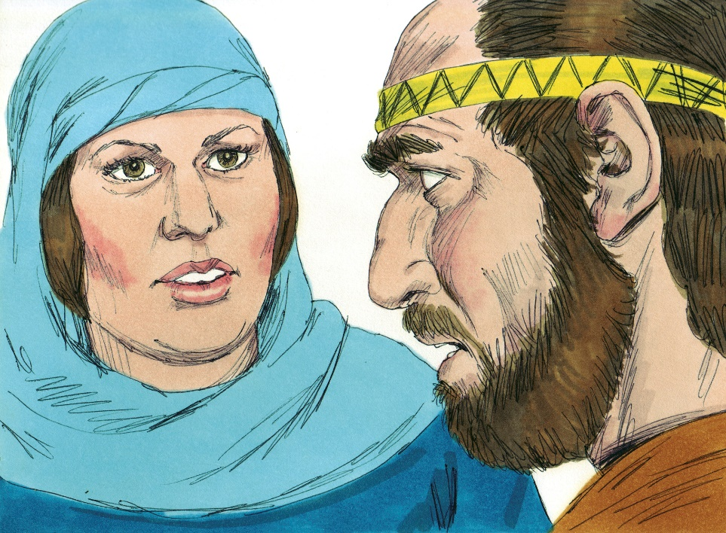
“Women Serve the Lord” (Judges, Chapter 4)
God heard the cry of his people, Israel, and led Deborah and Barak in victory over the Canaanites.
© BibleArtLibrary/www.istockphoto.com

Slide 10
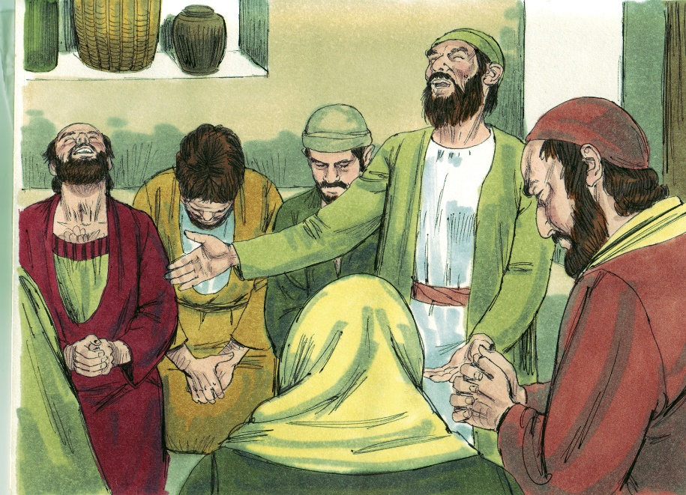
“Women Serve the Lord” (Judges, Chapter 4)
The people of Israel cried out to the Lord for help after twenty years of cruelty and violence at the hands of the Canaanite king, Jabin.
God called Deborah, a prophet and Judge of Israel, to lead Israel’s army against the Canaanites.
© BibleArtLibrary/www.istockphoto.com

Slide 11
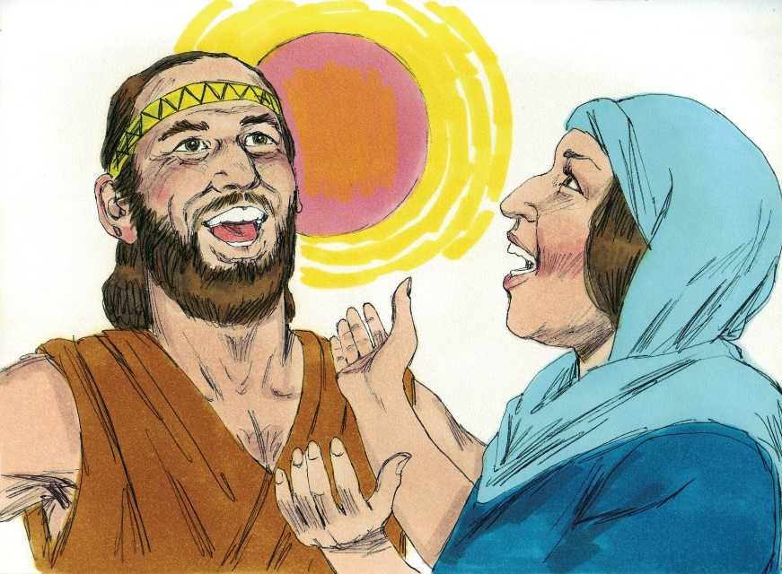
“Women Serve the Lord” (Judges, Chapter 4)
Under the leadership of Deborah and the Israelite general Barak, the Lord led the Israelites to victory over Jabin.
Jabin’s general, Sisera, was killed by another woman, Jael.
© BibleArtLibrary/www.istockphoto.com

Slide 12
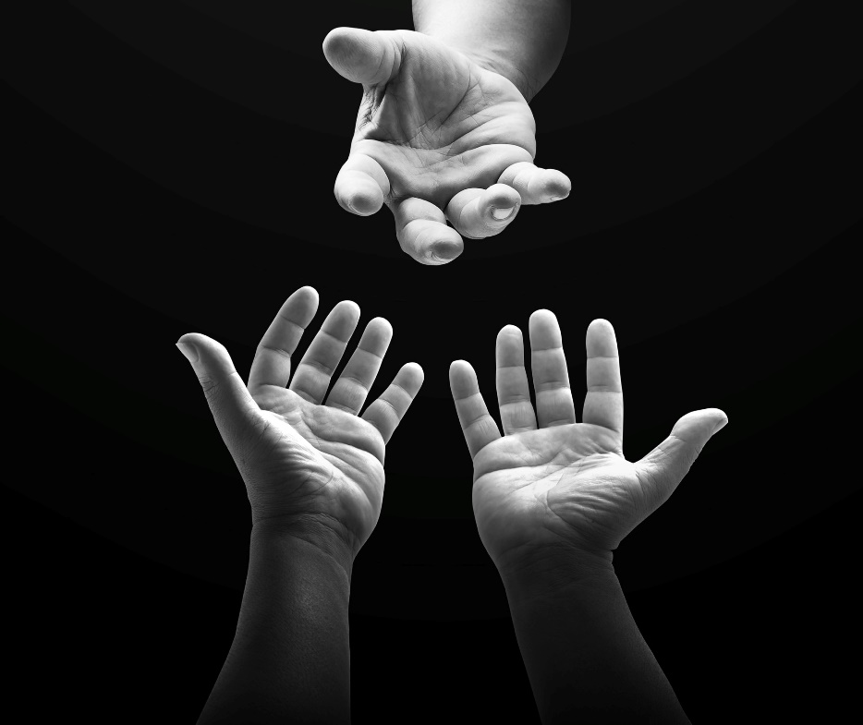
“Bad Haircut Leads to Blindness” (Judges, Chapter 16)
Even when we find ourselves in harm’s way as a result of sin, we can always call upon God for strength, and he will answer us.
© CHOATphotographer/www.shutterstock.com

Slide 13
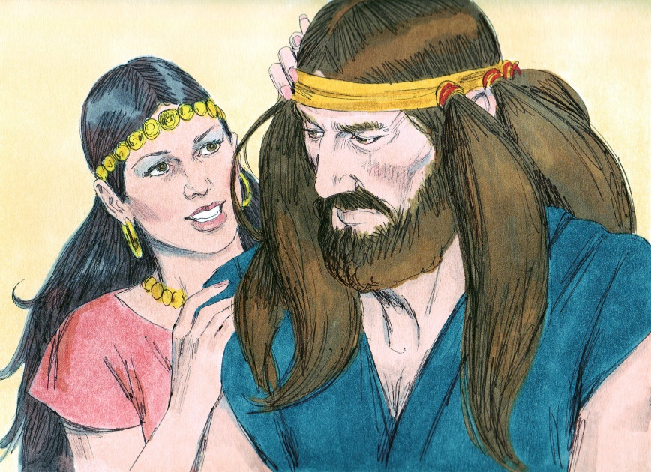
“Bad Haircut Leads to Blindness” (Judges, Chapter 16)
Samson’s strength was so great that the Philistines could not defeat him in battle.
When Samson fell in love with a Philistine woman, Delilah, he let down his guard and revealed the secret to his strength.
© BibleArtLibrary/www.istockphoto.com

Slide 14
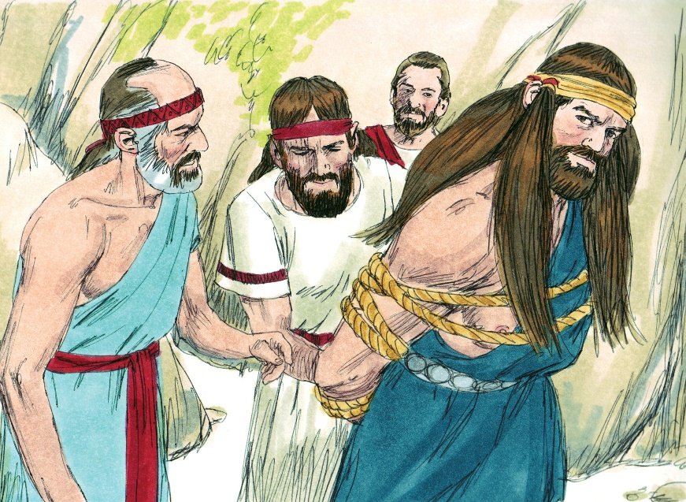
“Bad Haircut Leads to Blindness” (Judges, Chapter 16)
After Delilah betrayed Samson, the Philistines captured and blinded him and made him a slave.
At a big celebration, Samson prayed to God, and God restored his strength. This allowed Samson to bring down the building, killing himself and all the gathered Philistines.
© BibleArtLibrary/www.istockphoto.com

Slide 15
Review Activity
Get into groups of three to five students and reenact the story of Deborah or the story of Samson for the rest of the class.
It is okay for more than one group to reenact the same story. Each group will offer another perspective on the story, which will help the class better understand the story.
To prepare your reenactment, or skit, review your assigned story:
Story of Deborah: Judges, Chapter 4
Story of Samson: Judges, Chapter 16

