Slide 1
The Ascension in Art
The Paschal Mystery Course
Document # TX001333
Notes:
(Notes: The students may journal the answer to the question for each of the six slides, or you may wish to lead a class discussion of the questions. Assure the students that the questions have no right or wrong answers; they are springboards for deeper thought. Some discussion prompts are suggested in the notes for each slide, but you may wish to allow significant thinking time before prompting the students.)

Slide 2
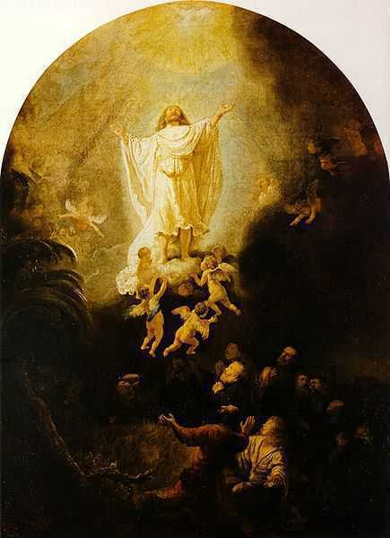
How do you respond to Rembrandt’s use of darkness and light?
Image in public domain
Notes:
(Notes: Christ seems to be moving from darkness into light. Prompt the students to explore several meanings of each symbol.)

Slide 3
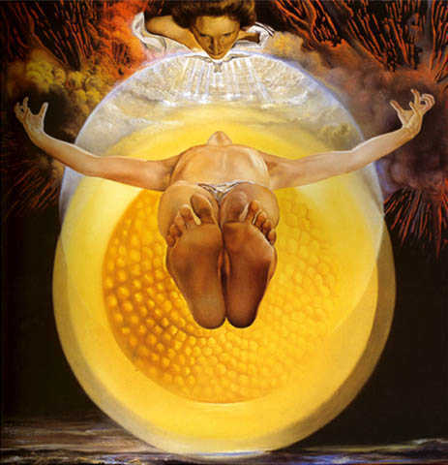
How do you respond to Dali’s use of perspective?
Artnet.com
Notes:
(Notes: Dali’s use of perspective allows the viewer to stand with those below. Prompt the students to comment on the experience of the disciples.)

Slide 4
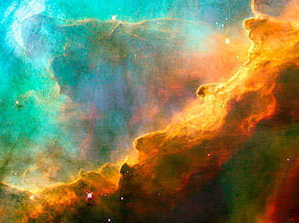
A Christian blogger used this photo taken by the Hubble space telescope to represent the Ascension. What do you think?
Image in public domain
Notes:
(Notes: The students may be able to see an image of a man with outstretched arms. Prompt the students to comment on the merits of using abstract forms of art to depict spiritual realities.)

Slide 5
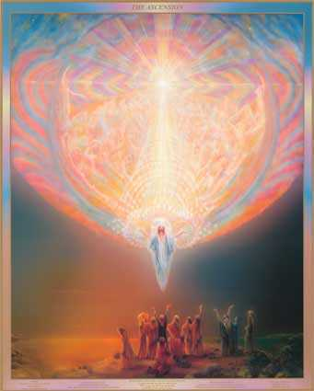
What details strike you in this image by Catherine Andrews?
thelitpath.com
Notes:
(Notes: Prompt the students to comment on the body language of the various figures below, and on the crowd of figures above.)

Slide 6
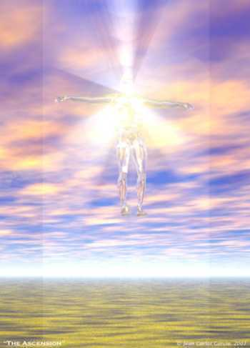
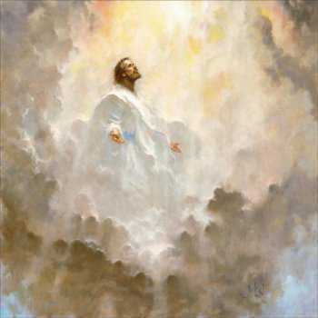
In these images by Brian Jekel and Juan Carlos Garcia, Jesus seems to dissolve. What do you think the artists are trying to say?
picturesofjesus4you.com
astrologycourse.org
Notes:
(Notes: In biblical times God was thought to dwell in the heavens. Prompt the students to think about how they would portray the idea of returning to the Father, given our modern worldview.)

