Slide 1
The Book of Exodus
The Living Word: The Revelation of God’s Love, Second Edition
Unit 3, Chapter 8
Document#: TX004686

Slide 2

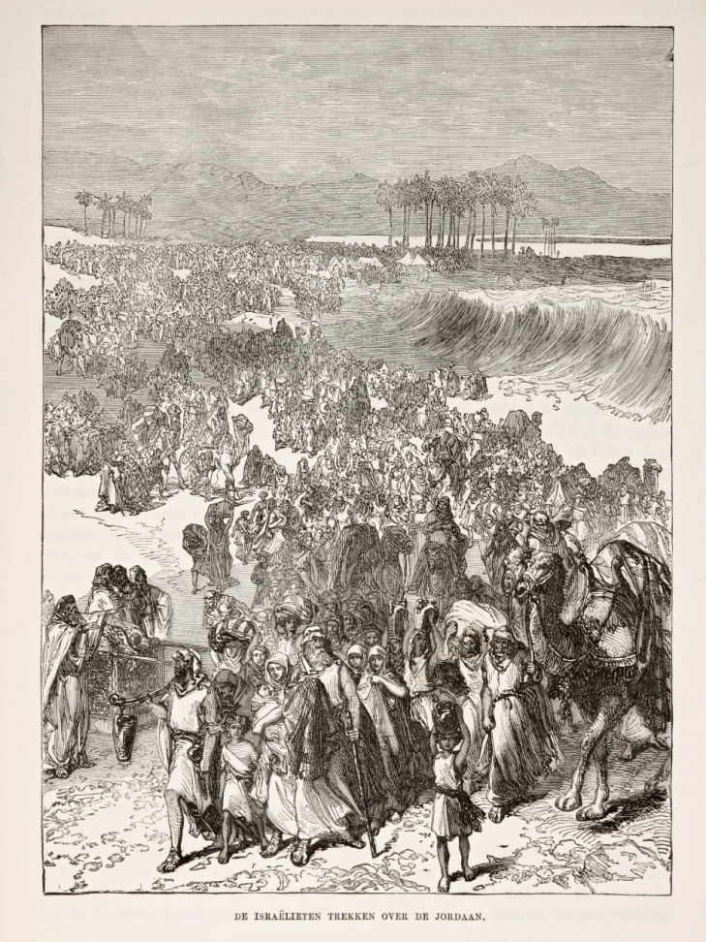
Slavery, Liberation, and Trust
The Book of Exodus covers the period from about 1500 to 1250 BC.
It tells of a God who saves his people.
God longs to be in a covenant relationship with them.
© Jaap2 / iStockphoto.com
Notes:
Notes: Explain that the Exodus event gave the Israelites an identity as a holy nation governed by God’s Law.
This slide corresponds to content in the chapter 8 introduction in the student book.

Slide 3
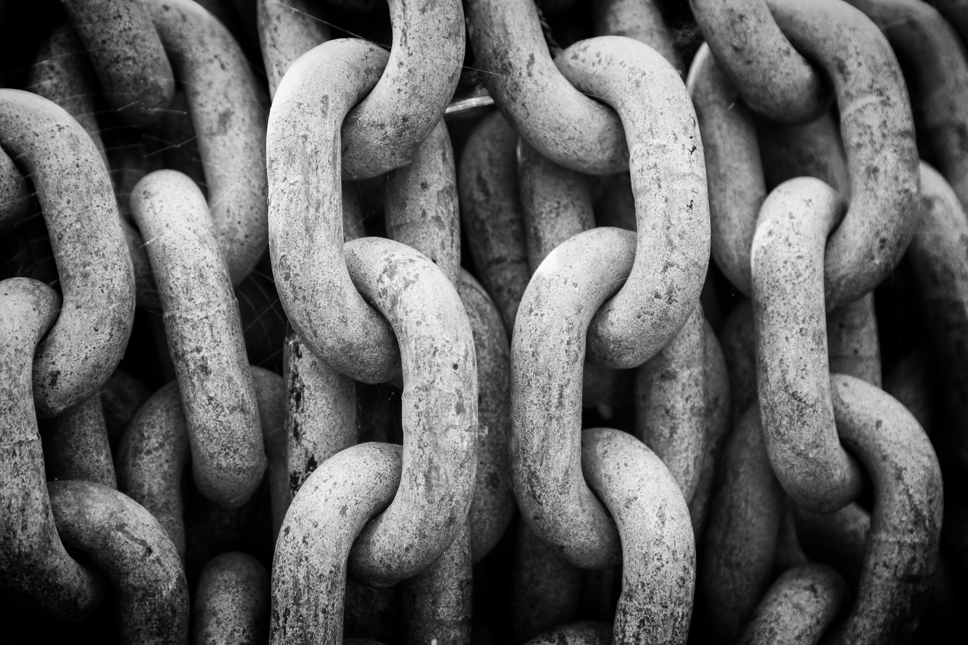
A People Enslaved
Jacob’s descendants enjoyed welcome and peace in Egypt for several generations.
But the Egyptian pharaoh began to see the growing number of Israelites as a threat.
He ordered that
the Israelites, or
Hebrews, be
enslaved.
© Daz Brown Photography / Shutterstock.com
Notes:
Notes: Ask the students why the pharaoh ordered the deaths of all male Israelite babies at birth. (He was fearful of the growing slave population.)
This slide corresponds to content in article 38, “A People Enslaved,” in the student book.

Slide 4
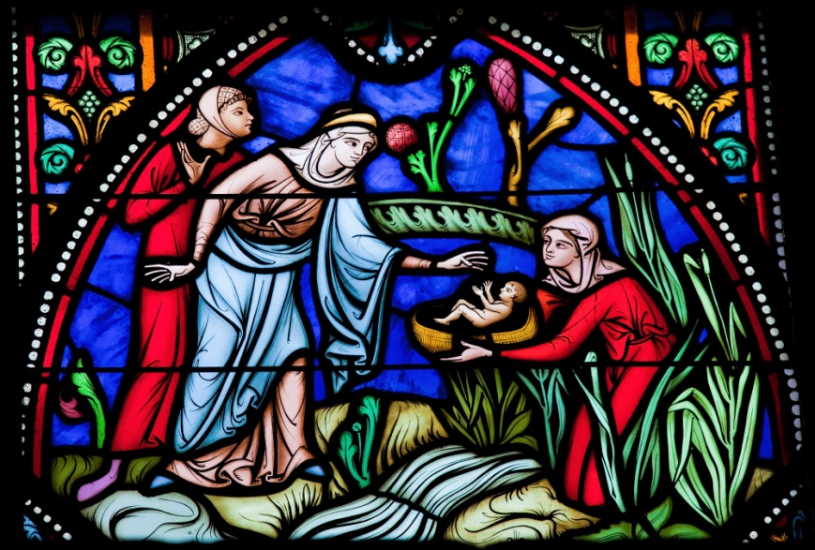
Young Moses
Moses’ mother, an Israelite, placed him in a basket and floated it down the Nile River.
Moses was adopted by Pharaoh’s daughter, who enlisted his birth mother to care for him.
He grew up in
Pharaoh’s
household.
© jorisvo / Shutterstock.com
Notes:
Notes: Discuss with the students how God used women to save Moses from death: the midwives, Moses’ mother, his sister Miriam, and Pharaoh’s daughter.
This slide corresponds to content in article 38, “A People Enslaved,” in the student book.

Slide 5
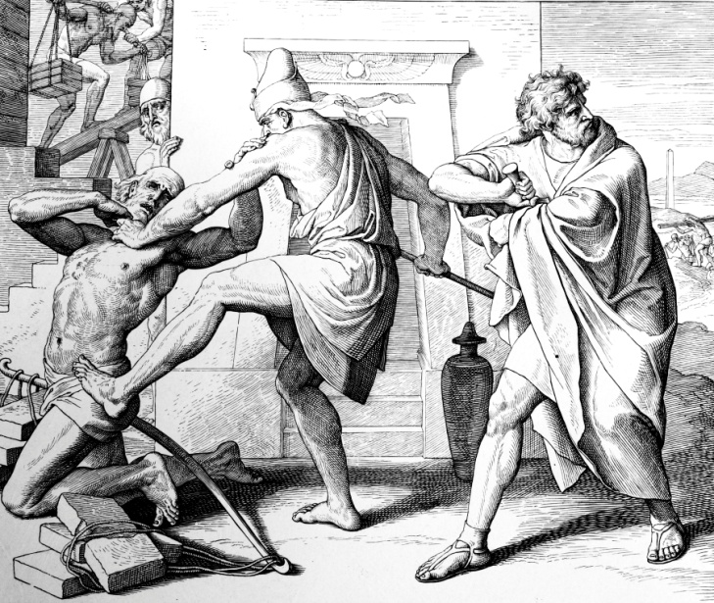
Moses, the Fugitive
Moses killed an Egyptian
who was beating an
Israelite slave; he hid
the body.
When Moses’ actions
became known, he feared
for his life and fled to Midian.
There, he married the daughter of a local priest and became a shepherd.
© gldburger / iStockphoto.com
Notes:
Notes: Ask the students what elements in Moses’ life story seem surprising, given the work God called him to do. Ask if they see any ways Moses’ personal history might have prepared him for this work.
This slide corresponds to content in article 38, “A People Enslaved,” in the student book.

Slide 6
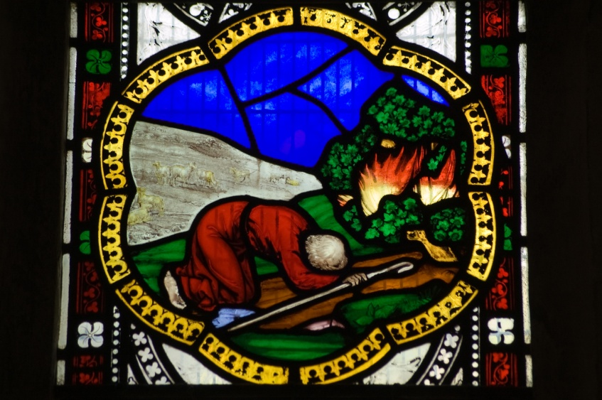
Moses’ Encounter with God
On Mount Horeb, God addressed Moses from a burning bush.
God revealed his sacred divine name: Yahweh.
Yahweh is often translated as “I am,” or “I am who I am.”
© BasPhoto / Shutterstock.com
Notes:
Notes: Explain to the students that in ancient cultures, a name often expressed a person’s essence. Point out that in parts of the Bible, God’s name is replaced with “the Lord,” because Jewish tradition regards God’s name as too holy to pronounce.
This slide corresponds to content in article 39, “Moses and the Exodus,” in the student book.

Slide 7
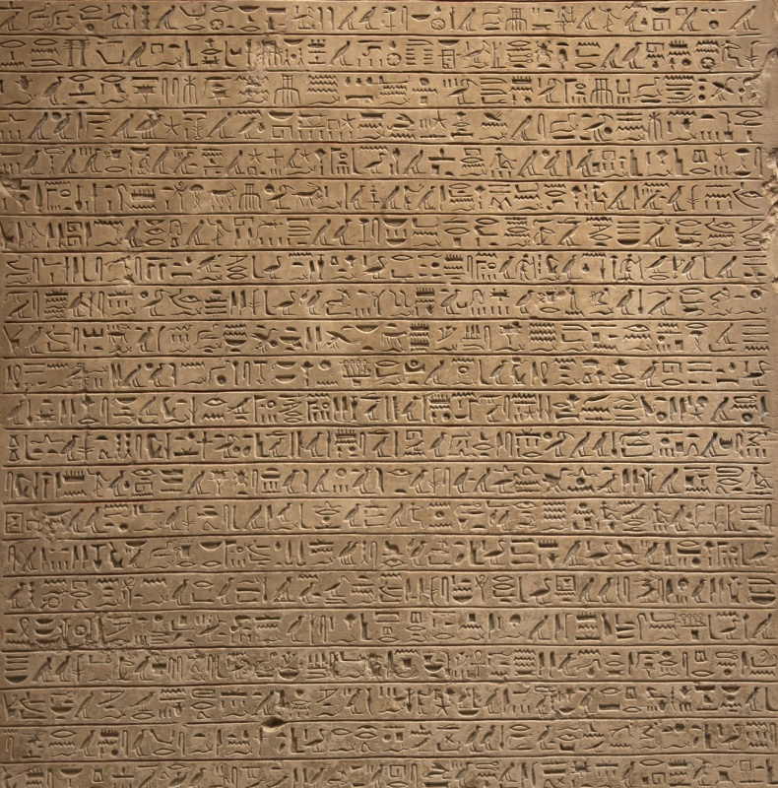
God’s Messenger
God had heard the cries of his children enslaved in Egypt.
He called Moses to return to Egypt.
Moses was to tell Pharaoh to release the Israelites.
© jsp / Shutterstock.com
Notes:
Notes: Ask the students where Moses was to lead the people, once they were free (into the land of Canaan, the land promised to Abraham and his descendants).
This slide corresponds to content in article 39, “Moses and the Exodus,” in the student book.

Slide 8
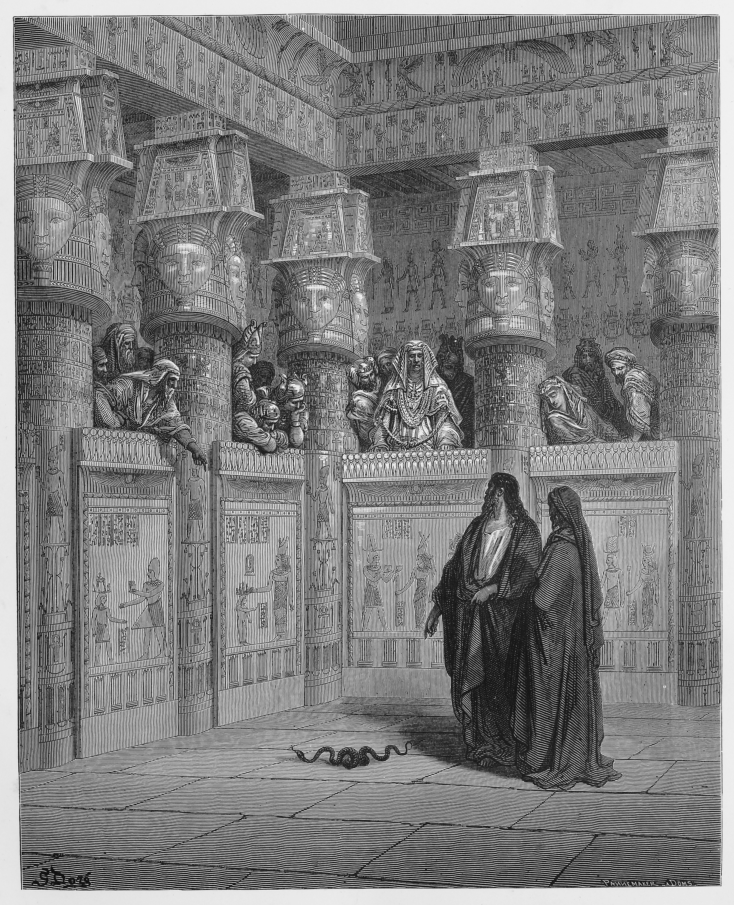
The First Nine Plagues
Moses and his brother Aaron confronted Pharaoh and worked wonders to show the power God.
Pharaoh rejected the demands of Yahweh.
God unleashed plagues on Egypt, each time demanding release of the Israelites.
© Nicku / Shutterstock.com
Notes:
Notes: Point out to the students that Pharaoh was not willing to submit to Yahweh’s demands because Pharaoh was regarded as a god in Egypt. He didn’t want to let his own perceived divine status be challenged.
This slide corresponds to content in article 39, “Moses and the Exodus,” in the student book.

Slide 9
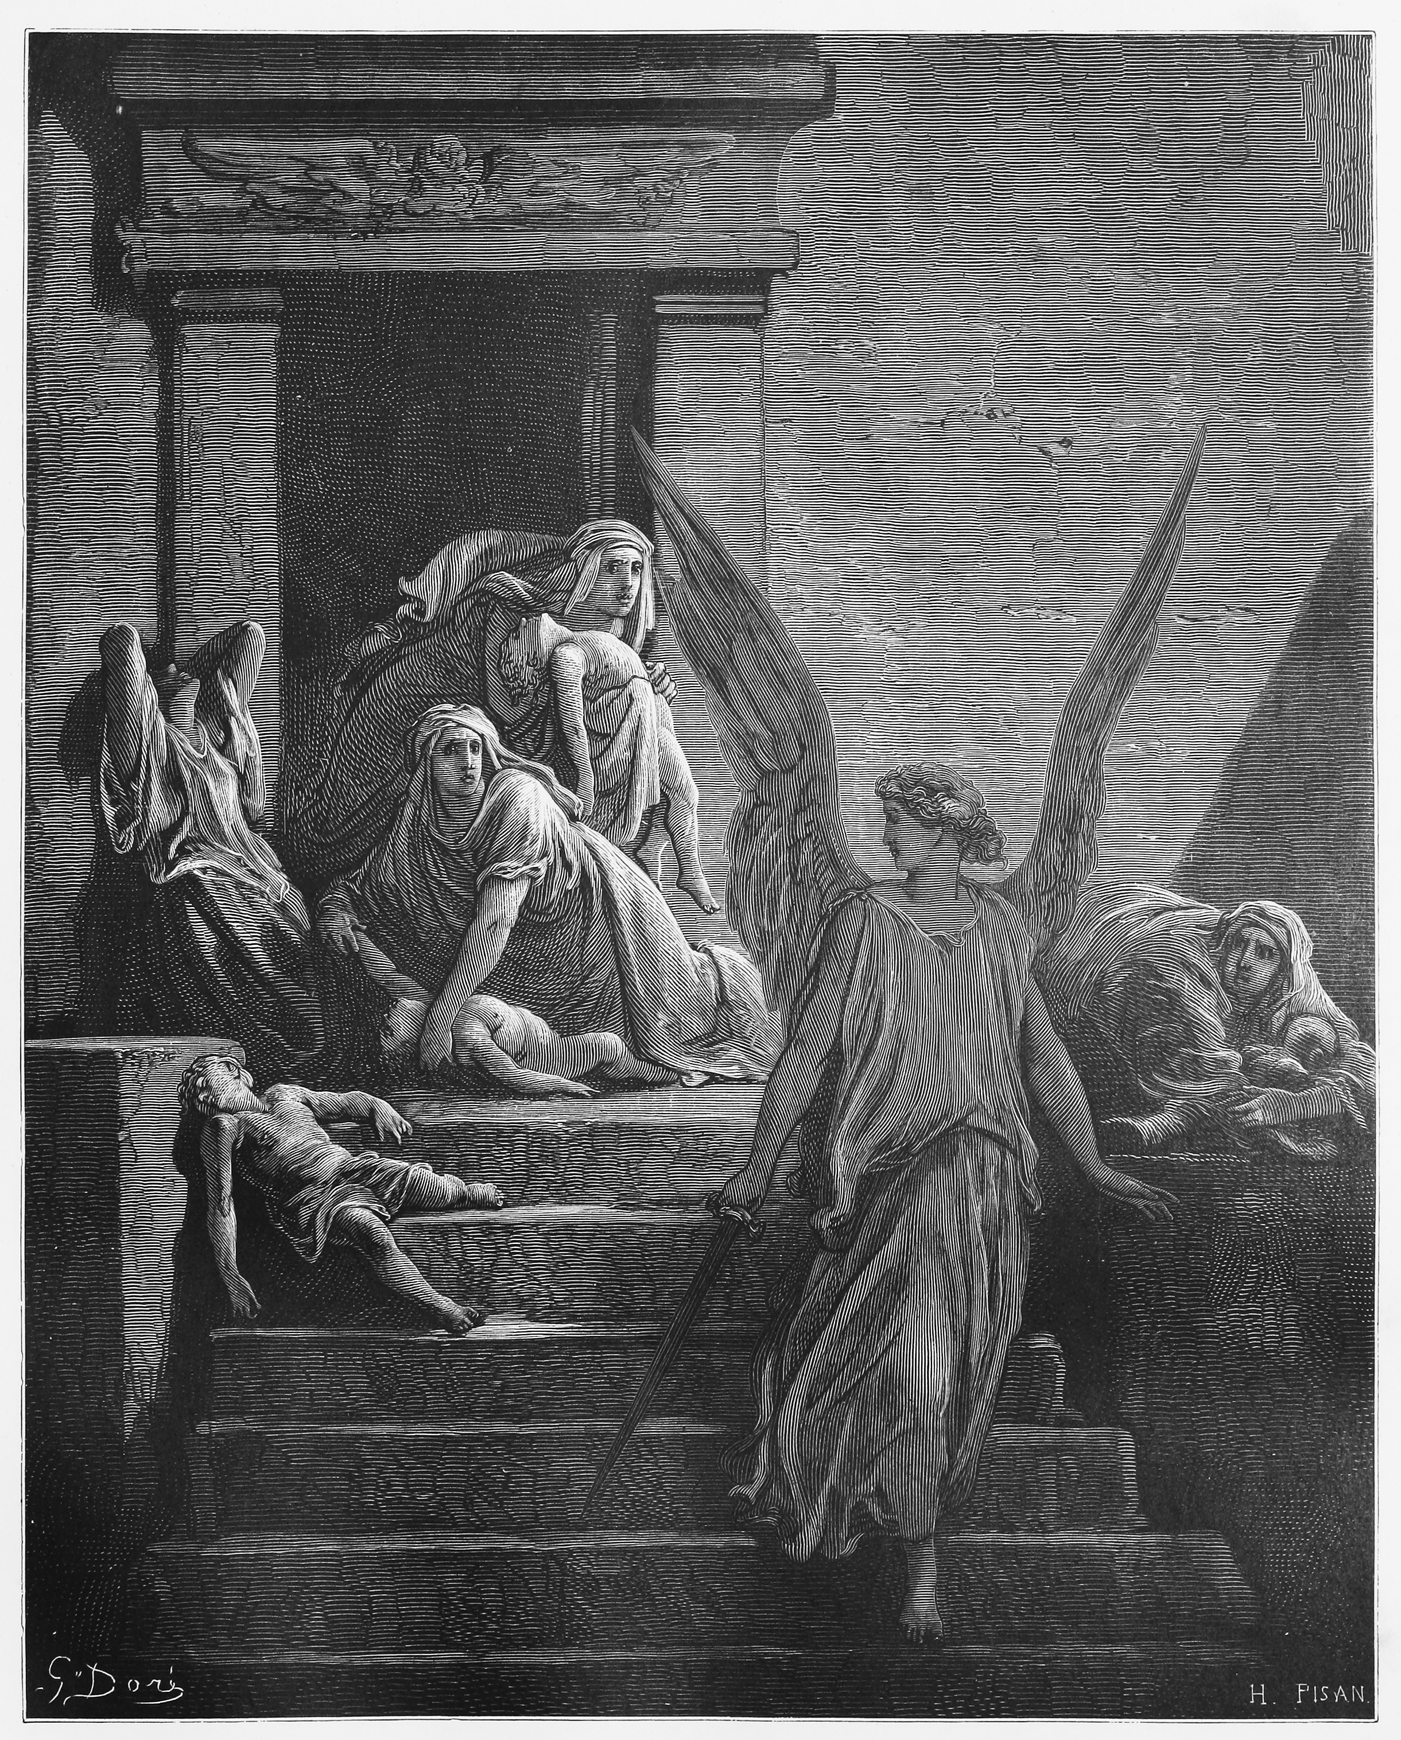
The Tenth Plague
God directed the Israelites to kill and eat a lamb and to put some of its blood on their doorposts.
The Lord then struck down every firstborn human and beast.
The blood on the doorposts of the Israelites’ homes protected them.
© Nicku / Shutterstock.com
Notes:
Notes: Explain to the students that the events surrounding the tenth plague are called Passover. Ask the students to share their own knowledge or experience of the Passover meal, which is celebrated annually by Jews.
This slide corresponds to content in article 39, “Moses and the Exodus,” in the student book.

Slide 10
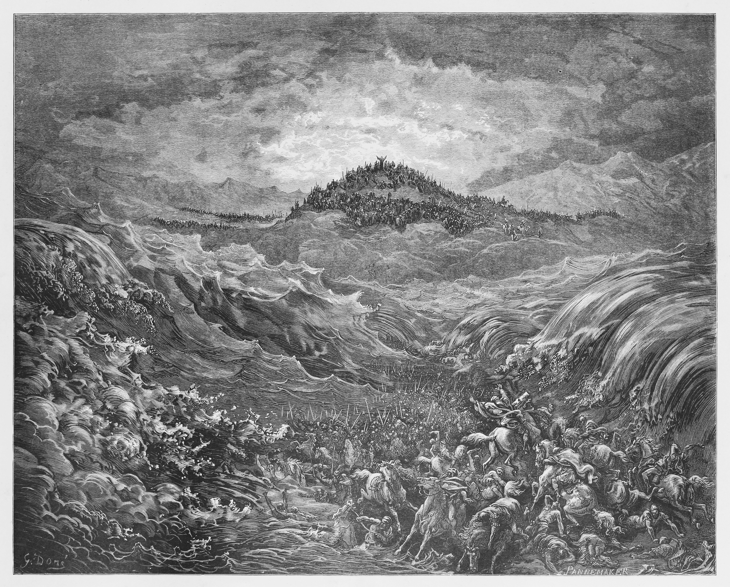
The Exodus
Grief-stricken, Pharaoh begged Moses and his people to leave Egypt.
He then changed his mind and sent chariots in pursuit.
God allowed the
Israelites to pass
through the Red Sea,
but the Egyptians
were drowned.
© Nicku / Shutterstock.com
Notes:
Notes: Point out to the students that the Exodus event shows God’s responsiveness to the suffering of his people and his saving power.
This slide corresponds to content in article 39, “Moses and the Exodus,” in the student book.

Slide 11
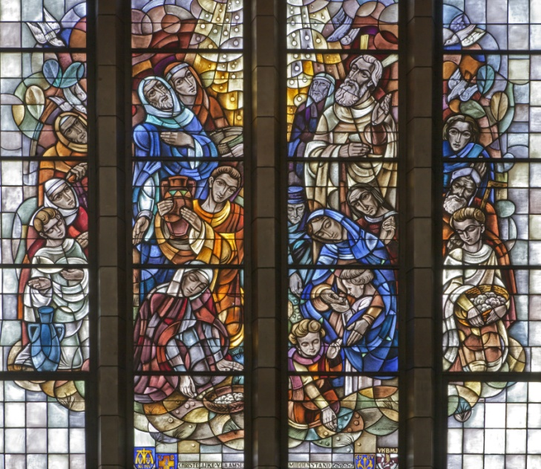
Building Identity and Trust in the Wilderness
The Israelites crossed a desert to get to the Promised Land.
They complained and began to idealize their life in Egypt.
But God rained down
manna for them to eat
and drew water from a
rock.
© Renata Sedmakova / Shutterstock.com
Notes:
Notes: Ask the students about the difficulties modern people may encounter on their life journey, causing them to question God’s presence. Ask them how it is possible to keep faith at such times.
This slide corresponds to content in article 40, “Building Identity and Trust in the Wilderness,” in the student book.

Slide 12
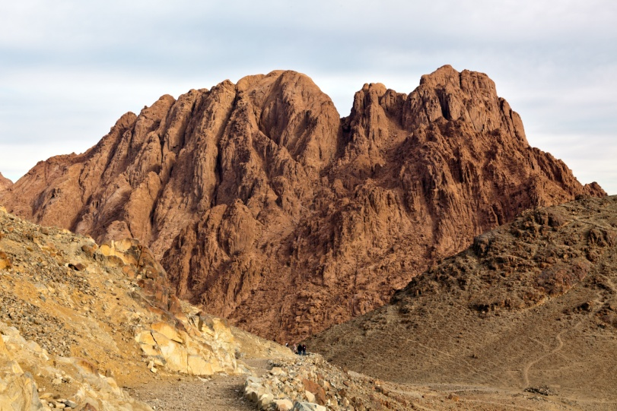
The Covenant with Moses
On Mount Sinai, God formed a covenant with his Chosen People.
This covenant includes laws and obligations known as the Ten Commandments.
The Ten Commandments are also known as the Decalogue.
© IGOR ROGOZHNIKOV / Shutterstock.com
Notes:
Notes: Point out to the students that Mount Sinai and Mount Horeb are the same. This is the mountain where God first revealed himself to Moses.
This slide corresponds to content in article 41, “The Covenant with Moses,” in the student book.

Slide 13
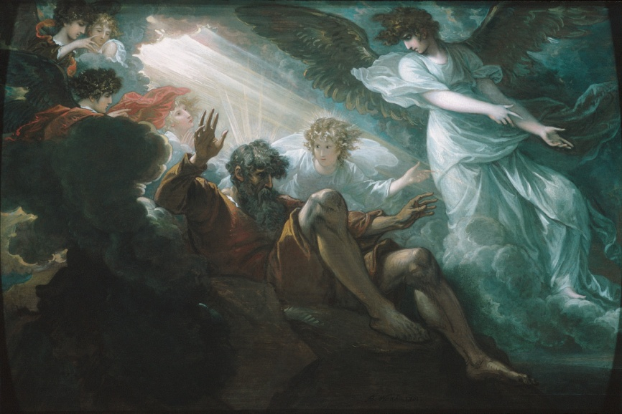
From Liberation to Covenant
In the Sinai Covenant, God told the Israelites that he would be their God.
In return they must be
a moral people who
live according to his
Law.
God promised that
they would dwell in
the Promised Land.
© Benjamin West / The MET Museum. Gift of Mr. and Mrs. James W. Fosburgh, by exchange, 1969
Notes:
Notes: Explain to the students that in revealing his Law, God was also revealing himself to be a God who loves justice.
This slide corresponds to content in article 41, “The Covenant with Moses,” in the student book.

Slide 14
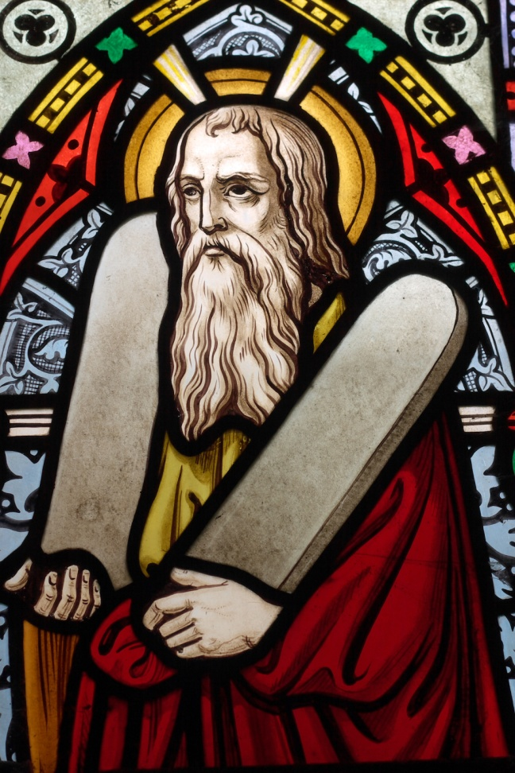
The Ten Commandments
The Ten Commandments convey God’s expectations of his people.
They summarize the Law of God in the entire Torah, the books of law.
They teach us how to live in right relationship with God and others.
© Sybille Yates / Shutterstock.com
Notes:
Notes: Ask the students how the Ten Commandments can be seen as a gift, rather than a set of restrictions.
This slide corresponds to content in article 41, “The Covenant with Moses,” in the student book.

Slide 15
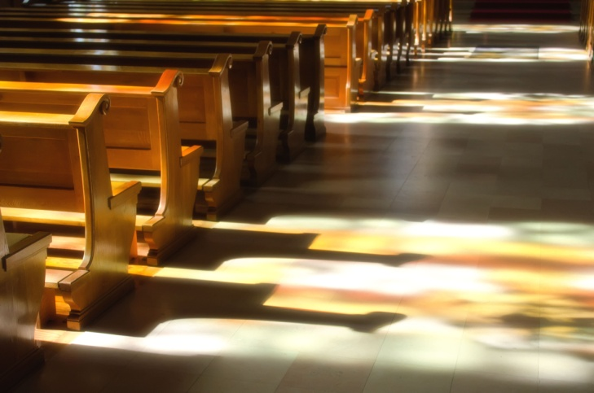
The First Three Commandments
I am the Lord your God: you shall not have strange Gods before me.
You shall not take the name of the Lord your God in vain.
Remember to keep
holy the Lord’s
Day.
© njaj / Shutterstock.com
Notes:
Notes: Ask the students how each of these Commandments contributes to a strong relationship with God.
This slide corresponds to content in the Primary Sources sidebar in article 41 in the student book.

Slide 16

Commandments Four through Seven
• Honor your father and your mother.
• You shall not kill.
• You shall not commit adultery.
• You shall not steal.
© Monkey Business Images / Shutterstock.com
Notes:
Notes: Ask the students how each of these Commandments contributes to a just society.
This slide corresponds to content in the Primary Sources sidebar in article 41 in the student book.

Slide 17

Commandments Eight through Ten
You shall not bear false witness against your neighbor.
You shall not covet your neighbor’s wife.
You shall not covet your neighbor’s goods.
© Phillip Minnis / Shutterstock.com
Notes:
Notes: Discuss with the students the meaning of “bearing false witness” and “coveting.”
This slide corresponds to content in the Primary Sources sidebar in article 41 in the student book.

Slide 18
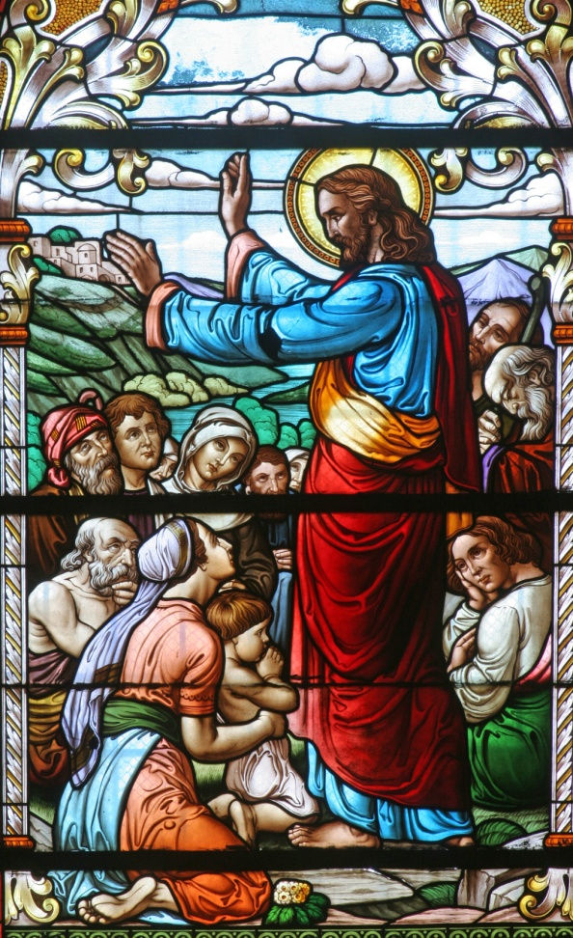
The Old Law and the New Law
The Old Law given to Moses was a preparation for the Gospel, the New Law, revealed through Jesus Christ.
Jesus affirmed the Old Law received by Moses and brought it to perfection.
© Zvonimir Atletic / Shutterstock.com
Notes:
Notes: Call the students’ attention to the Did You Know? sidebar in article 42 in the student book. Discuss the parallels outlined there.
This slide corresponds to content in article 42, “The Old Law and the New Law,” in the student book.

Slide 19
Acknowledgment
The Ten Commandments, as listed on slides 15–17, are from the English translation of the Catechism of the Catholic Church for use in the United States of America, second edition (CCC), pages 496–497. Copyright © 1994 by the United States Catholic Conference, Inc.—Libreria Editrice Vaticana (LEV). English translation of the Catechism of the Catholic Church: Modifications from the Editio Typica copyright © 1997 by the United States Catholic Conference, Inc.—LEV.

